Slide 1
Charlemagne Unites Germanic Kingdoms

Slide 2
The Middle Ages
500 to 1500 A.D.
A new culture emerges with roots in-
The classical heritage of Rome
The beliefs of the Roman Catholic Church
The customs of various Germanic tribes

Slide 3
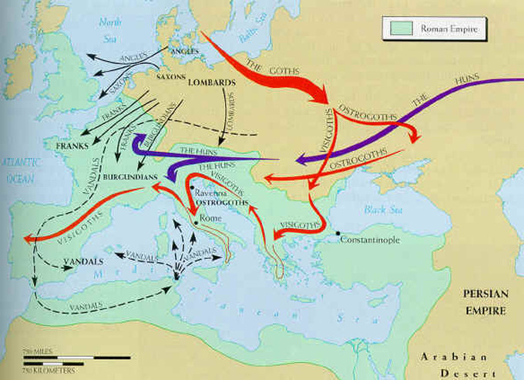
Invasions of Western Europe
In the 5th century Germanic invaders overran the western half of the Roman Empire
Caused-
Disruption of trade- destroyed Europe’s cities as economic centers
and money became scarce
Downfall of cities- abandoned as
centers of administration
Population shifts- people fled
from cities to countryside

Slide 4
Changes with Invasion
Decline in learning-
Germanic invaders weren’t literate
Romans left cities and left behind education
Literacy dropped, although Germanic tribes did have strong oral tradition of songs and legends
Loss of common language-
As Germans mixed with Romans, Latin changed
French, Spanish and other Roman-based languages developed from Latin

Slide 5
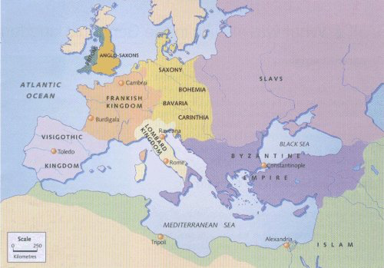
Germanic Kingdoms Emerge
Germanic kingdoms replaced Roman provinces
Borders constantly change with wars
Church survives and provides order and security

Slide 6
Life in the Germanic Kingdoms
Governed by unwritten rules and traditions rather than government
Wouldn’t respect a king they didn’t know
Germanic chiefs led a band of warriors
Gave them food, weapons, and security
In war, warriors fought to the death to defend their chief

Slide 7
Germanic Leaders
Fill out the chart on the different leaders of the Germanic kingdoms using pages 354-357 in the textbook

Slide 8
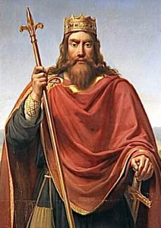
The Franks
Controlled Gaul (now France and Switzerland)
Led by Clovis
Converted to Christianity during a battle
The Church supported his future campaigns against other Germanic tribes
Unified the Frankish kingdom and the Church

Slide 9
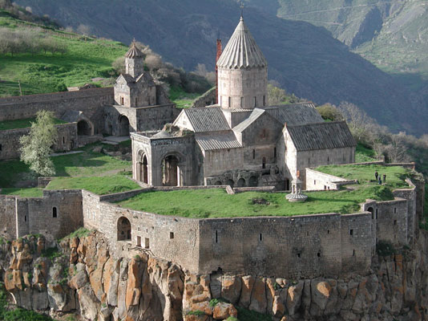
Germans Adopt Christianity
Monasteries develop
Religious communities where monks dedicated their lives to
serving God
Nuns create similar
communities called
convents
Become Europe’s most
educated communities-
opened schools, keep
libraries and write books

Slide 10
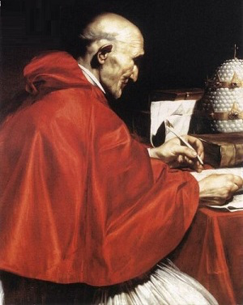
The Pope Expands Power
Pope Gregory I takes over in 590
Pope becomes secular- power in politics as well as religion
Used church revenues to raise armies, repair roads and help the poor
Develops the idea of a spiritual kingdom spanning out from Rome

Slide 11
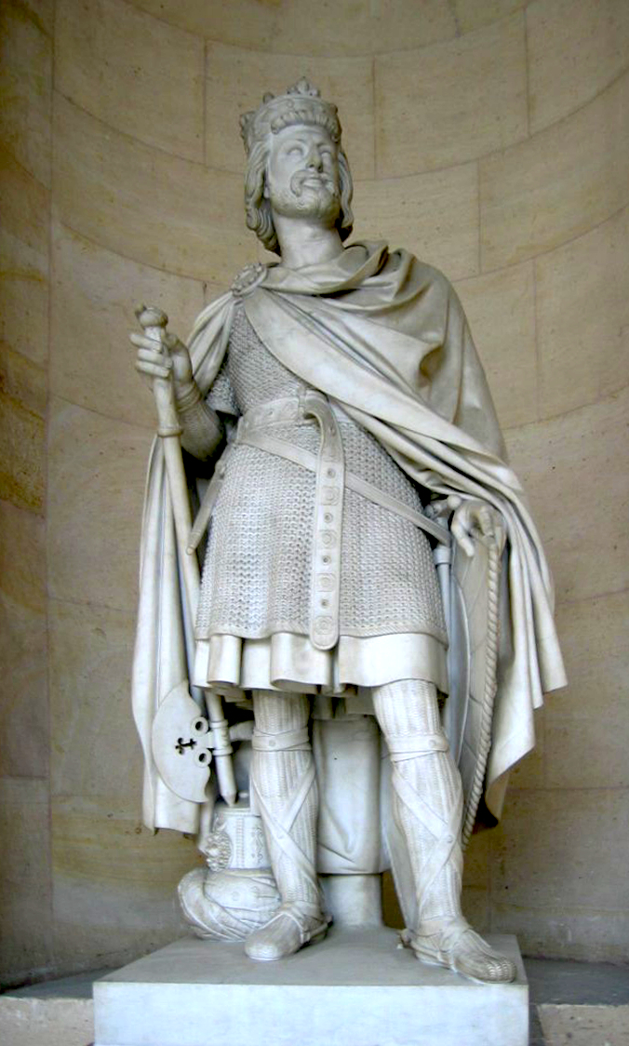
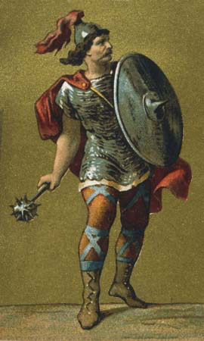
An Empire Evolves
By 719, Charles Martel (Charles the Hammer) has taken control of the Frankish kingdom
Becomes Christian hero when he wins the Battle of Tours in 732
Defeats Muslim raiders
from Spain

Slide 12
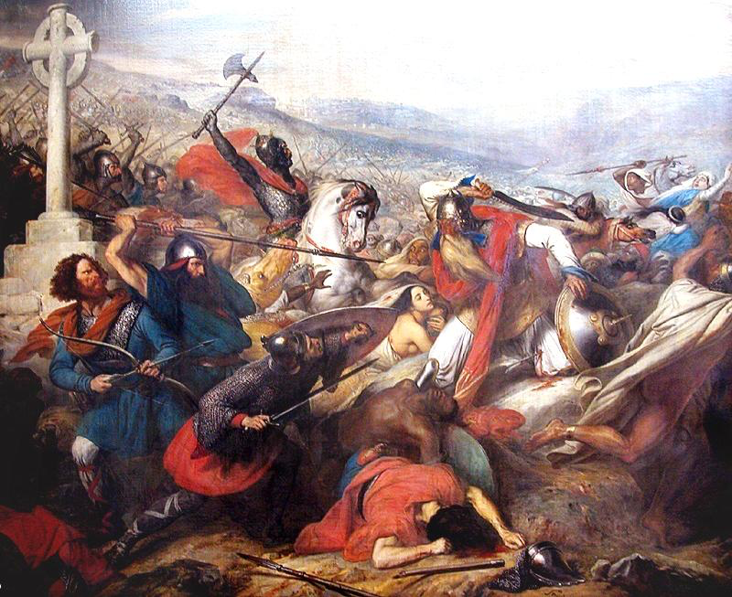
The Battle of Tours

Slide 13
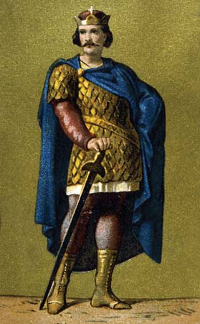
An Empire Evolves
Charles passes on power to his son Pepin the Short
Pepin is appointed king by the Pope
Starts the Carolingian Dynasty- ruled the Franks from 751-987

Slide 14
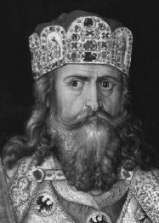
Charlemagne Becomes Emperor
Charlemagne (Charles the Great)- son of Pepin, takes over in 771
Builds largest empire since ancient Rome
Conquered new lands and spread Christianity
Reunited Western Europe in one empire
After crushing an uprising against the Pope, Pope Leo III declared him an Emperor- united Germanic people, the Church and the heritage of the Roman Empire

Slide 15
Charlemagne Leads a Revival
Strengthened his power by limiting the power of nobles
Made sure the counts (powerful land owners) governed justly
Encouraged learning and opened schools

Slide 16
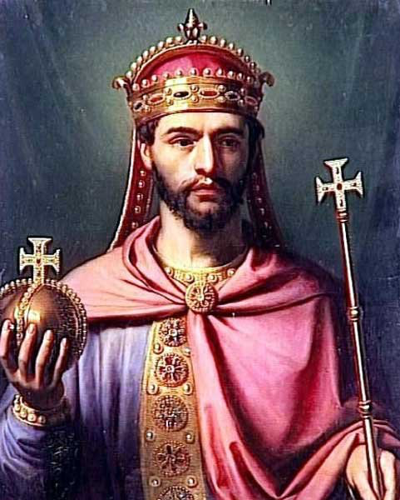
The Fall
Charlemagne left his son Louis the Pious in charge
Very religious, but poor ruler
Louis leaves his 3 son’s the empire
Fight over power
Treaty of Verdun divided the empire into 3 kingdoms
Carolingian kings lost power and central authority broke down

