Slide 1
Church Reform

Slide 2
Setting the Stage
The period between 500 and 1000 in Western Europe was known as the Dark Age. Magyars seeking plunder pushed up from the Danube River region. Vikings raided western European church monasteries. These groups destroyed many of these centers of learning. Around the 900s, however, a new spirit invaded the Church and brought about a spiritual revival in the clergy. Filled with new energy, the church began restructuring itself and started massive building programs to create new places of worship.

Slide 3
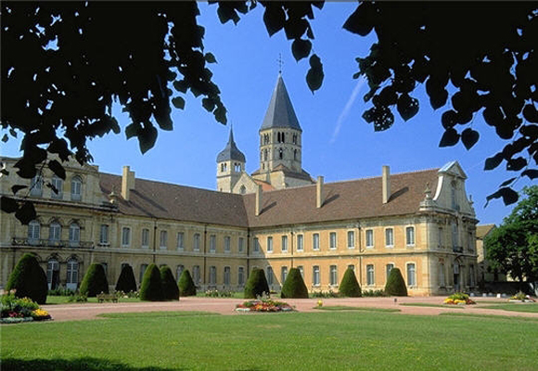
The Age of Faith
Monasteries led the revival
Cluny, France- reformers wanted a return to basic principles of the Christian religion
Influenced by the new monasteries and increasing religious devotion, popes restored and expanded the Church’s power and authority

Slide 4
Troubles Remain
Some priests were nearly illiterate and could barely read prayers
Some had questionable morals
Many cared more about the position as lords than as spiritual leaders

Slide 5
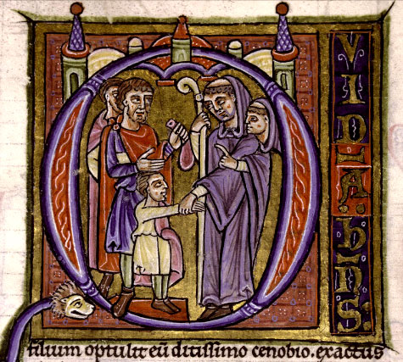
Troubles Remain
3 Major Concerns-
Many village priests married and had families
Simony- bishops sold positions in the Church
The continued battle over lay investiture

Slide 6
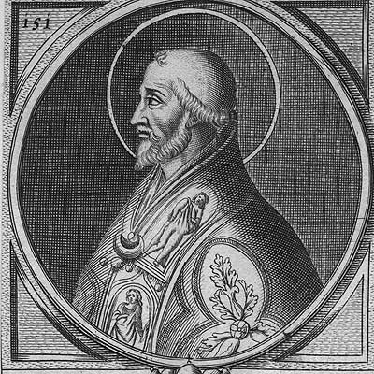
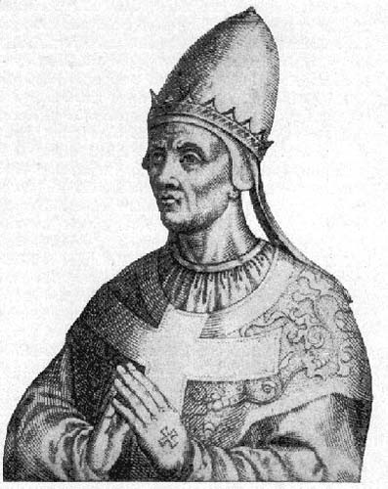
Reform and Church Organization
Pope Leo IX and Gregory VII enforced laws against marriage of priests and simony
In the 1100 and 1200s the Church was reorganized to resemble a kingdom
Pope was the head
Papal Curia- pope’s advisors, also acted as the court
Diplomats for the pope traveled throughout Europe to deal with bishops and kings
Collected taxes- tithes- used money to help sick and poor- operated most hospitals in medieval Europe

Slide 7
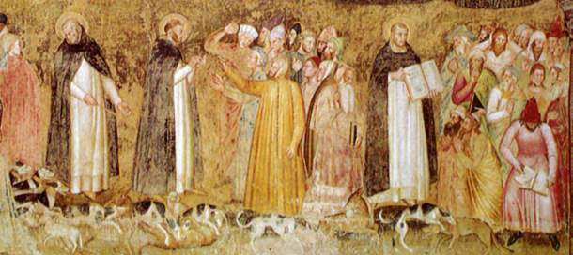
Friars
Traveled from place to place preaching and spreading Christianity
Preached to the poor
Owned nothing and lived by begging

Slide 8
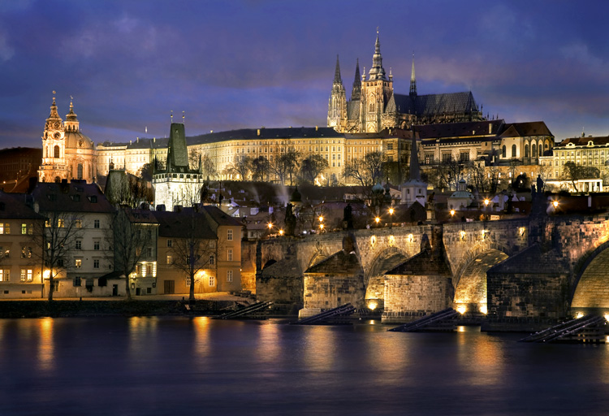
Cathedrals – Cities of God
Large churches in city areas
Seen as a representation of the city of God- decorated with all the riches Christians could offer

Slide 9
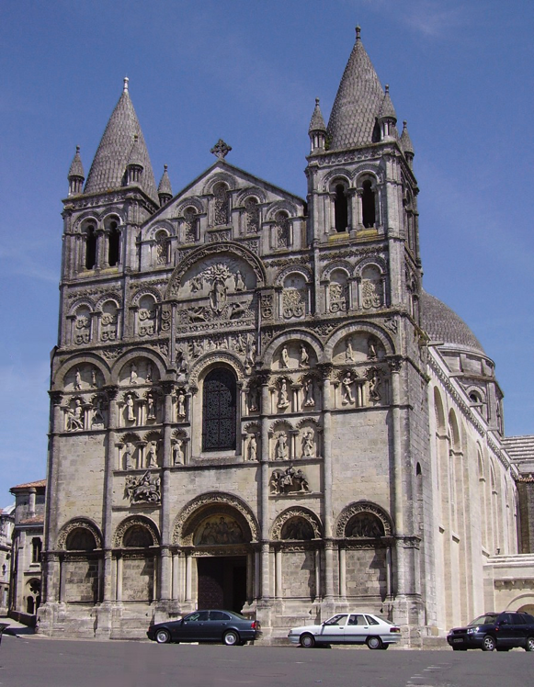
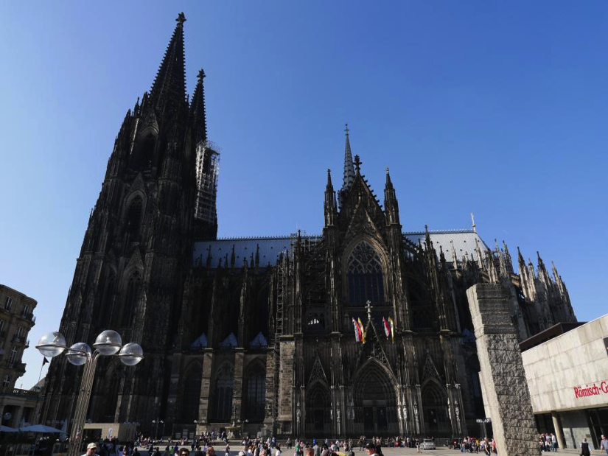
Cathedrals
New styles emerge- Gothic
Unlike the heavy, gloomy Romanesque buildings
Tall, huge stained glass windows, sculptures and wood carvings
Nearly 500 Gothic churches were built between 1170 and 1270

