Slide 1
Europeans Explore the East

Slide 2
Setting the Stage
By the early 1400s, Europeans were ready to venture beyond their borders. The Renaissance encouraged, among other things, a new spirit of adventure and curiosity. This spirit of adventure, along with several other important reasons, prompted Europeans to explore the world around them. These explorations began a long process that would bring together the peoples of many different lands and permanently change the world.

Slide 3
Reasons
Desire for new sources of wealth
Trade of spices and other luxury goods from Asia
Spice trade began during the Crusades
Lack of supply meant very high prices
Muslims and Italians controlled the trade from East to West
The desire to spread Christianity
Felt duty to continue to fight Muslims and convert non-Christians

Slide 4
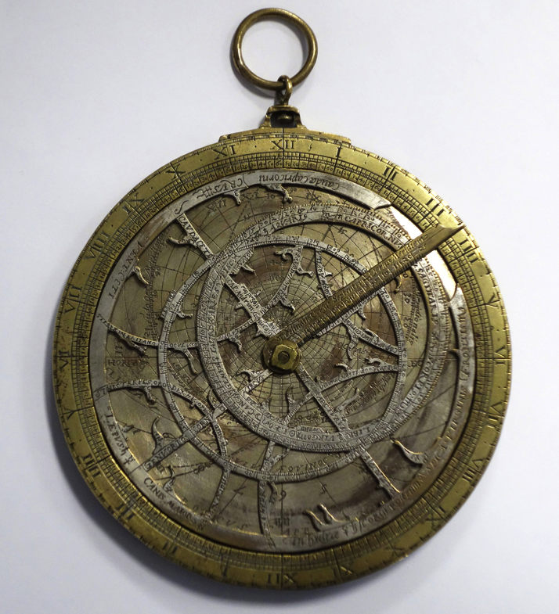
Technology Makes Exploration Possible
Changed sails to be able to navigate against the wind better
Astrolabe- used to track location based on degree rings and star location
Magnetic compasses

Slide 5
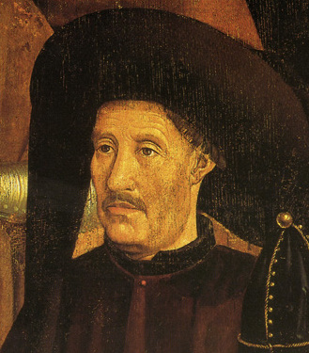
Portugal Leads the Way
Strong government support- Prince Henry
Desire to explore for wealth after conquering Ceuta
1419- Henry founds a navigation school in Portugal
Start exploring western Africa
Traded for gold, ivory and eventually slaves

Slide 6
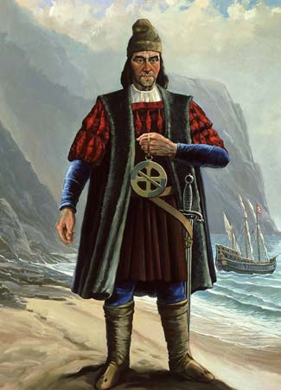
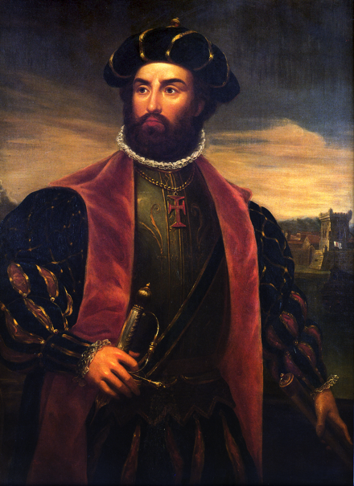
Portugal Leads the Way
1488- Bartolomeu Dias sailed around the tip of Africa
1497- Vasco da Gama explores east African coast and India

Slide 7
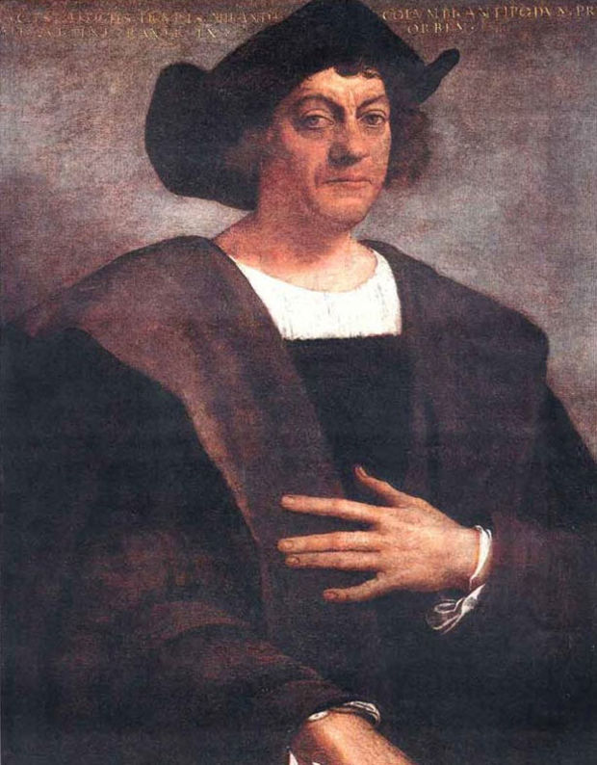
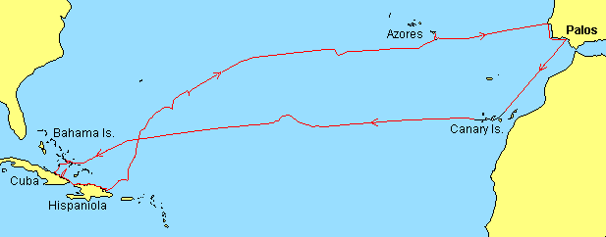
Spain’s Explorations
1492- Christopher Columbus sails to America
Trying to find a new route to Asia
Portugal believes he reached the Indies and staked a claim to land they claimed first

Slide 8
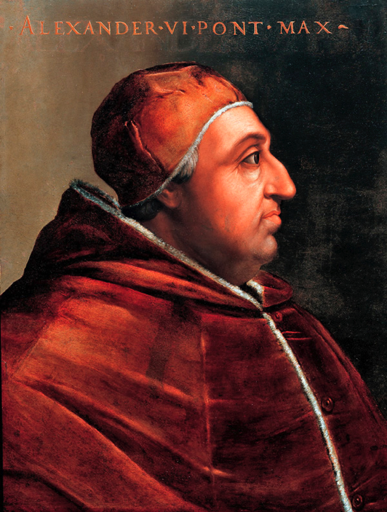
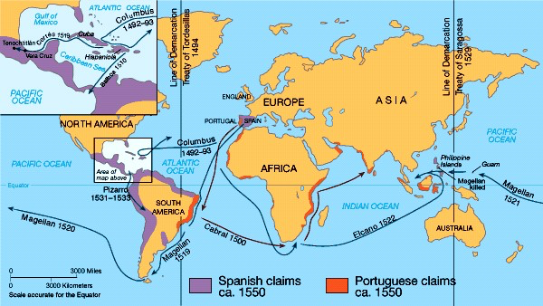
Spain’s Explorations
Pope Alexander VI suggested an imaginary line down the middle of the Atlantic Ocean (Line of Demarcation)
Everything east was Portugals, everything west was Spains
The line was moved to include parts of Brazil
Agreed to with the Treaty of Tordesillas

Slide 9
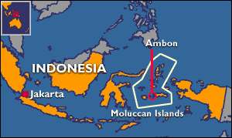
Portugal’s Trading Empire
Took control of spice trade from Muslims
Used cannons on ships
Controlled Strait of Hormuz- stopped Muslims from reaching India
Continued east to Indonesia
Capture Moluccas- islands so rich with spices they’re known as the Spice Islands
Brought back spices at about 1/5 the cost of Italian and Muslim traders sold it for

Slide 10
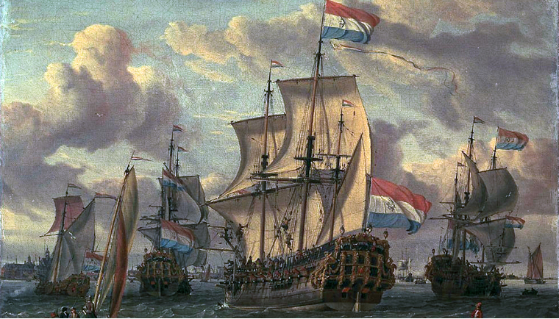
Others Challenge the Portuguese
The English and Dutch (Netherlands) get involved in Asia
Erode Portuguese power and these 2 now begin battling
Both establish an East India Company- had power to mint money, make treaties and raise their own armies
Dutch were more powerful and eventually gain control

Slide 11
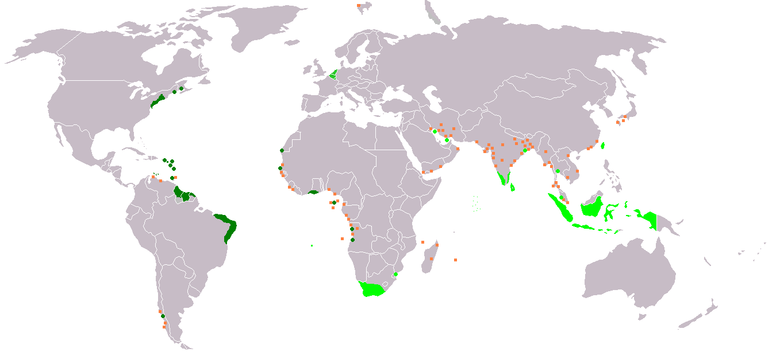
Dutch Rule
By 1700-
Dutch ruled most of Indonesia
Had trading posts in several Asian countries
Controlled the Cape of Good Hope (southern tip of Africa)

Slide 12
British and French Traders
Focus on outposts in India

