Slide 1
North American Societies

Slide 2
Setting the Stage
Between 40,000 and 12,000 years ago, hunter-gatherers migrated across the Bering Strait land bridge from Asia and began to populate the Americas. Migrating southward, those first Americans reached the southern tip of South America by somewhere between 12,000 and 7000 B.C. At the same time, they began to spread out east and west across North America. Over the centuries, the early North American peoples adapted to their environment, creating a very diverse set of cultures.

Slide 3
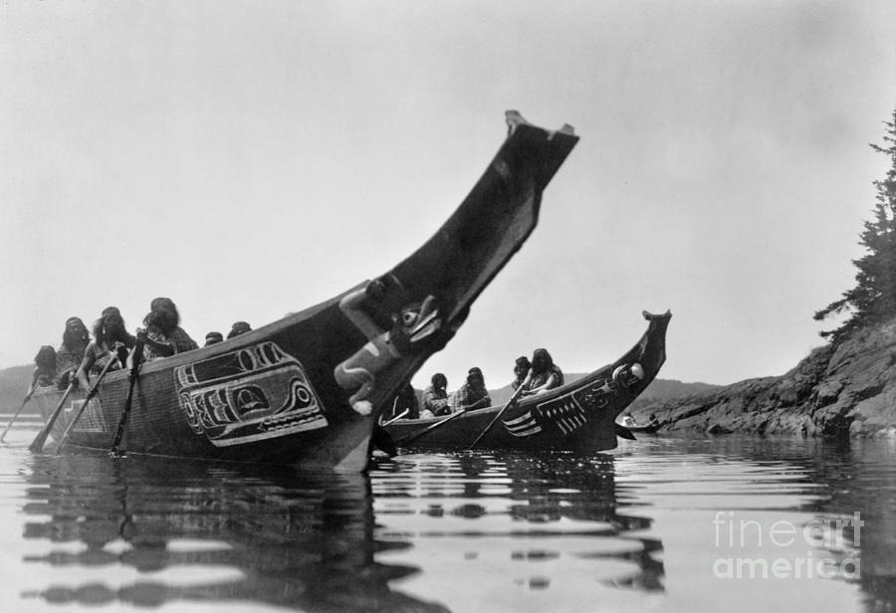
The Pacific Northwest
Kwakiutl, Nootka and Haida peoples
Developed canoes to hold 15 people- hunted whales
Coastal forest provided food
With abundance, differences in wealth created social classes
Displayed their rank in a potlatch- gave food, drink and gifts to the community

Slide 4
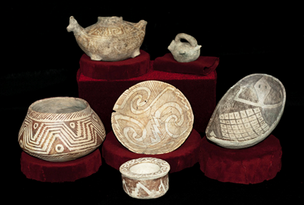
The Southwest
Dry, desert lands
Hohokam- used irrigation to produce corn, beans and squash
Used pottery rather than baskets- showed contact with Mesoamerican people to the south

Slide 5
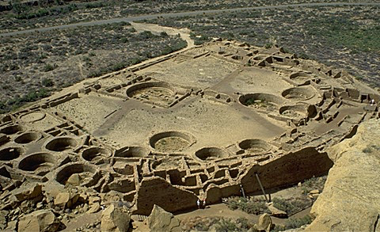
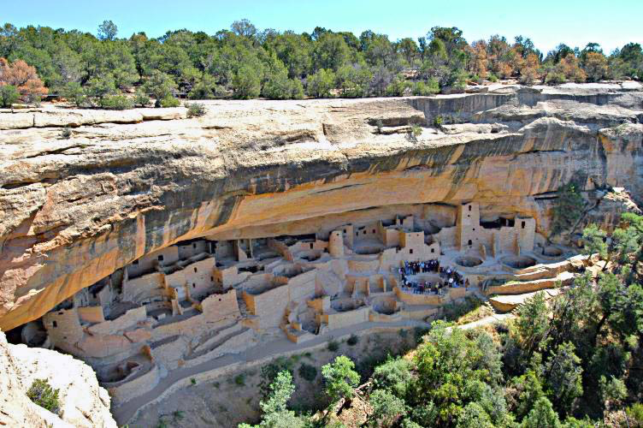
The Southwest
The Anasazi- lived in four corners region
Built cliff dwellings
By 900s- lived in pueblos- villages of large, apartment-style compounds made of stone and adobe
Pueblo Bonito (beautiful village)- 5 stories high, housed over 1,000 people, over 600 rooms
Kivas- underground or partly underground ceremonial chambers used for religious practices

Slide 6
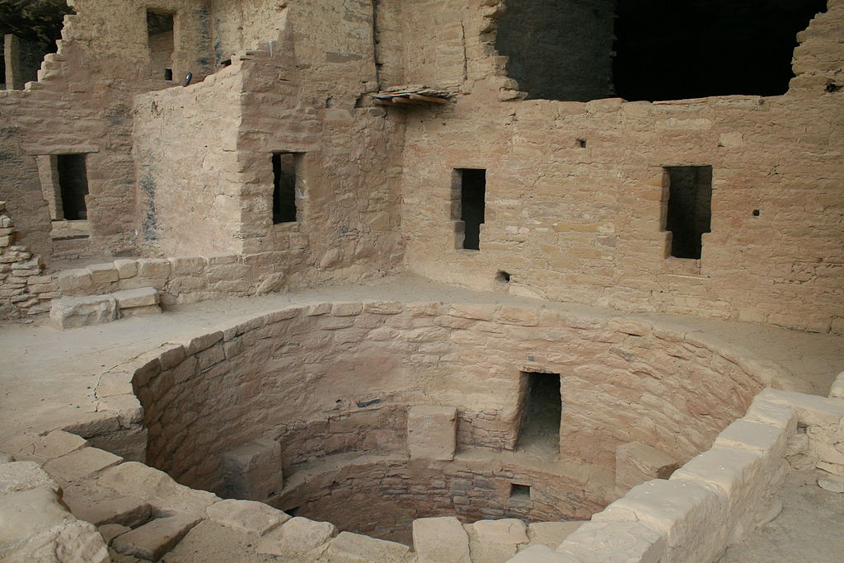
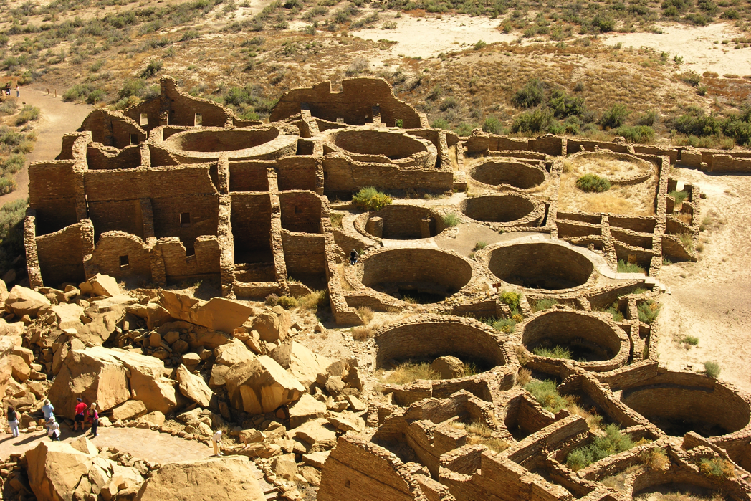
The Southwest
Many pueblos were abandoned around 1200
Maybe because of prolonged drought
Pueblo groups like Hopi and Zuni continued their practices

Slide 7
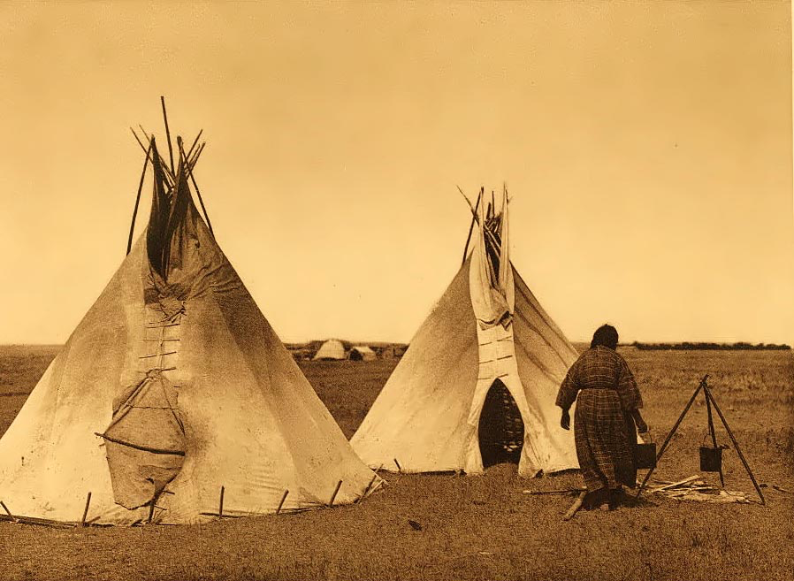
Nomadic Plains Tribes
Comanche, Kiowa and Apache
Bison
Planted, hunted and had trade networks

Slide 8
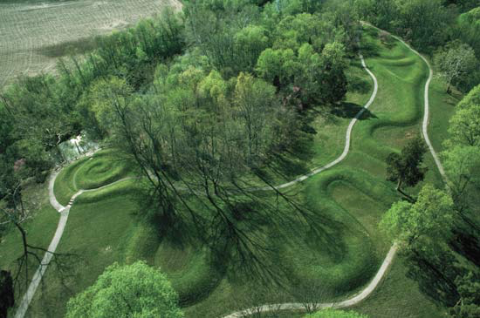
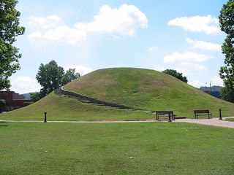
Eastern Woodlands
East of Mississippi River
The Mound Builders- the Adena
700 B.C.- build huge earthen mounds- buried their dead
500 years later, Hopewell do the same thing
Make much larger mounds, and use for a variety of reasons

Slide 9
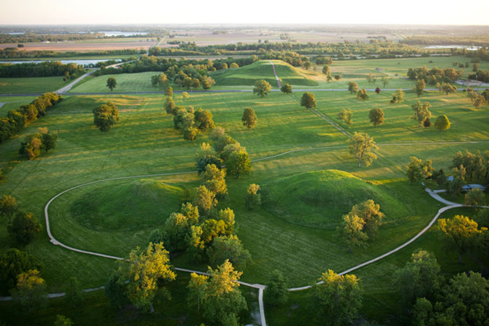
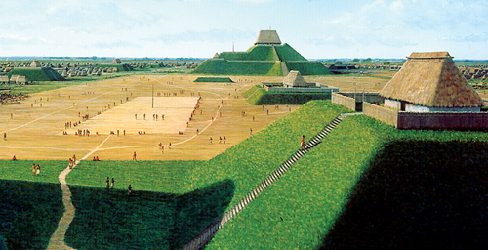
Eastern Woodland
Last of the Mound Builders were the Mississippians- 800 A.D. to European arrival
Thriving villages on farming and trade
Cahokia- 30,000 people
Led by priest-rulers
100 foot high, earthen pyramid with a wooden temple on top

Slide 10
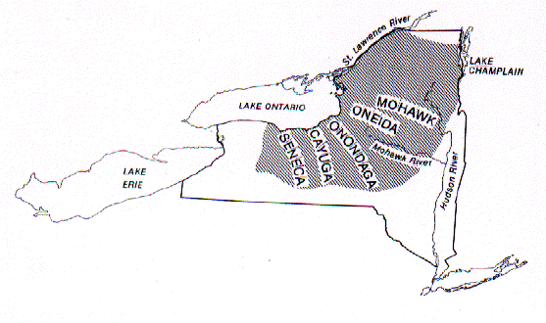
Northeastern Alliances
Form to ensure protection of tribal lands
Iroquois- political alliance of Mohawk, Oneida, Onondaga, Cayuga and Seneca
Joint protection and cooperation among the tribes

Slide 11
Cultural Connections
Huge trade networks
Religion- most believed in nature spirits and sacred spirits
Great respect for the land as source of life- sacred, couldn’t be bought and sold
Social patterns- family was basis for social organization
Parents, children, grandparents and other close relatives
Clans- groups descended from common ancestor who lived together
Totems- natural object to symbolize the unity of a clan

