Slide 1
Spain Builds An American Empire

Slide 2
Setting the Stage
Competition for wealth in Asia among European nations was fierce. This competition prompted a sea captain named Christopher Columbus to make a daring voyage from Spain in 1492. Instead of sailing south around Africa and then east, Columbus sailed west across the Atlantic in search of an alternate trade route to Asia and its riches. Columbus never reached Asia. Instead, he stepped onto an island in the Caribbean. That event would bring together the peoples of Europe, Africa and the Americas.

Slide 3
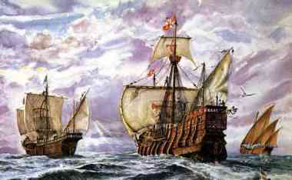
The Voyages of Columbus
The Nina, Pinta and Santa Maria leave August 3, 1492
October 12- land in America, but thought it was the East Indies
Probably actually on an island in the Bahamas
Claimed the land for Spain and called it San Salvador, or “Holy Savior”

Slide 4
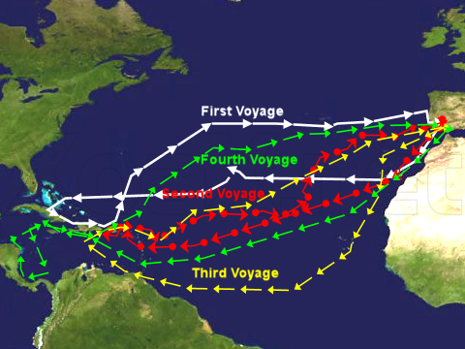
Empire Building
Columbus was looking for gold
Found none, explored other islands, claimed each one
Takes second voyage in 1493
Fleet of 17 ships and over 1,000 people
Intended to form colonies

Slide 5
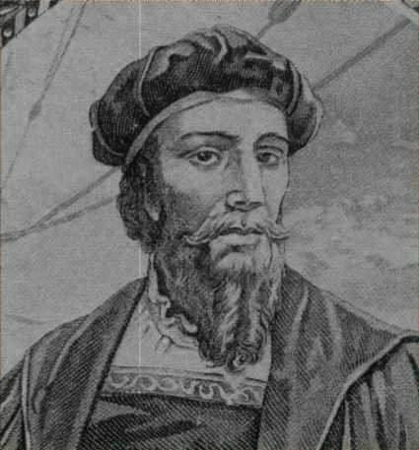
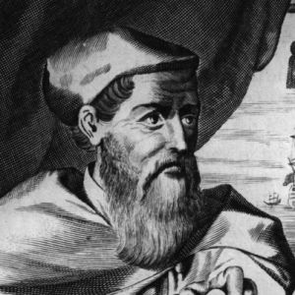
Other Explorers Take Off
1500- Portuguese Pedro Alvares Cabral reaches Brazil
1501- Italian Amerigo Vespucci, in service to Portugal, sailed eastern coast of South America
Went back to Europe and said it wasn’t India, but a “new” world
Mapmaker named it America after the explorer

Slide 6
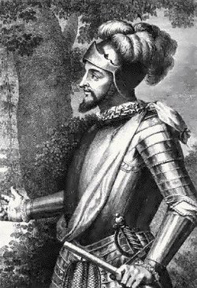
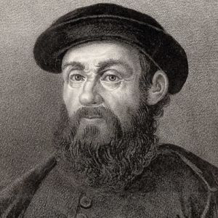
Other Explorers Take Off
Vasco Nunez de Balboa marches through Panama to the Pacific
1519- Ferdinand Magellan sails around the southern tip of South America

Slide 7
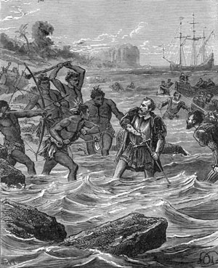
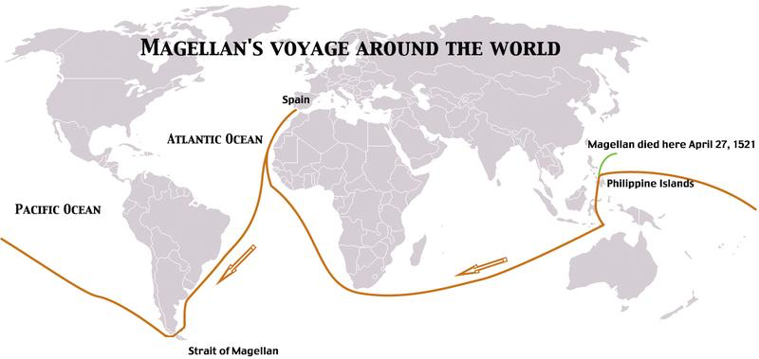
Magellan’s Voyage
Sailed for months and eventually ran out of food
Explored Guam, then reached the Philippines
Magellan was killed in a local war
His crew continued sailing
Hit hard by disease and starvation
1522- only 18 men and 1 ship, out of an original 250 and 5 ships, made it back to Spain
First group to circumnavigate the world

Slide 8
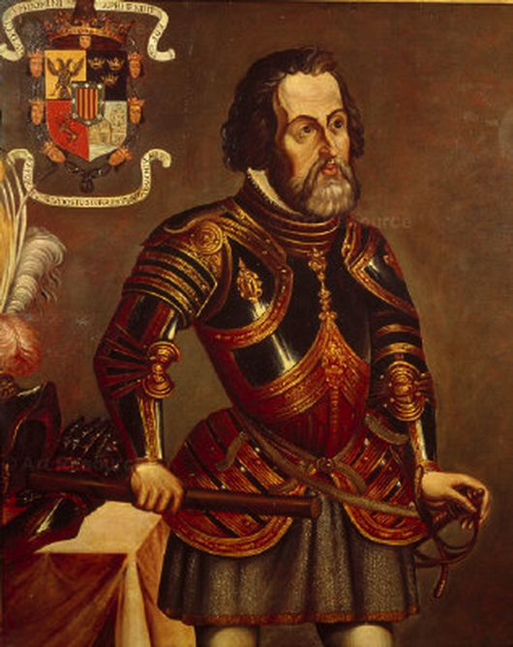
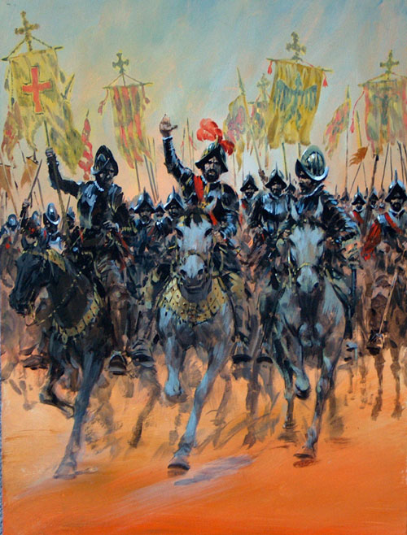
Spanish Conquests in Mexico
1519- Hernando Cortes landed in Mexico
Known as conquistadors, or conquerors
Lured by rumors of gold and silver
Carved out colonies in Mexico, South American and the United States

Slide 9
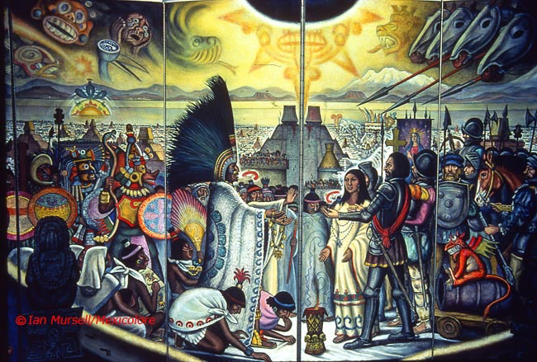
Cortes Conquers the Aztecs
Force of 600 men march for weeks and reach capital of Tenochtitlan
Aztec emperor Montezuma II thought Cortes was a god wearing armor
Agreed to give Cortes a share of the empire’s gold
Spring 1520- Cortes’s men killed Aztec warriors and chiefs during a religious festival
June 1520- Aztecs rebelled and drove out Cortes’s forces

Slide 10
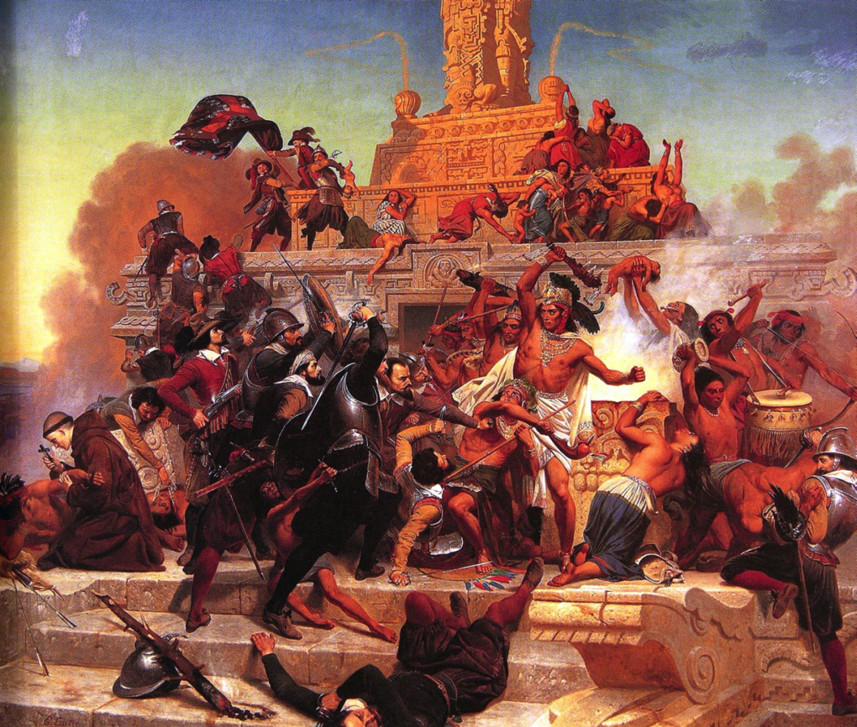
Cortes Conquers the Aztecs
Cortes strikes back and conquers the Aztecs in 1521
Superior weaponry- arrows vs. muskets and cannons
Enlisted various native groups- hated Aztec’s harsh practices (human sacrifice)
Disease spread rapidly- measles, mumps, smallpox and typhus

Slide 11
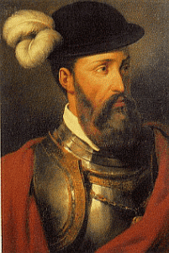
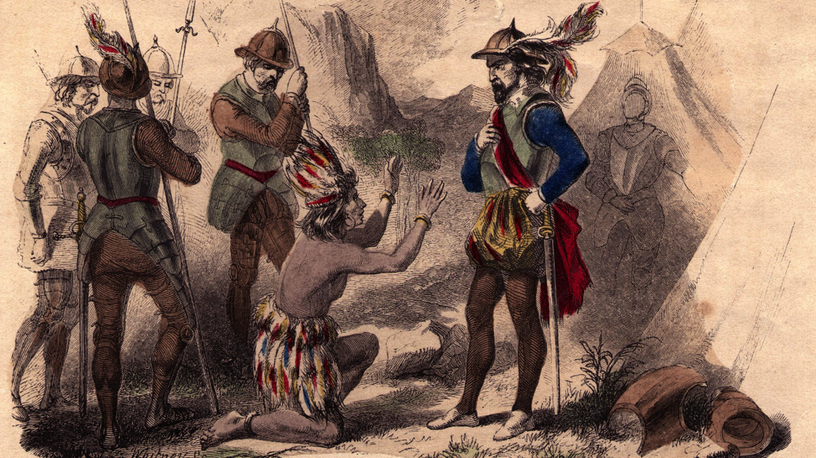
Spanish Conquests in Peru
1532- Francisco Pizarro marched into South America and conquered the Incans
Army of 200 met Incan ruler Atahualpa
Spanish ambushed and kidnapped him
Gives them gold and silver for his release, but the Spanish strangle him after receiving the ransom
Pizarro marched on Cuzco, the Incan capital

Slide 12
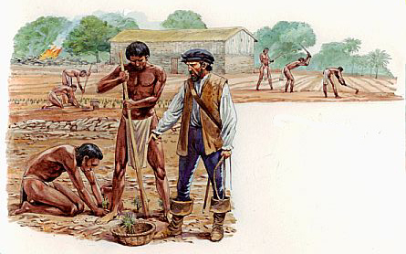
Spain’s Pattern of Conquest
Lived among the people
Most Spanish settlers were men- relationships with native women were common
Mestizo- mixed Spanish and Native American families
Encomienda- natives farmed, ranched or mined for Spanish landlords
Many landlords abused the natives and worked them to death

Slide 13
The Portuguese in Brazil
Finding no gold or silver, settlers start moving in
Begin growing sugar
Clear huge areas and build huge sugar plantations
Demand for sugar huge in Europe- makes Portugal lots of money

Slide 14
Spain’s Influence Expands
Builds wealth with treasures from the new world
Builds largest navy and military in the world

Slide 15
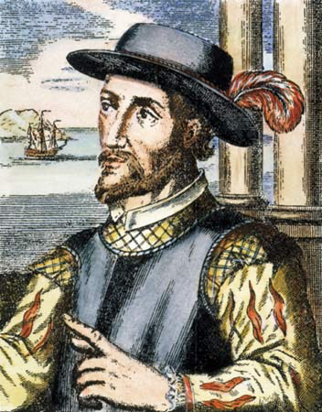
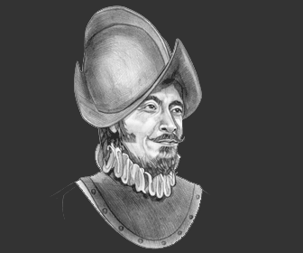
Conquistadors push North
1513- Juan Ponce de Leon landed in Florida and claimed it for Spain
1541- Francisco Vasquez de Coronado led expedition throughout much of present-day Arizona, New Mexico, Texas, Oklahoma and Kansas
Found little gold- Spanish assign priests to explore and colonize the area

Slide 16
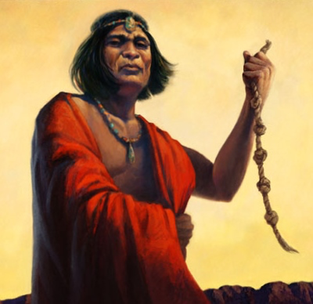
Opposition to Spanish Rule
Spanish priests protested the encomienda system
Natives led numerous rebellions
1680- Pope, a Pueblo ruler, led 8,000 warriors
Drove Spanish out of New Mexico and back into New Spain
Kept them out for the next 12 years
By then, other European nations had begun to establish their own colonies in the Americas

