Slide 1
Spain’s Empire and European Absolutism

Slide 2
Setting the Stage
From 1520 to 1566, Suleyman I exercised great power as sultan of the Ottoman Empire. A European monarch of the same period, Charles V, came close to matching Suleyman’s power. As the Hapsburg king, Charles inherited Spain, Spain’s American colonies, parts of Italy, and lands in Austria and the Netherlands. As the elected Holy Roman emperor, he ruled much of Germany. It was the first time since Charlemagne that a European ruler controlled so much territory.

Slide 3
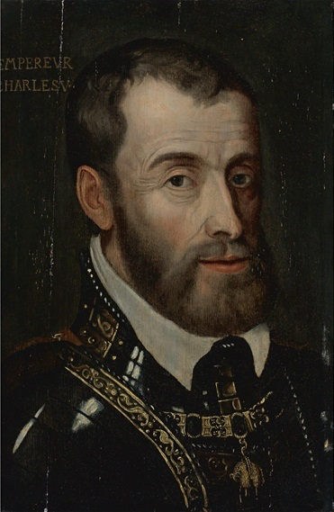
Charles V
Devout Catholic- fought Muslims and opposed Lutherans
Unwillingly agrees to the Peace at Augsburg
The next year, the divides his empire and retreats to a monastery
Gave Austria and the Holy Roman Empire to his brother, Ferdinand
Gave Spain, the Spanish Netherlands and the American colonies to his son, Philip II

Slide 4
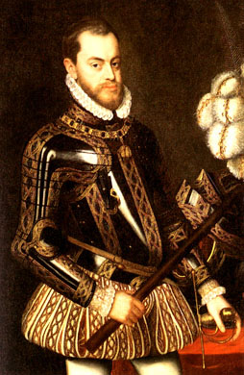
Philip II’s Empire
Shy, serious, deeply religious, hard working
Trusted no one
Took over Portuguese empire after their king died
Philip was the king’s nephew
Expanded his empire with Portuguese strongholds in India, Africa and the East Indies

Slide 5
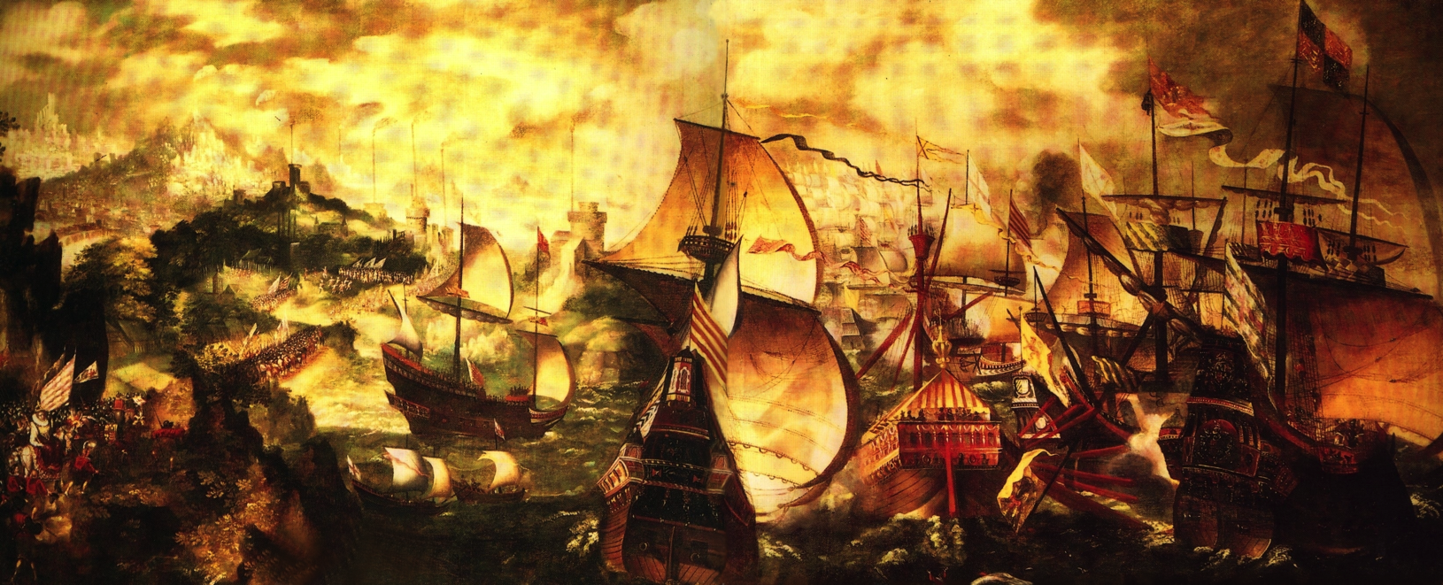
Philip II’s Empire
Empire provided great wealth
Got over 339,000 pounds of gold and over 16,000 tons of silver from the colonies
Believed it was his duty to defend Catholicism
Joined attacks against Ottoman Empire at the pope’s request
Launched attacks against English and Queen Elizabeth I- was defeated in this attack

Slide 6
Golden Age of Spanish Art
El Greco (The Greek)- Domenikos Theotokopoulos
Clashing colors, distorted human figure, expressed emotion symbolically
Showed the deep Catholic faith of Spain

Slide 7
Golden Age of Spanish Art
Diego Velazquez-
Reflected the pride of the empire
Used rich colors

Slide 8
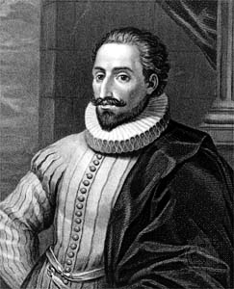
Literature
Don Quixote de la Mancha by Miguel de Cervantes-
1605
Birth of the modern European novel
Some argue he was mocking chivalry
Others argue it was about an idealistic person who longed for the romantic past because of frustrations with his materialistic world

Slide 9
The Empire Weakens
Inflation- decline in value of money, increase in prices
Economic problems develop- no middle class
Still used old methods to make goods = more expensive
People bought goods produced outside of Spain, from countries who were mostly enemies of Spain
Philip declared Spain bankrupt 3 times

Slide 10
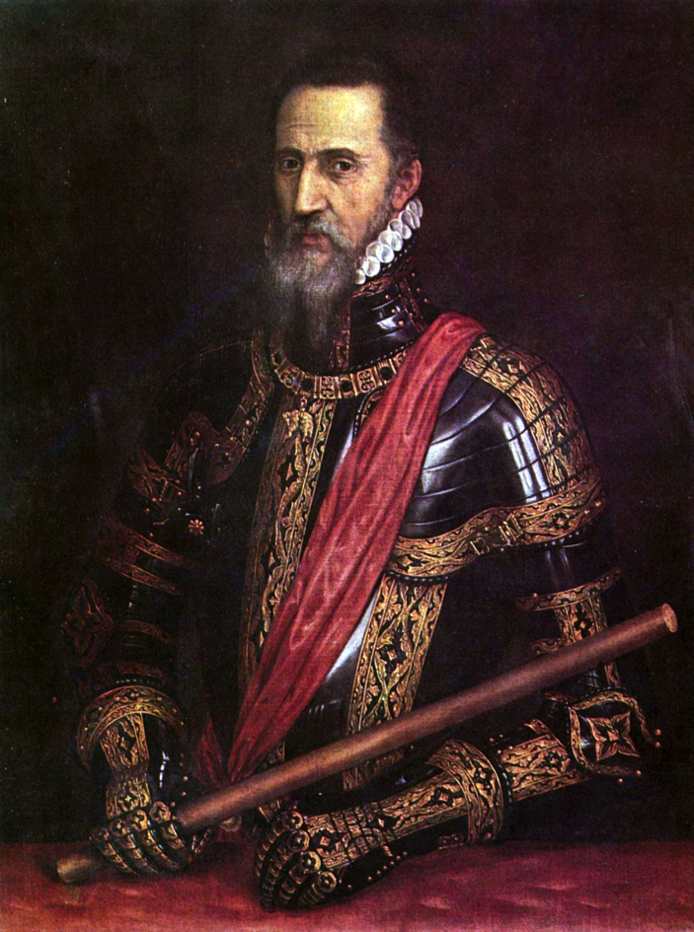
The Dutch Revolt
Spain = Catholic, Dutch = Calvinist
Spain = economic problems, Dutch = prosperous middle class
Philip tries to crush Protestantism
Protestants revolt and sweep through Catholic Churches
Philip sends in Duke of Alva to punish rebels
Duke executed 1500 Protestants
Dutch fight on for 11 years
1579- 7 northern provinces unite and become independent
10 southern provinces stayed under Spanish rule (today make up Belgium)

Slide 11
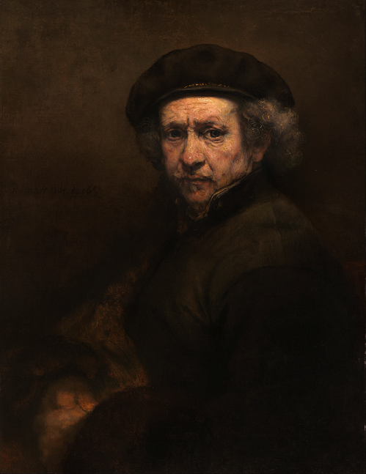
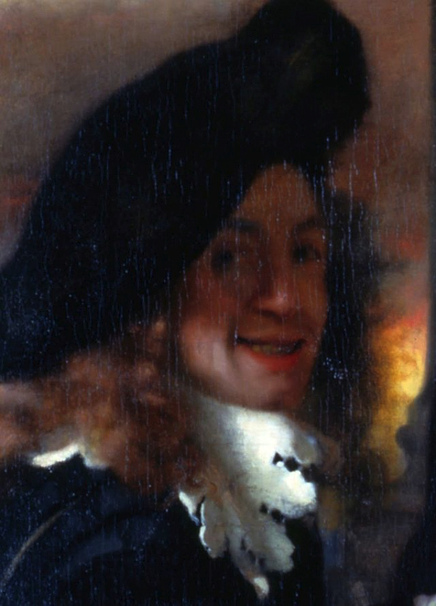
The Independent Dutch
Republic- had governors from each republic
Practiced religious tolerance
Great art-
Rembrandt van Rijn- painted portraits of wealthy middle-class merchants and groups
Jan Vermeer- painted domestic, indoor scenes
Showed how important merchants and middle class were in Dutch society

Slide 12
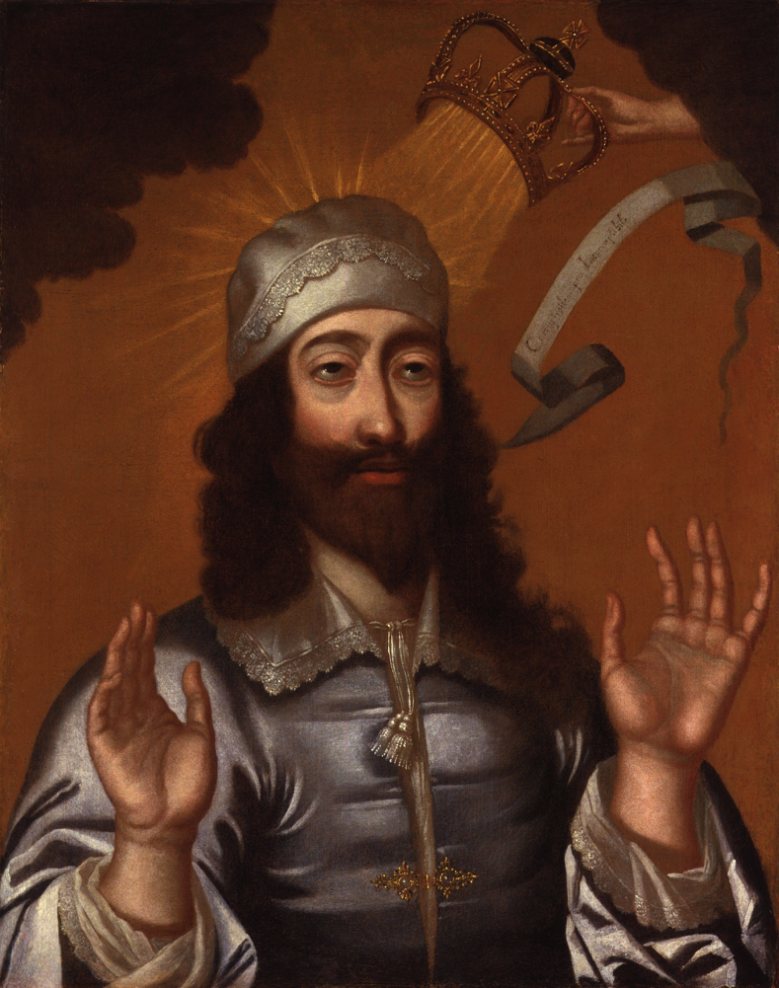
Absolutism in Europe
Absolute monarchs- leaders ruled without limits on their power- want to control every aspect of society
Believe in divine right- idea God gave them power to rule

Slide 13
Growing Power
Church authority broke down- allowed monarchs to take more power
Growing middle class supported monarchs- promised peaceful, supportive economic climate
Use wealth from colonies to follow through with these promises

Slide 14
Crises Lead to Absolutism
17th century = constant conflict
Governments build huge armies and put in high taxes
Brought widespread unrest
Monarchs respond by increasing their own power

