Slide 1
Tang and Song China

Slide 2
Setting the Stage
After the Han Dynasty collapsed in A.D. 220, no emperor was strong enough to hold China together. Over the next 350 years, more than 30 local dynasties rose and fell. Finally, by 589, an emperor named Wendi had united northern and southern China once again. He restored a strong central government. Under the next two dynasties, the Tang and the Song, China experienced a prolonged golden age. It became the richest, most powerful, and most advanced country in the world.

Slide 3
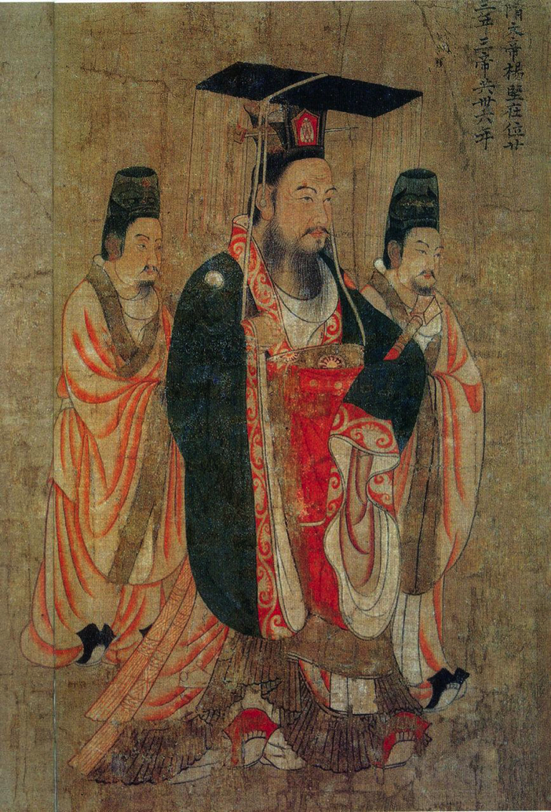
Struggles in the Sui Dynasty
Wendi- 1st emperor of Sui Dynasty
Completes Grand Canal- connects trade between northern cities and southern rice-producing region
Over a million people worked on it- around half died
Thousands rebuild Great Wall
Endless labor on projects turn people against the Sui Dynasty
618- Revolt and kill the second Sui emperor

Slide 4
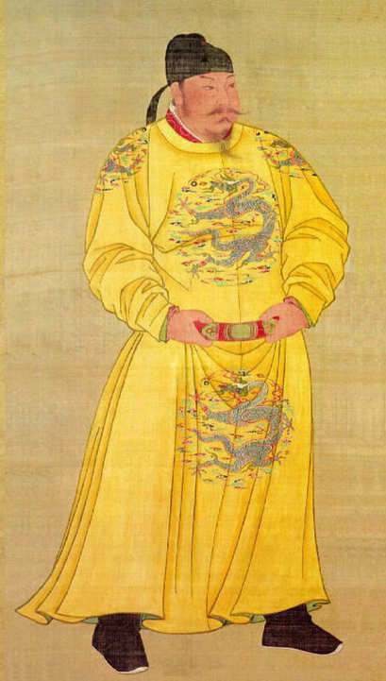
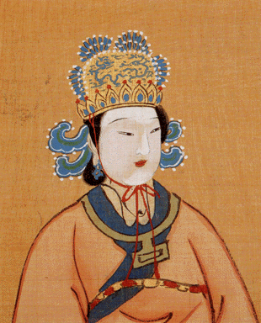
The Tang Dynasty
Rule from 618-907
Tang Taizong- emperor who begins the big achievements
Armies reconquered lands China lost in decline of Han dynasty
Wu Zhao- empress who leads takeover of Korea
Only woman emperor ever in China

Slide 5
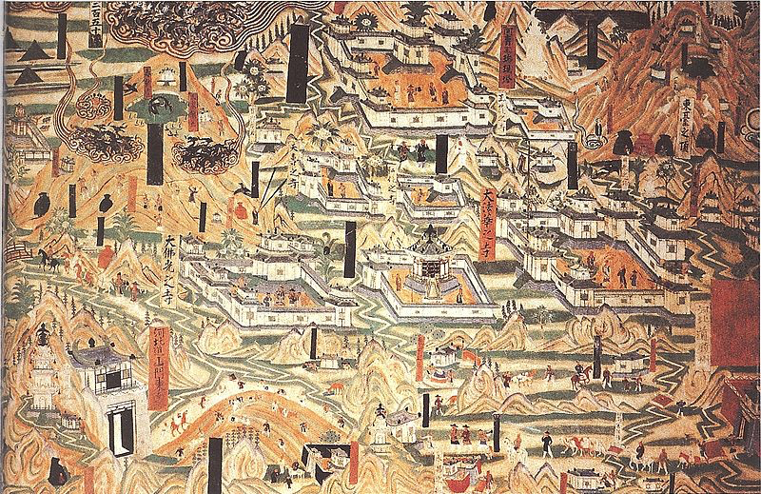
The Tang Dynasty
Expand network of roads and canals
Strengthen central government
Promote foreign trade
Improve agriculture

Slide 6
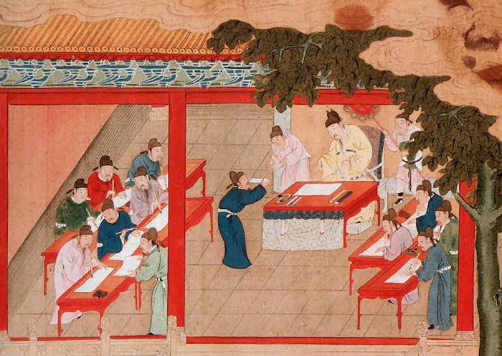
Scholar-Officials
Tough civil service examination system
Those who pass become part of elite group of scholar-officials
Only wealthy could afford the years of education needed to pass
Creates very intelligent and capable governing class
Talent and education grow in importance rather than noble birth

Slide 7
The Tang Lose Power
Rising costs of government = crushing taxes = hardship on the people
Struggle to control huge empire
Muslim armies defeat Chinese and take Central Asia
907- Chinese rebels take over Tang capital and murder the last Tang emperor- a child

Slide 8
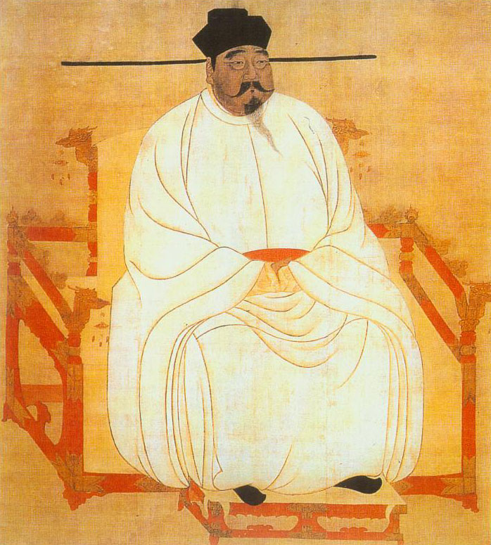
The Song Dynasty Restores China
960- General Taizu reunites China and is 1st Song emperor
Song Dynasty lasts 960-1279
Smaller than Tang dynasty, but stable, powerful and prosperous
Never gain lost territory back
Lose more territory in northern China to Jurchen (Manchurian people) but keep southern China
Make grand capital at Hangzhou
Rapid economic growth

Slide 9
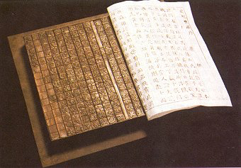
An Era of Prosperity and Innovation
Population nearly doubles- 100 million
Movable type- printer could arrange blocks of individual characters in a frame to make a page for printing
Gun powder developed- leads to bombs, grenades, small rockets and cannons
Develop porcelain, mechanical clock, paper money and magnetic compass
Advances in math- use of negative numbers

Slide 10
An Era of Prosperity and Innovation
New form of fast-ripening rice- harvest 2 rice crops a year instead of 1
Production of more food needed to feed growing population

Slide 11
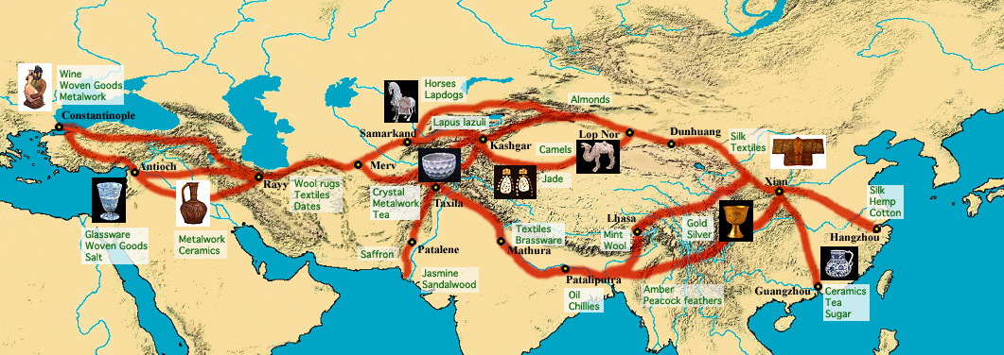
An Era of Prosperity and Innovation
Foreign trade flourished
Silk Roads- link China to the West
Sea trade expands
Culture spreads through trade
Buddhism expands into Vietnam, Korea and Japan

Slide 12
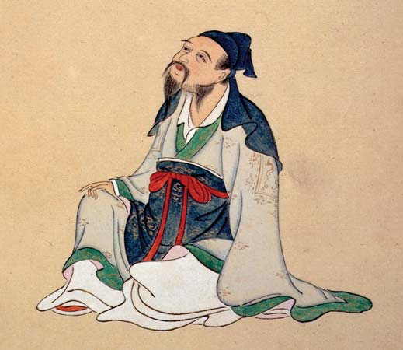
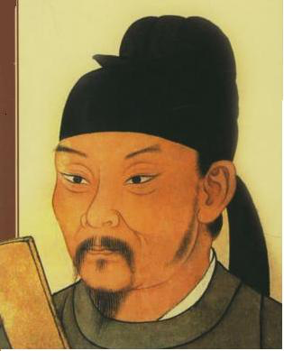
A Golden Age of Poetry and Art
Tang period produces great poetry
Li Bo- writes of life’s pleasures
Tu Fu- praised orderliness, Confucian virtues, and hardships of soldiers
Song period produces paintings
Emphasizes beauty of natural landscapes and objects
Didn’t use bright colors- black ink is favorite paint

Slide 13
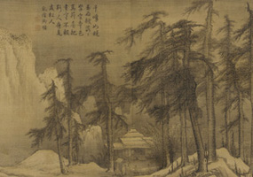
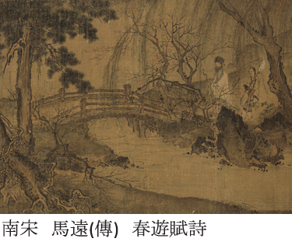
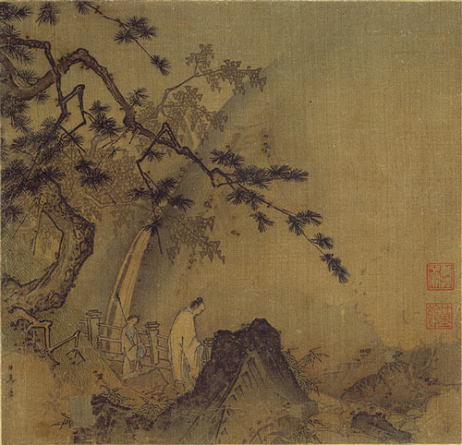
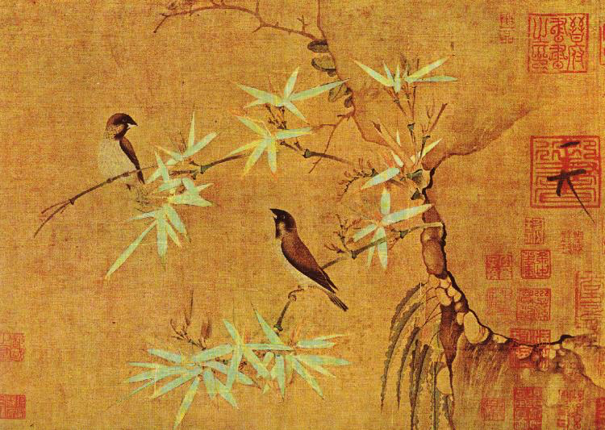

Slide 14
Changes in Chinese Society
Increasingly mobile- physically and socially
Levels of society-
Gentry- powerful, well-to-do people- obtain status through education and civil service, not land ownership
Urban middle class- merchants, shopkeepers, artisans, minor officials
Laborers, soldiers and servants
Peasants

Slide 15
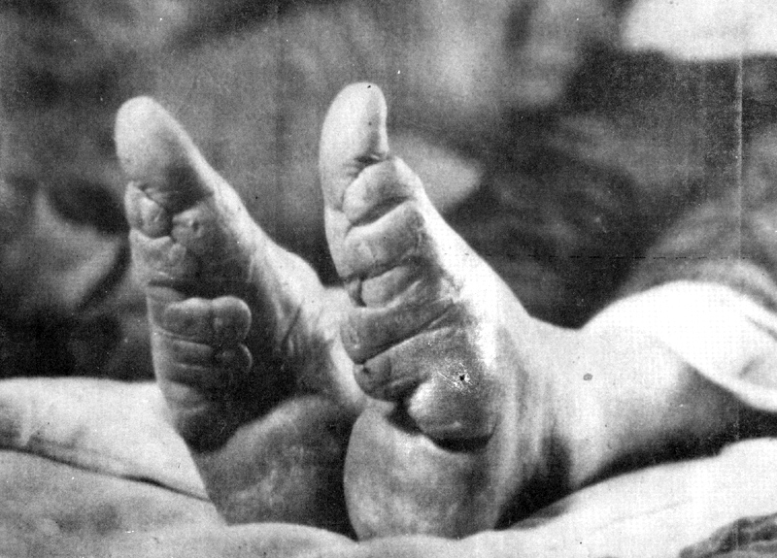
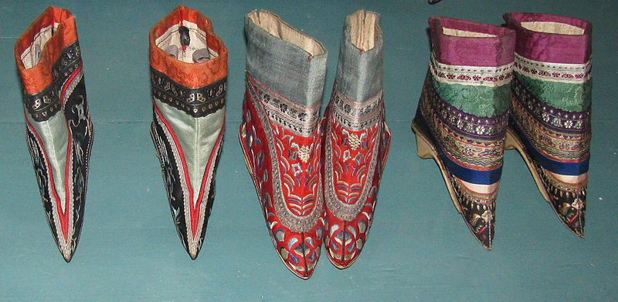
Changes in Chinese Society
Women were below men- gets worse during this time period
Binding of feet of upper-class girls
Bound tightly with cloth, breaking the arch and curling all but the big toe under- made a “lily-foot”
Crippled for life
Reflect wealth and prestige of the husband who could afford a beautiful but impractical wife

