Slide 1
The Byzantine Empire

Slide 2
Setting the Stage
The Western Roman Empire crumbled in the fifth century as it was overrun by invading Germanic tribes. By this time, however, the once great empire had already undergone significant changes. It had been divided into western and eastern empires, and its capital had moved east from Rome to the Greek city of Byzantium. The city would become known as Constantinople after the emperor Constantine, who made it the new capital in A.D. 330. For nearly a thousand years after the collapse of the Western Roman Empire, Byzantium and its flourishing capital would carry on the glory of Rome.

Slide 3
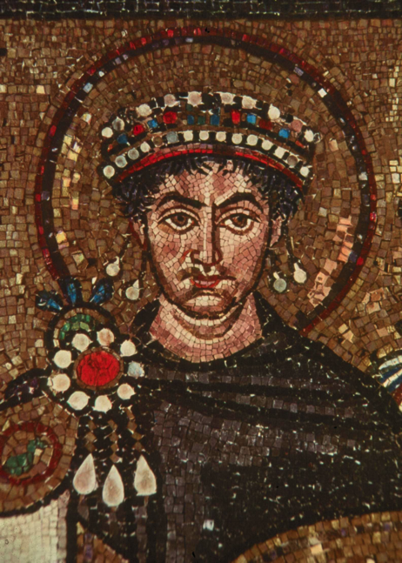
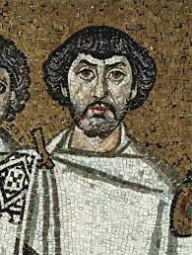
A New Rome in a New Setting
395- Roman empire divided
527- Justinian takes the throne of Eastern Empire
Sends Belisarius to defend North Africa from German invasion
2 years later- Belisarius attacks Rome and took it from the Ostrogoths
Rome changes hands 6 times over next 16 years

Slide 4
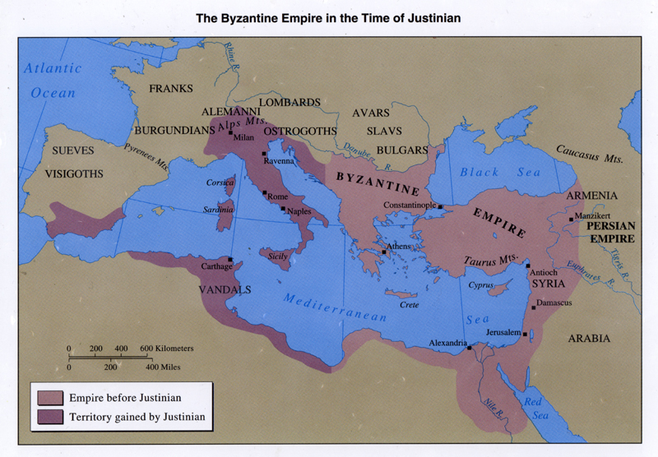
A New Rome in a New Setting
Justinian takes over all of Italy and parts of Spain
Holds all of old Roman Empire
Ruled with absolute power
Head of state and church
Constant risk- 88 Byzantine emperors, 29 die violently

Slide 5
Life in New Rome
Most spoke Greek instead of Latin
Justinian Code- uniform code of laws, 4 works
Code- nearly 5,000 Roman laws
Digest- opinions of Rome’s greatest legal thinkers about laws
Institutes- textbook telling law students how to use the laws
Novellae- new laws
Solved legal questions in marriage, slavery, property, inheritance, women’s rights, and criminal justice

Slide 6
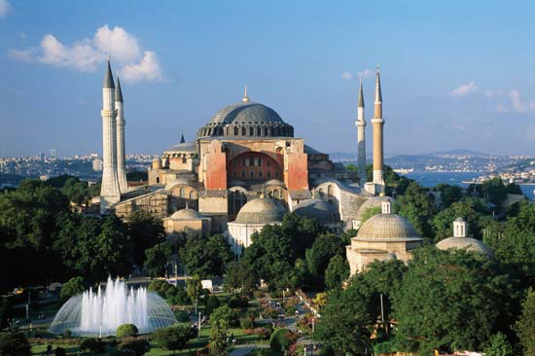
The Imperial Capital
Launches huge public works program
Reconstructs fortification walls around Constantinople
Hagia Sophia- most splendid church in Christian world
Built baths, aqueducts, law courts, schools and hospitals
Enlarged palace into vast complex
Values classical learning- Greek and Latin grammar and philosophy

Slide 7
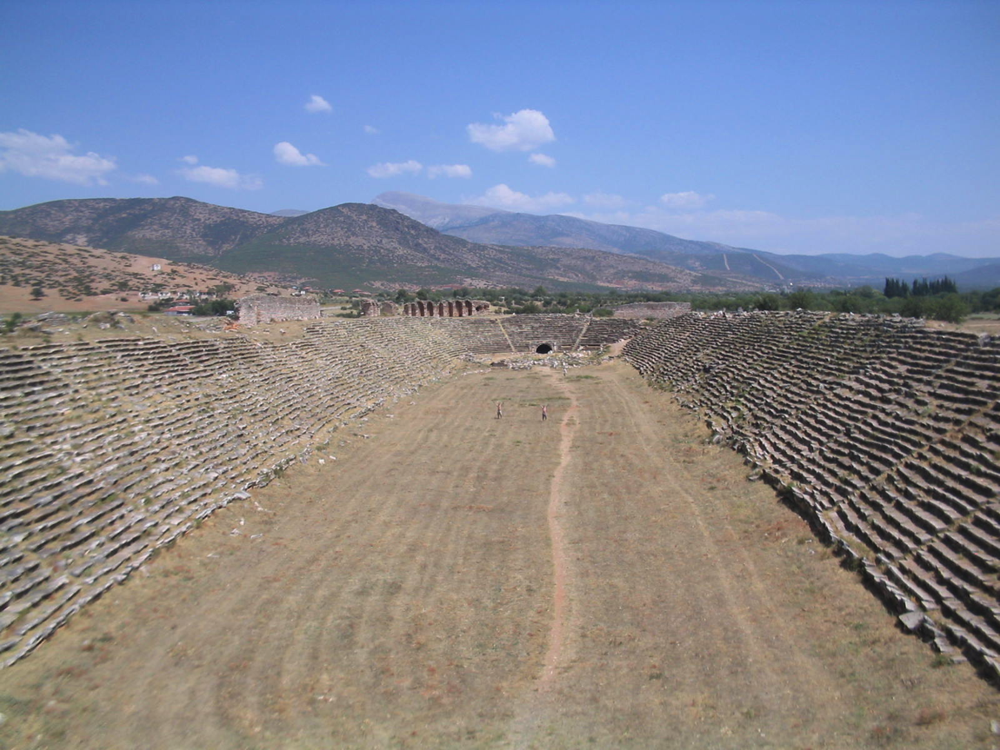
Life in Constantinople
Merchants and food vendors lined main street
Acrobats and musicians performed
Hippodrome-
Held 60,000
Had chariot races

Slide 8
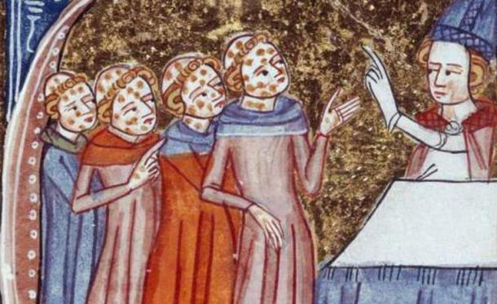
The Empire Falls
The Plague of Justinian
Similar to bubonic plague
Arrived from India on ships infested with rats
10,000 people die every day in 542
Continued breakouts until 700
565- Justinian dies
Riots, religious quarrels, foreign conflicts
Attacks
Lombards in west; Avars, Slavs and Bulgars in north; Sassanid Persians in east
Hold on by using bribes, diplomacy, political marriages and military power
Falls to Ottoman Turks in 1453

Slide 9
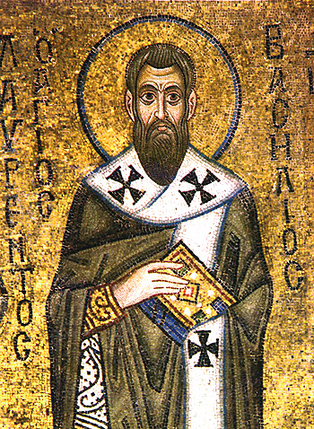
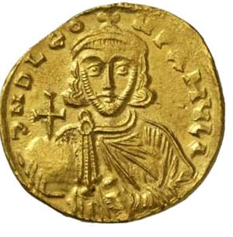
The Church Divides
Develops differently in east and west- huge empire
Eastern-
Saint Basil- writes how monks and Christians should behave
Emperor Leo III banned use of icons- religious images used to Eastern Christians to aid their devotions
Leads to riots and clergy rebellions

Slide 10
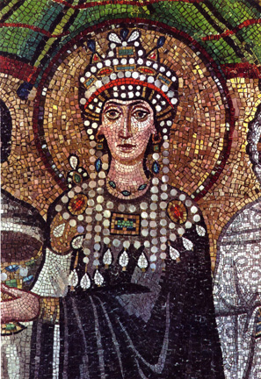
The Church Divides
Western-
Pope gets involved in icon dispute- supports use of icons
One pope excommunicates (declares an outcast of the church) a Byzantine emperor
Empress Theodora finally restores icons 100 years after the dispute began
1054- pope and patriarch excommunicate each other over dispute

Slide 11
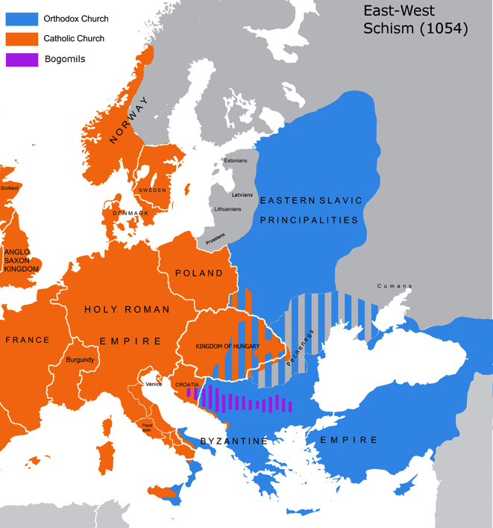
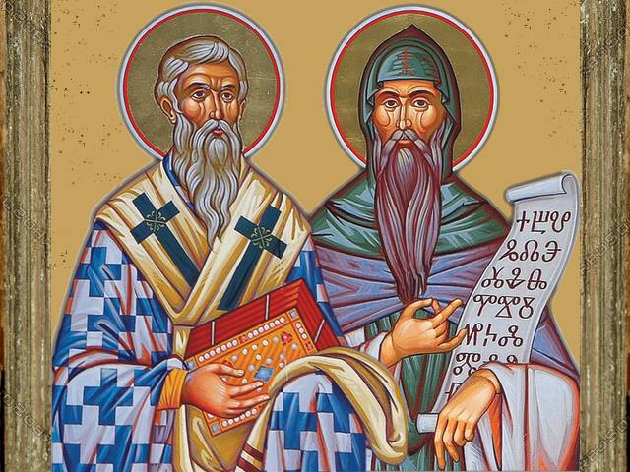
The Church Divides
Church officially splits
Roman Catholic Church in the West
Orthodox Church in the East
Both sides battle for converts
Saint Methodius and Saint Cyril invent alphabet for Slavic languages- could then read Bible on own
Slavic languages, including Russian, now written in Cyrillic alphabet

