Slide 1
The Rise of Islam

Slide 2
Setting the Stage
The cultures of the Arabian Peninsula were in constant contact with one another for centuries. Southwest Asia (often referred to as the Middle East) was a bridge between Africa, Asia and Europe, where goods were traded and new ideas were shared. One set of shared ideas would become a powerful force for change in the world- the religion of Islam.

Slide 3
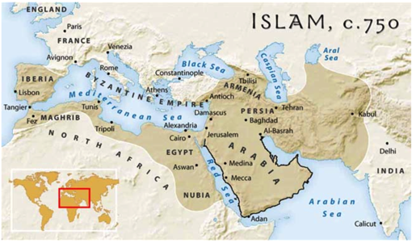
Deserts, Towns and Trade Routes
The Arabian Peninsula- crossroads of major trade routes
Mainly desert setting
Nomads called Bedouins organized into clans
In oases areas, market towns grew

Slide 4
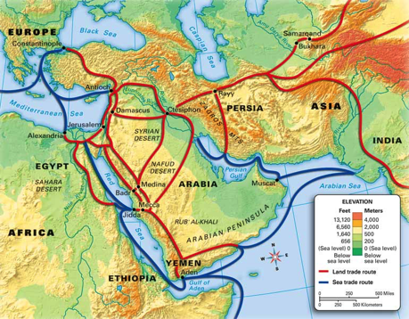
Crossroads of Trade and Ideas
Early 600s- trade routes connect Arabia to ocean and land routes
Byzantines and Persian empires to north, Silk Roads to east

Slide 5
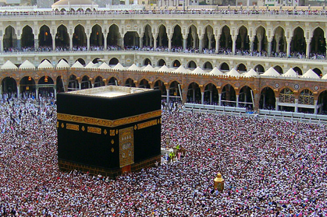
Mecca
Certain holy months, groups stopped to worship at ancient shrine in city of Ka’aba
Associated with Abraham- Hebrew prophet
Over time, became associated with over 360 idols from many tribes
Belief in Allah- the one God in Arabic
In mixed religious environment, Muhammad was born

Slide 6
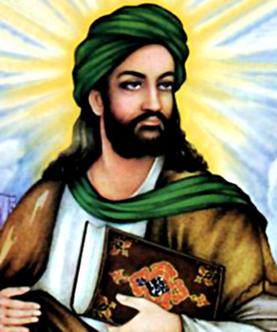
The Prophet Muhammad
Born 570 A.D.
Orphaned at 6 years- raised by grandfather and uncle
Little schooling
At 25, becomes trader and business manager for Khadijah
Wealthy businesswoman
Later marry

Slide 7
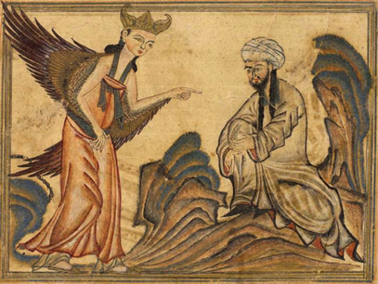
The Prophet Muhammad
Takes interest in religion
40- a voice calls him while meditating in a cave outside Mecca
Voice was of angel Gabriel
Told Muhammad he was a messenger of Allah

Slide 8
The Prophet Muhammad
Starts teaching that Allah was the one and only God
Must abandon all other gods
Islam- submission to the will of Allah
Muslim- one who has submitted

Slide 9
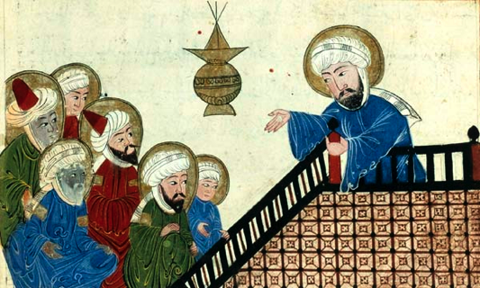
The Prophet Muhammad
613- begins to preach publicly
Met with hostility
Thought it would lead to neglect of traditional gods and Mecca would lose it’s spot as pilgrimage center

Slide 10
The Hijrah
Followers were attacked
Leaves Mecca in 622 for Yathrib- 200 miles north
Hijrah- migration from Mecca to Yathrib (later named Medina)
Marks turning point for Muhammad
Attracts many devoted followers
Becomes political leader and military leader

Slide 11
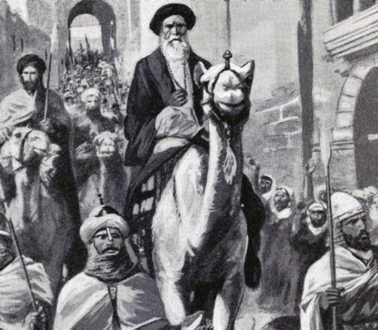
Return to Mecca
630- returns with 10,000 followers
Mecca’s leaders surrender
Destroys idols in the Ka’aba and has call to prayer from its roof
Many convert and join umma- Muslim religious community

Slide 12
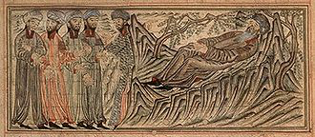
Death of Muhammad
Dies 2 years later
Made huge strides in unifying Arabian Peninsula under Islam

Slide 13
Beliefs and Practices of Islam
One God- Allah
There is good and evil
Each person is responsible for his/her life

Slide 14
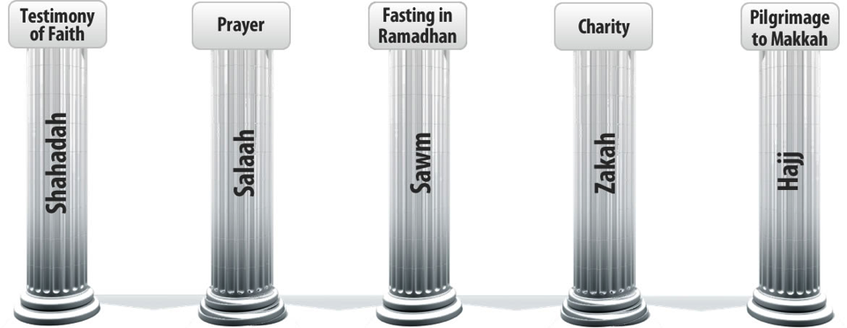
Beliefs and Practices of Islam
The Five Pillars of Islam- all believers have to carry out five duties

Slide 15
Beliefs and Practices of Islam
Faith- “There is no God but Allah, and Muhammad is the Messenger of Allah.”

Slide 16
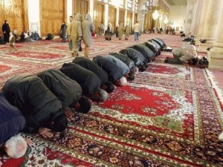
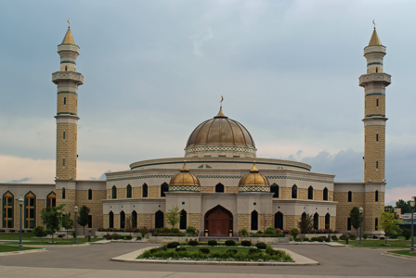
Beliefs and Practices of Islam
Prayer- 5 times a day, face Mecca and pray
Mosque- Islamic house of worship

Slide 17
Beliefs and Practices of Islam
Alms- money to the poor (religious tax)

Slide 18
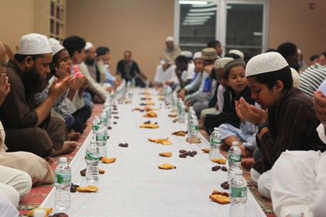
Beliefs and Practices of Islam
Fasting- holy month of Ramadan, fast between dawn and sunset
Eat simple meal at end of day
To remind Muslims that spiritual needs are greater than physical needs

Slide 19
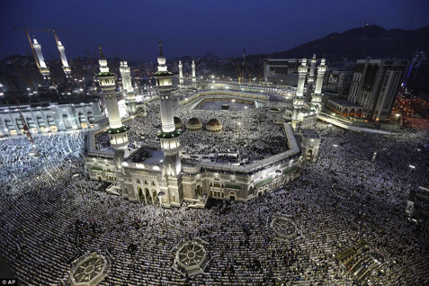
Beliefs and Practices of Islam
Pilgrimage- all who are physically and financially able perform the hajj- pilgrimage to Mecca at least once
Wear identical garments so they all stand as equals before Allah

Slide 20
A Way of Life
Forbidden to eat pork or to drink alcohol
Friday afternoons = communal worship
No priests or central religious authority

Slide 21
Sources of Authority
Qur’an- holy book of Muslims, records Muhammad’s revelations
Written in Arabic
Sunna- Muhammad’s example- best model for proper living
Shari’a- body of law encompassing Sunna and the Qur’an
Regulates family life, moral conduct, business and community life

Slide 22
Links to Judaism and Christianity
To Muslims, Allah is same God as in Christianity and Judaism
View Jesus as prophet, not the Son of God
Qur’an similar in significance to Torah and New Testament
See Qur’an as final book- perfects eh earlier revelations
All believe in heaven, hell and day of judgment
All trace ancestry to Abraham

