Slide 1
The Scientific Revolution

Slide 2
Setting the Stage
The period between 1300 and 1600 was a time of great change in Europe. The Renaissance, a rebirth of learning and the arts, inspired a spirit of curiosity in many fields. Scholars began to question ideas that had been accepted for hundreds of years. Meanwhile, the religious movement known as the Reformation prompted followers to challenge accepted ways of thinking about God and salvation. While the Reformation was taking place, another revolution in European thought had begun, one that would permanently change how people view the physical world.

Slide 3
The Roots of Modern Science
The Medieval View
The geocentric theory- earth was an immovable object at the center of the universe
Idea came from Aristotle and Ptolemy

Slide 4
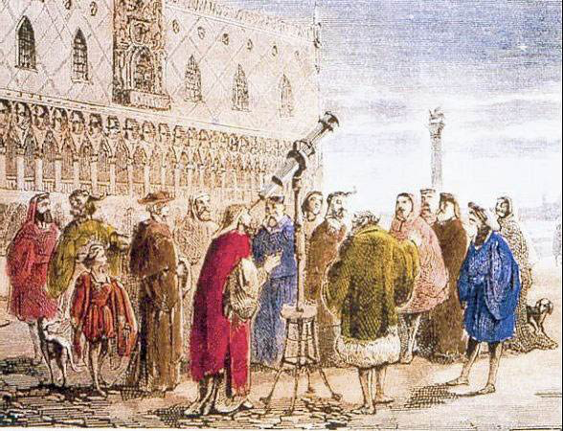
The Roots of Modern Science
A New Way of Thinking
Scholars start challenging the ideas of ancient thinkers and the Church
Scientific Revolution- change in European thought about the natural world based upon careful observation and a willingness to question accepted beliefs

Slide 5
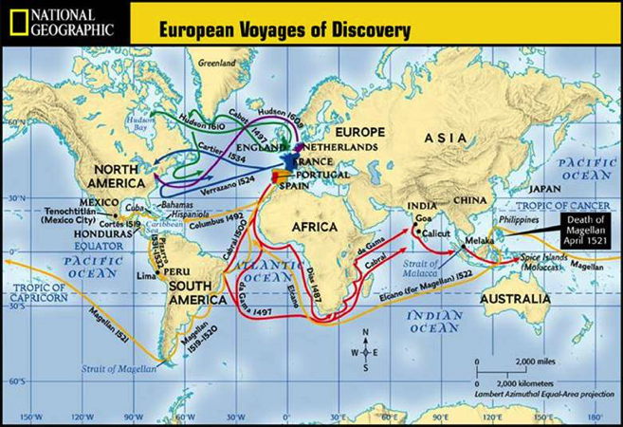
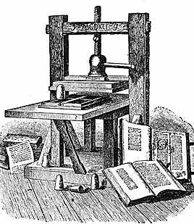
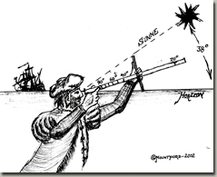
Factors Leading to the Revolution
Exploration of Africa, Asia and the Americas
Opened Europeans to the possibilities of new truths to be found
Printing Press
Challenging ideas spread
Exploration leads to research
Need for better understanding in astronomy and navigation for tools
Looking closer at the world around them, people made new observations

Slide 6
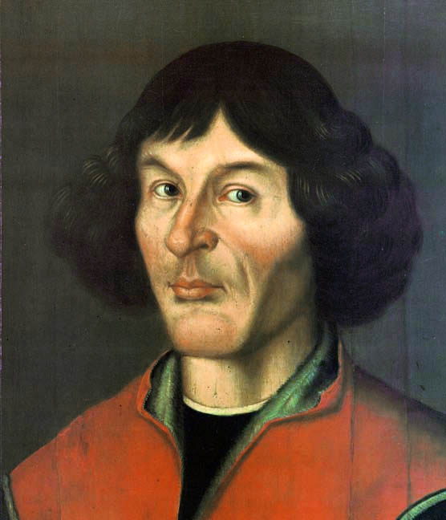
The Heliocentric Theory
Nicolaus Copernicus- Polish, questioned geocentric theory
Developed idea that the planets revolve around the sun
Knew most clergy and scholars would reject it because it conflicted with religious views
Didn’t publish his findings until he was on his deathbed

Slide 7
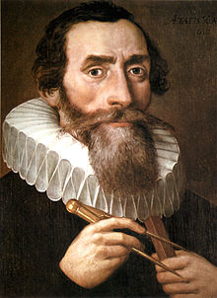
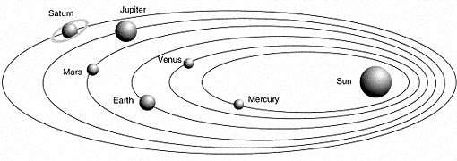
Johannes Kepler
Concluded certain mathematical laws govern planetary motion
Revolve in elliptical orbits instead of circles
Showed mathematically that planets revolve around the sun

Slide 8
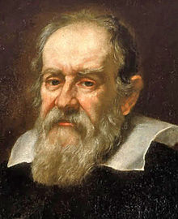
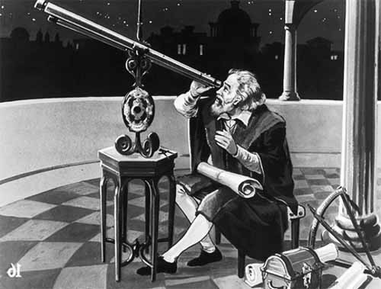
Galileo Galilei
Italian scientist
Built own telescope
1610- published book Starry Messenger
Jupiter had 4 moons
Sun had dark spots
Earth’s moon has rough, uneven surface
1616- Church warns him to not defend the ideas of Copernicus
Remained silent, but continued his studies

Slide 9
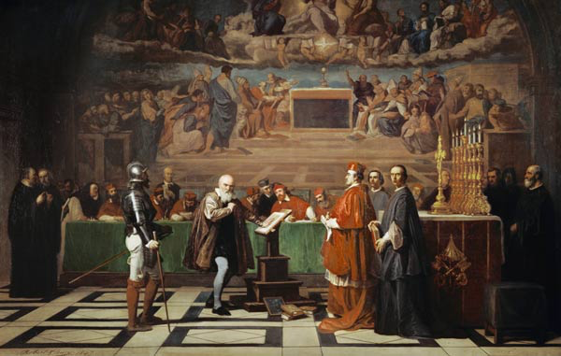
Galileo Galilei
1632- published Dialogue Concerning the Two Chief World Systems
Showed Galileo supported the Copernican theory
The pope puts Galileo on trial
Under threat of torture, he reads a statement saying Copernicus was wrong
House arrest and was never again free
1992- the Church acknowledged Galileo was right

Slide 10
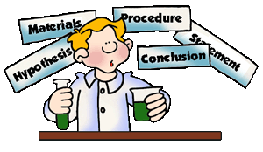
The Scientific Method
Logical procedure for gathering and testing ideas
Problem or question from an observation
Form a hypothesis (unproved assumption)
Test hypothesis
Analyze and interpret data to form a conclusion

Slide 11
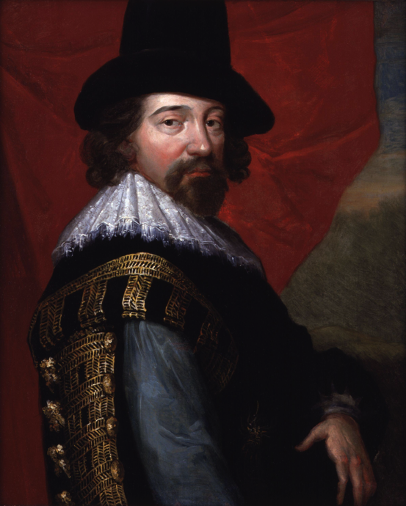
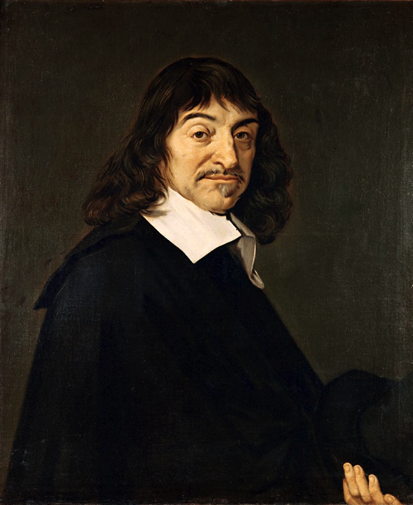
Bacon and Descartes
Francis Bacon said scientists would generate practical knowledge that would improve lives
Urged scholars to experiment then draw conclusions
Known as empiricism, or experimental method
Rene Descartes developed analytical geometry- linked algebra and geometry
Said everything should be doubted until proved by reason
Started with basic truth that only he existed
From there developed other basic truths

Slide 12
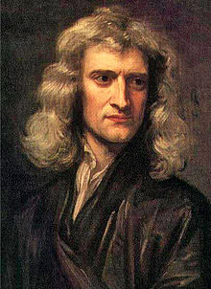
Newton Explains Gravity
Isaac Newton- English scientist
Every object in the universe attracts every other object
Degree of attraction depends on the mass of the objects and distance between them
1687- writes The Mathematical Principles of Natural Philosophy
Universe was like a clock
Worked together in ways that could be explained mathematically
Believed God was the creator who set everything in motion

Slide 13
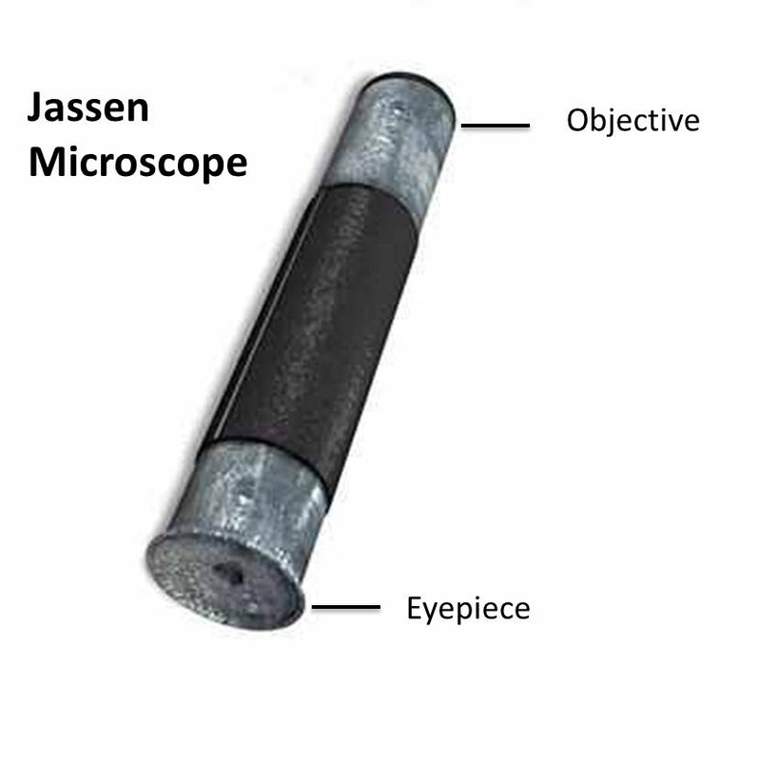
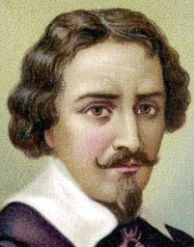
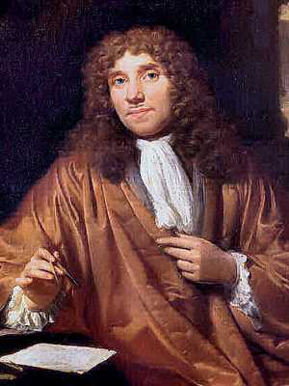
Scientific Instruments
1590s- first microscope by eyeglass maker Zacharias Janssen
1670s- Anton van Leeuwenhoek uses it to study bacteria in tooth scrapings and studies red blood cells

Slide 14
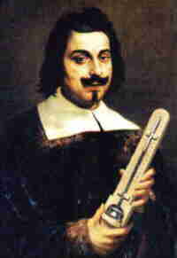
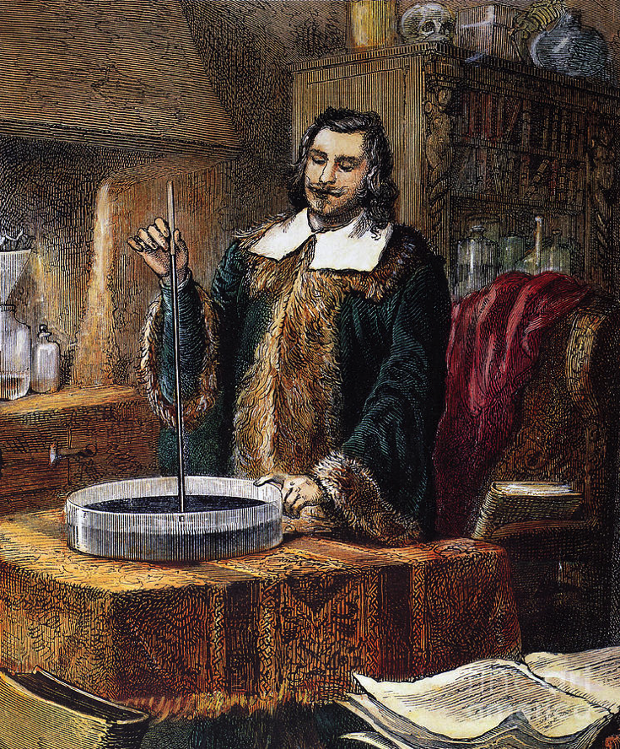
Scientific Instruments
1643- Evangelista Torricelli develops first mercury barometer- used to measure atmospheric pressure and predict weather

Slide 15
Scientific Instruments
1714- Gabriel Fahrenheit makes thermometer to use mercury in glass- showed water freezing at 32°
1742- Anders Celsius makes another scale showing freezing at 0°

Slide 16
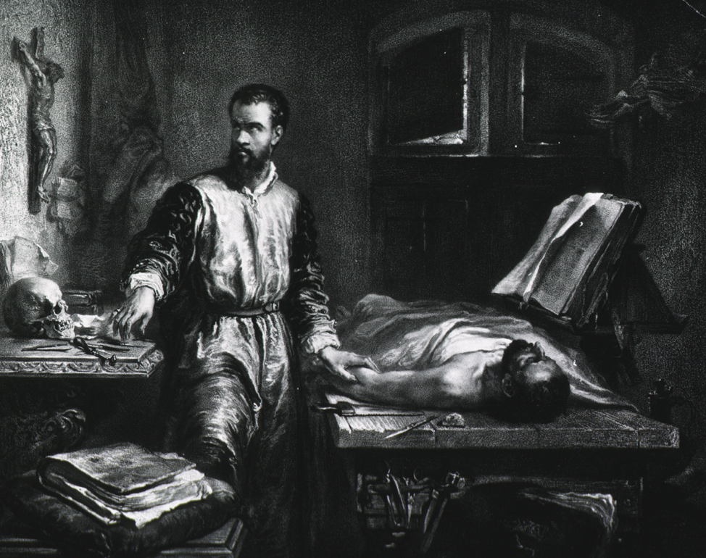
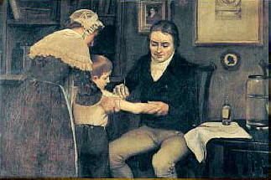
Medicine
1543- Andreas Vesalius dissected human corpses and published observations
Late 1700s- Edward Jenner introduced vaccine to prevent smallpox

Slide 17
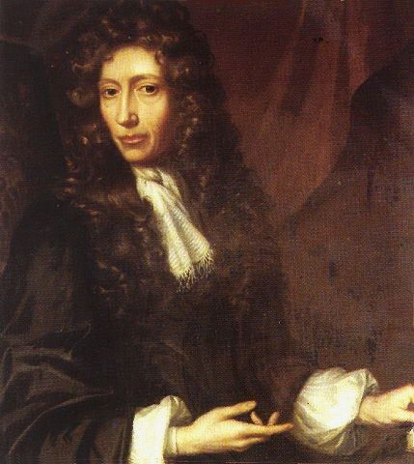
Chemistry
Mid 1600s- Robert Boyle challenged Aristotle’s idea of 4 main elements (earth, air, fire, water)
Said smaller particles joined together in different ways
Boyle’s Law- explains how volume, temperature and pressure of gas affect each other

