Slide 1
China Limits European Contacts

Slide 2
Setting the Stage
The European voyages of exploration had led to opportunities for trade. Europeans made healthy profits from trade in the Indian Ocean region. They began looking for additional sources of wealth. Soon, European countries were seeking trade relationships in East Asia, first with China and later with Japan. By the time Portuguese ships dropped anchor off the Chinese coast in 1514, the Chinese had drive out their Mongol rulers and had united under a new dynasty.

Slide 3
The Ming Dynasty
1368-1644
Vassals from throughout Asia paid Ming overlords a tribute
China expected the same from Europeans

Slide 4
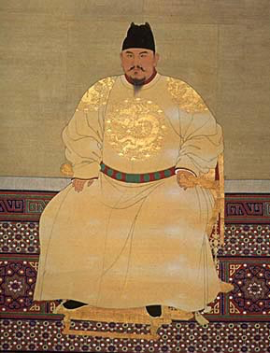
The Rise of the Ming
Hongwu- peasant’s son who commanded the rebel army
Forces Mongols out of China
Becomes first Ming emperor
Began reforms to restore agricultural lands, erase the Mongol past and promote China’s power and prosperity
Encouraged a return to Confucian moral standards
Later he became a tyrant- conducted purges killing thousands

Slide 5
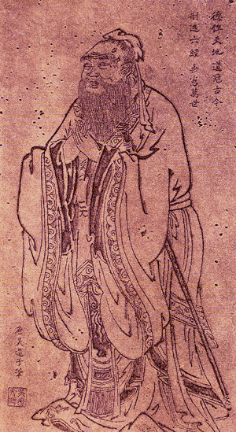
Confucian Values
Ideal society depended on agriculture, not commerce
Farmers, not merchants, made ideal citizens
Emphasizes personal and governmental morality, correctness of social relationships, justice and sincerity

Slide 6
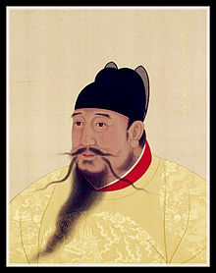
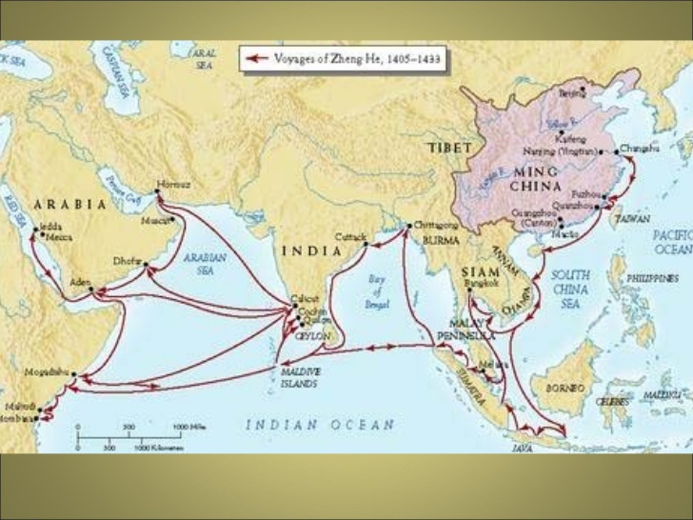
The Rise of the Ming
Yonglo takes over after death of Hongwu
Launched voyages to explore the world before any Europeans did

Slide 7
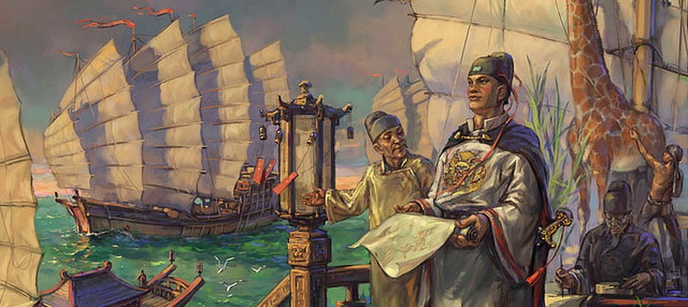
Zheng He
Chinese Muslim admiral
Led all 7 voyages
Went all the way to eastern Africa
40 to 300 ships went in each expedition
Fighting ships, storage vessels, huge treasure ships (over 400 feet long), and over 27,000 people
After the 7th voyage, China withdrew to isolation

Slide 8
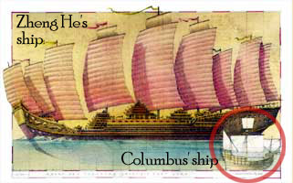
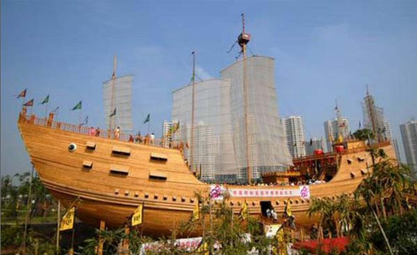

Slide 9
Relations with Foreign Countries
Only the government was to conduct foreign trade and only through 3 coastal ports
Leads to smuggling- trade still flourished
Commercial industry flourished but never became highly-industrialized
Taxes skyrocketed while agricultural taxes stayed low
European traders and missionaries come in huge numbers

Slide 10
Fall of the Ming Dynasty
Problems in the Ming Dynasty after 200 years
Ineffective rulers
Corruption
No money in the government
High taxes and bad harvests pushed millions into starvation

Slide 11
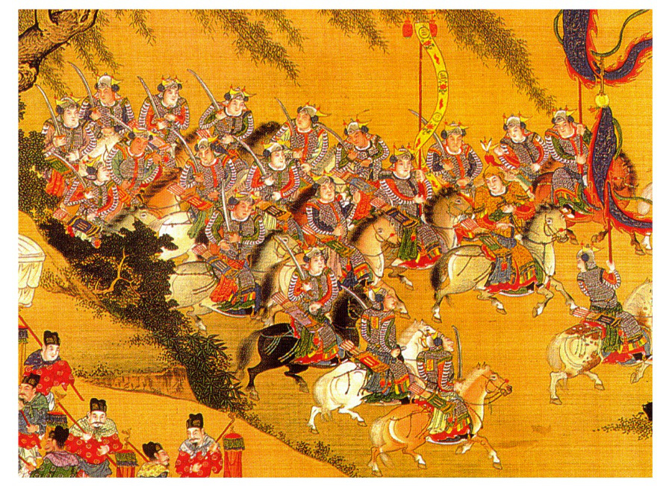
The Manchus
People of the region of Manchuria
Invade China and the Ming Dynasty collapsed
Establish the Qing Dynasty
Ruled for more than 260 years
Expanded borders to include Taiwan, Chinese Central Asia, Mongolia and Tibet

Slide 12
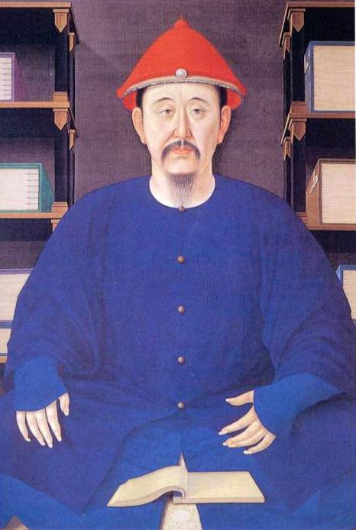
China Under the Qing
Upheld China’s Confucian beliefs and social structure
Made country’s frontiers safe
Kangxi- ruled for 60 years
Cut taxes and expenses
Gave intellectuals government positions
Stayed up on developments in science, medicine and math in Europe

Slide 13
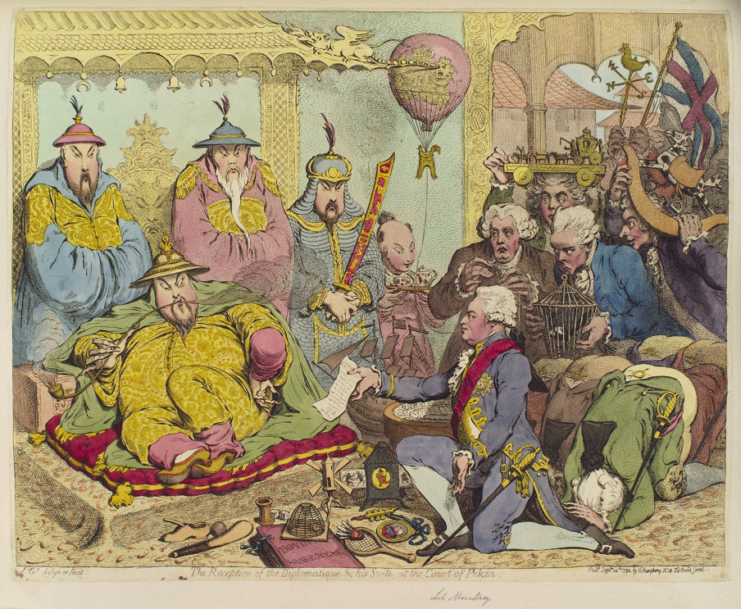
Chinese Isolation
Chinese only allowed trading at special ports and paying tributes
Accepted the Dutch as trade partners
They followed the Chinese rules for trade
Returned with traditional goods, as well as new good- tea
King George of Britain tries to get in, but refuses China’s rules

Slide 14
Life in the Ming and Qing Dynasties
Life improved for most Chinese
Farming techniques modernized- fertilizer and irrigation
New foods introduced from Europe
As nutrition picks up, there is a population explosion
Favored sons over daughters- many female infants were killed

