Slide 1
European Nations Settle North America

Slide 2
Setting The Stage
Spain’s successful colonization efforts in the Americas did not go unnoticed. Other European nations, such as England, France and the Netherlands, soon became interested in obtaining their own valuable colonies. The Treaty of Tordesillas, signed in 1494, had divided the newly discovered lands between Spain and Portugal. However, other European countries ignored the treaty. They set out to build their own empires in the Americas. This resulted in a struggle for North America.

Slide 3
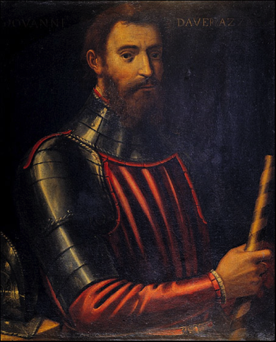
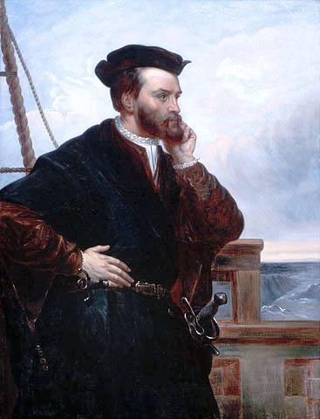
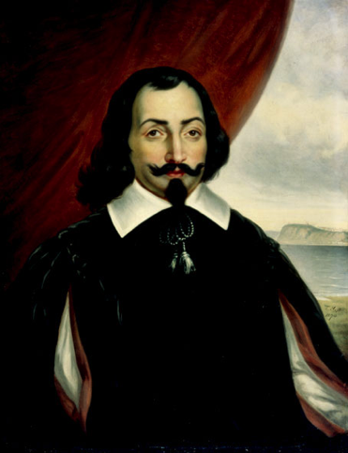
Establishing New France
1524- Giovanni da Verrazzano looks for a sea route through North America to the Pacific
Doesn’t find one, but finds New York harbor
1534- Jacques Cartier finds a gulf off eastern Canada and goes inland on a river he names the St. Lawrence
Finds an island and names it Mont Real (Mount Royal), or today called Montreal
1608- Samuel de Champlain along with 32 settlers founds Quebec
Becomes the capital of New France

Slide 4
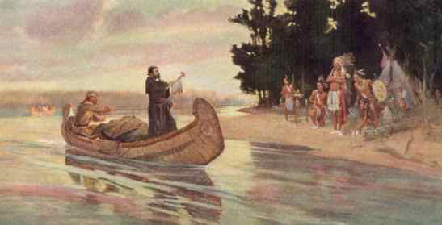
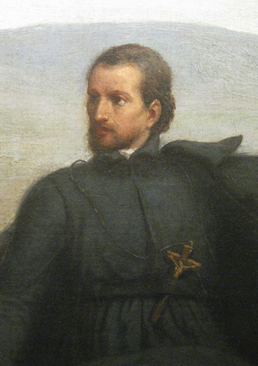
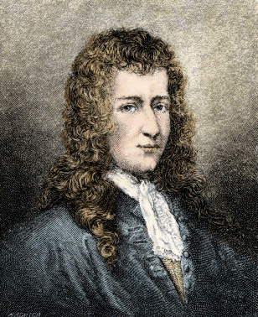
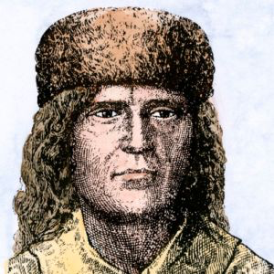
Establishing New France
1673- Priest Jacques Marquette and trader Louis Joliet explored the Great Lakes and upper Mississippi
1683- Sieur de La Salle explored the lower Mississippi
Claimed river valley for France
Named it Louisiana in honor of the French King Louis XIV
Early 1700s- New France controls midwestern U.S. and eastern Canada

Slide 5
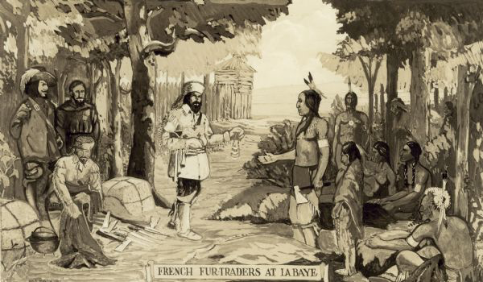
A Trading Empire
Population in New France was only 65,000 by 1760
Settlers included-
Priests trying to convert Natives
Fur traders

Slide 6
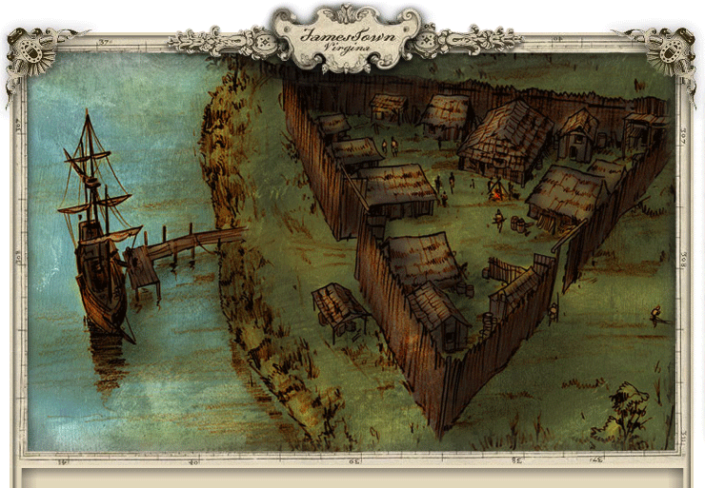
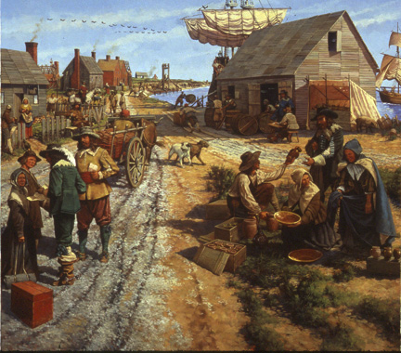
The English Arrive
1606- a London company sends 3 ships and 100 settlers
1607- 4 months later they land and call their settlement Jamestown in honor of King James
Start was disastrous
Looked for gold instead of planting
70% of people died of hunger, disease or battles with Natives
Saved by development of tobacco

Slide 7
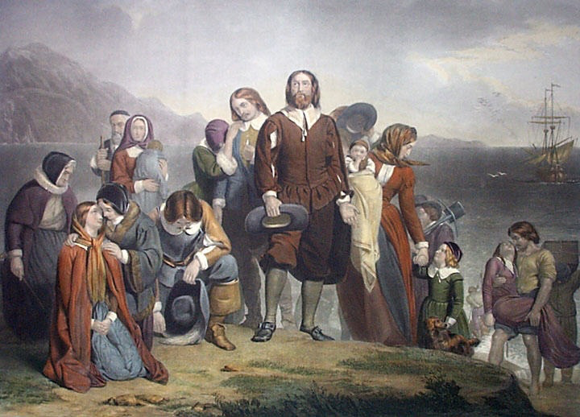
Puritans Create New England
1620- Pilgrims found the 2nd English colony- Plymouth
Seeking religious freedom
10 years later- Puritans, another group seeking religious freedom, settle a colony at Massachusetts Bay

Slide 8
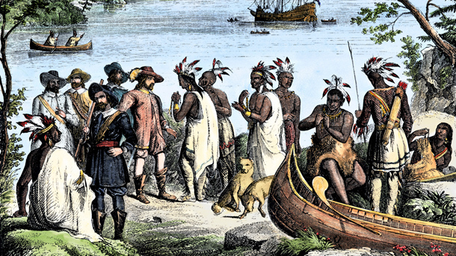
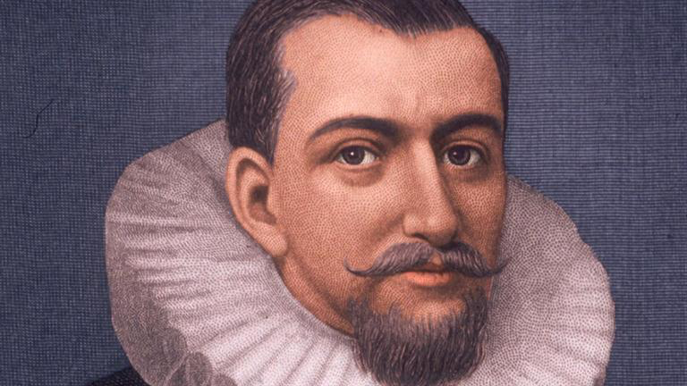
Dutch Create New Netherland
1609- Henry Hudson was searching for a sea route to Asia
Didn’t find, but explored 3 waterways- Hudson River, Hudson Bay, Hudson Strait
Established a fur trade with the Iroquois
Dutch holdings become known as New Netherland
Made money on fur, but failed to attract people until the Dutch open up to a variety of people

Slide 9
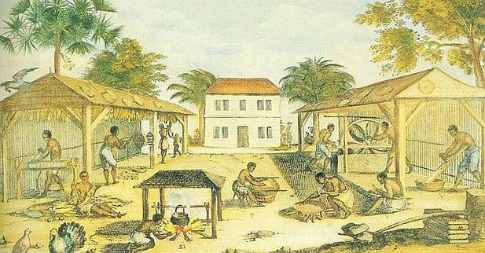
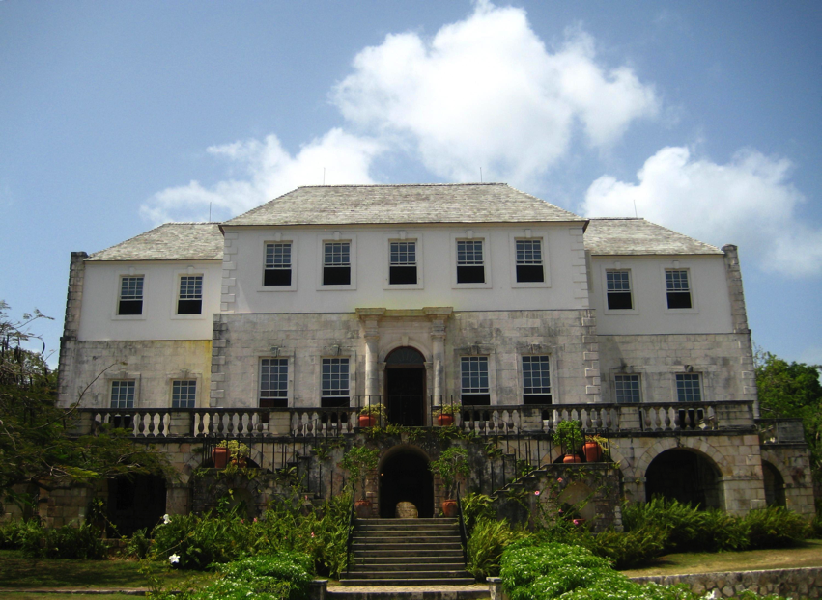
Colonizing the Caribbean
French take Haiti, Guadeloupe and Martinique
English take Barbados and Jamaica
Dutch take Antilles and Aruba
All built huge cotton and sugar plantations- used slaves as laborers

Slide 10
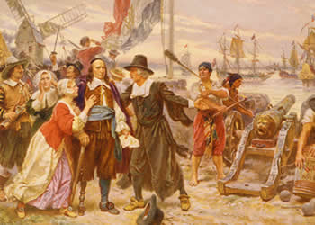
The English Oust the Dutch
New Netherland separated the north and south English colonies
1664- King Charles II appoints his brother, the Duke of York, to push out the Dutch
Dutch surrender without a single shot being fired
English rename the territory New York
By 1750- about 1.2 million English settlers in the 13 colonies

Slide 11
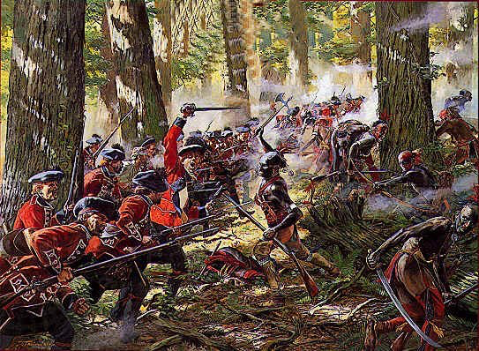
England Battles France
England pushes west for more land
Run into New France
1754- French and Indian War- dispute over land in the Ohio River Valley
Part of a larger, world-wide conflict known as the Seven Years’ War
British win and French surrender their North American holdings

Slide 12
Native Americans Respond
French and Dutch were cooperative with Natives
Both benefit from the fur trade
English struggle with Natives
Issues over land and religion
English want to populate their colonies- push Natives off land
Puritans view Natives as agents of the devil and threats to their godly society

Slide 13
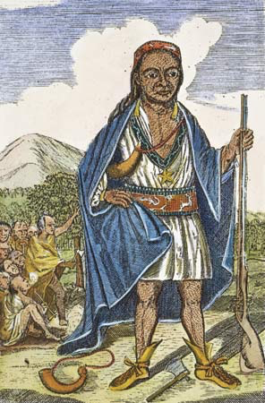
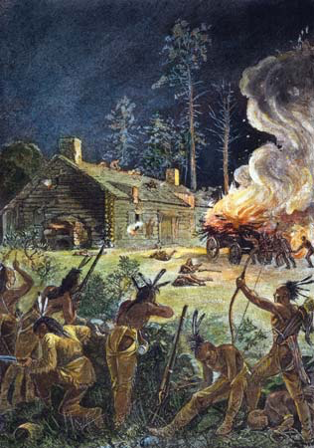
Settlers and Natives Battle
1622- Powhatan tribe attack villages around Jamestown
Kill about 350
Colonists strike back and kill hundreds
1675- King Philip’s War- Native ruler Metacom (a.k.a. King Philip) led attacks on colonial villages in Massachusetts
Both sides massacred hundreds
After a year, the English win

Slide 14
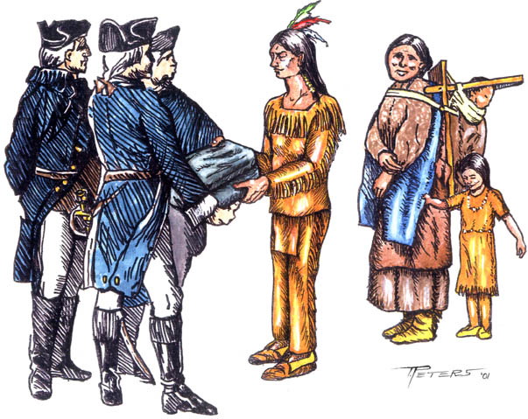
Natives Fall to Disease
1616- smallpox ravaged Natives
Population of one tribe dropped from 24,000 to 750 by 1631
Leads to a shortage of labor in the colonies
Colonists turn to slave labor from Africa

