Slide 1
Feudalism in Europe

Slide 2
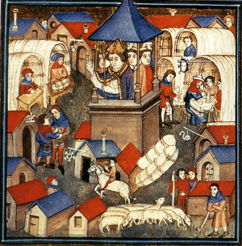
Feudalism
A political system in which nobles, or lords, are granted the use of lands that legally belong to the king
In return, they owe loyalty and military service to the king, and protection to the people who live on their estates

Slide 3
Feudalism in Europe
Charlemagne’s grandsons broke apart his kingdom
New waves of invaders attacked Europe

Slide 4
Invasions
Muslims from south raided Italy
Magyar from east- terrorized Germany and Italy
Vikings from the north

Slide 5
Viking Invasions
From Scandinavia (Denmark, Norway, Sweden)
Worshiped warlike gods
Quick attacks- beached ships, attacked, back to sea before locals could mount a defense
Huge warships- held 300 warriors, 72 oars
Were also traders, farmers and explorers
Explored Russia, Leif Ericson found North America around 1000

Slide 6
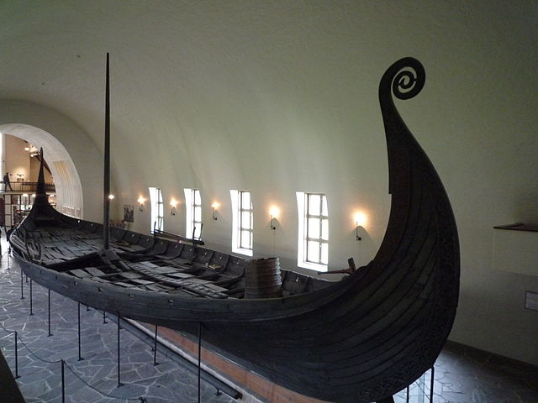
Viking Invasions

Slide 7
The End of Viking Raids
As Vikings accept Christianity, they stop raiding monasteries
As the climate warmed, Scandinavia became more agricultural
More people farmed, less adopted the sea lifestyle

Slide 8
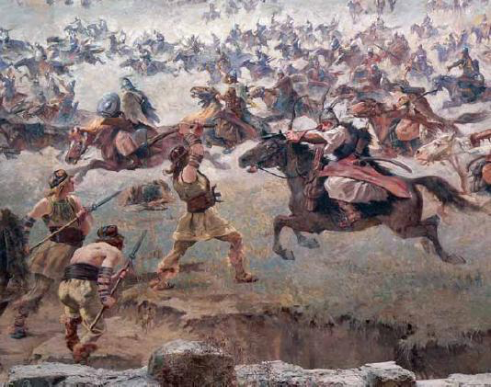
Magyars Attack
Magyars- nomadic people
Attack from Hungary
Superb horsemen
Didn’t settle conquered land- took captives to sell as slaves

Slide 9
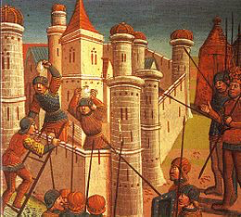
Muslims Attack
Muslims
Attack from North Africa
Goal was to conquer and settle, but eventually became to plunder as well
Expert seafarers

Slide 10
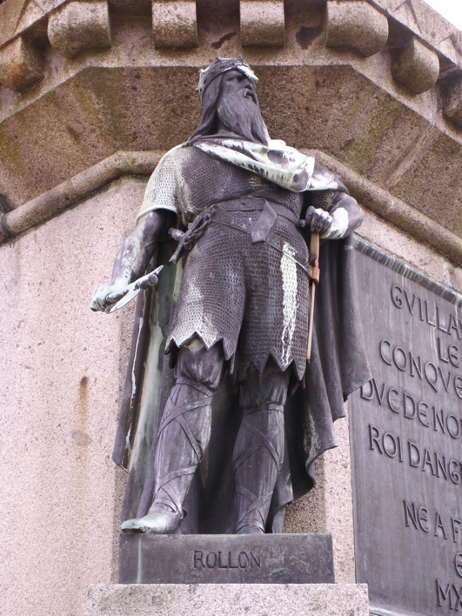
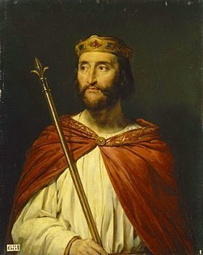
Feudalism Takes Over
Rollo was head of a Viking Army
Plundered the Seine River valley
Charles the Simple was king of France
Gave Rollo a huge piece of French land- became known as Northmen’s land, or Normandy

Slide 11
Feudalism Takes Over
Charles was the lord- landowner
Granted land was called a fief
Rollo was the vassal- person receiving the land in exchange for loyalty and military protection

Slide 12
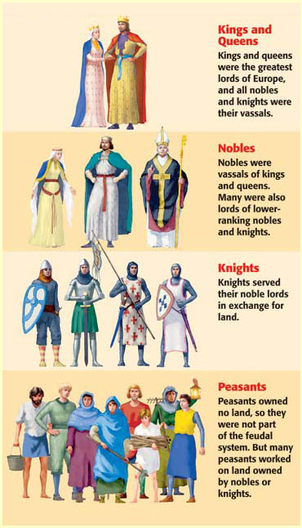
The Feudal Pyramid
Kings
Nobles and bishops
Knights
Peasants

Slide 13
Social Classes
Classes were well-defined and normally inherited
3 classes-
Those who fought (nobles and knights)
Those who prayed (men and women of the Church)
Those who worked (peasants)
Most people were peasants- most peasants were serfs
People who legally could not leave the place where they were born- what they produced belonged to the lord

Slide 14
Manors
Manor- the lord’s estate
Lords provided serfs with housing, farmland and protection from bandits
Serfs cared for the lands, animals and maintain the estate
Normally 15-30 families lived on a manor
Peasants rarely traveled more than 25 miles from their manor
Had manor house, village church, peasant cottages, lord’s demesne, peasant crofts, mill, common pasture, woodland

Slide 15
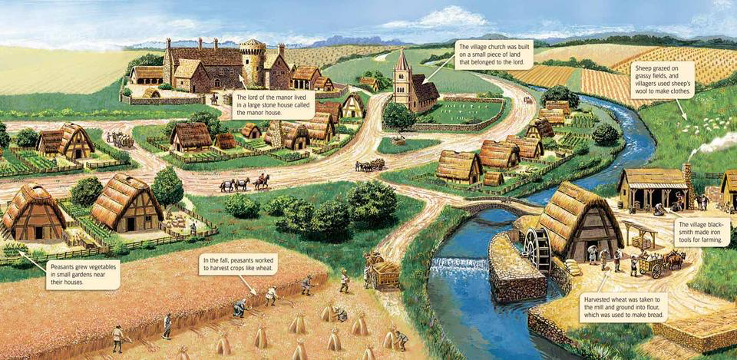
Manors

Slide 16
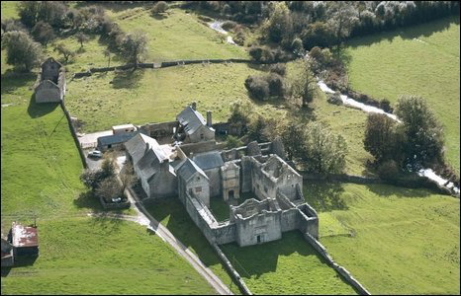
The Harshness of Manor Life
Tax on all grain ground in the mill- any baking bread elsewhere was a crime
Tax on marriage- could only marry with the lord’s consent
Tithe (church tax) to the priest- 1/10th of their income
Lived in crowded cottages close to neighbors
Had 1 or 2 rooms, dirt floors (warmed by bringing pigs inside), pile of straw for a mattress

Slide 17
The Harshness of Manor Life
Diet- mainly vegetables, coarse brown bread, grain, cheese and soup
As soon as children were old enough they worked in the fields
Many did not survive to adulthood- malnutrition and illness
Average life expectancy was 35 years
Accepted their role- believed that God determined a person’s place in society

