Slide 1
Islam Expands

Slide 2
Setting the Stage
When Muhammad died in 632, the community faced a crisis. Muslims, inspired by the message of Allah, believed they had a duty to carry his word to the world. However, they lacked a clear way to choose a new leader. Eventually, the issue of leadership would divide the Muslim world.

Slide 3
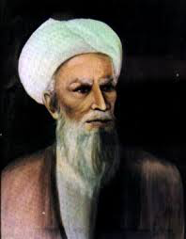
The First Caliph
Caliph- successor or deputy
Muhammad died and hadn’t named a successor
Muslims elect Abu-Bakr as the first Caliph
Loyal friend of Muhammad

Slide 4
Rightly Guided Caliphs
Abu-Bakr and next 3 caliphs (Umar, Uthman and Ali) all knew Muhammad
Used him and Qur’an as guide to leadership
Abu-Bakr invokes jihad- striving, inner struggle against evil; in Qur’an means armed struggle against unbelievers
Some tribes abandoned Islam, some refused to pay taxes

Slide 5
Rightly Guided Caliphs
Under Abu-Bakr, Muslims control Arabia
Under Umar, conquered Syria and lower Egypt
Uthman and Ali expand empire to over 6,000 miles

Slide 6
Success Invading
Byzantine and Sassanid rule persecuted people for religious beliefs
Many welcomed Muslim invaders
Muslims allowed them to follow their own religion

Slide 7
Internal Conflict Creates Crisis
Uthman murdered in 656
Civil war ensues
Ali challenged by governor of Syria Muawiya
Ali assassinated in 661

Slide 8
Internal Conflict Creates Crisis
Umayyads family comes to power
Moved capital to Damascus, Syria
Surround themselves with wealth
Leads to a fundamental division in Muslim community

Slide 9
Sunni-Shi’a Split
Shi’a- believed caliph needed to be a descendant of the Prophet
Resist rule of the Umayyads
Sunni- followers of Muhammad’s example, those who did not outwardly resist Umayyads rule
Sufi- reject luxurious life of the Umayyads

Slide 10
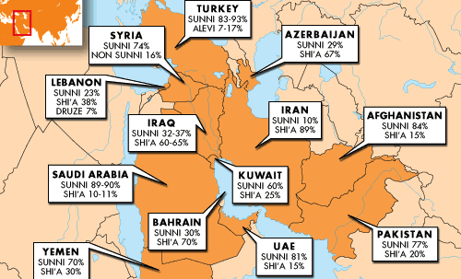

Slide 11
Fall of Umayyads
750- religious and political opposition leads to their fall
Abbasids take control
Murder remaining Umayyads
Abd al-Rahman escapes to Spain
Spain was ruled by Muslims from North Africa- Berbers
Took Spain, marched towards Paris but stopped at Battle of Tours in 732

Slide 12
Rule of Abbasids
Move capital to Baghdad, Iraq- on key trade route
Build strong bureaucracy
Tax on land, imports, exports and non-Muslim’s wealth

Slide 13
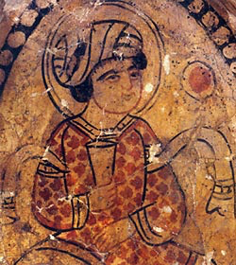
Division of Muslim Lands
Abbasids rule from 750-1258
Independent Muslim states spring up- local leaders dominate many smaller regions
Fatimid caliphate formed by Shi’a Muslims
Claim descent from Muhammad’s daughter
Starts in North Africa, spreads to Arabia and Syria

Slide 14
Muslim Trade Network
Two major sea networks- Mediterranean Sea and Indian Ocean
Land networks connect Silk Roads of China and India with Europe and Africa
Banks develop- system of sakk begins
In Europe called checks

