Slide 1
Maya Kings and Cities

Slide 2
Setting the Stage
In the early centuries A.D., most North American peoples were beginning to develop complex societies. Further south, the peoples of Mexico and Central America were entering into the full flower of civilization. A prime example of this cultural flowering were the Maya, who built an extraordinary civilization in the heart of Mesoamerica.

Slide 3
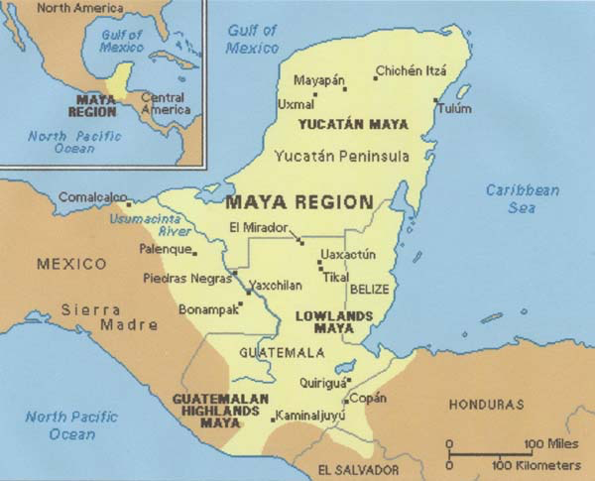
Homeland
Stretches from southern Mexico to northern Central America
Includes:
Dry scrub forests of Yucatan
Dense, steamy jungles of southeastern Mexico
Mountainous regions

Slide 4
Urban Centers
Important cities- Tikal, Copán, Palenque, Uxmal and Chichén Itzá
Each independent city-state ruled by a god-king
Cities featured giant pyramids, temples, palaces and stone carvings dedicated to the gods and rulers
Ball courts- stone-sided, played a game they believed would keep cycles of sun and moon and bring rain
Tens of thousands lived in residential areas around the city center

Slide 5
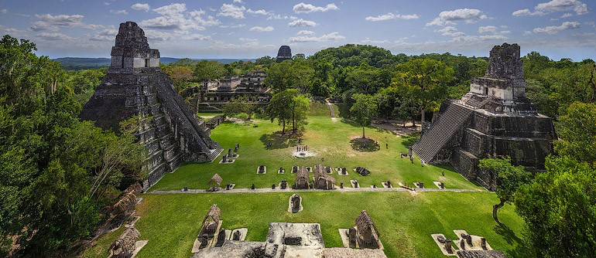
Tikal

Slide 6
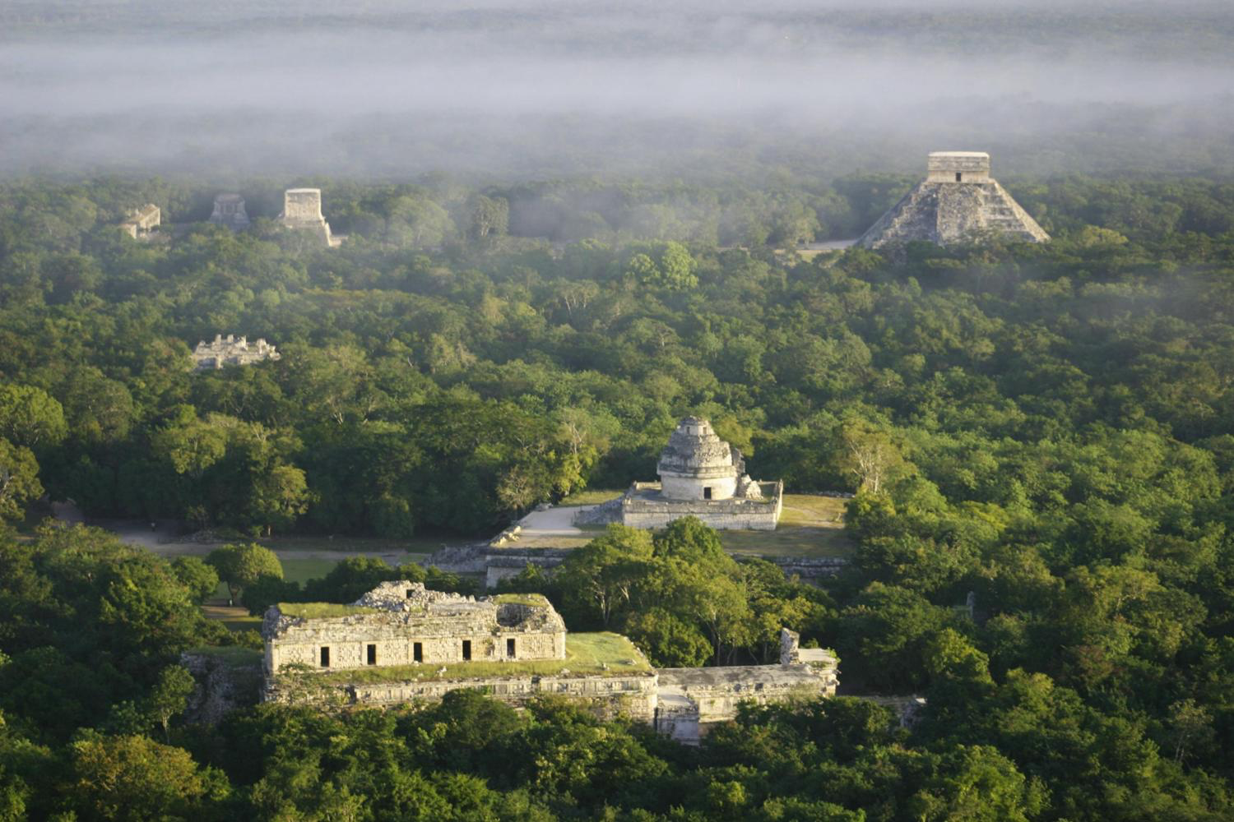
Chichén Itzá

Slide 7
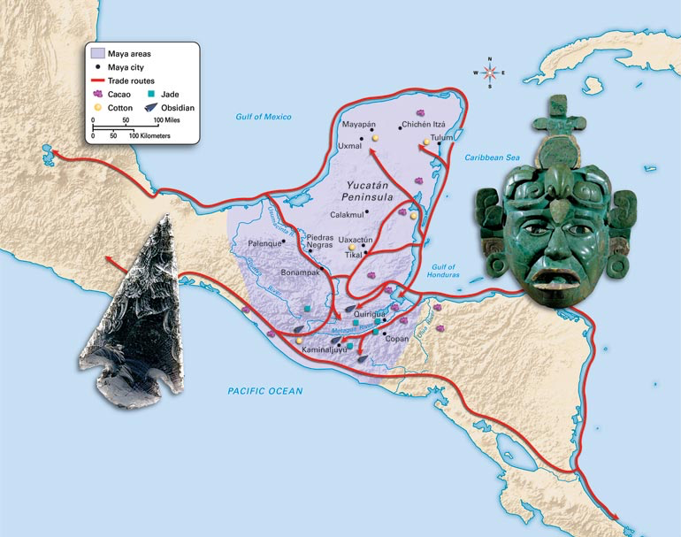
Trade
Cities were independent, but linked through trade
Trade salt, flint, feathers, shells, honey, cotton textiles, jade ornaments
Cacao beans sometimes served as currency

Slide 8
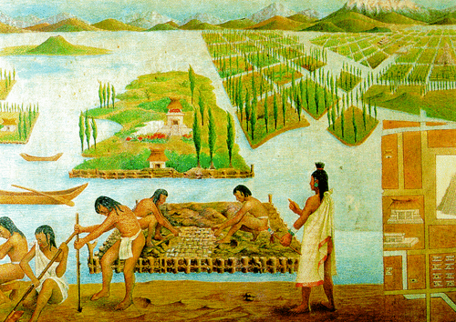
Agriculture
Maize, beans and squash
Use slash-and-burn techniques
Plant on raised beds above swamps and hillside terraces

Slide 9
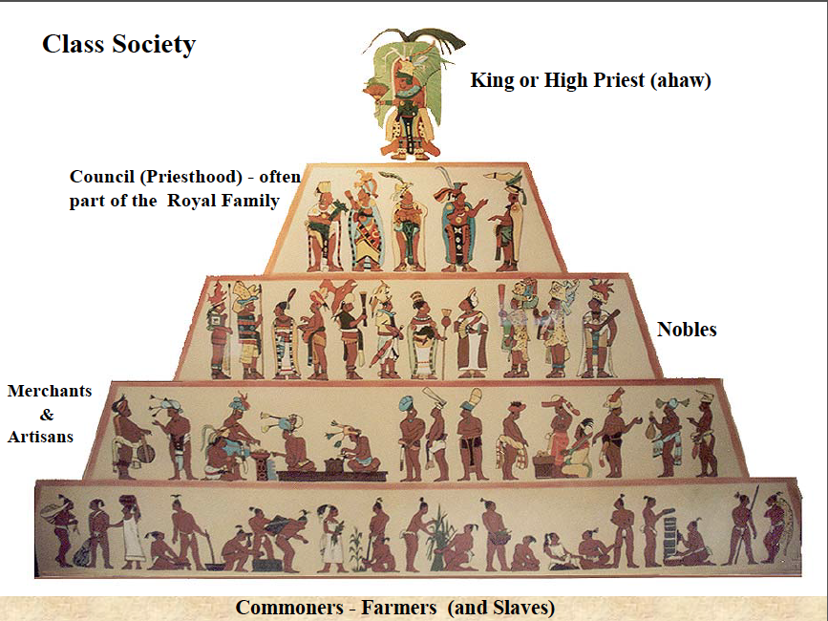
Social Classes
Successful farming leads to accumulating wealth, leads to social classes
King sits at the very top, then classes fall
Top class = noble class = priests and leading warriors
Next = merchants and those with specialized knowledge and skills
Last = peasant majority

Slide 10
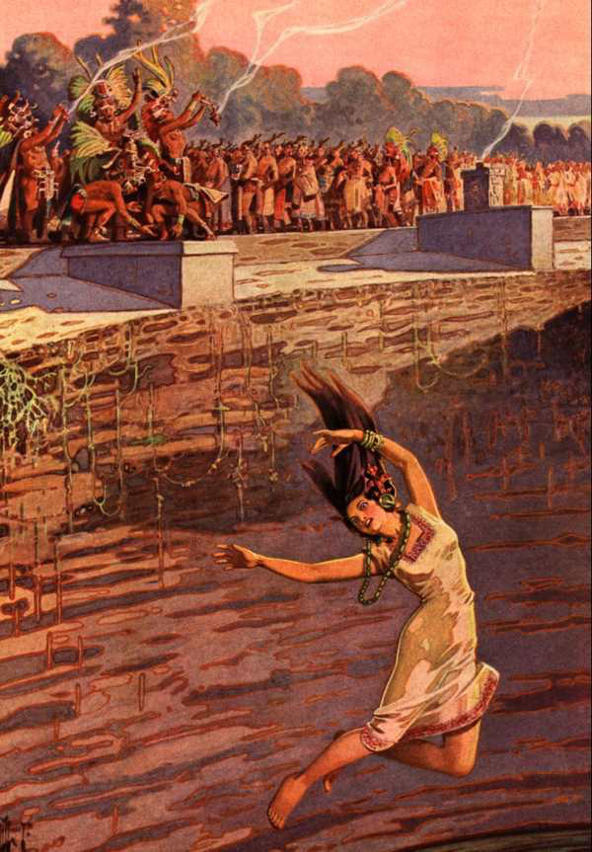
Religion Shapes Life
Many gods (corn, death, rain, war, etc.)
Could be good or evil or both
Prayed, made offerings of food, flowers and incense
Also pierced and cut themselves- offer blood to nourish the gods
Carry out human sacrifice
Throw captives into deep sinkholes along with gold, jade and other offerings

Slide 11
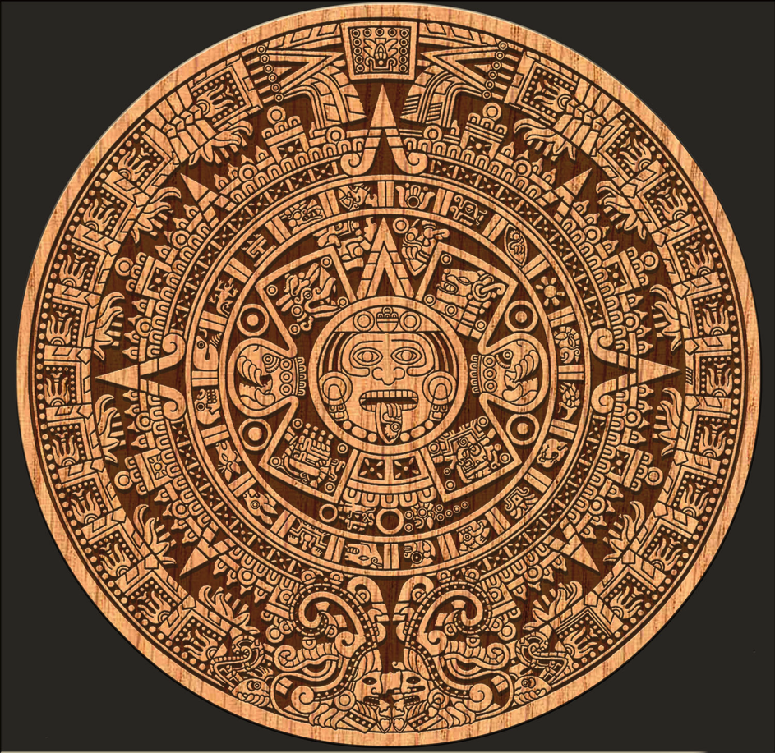
Math and Religion
Religious beliefs led to development of calendar, mathematics and astronomy
Gods were in charge of different days- important to have a calendar to know which god was in charge of each day
260 day religious calendar- 13 20-day months
2nd 365 day solar calendar- 18 20-day months, with separate 5 days at the end

Slide 12
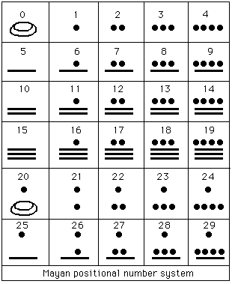
Development of Calendars
Based on movement of sun, planets and moon
Calculated solar year at 365.2420 days- only .0002 off of what we accept today
Used math system with concept of zero and base 20 system

Slide 13
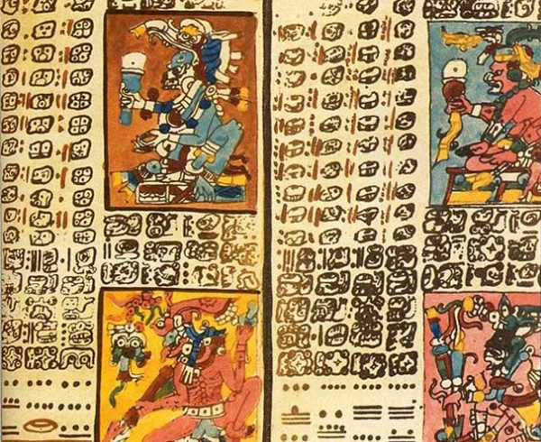
Written Language
Most advanced writing system
800 hieroglyphic symbols, or glyphs
Record important events by carving in stone or on codex- bark-paper book
Only 3 codex books have survived
Popol Vuh- book detailing Maya version of story of creation

Slide 14
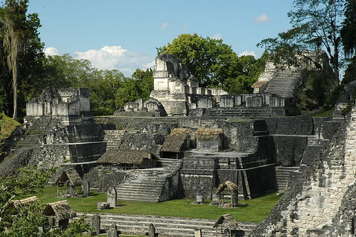
Mysterious Maya Decline
Late 800s- suddenly abandon many of their cities
Toltec (warlike people from north) invade and take over much of the territory
Theories-
700s- warfare between city-states disrupts trade, leads to depression
Population growth and over framing damaged environment- leads to famines, food shortages and disease

