Slide 1
The Crusades

Slide 2
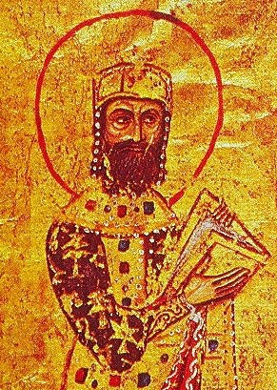
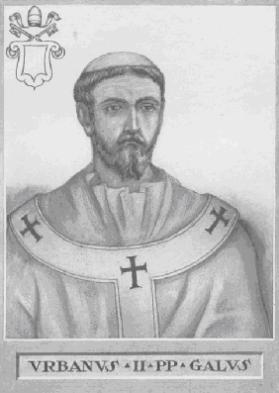
The Beginnings
Byzantine emperor Alexius Comnenus begs Robert, Count of Flanders, and Pope Urban II to send help against Muslim Turks to threatened to take over the capital of Constantinople
Pope Urban II issues a call for Crusades- a holy war

Slide 3
Goals of the Crusades
Stop Muslim attacks
Reclaim Palestine and reunite Christendom
Some fighting looked for land and position in society
Merchants want control of key trade routes to India, Southeast Asia and China

Slide 4
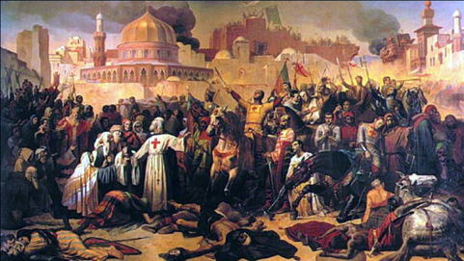
The First Crusade
Huge support
1097- 3 armies gathered outside Constantinople
Most were French, but all of Europe was represented
An army of 12,000- less than a ¼ of the original army, approached Jerusalem
July 15, 1099 they captured the city

Slide 5
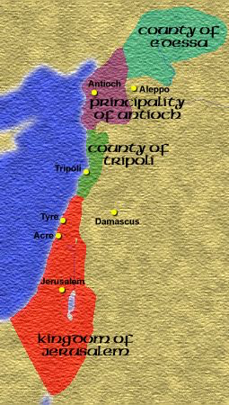
The First Crusade
Took a very narrow strip of land- 650 miles worth
Made 4 Crusader states out of it
Were vulnerable to counteract by the Muslims

Slide 6
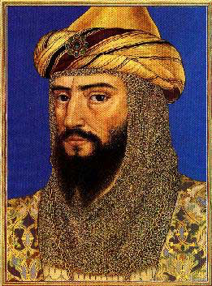
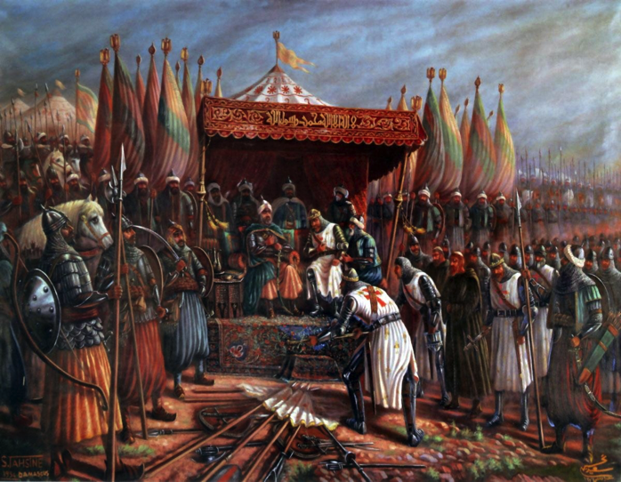
The Second Crusade
1144- Edessa was reconquered by the Turks
Second Crusade organized to recapture the city
Failed and Jerusalem also fell to Muslims under command of Saladin

Slide 7
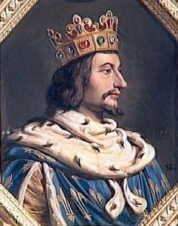
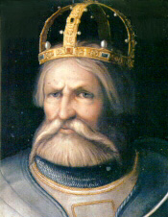
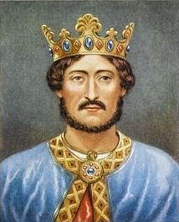
The Third Crusade
Led by 3 of Europe’s most powerful monarchs-
Philip II (Augustus) of France, Frederick I (Barbarossa) of Germany and Richard the Lion-Hearted of England
Trying to recapture Jerusalem

Slide 8
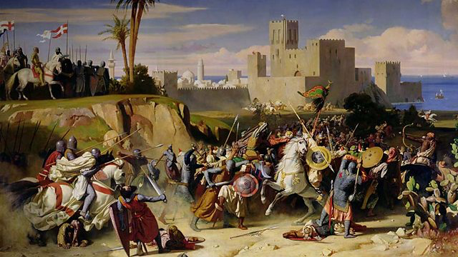
The Third Crusade
Philip argued with Richard and left
Frederick drowned on the trip
Richard led the Crusade
Neither side could gain control- truce in 1192
Jerusalem remained under Muslim rule
Unarmed Christian pilgrims could freely visit the city’s holy places

Slide 9
The End of the Crusades
More crusades were carried out in the 1200s
Personal gain and greed overshadowed the true purpose
None were successful

Slide 10
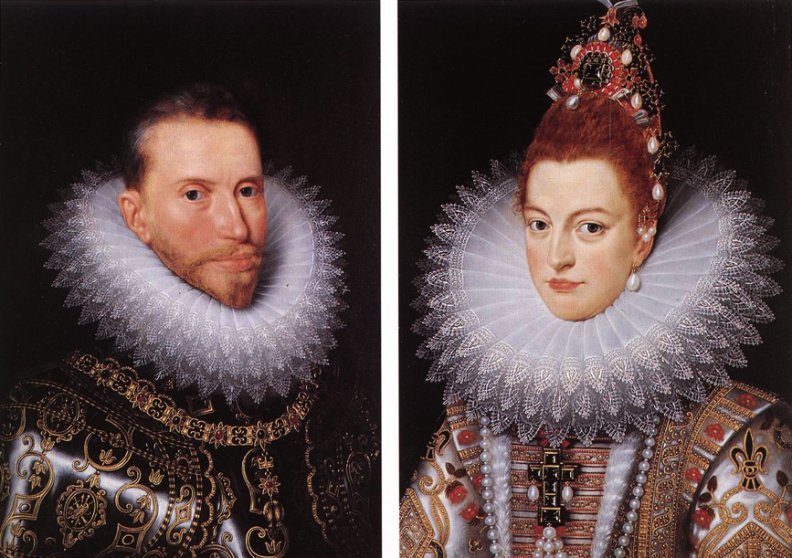
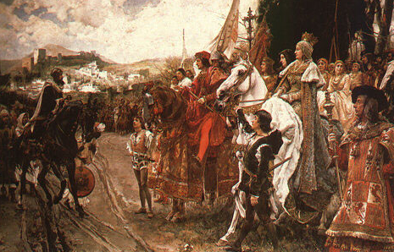
The Spanish Crusade
Muslims, called Moors, controlled most of Spain
Reconquista- effort by Spanish to drive out the Muslims
Lasted hundreds of years
By 1492- Muslims finally fell to Ferdinand and Isabella

Slide 11
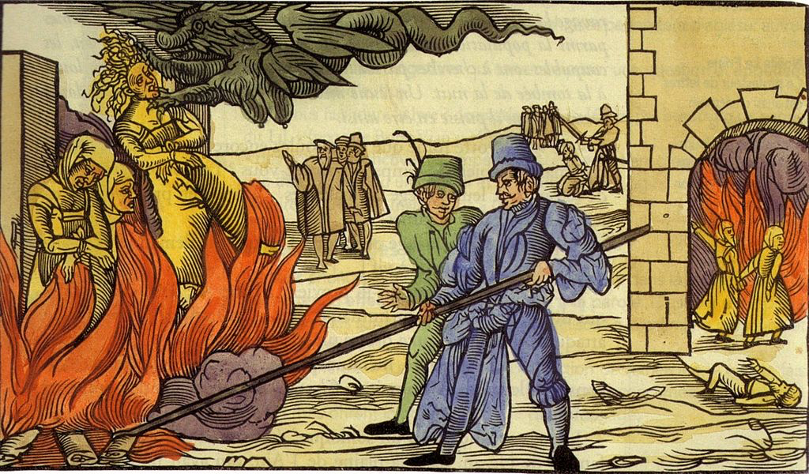
The Spanish Crusade
Inquisition- court held by the Church to suppress heresy
A person suspected of heresy was questioned for weeks and sometimes tortured
Once they confessed, they were burned at the stake

Slide 12
Effects of the Crusades
Example of the power of the Church
Thousands left home to travel to the Holy Land
Trade increased between the West and Asia
Failure of later Crusades weakened the pope and gave more power to kings
Created intolerance and prejudice towards Muslims

