Slide 1
The Enlightenment in Europe

Slide 2
Setting the Stage
In the wake of the Scientific Revolution, and the new ways of thinking it prompted, scholars and philosophers began to reevaluate old notions about other aspects of society. They sought new insight into the underlying beliefs regarding government, religion, economics and education. Their efforts spurred the Enlightenment, a new intellectual movement that stressed reason and thought and the power of individuals to solve problems. Known also as the Age of Reason, the movement reached its height in the mid-1700s and brought great change to many aspects of Western civilization.

Slide 3
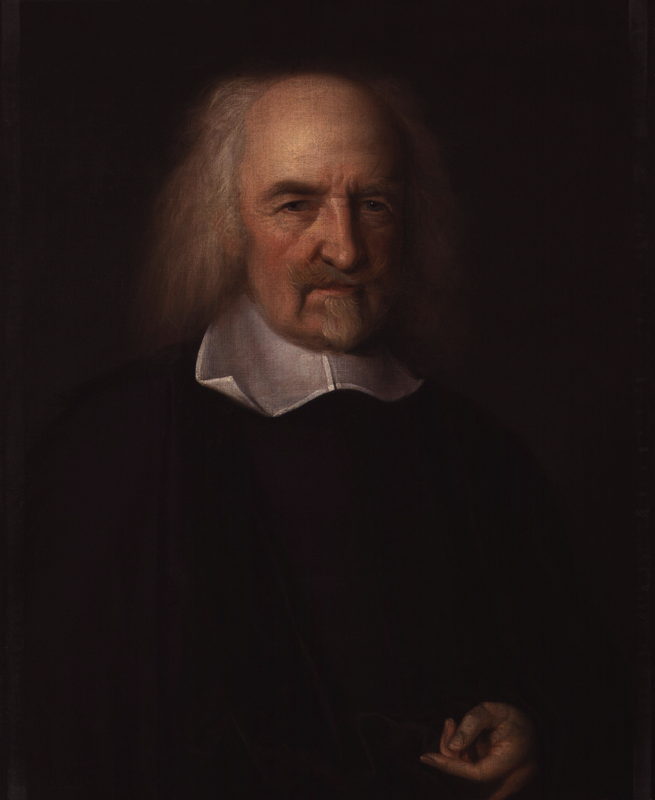
Two Views on Government
Thomas Hobbes
Horrors of English Civil War convinced him all humans were naturally selfish and wicked
Social contract- idea people had to give their rights to a strong ruler who would give them law and order
Hobbes thought an absolute monarch was best to impose order and demand obedience

Slide 4
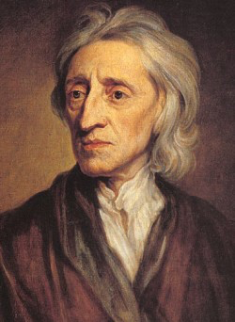
Two Views on Government
John Locke
Believed people learned from experience and improved
Favored self-government
All people are born free and equal with natural rights to life, liberty and property
Purpose of government is to protect those rights
People have right to overthrow abusive government and establish a new one
Government’s power comes from consent of the people

Slide 5
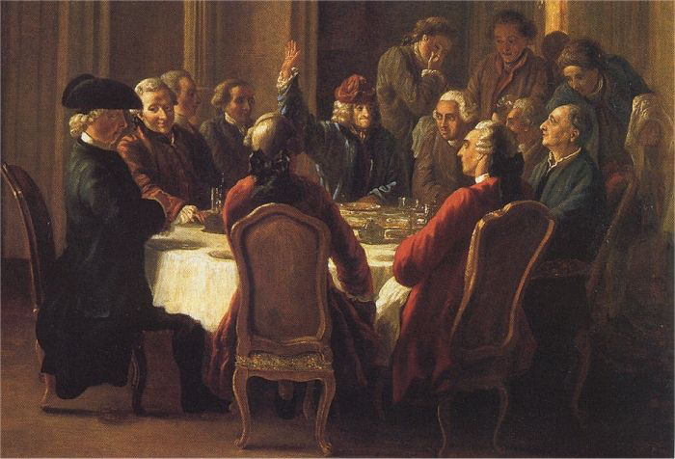
The Philosophes
Philosophes- social critics in France, met to discuss politics and ideas
Five concepts formed core beliefs-
Reason- truth could be found through reason and logical thinking
Nature- what was natural was also good and reasonable
Happiness- reject medieval idea of finding joy hereafter and pushed for well-being on earth
Progress- society and humankind can improve
Liberty- called for rights won in the Glorious Revolution and Bill of Rights

Slide 6
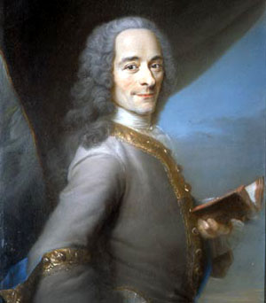
Voltaire Combats Intolerance
Voltaire- pen name for Francois Marie Arouet
Published over 70 books of political and philosophical essays and drama
Sent to prison twice, exiled to England for 2 years
Fought for tolerance, reason, freedom of religion and freedom of speech
“I do not agree with a word you say but will defend to the death your right to say it”

Slide 7
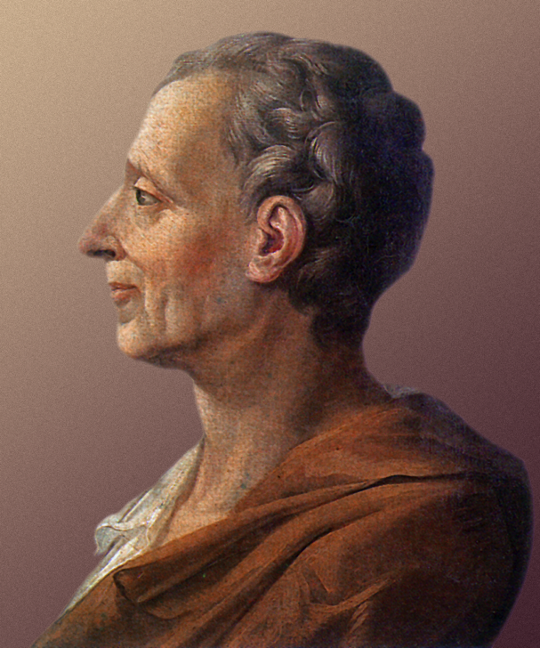
Montesquieu and Government
Baron de Montesquieu studied politics
Argued Britain’s separation of powers was best for government
King held executive
Parliament held legislative
Courts held judicial
Separating powers keeps 1 person from gaining total control
Power should be a check to power- checks and balances

Slide 8
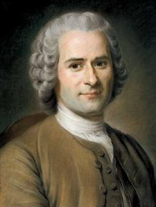
Rousseau and Freedom
Jean Jacques Rousseau- committed to individual freedom
Thought civilization corrupted people’s natural goodness
Believed in direct democracy
Saw social contract as agreement among free people to create a society and government

Slide 9
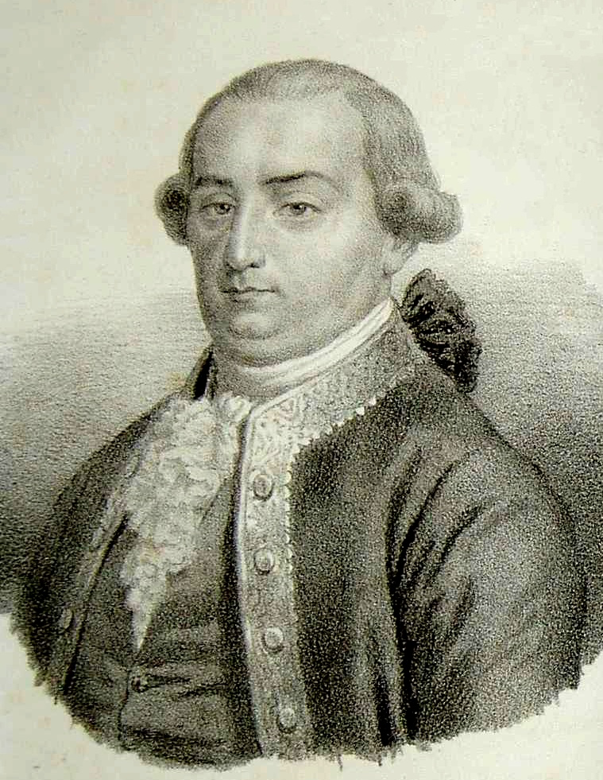
Beccaria and Criminal Justice
Cesare Beccaria believed laws existed to preserve social order, not avenge crimes
Argued for-
Speedy trial
Eliminating torture
Degree of punishment should fit seriousness of crime
Abolishing capital punishment

Slide 10
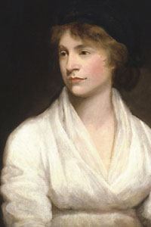
Wollstonecraft and Education
Mary Wollstonecraft argued for women’s rights
Argued against Rousseau that women’s education shouldn’t be secondary to men’s
Urged women to enter male-dominated fields like medicine and politics

Slide 11
Legacy of the Enlightenment
Challenged long-held ideas about society
Encouraged reform- inspired the American and French revolutions
Three long-term effects-
Belief in progress- confidence that human reason could solve social problems
A more secular (non-religious) outlook- people started questioning the teachings of the Church
Importance of the individual- use yourself to judge right and wrong, not the Church or royalty

Slide 12
Major Ideas of the Enlightenment
Idea | Thinker | Impact
Natural rights- life, liberty, property | Locke | Fundamental to U.S. Declaration of Independence
Separation of powers | Montesquieu | France, U.S. and Latin American nations use separation of powers in new constitutions
Freedom of thought and expression | Voltaire | Guaranteed in U.S. Bill of Rights and French Declaration of the Rights of Man and Citizen; European monarchs reduce or eliminate censorship
Abolishment of torture | Beccaria | Guaranteed in U.S. Bill of Rights; torture outlawed or reduced in nations of Europe and the Americas
Religious freedom | Voltaire | Guaranteed in U.S. Bill of Rights and French Declaration of the Rights of Man and Citizen; European monarchs reduce persecution
Women’s equality | Wollstonecraft | Women’s rights groups form in Europe and North America

