Slide 1
The Mongol Conquests

Slide 2
Setting the Stage
While the Chinese prospered during the Song Dynasty, a great people far to the north were also gaining strength. The Mongols of the Asian steppe lived their lives on the move. They prided themselves on their skill on horseback, their discipline, their ruthlessness, and their courage in battle. They also wanted the wealth and glory that came with conquering mighty empires. This desire soon exploded into violent conflict that transformed Asia and Europe forever.

Slide 3
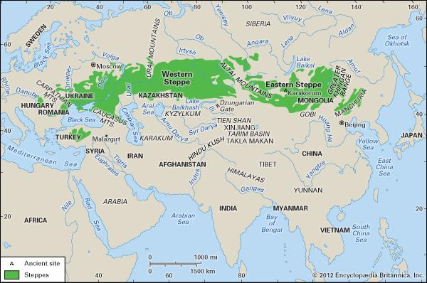
Nomads of the Asian Steppe
Dry grassland across Eurasia
Land trade route
Pastoralists- herded domestic animals, constantly on the move to find good pastures to feed their herd
Follow seasonal pattern- leads to battles over land and water rights

Slide 4
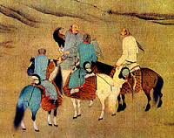
Nomads of the Asian Steppe
Live on horseback
Depend on their animals for food, clothing and housing
Travel in clans- members claim to be descended from common ancestor
Tempted by rich land and wealth of townspeople
Leads to raiding towns and villages

Slide 5
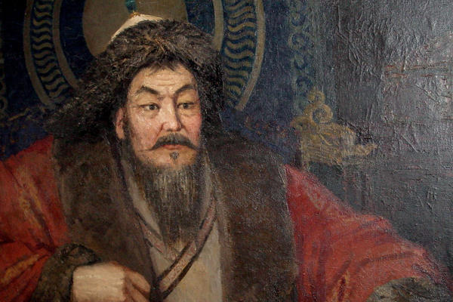
The Rise of the Mongols
Roamed eastern steppe in clans
Genghis Khan unites them with a purpose- conquest
Takes over in 1206
Rules 21 years

Slide 6
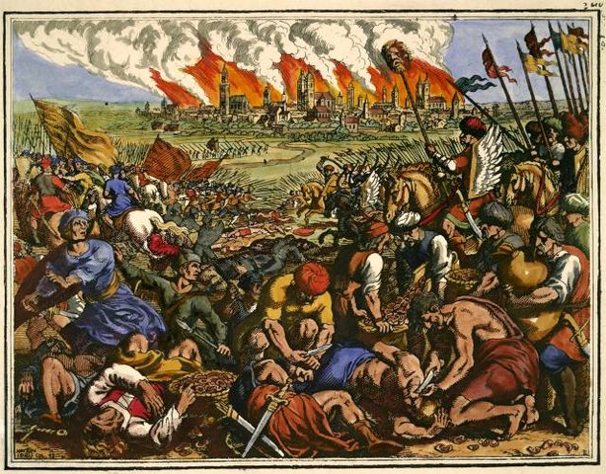
Rule of Genghis Khan
Angered by murder of Mongol traders and ambassador by Muslims
Launches campaign of terror across Central Asia
Destroy city after city and slaughtered inhabitants
1225- Central Asia is under Mongol control

Slide 7
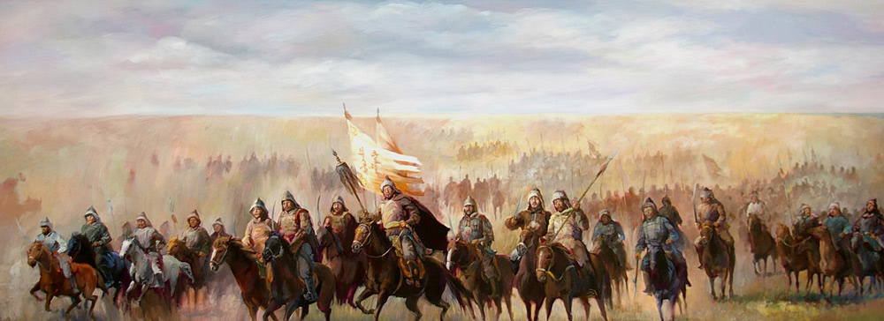
Rule of Genghis Khan
Brilliant organizer- assembles “mighty fighting force”
Groups soldiers in armies of 10,000, each broken into 1,000-man brigades, 100-man companies and 10-man squads
Gifted strategist- used tricks to confuse enemy
Set up ambushes
Extremely cruel- terrified enemies into surrender
City refused to open gates = kill entire population once he got in

Slide 8
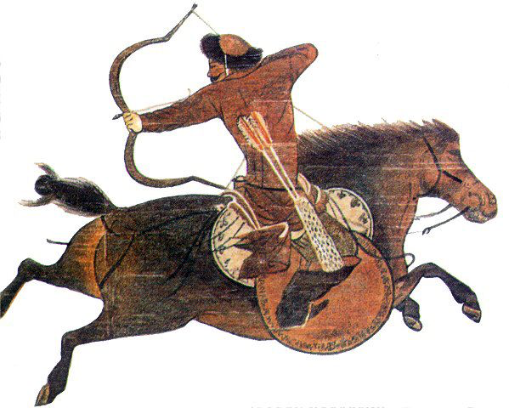
A Mighty Fighting Force
“Mongol soldiers were superb horsemen, having spent all their lives in the saddle. Annual game roundups gave young men the chance to practice skills they would use in battle and gave their leaders the opportunity to spot promising warriors. When on the move, each soldier was accompanied by three extra horses. By changing mounts, soldiers could stay in the saddle for up to ten days and nights at a time. When charging toward a target, they covered as much as 120 miles a day. If food was scarce, a Mongol soldier might make a small gash in the neck of one of his horses and sustain himself by drinking the blood. Stirrups allowed mounted warriors to stand, turn, and shoot arrows behind him.”

Slide 9
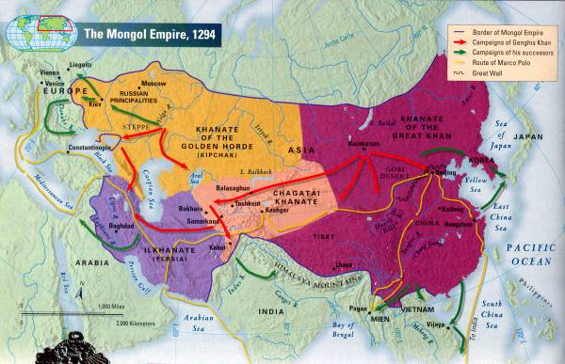
The Mongol Empire
1227- Genghis Khan dies of illness
Successors continue to expand the empire from China to Poland
Largest unified land empire in history
Divide empire into 4 khanates- regions
Khanate of the Great Khan- Mongolia and China
Khanate of Chagatai- Central Asia
Ilkhanate- Persia
Khanate of the Golden Horde- Russia

Slide 10
The Mongols as Rulers
Many conquered areas never recovered
Populations wiped out, irrigation systems destroyed
Ferocious in war, but tolerant in peace
Some Mongols even adapt to culture of people they conquered
Growing cultural differences lead to eventual splitting up of empire

Slide 11
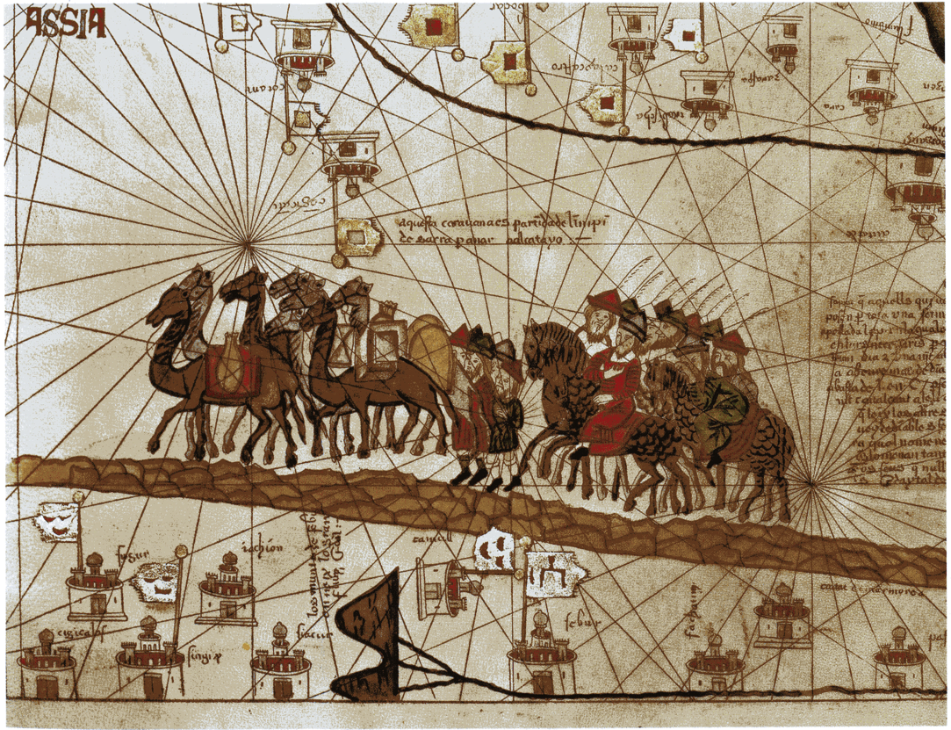
The Mongol Peace
Mid-1200s to mid-1300s- period of stability, law and order across much of Eurasia
Called the Pax Mongolica- Mongol Peace
Guaranteed safe passage for traders, travelers and missionaries across the empire
Trade increases- ideas and inventions travel along trade routes
Gunpowder reaches Europe
Bubonic plague may have spread from Mongols

