Slide 1
The Reign of Louis XIV

Slide 2
Setting the Stage
In 1559, King Henry II of France died, leaving four young sons. Three of them ruled, one after the other, but all proved incompetent. The real power behind the throne during this period was their mother, Catherine de Medicis. Catherine tried to preserve royal authority, but growing conflicts between Catholics and Huguenots- French Protestants- rocked the country. Between 1562 and 1598, Huguenots and Catholics fought eight religious wars. Chaos spread through France.

Slide 3
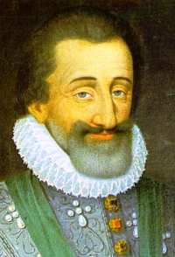
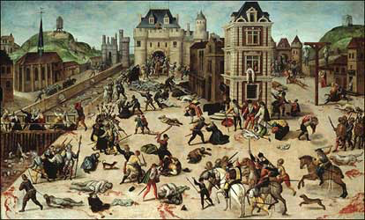
St. Bartholomew’s Day Massacre
Paris, 1572- many Huguenot nobles were attending the marriage of Catherine’s daughter to Huguenot prince, Henry of Navarre
Most of the nobles were killed, but Henry survived
6 weeks of slaughter ensued across France

Slide 4
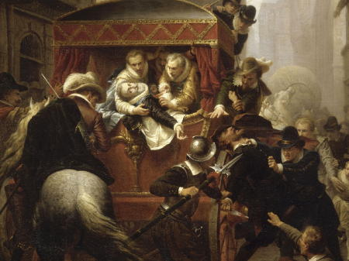
Henry of Navarre
1589- Catherine and her last son died, Henry takes the throne
First king of the Bourbon dynasty
Many Catholics oppose him- Henry converts to Catholicism
Edict of Nantes- declared the Huguenots could live in peace and set up their own houses of worship in France
Restored France’s power and brought a time of peace
1610- someone leaps into Henry’s royal carriage and stabbed him to death

Slide 5
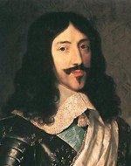
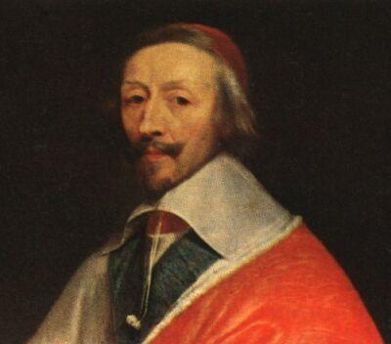
Louis XIII and Cardinal Richelieu
Henry’s son Louis XIII takes over
Weak king, but appoints strong minister
Cardinal Richelieu- in effect, became the ruler of France
Moved against the Huguenots- didn’t allow their cities to have walls to retreat behind if they defied the king
Tried to weaken the nobles’ power- ordered them to take down fortified castles
Wants to restrict power of Hapsburg rulers (controlled Spain, Austria, the Netherlands and the Holy Roman Empire)

Slide 6
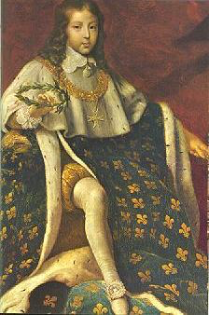
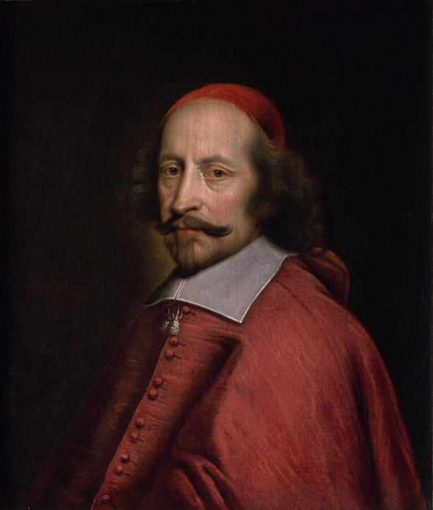
Louis XIV Comes to Power
Takes over in 1643 at 4 years old after the death of his father
Cardinal Mazarin takes over after Cardinal Richelieu’s death
Ends the Thirty Years’ War
Most hated him- increased taxes
Huge riots against Mazarin also threatened Louis- he vowed to become so powerful they could never threaten him again
Mazarin died in 1661- 22 year old Louis takes complete power

Slide 7
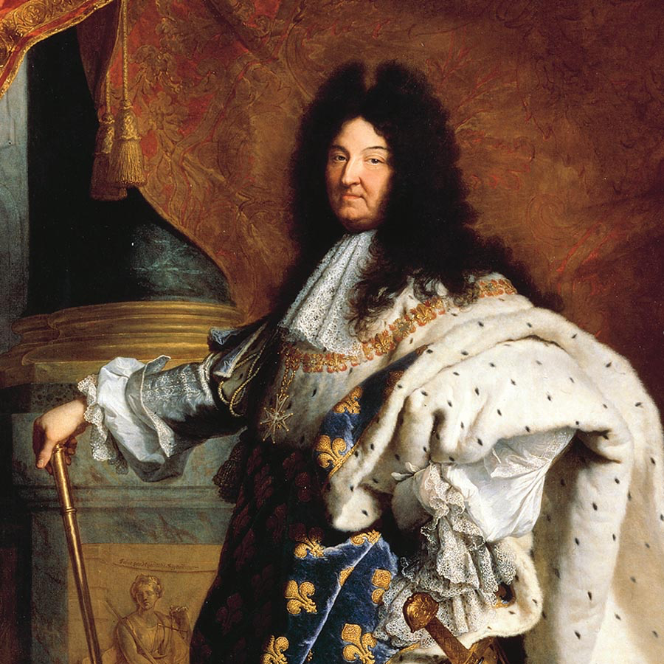
Louis Weakens the Nobles’ Authority
Excluded nobles from councils
Increased power of intendants- government agents who collected taxes and administered justice

Slide 8
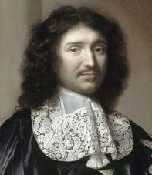
Economic Growth
Jean Baptiste Colbert- Louis XIV’s minister of finance- tried to make France self- sufficient
Gave government funds and tax benefits to French companies
Placed high import tariff
Recognized the importance of colonies
Colbert dies and Louis takes action that slows economic growth
Cancels the Edict of Nantes
Thousands of Huguenots (many skilled workers) fled France

Slide 9
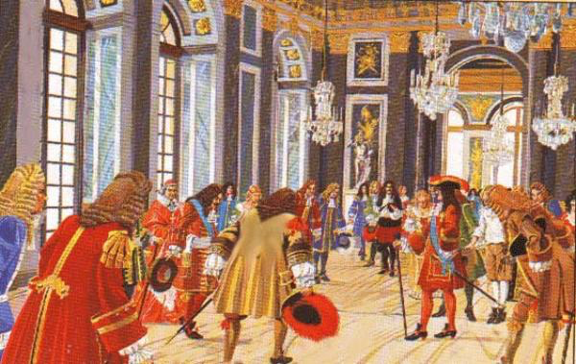
Louis XIV’s Grand Style
Surrounded himself with luxury
Every meal was a feast
Had nearly 500 staff members at his palace
Nobles were expected to be at the palace and Louis took note of anyone absent
Palace of Versailles- about 500 yards long, faced huge royal courtyard, like a small royal city

Slide 10
Support of the Arts
Largest supporter of the arts since Augustus of Rome
Performed lead role in the ballet The Sun King
Purpose shifts from glorifying God (Middle Ages) and human potential (Renaissance) to glorifying the king and values that supported his rule

Slide 11
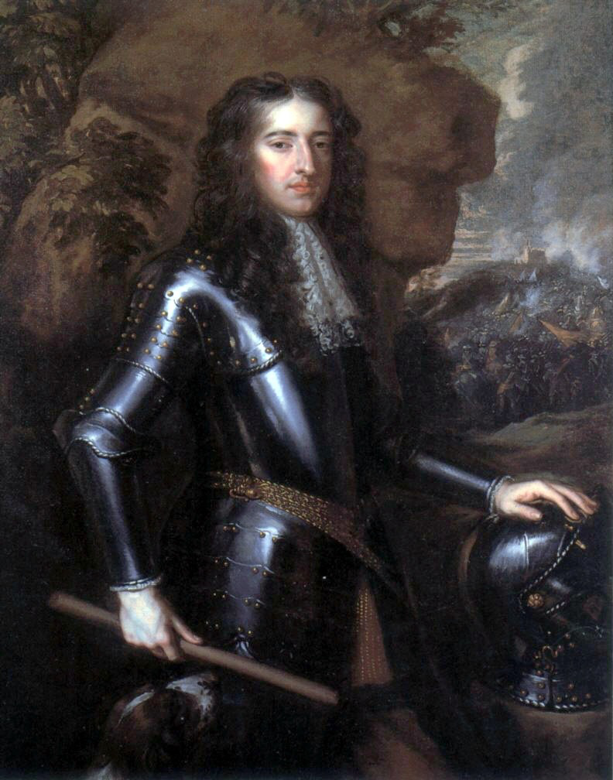
Struggles in Europe
Tries to take over the Spanish Netherlands
They open the flood gates and flood the countryside
1689- Dutch prince William of Orange becomes king of England
Joins League of Augsburg with the Austrian Hapsburg emperor, the kings of Sweden and Spain, and leaders of several smaller European countries
This alliance could now equal the power of the French

Slide 12
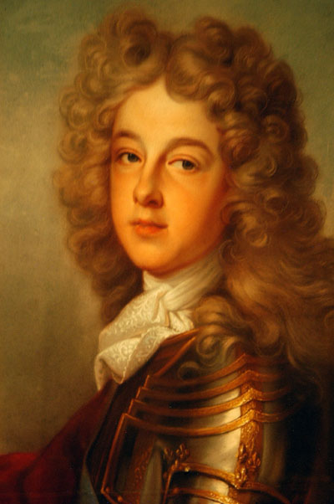
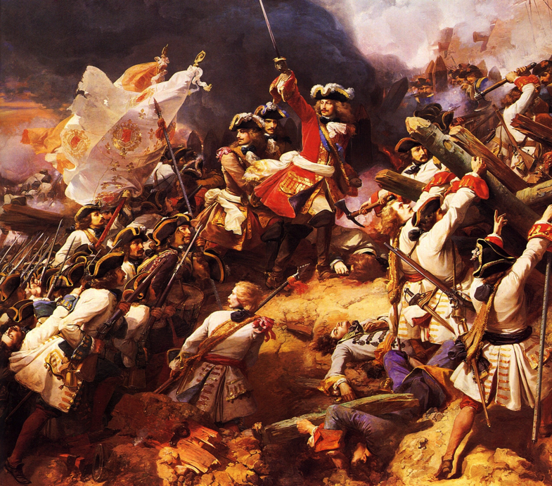
The War of Spanish Succession
Spanish King Charles II dies without an heir
Promised the throne to Louis XIV’s grandson Philip of Anjou
Other powers felt threatened and joined together to stop this from happening
The war that followed is known as the War of Spanish Succession

Slide 13
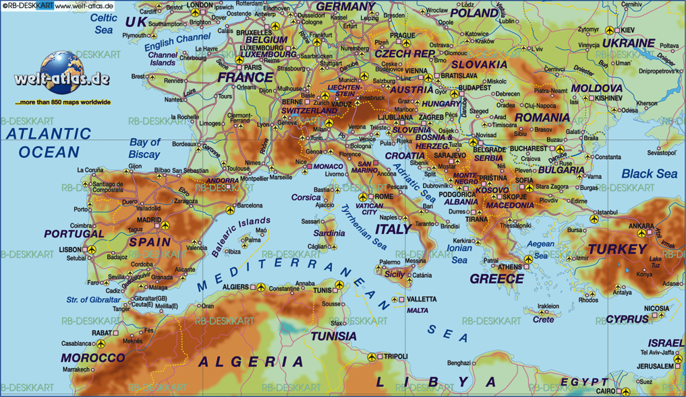
The War of Spanish Succession
Lasts 13 years
Treaty of Utrecht- Philip could remain king of Spain as long as the French and Spanish empires were not united
Britain is the big winner-
Get Gibraltar (fortress controlling entrance to the Mediterranean)
Can send slaves to sell in the Spanish colonies
Gained Nova Scotia and Newfoundland from France

Slide 14
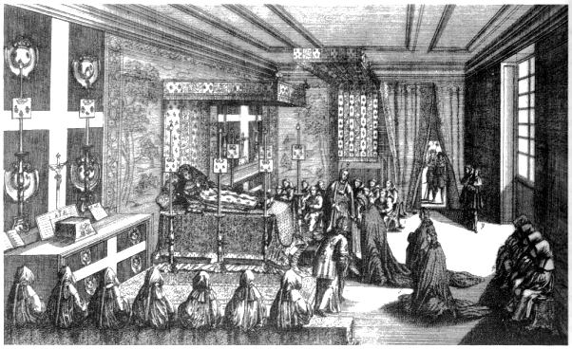
Louis XIV’s Death and Legacy
Dies 1715 with regret that his wars had ruined France
People celebrated his death
France ranked above all other European nations in art and literature, and considered the military leader
France was in huge debt- wars and building Palace of Versailles
Huge resent over taxes and Louis’s abuse of power plagues his heirs and leads to revolution down the road

