Slide 1
The Russian Empire

Slide 2
Setting the Stage
In addition to sending its missionaries to the land of the Slavs during the ninth century, Byzantium actively traded with its neighbors to the north. Because of this increased interaction, the Slavs began absorbing many Greek Byzantine ways. It was this blending of Slavic and Greek traditions that eventually produced Russian culture.

Slide 3
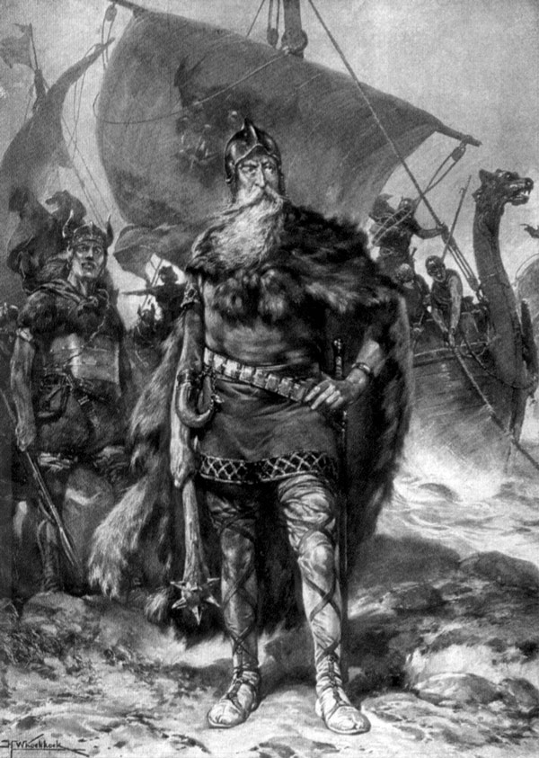
Russia’s Birth
Originally lived in region west of Ural Mountains around Dnieper, Don and Volga rivers
800s- Vikings called Varangians, or Rus, settle among them
Slavs invite Viking chief Rurik to be their king
Founds city of Novgorod
Oleg from Novgorod settles in Kiev- allows trade to Constantinople
Vikings mix with Slavs and cultural lines disappear

Slide 4
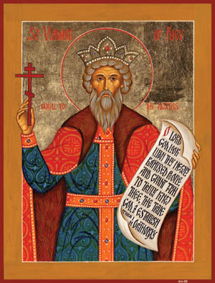
Kiev Becomes Orthodox
957- Princess Olga visits Constantinople and converts to Christianity
Grandson Vladimir takes over
Sends teams to observe major religions
Poor reports from Islam, Judaism and Western Christianity, but good reports from Byzantium (Orthodox)
Vladimir makes all convert
989- baptism of all Kiev citizens held in Dnieper River

Slide 5
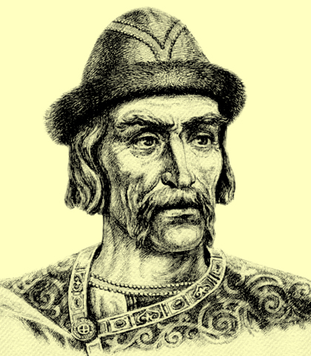
Kiev’s Power
Kiev grows to capital that marks Russia’s first important unified territory
Expands west into Poland and north towards Baltic Sea
Yaroslav the Wise takes over
Married off daughters and sisters to kings and princes in Western Europe- builds trading alliances
Creates legal code
Built 1st library in Kiev
Christianity blossoms- over 400 churches in Kiev

Slide 6
Kiev’s Decline
1054- Yaroslav dies
Divided throne among his sons
Tore territory apart fighting for best territories
Disrupts trade

Slide 7
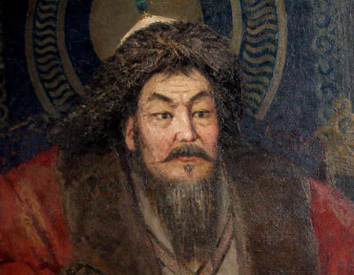
The Mongol Invasions
Mid-1200s- ferocious group of horsemen from central Asia invade Russia
Led by Genghis Khan- most feared warrior of the time
Killed around 40 million people
Lured by wealth of cities in the West

Slide 8
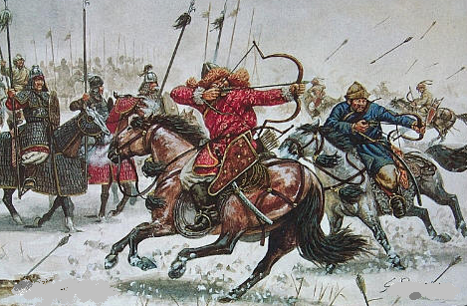
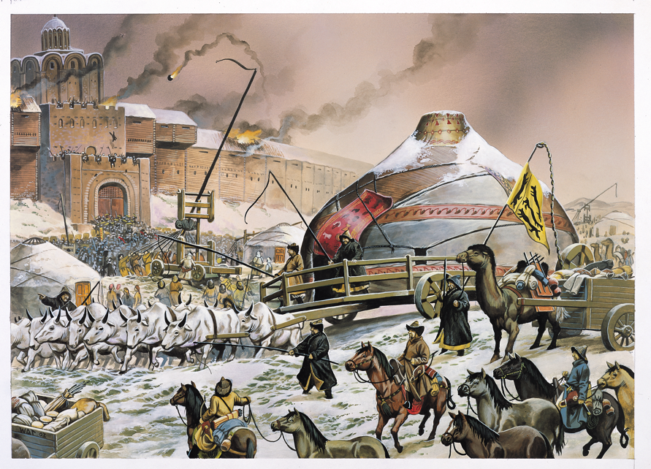
The Mongol Invasions
Brutal- savage killing and burning of villages
Mongol Empire stretches from Yellow Sea to the Baltic Sea, from Himalayas to northern Russia
1240- attack and demolish Kiev
Mongols rule all of southern Russia for 200 years

Slide 9
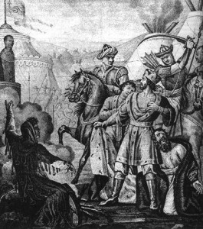
Mongol Rule of Russia
Russians could follow their customs as long as they didn’t rebel
Demand absolute obedience and massive tributes
Isolated Russia- little access to new ideas and inventions

Slide 10
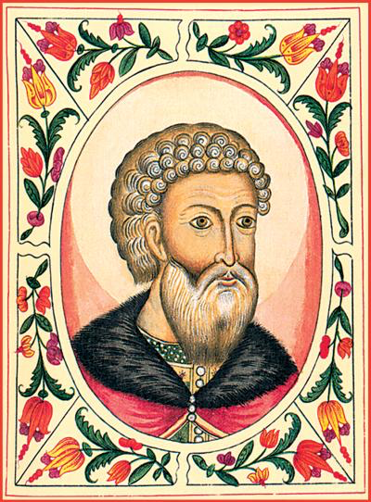
Russia Breaks Free
Moscow founded in 1100s
Near Volga, Dnieper and Don rivers
Late 1320s- Moscow Prince Ivan I earns gratitude of Mongols
Crushed Russian revolt against them
Appointed as “Grand Prince” and tax collector for all Mongol Slavic lands

Slide 11
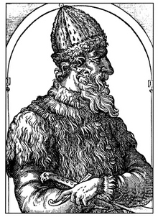
Russia Breaks Free
Ivan convinces Patriarch of Kiev to move to Moscow
Forms alliance between Moscow and the Church
Grow territory
Land purchases, wars, trickery and marriages
Becomes empire under Ivan III

Slide 12
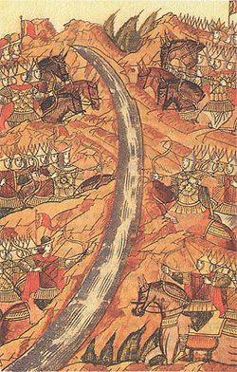
Ivan III
Openly challenged Mongol rule
Takes name czar- Russian version of Caesar
Wants to make Russia the “Third Rome”
Russian and Mongol armies face off at Ugra River
Neither side advanced to fight
Both turn around and go home
Marked as liberation from Mongol rule

