Slide 1
Central European Monarchs Clash

Slide 2
Setting the Stage
For a brief while, the German rulers appeared to have settled their religious differences through the Peace of Augsburg (1555). They had agreed that the faith of each prince would determine the religion of his subjects. Churches in Germany could be either Lutheran or Catholic, but not Calvinist. The peace was short-lived, soon to be replaced by a long war. After the Peace of Augsburg, the Catholic and Lutheran princes of Germany watched each other suspiciously.

Slide 3
Tensions Grow
Both Lutherans and Catholic princes try to gain followers
Both also feel threatened by Calvinism
Lutherans form the Protestant Union in 1608
Catholics form the Catholic League in 1609

Slide 4
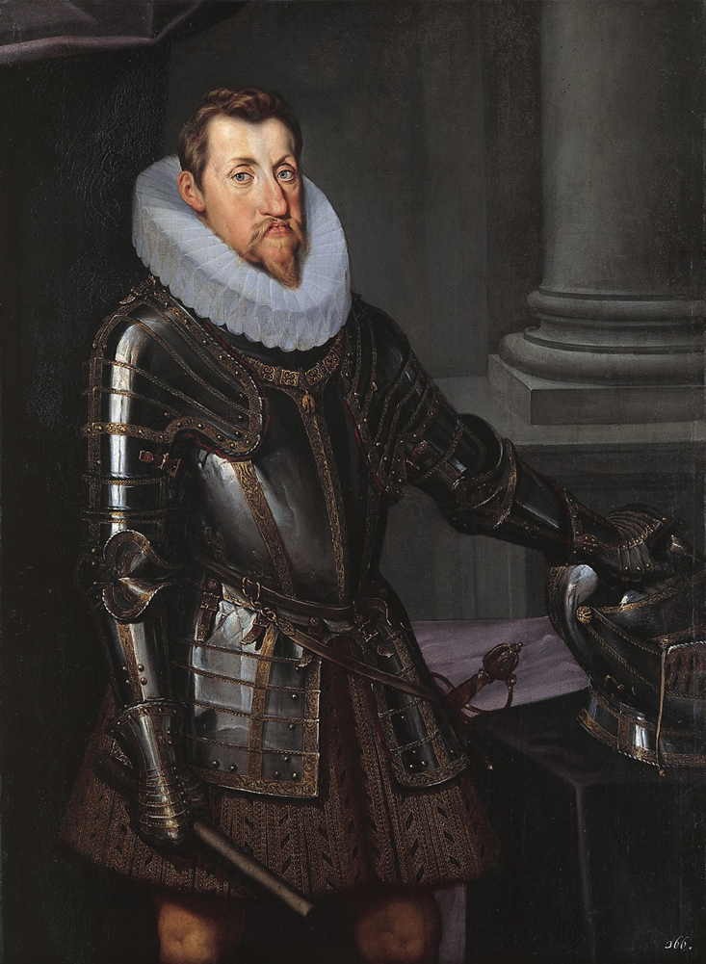
The Thirty Years’ War
1618- Future Holy Roman Emperor Ferdinand II (Catholic) was head of the Hapsburg family
Ruled over Bohemia (Czech area, lots of Protestants)
Closed Protestant churches = Protestants revolt
Ferdinand sends in troops
Other Protestant German princes see this as an opportunity and get involved

Slide 5
Hapsburg Triumphs
First 12 years
Hapsburgs crushed Protestant armies
Put down the Czech uprising
Ferdinand paid his army by allowing them to plunder
Destroyed everything in their path

Slide 6
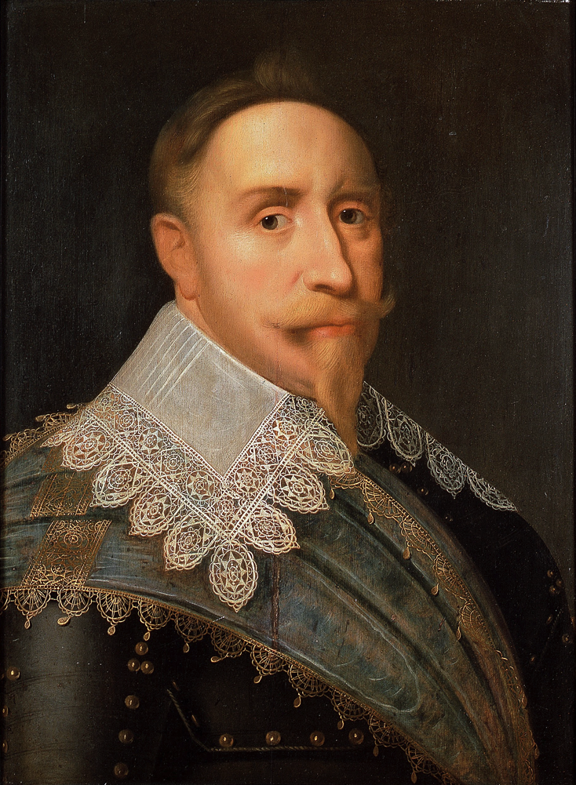
Hapsburg Defeats
1630- Protestant Gustavus Adolphus of Sweden shifts the tide of the war
Drove Hapsburgs out of northern Germany
Cardinals Richelieu and Mazarin dominated the rest of the war
Catholic, but fear the Hapsburgs more than the Protestants, so fight with the Protestants

Slide 7
Damage in Germany
Damage in Germany was awful-
Population drop (20 million to 16 million)
Trade and agriculture ruined
Economy ruined
Long road to recovery- part of why Germany wasn’t united state until 1800s

Slide 8
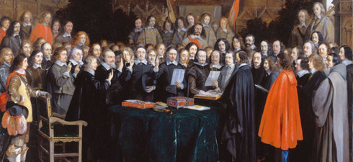
Peace of Westphalia
1648, ends the war
Weakened the Hapsburgs
Strengthened France by awarding it German territory
Made German princes independent of the Holy Roman Emperor
Ended religious wars in Europe
Introduced new method of peace negotiations
All parties meet to settle problems and decide terms of peace

Slide 9
Beginning of Modern States
Treaty led to abandoning of idea of a Catholic empire
Recognized Europe as a group of equal, independent states

Slide 10
States Form in Central Europe
Kingdom of Poland, Holy Roman Empire and Ottoman Empire
Not as powerful as Western Europe- developed differently
Nobles limited power of serfs- didn’t allow them freedom or social mobility
Nobles blocked development of strong kings- gave little income, no law courts and no standing armies

Slide 11
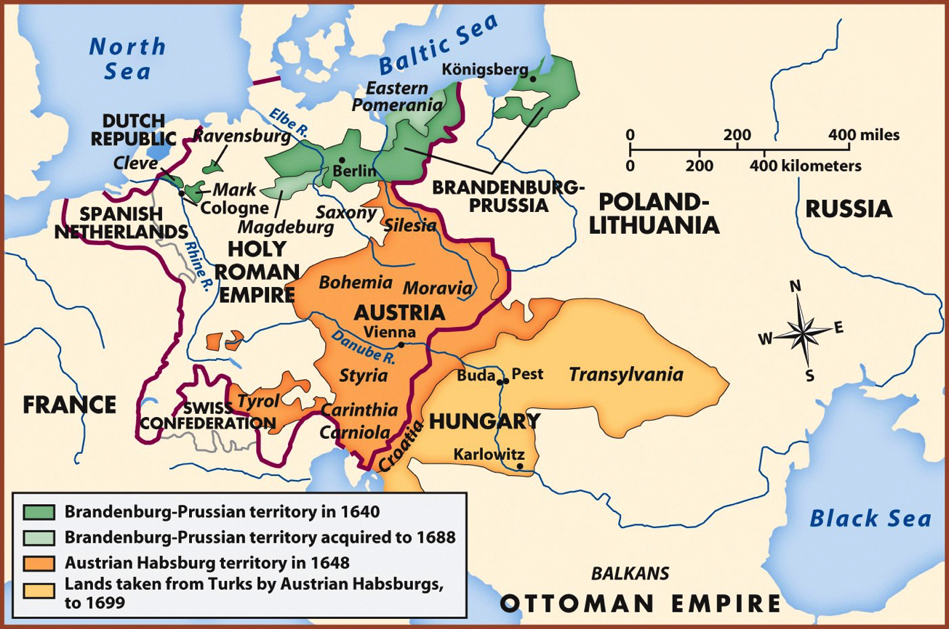
Austria Grows Strong
Austrian Hapsburgs try to become absolute monarchs
Conquered Bohemia during Thirty Years’ War
Created standing army
Retook Hungary from the Ottoman Empire
Struggle to rule over the diverse territory
Controlled Czechs, Hungarians, Italians, Croatians and Germans

Slide 12
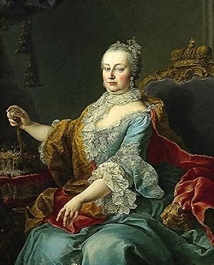
Maria Theresa Takes Over
Charles VI daughter takes the throne
Charles had leaders sign agreement recognizing her as the new leader after his death
Faces years of war from Prussia

Slide 13
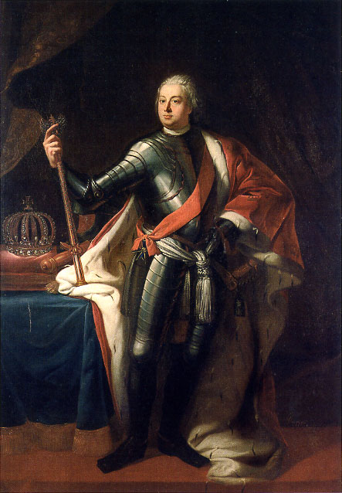
Prussia Challenges Austria
Hohenzollerns rule Prussia
Frederick William creates an absolute monarchy in Prussia
Builds best army in Europe
Puts in permanent taxation
Weakened representative assemblies

Slide 14
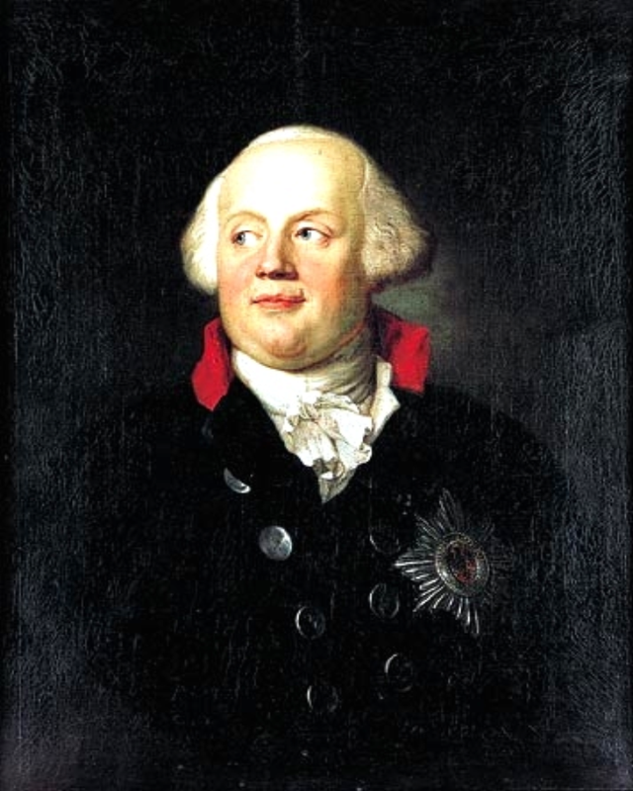
Frederick the Great
Frederick William worried his son wasn’t tough enough to rule
After Frederick II tries to run away with a friend, Frederick I makes him watch his friend’s beheading
Frederick II still takes over
Followed his father’s military policies but softened some laws
Encouraged religious toleration
Believed a ruler should be like a father to his people

Slide 15
War of Austrian Succession
1740- Frederick II sends troops to occupy Austrian land of Silesia (iron ore, textiles and food production)
Maria Theresa gets aid from Hungary and Britain, Prussia gets aid from France
Prussia wins and becomes a major power

Slide 16
Shift of Alliances
Maria Theresa approaches France about an alliance
Frederick learns of this and allies himself with Britain
Russia gets involved and allies itself with France and Austria

Slide 17
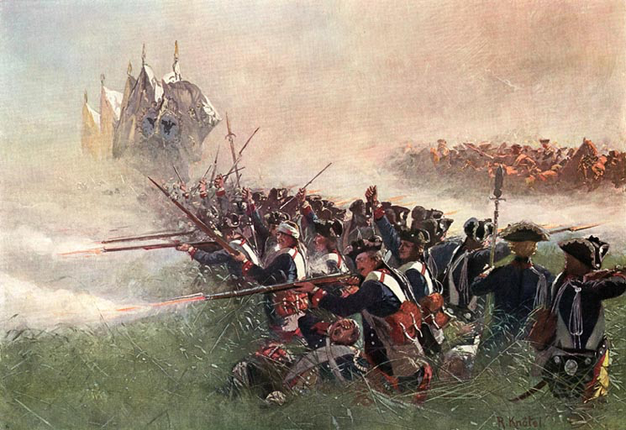
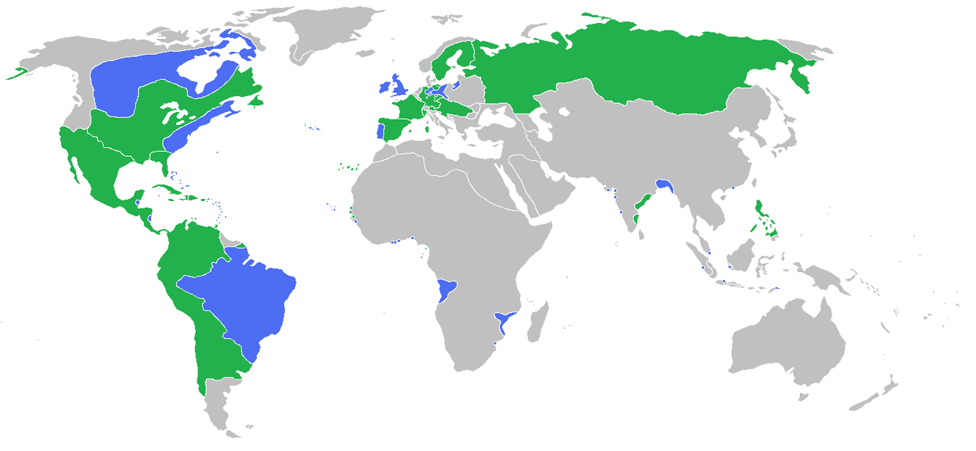
The Seven Years’ War
1756- Frederick attacks Saxony, an Austrian ally
Every great European power goes to war
Fought in Europe, India and North America
Britain emerged as real victors
France lost colonies in North America
Britain gained sole economic domination in India

