Slide 1
Changes in Medieval Society

Slide 2
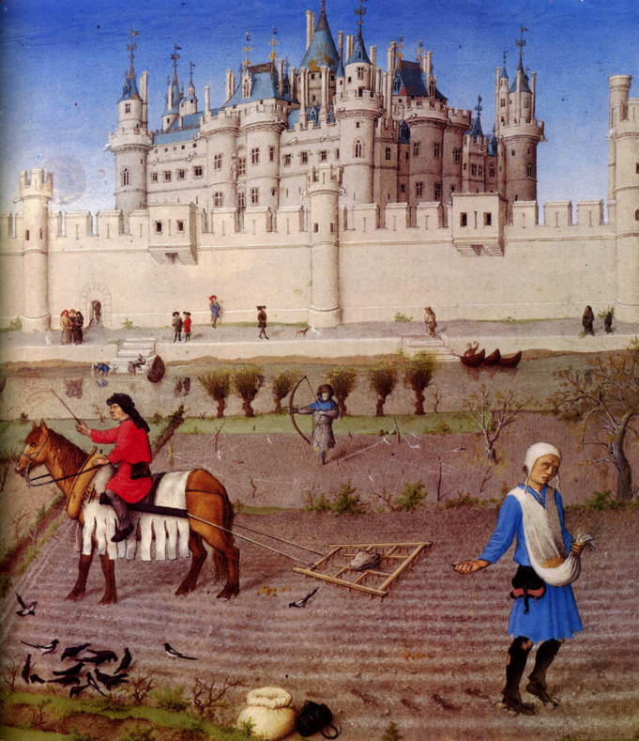
A Growing Food Supply
Warmer climate from 800 to 1200 allowed farmers to expand
Switch to horses from oxen
The three-field system
Could plant on 2/3 of land instead of 1/2 of it
People eat better ➔ better resist disease ➔ live longer ➔ growing population

Slide 3
Development of Guilds
Guild- an organization of workers in the same business working to improve the conditions of its members
Merchants band together to control number of products traded to keep prices up

Slide 4
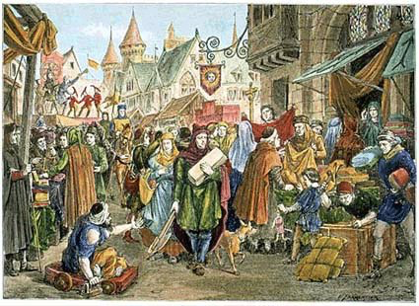
The Commercial Revolution
The expansion of trade and business
Fairs- huge fair days in towns around religious holidays or festivals
People from manors traveled to these fairs- no longer was everything contained to a self-sufficient manor
Foreign trade increases
Bank and trade systems developed

Slide 5
Urban Life Flourishes
As trade grows, towns grow
Normal towns at that time were 1500 to 2500 people
Life in towns was not clean but people still went because of economic opportunities
Merchant class battles the “social order” in Europe

Slide 6
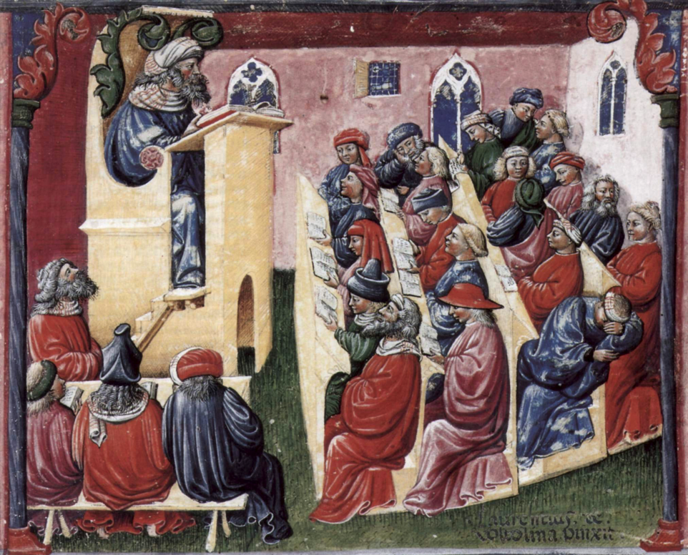
The Revival of Learning
Contact with Muslims and Byzantines increased learning
Brought back Greek philosophy
Learned science, philosophy, law, math, and Crusaders brought back knowledge of ships, navigation and weapons

Slide 7
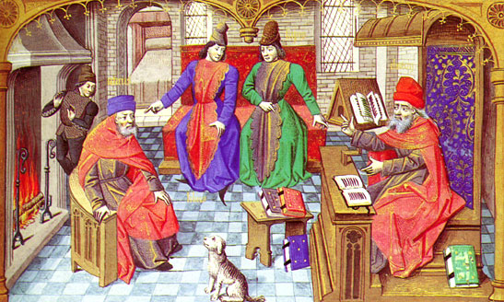
The Rise of Universities
Universities meant scholars meeting wherever they could
For most students, the goal was a job in government or the Church
Bachelor’s took 5 to 7 years, masters took at least 12 years

Slide 8
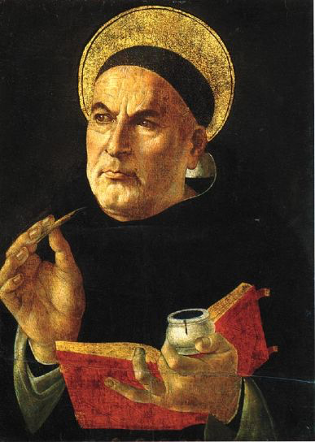
Christianity and Greek Philosophy
Thomas Aquinas- argued that religions truths could be proved by logical argument
Scholastics used Aristotle to debate the issues of their time

