Slide 1
Japan Returns to Isolation

Slide 2
Setting the Stage
In the 1300s, the unity that had been achieved in Japan in the previous century broke down. Shoguns, or military leaders, in the north and south fiercely fought one another for power. Although these two rival courts later came back together at the end of the century, a series of politically weak shoguns let control of the country slip from their grasp. The whole land was torn by factional strife and economic unrest. It would be centuries before Japan would again be unified.

Slide 3
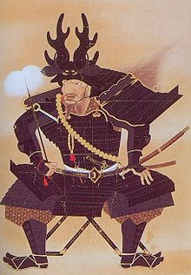
Local Lords Rule
1467- civil war
Japan collapsed into chaos
1467-1568- samurai seized control of old feudal estates
Offered peasants protection in return for loyalty
Daimyo- warrior chieftains- lords in a new type of feudalism

Slide 4
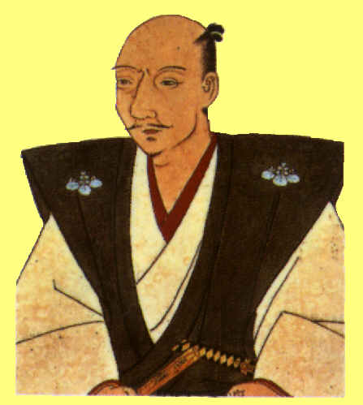
New Leaders Restore Order
Oda Nobunaga- brutal and ambitious
Seized the capital Kyoto in 1568
His 3,000 soldiers crush enemy samurai, but he couldn’t unify Japan
Committed seppuku- samurai ritual suicide- after one of his generals turned on him

Slide 5
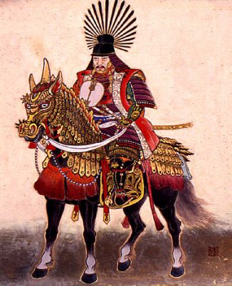
New Leaders Restore Order
Toyotomi Hideyoshi takes over-
Sets out to destroy enemy daimyo
Invades Korea with the goal of taking over all of China eventually
Dies in 1598- troops withdrew from Korea

Slide 6
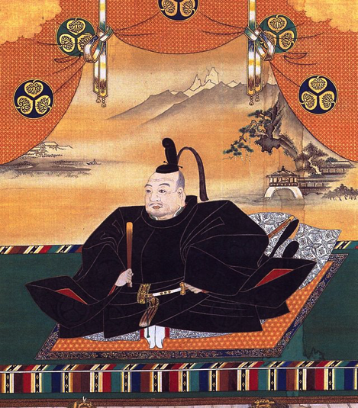
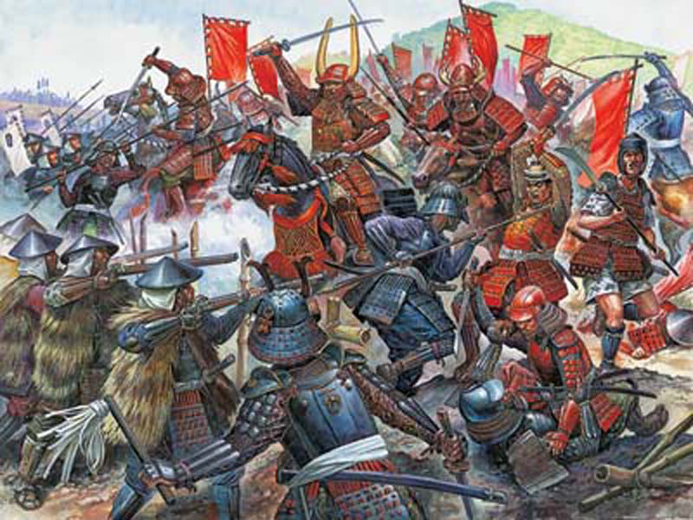
New Leaders Restore Order
Tokugawa Ieyasu takes over-
Completes the unification of Japan at Battle of Sekigahara
Moves capital to Edo- small fishing village (now Tokyo)
Alternate attendance policy-
Daimyo had to spend every other year in the capital, and had to leave family in Edo when they returned home
Established Tokugawa Shogunate- held power until 1867

Slide 7
Life in Tokugawa Japan
Farmers produced more food
Population rose
Peasants still lived in misery- high taxes
Very structured society
Emperor
Shogun- supreme military commander (actually held most power)
Daimyo- powerful landholding samurai
Samurai warriors
Peasants (4/5 of the population) and artisans
Merchants

Slide 8
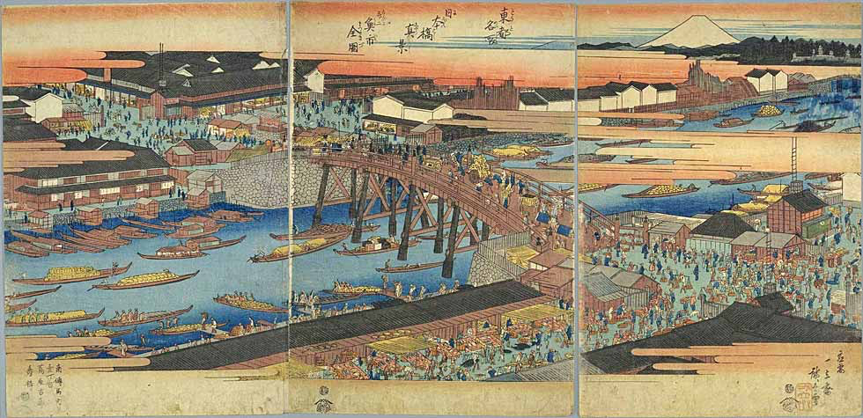
Life in Tokugawa Japan
Followed Confucian values
Farmers faced heaviest burden and many left for the cities
Shift from rural to urban society
Edo grows from small village to over 1 million (possibly largest city in the world at that time)

Slide 9
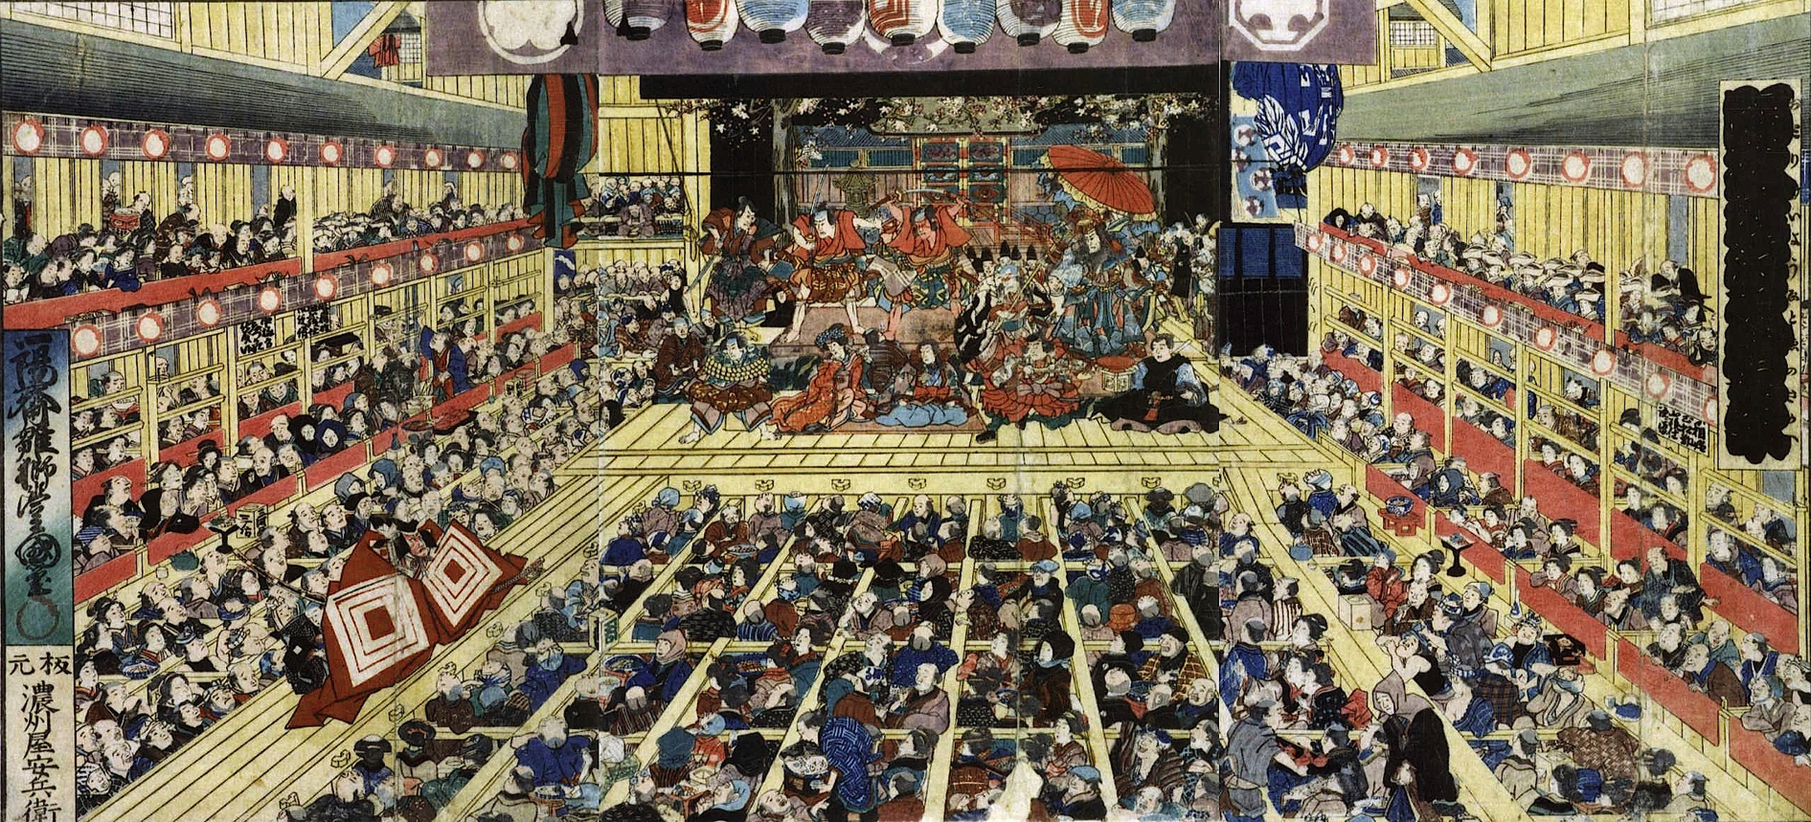
Life in Tokugawa Japan
Traditional culture thrives
Haiku develops- 3-line verse poetry
Kabuki theaters grow- actors in elaborate costumes, using music, dance, and mime, performed skits about modern life

Slide 10
Contact Between Europe and Japan
16th century- foreigners were welcomed
Brought new technologies and ideas
Clocks, eyeglasses, tobacco, and firearms- drastically change samurai way of life
Missionaries come- convert about 300,000
Upset Ieyasu- banned Christianity
Uprisings led Shoguns to believe Christianity was the core of rebellions
Japanese forced to show faithfulness to some branch of Buddhism

Slide 11
The Closed Country Policy
Excluded both missionaries and merchants
Nagasaki was the only port open to foreign (only Dutch and Chinese) traders
Remained closed to Europeans for over 200 years

