Slide 1
Muslim Culture

Slide 2
Setting the Stage
The Abbasids governed during a prosperous period of Muslim history. Riches flowed into the empire from all over Europe, Asia and Africa. Rulers could afford to build luxurious cities. They supported the scientists, mathematicians, and philosophers that those cities attracted. In the special atmosphere created by Islam, the scholars preserved existing knowledge and produced an enormous body of original learning.

Slide 3
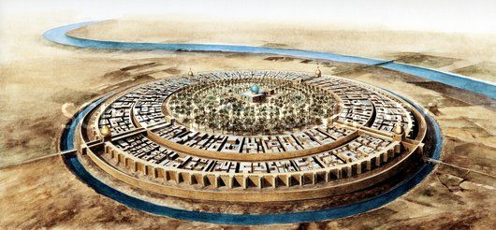
Rise of Muslim Cities
Baghdad-
Chose by Caliph al-Mansur as capital in 762
3 circular protective walls
Grand mosque and Caliph’s marble and stone palace at center
Main streets lined with shops
Up to 1 million at its peak

Slide 4
Social Classes
Upper class- Muslims at birth
Second class- converts to Islam
Third class- the “protected people”- Christians, Jews and Zoroastrians
Lowest class- slaves- many were prisoners of war and all were non-Muslim

Slide 5
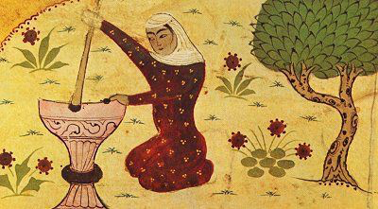
Role of Women
Had more economic and property rights than European, Indian and Chinese women of the time
Still expected to submit to men
Men could divorce by repeating “I dismiss thee” three times- it was finalized in 3 months

Slide 6
Responsibilities of Women
Wife of poor man- worked fields with husband
Wealthier- supervised household and servants
Had access to education
Rich or poor- had responsibility for raising children
Over time, more isolated and expected to be veiled when in public

Slide 7
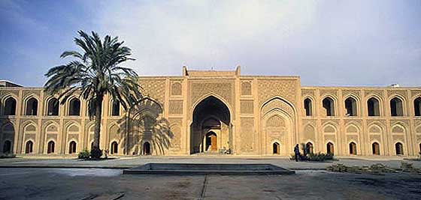
Education
Huge support for education beginning with the Prophet
Europe enters period of upheaval and chaos after fall of Rome in 476
Muslims keep the scientific knowledge from being lost
House of Wisdom- library, academy and translation center in Baghdad

Slide 8
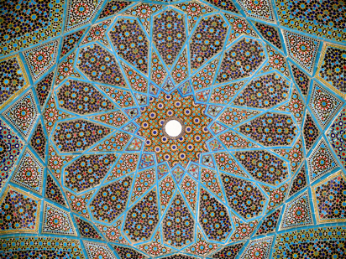
Art
Took over regions with rich artistic traditions
Adapted these to fit Islamic beliefs
Only Allah can create life = discourage images of living beings
Calligraphy- art of beautiful handwriting
Decorative arts- woodwork, glass, ceramics, textiles

Slide 9
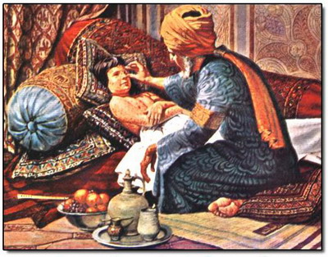
Medical Advances
Al-Razi (Rhazes)- greatest physician in the world between 500-1500 A.D.
Wrote Comprehensive Book- encyclopedia drawing on Greek, Syrian, Arabic and Indian sources
Wrote about treatment for smallpox and measles

Slide 10
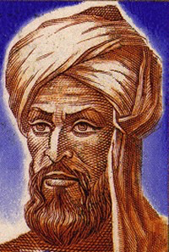
Math and Science
Rely on scientific observation and using math to find solutions to old problems
Conduct experiments in laboratory settings
Algebra is developed in the 800s by Al-Khwarizmi
Big in astronomy
Chart stars, comets, planets

