Slide 1
The Age of Chivalry

Slide 2
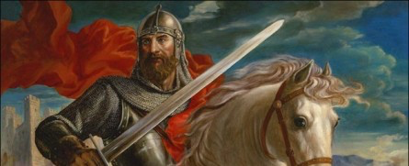
The Age of Chivalry
By the 1100s, a code of behavior began to arise
High ideals guided warriors’ actions and glorified their roles

Slide 3
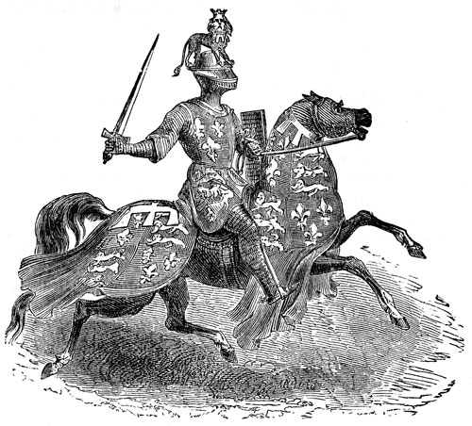
Knights
Soldiers on horseback
New technology changes warfare
Saddles and stirrups- kept a charging warrior mounted and allowed him to carry heavier weapons
Devoted their lives to war- using wealth from their fiefs, they could buy weapons, armor and warhorses
Often owed their lord about 40 days of combat a year

Slide 4
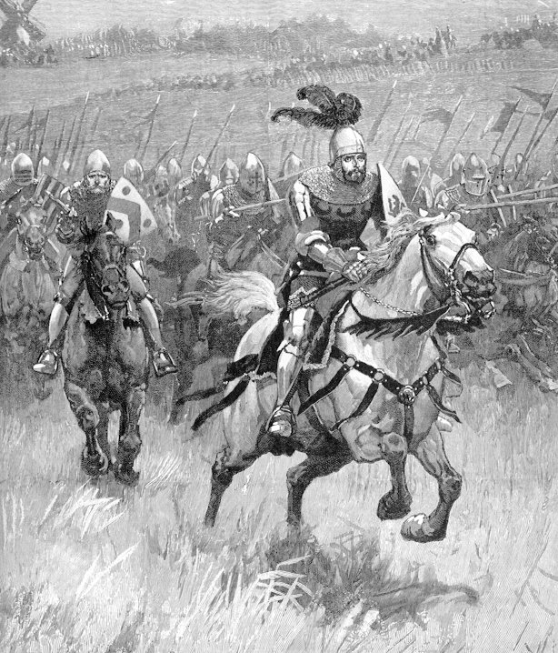
Chivalry
A complex set of ideals that demanded a knight fight in defense of three masters-
His earthly feudal lord
His heavenly Lord
His chosen lady
Also protected the weak and the poor
Loyal, brave and courteous

Slide 5
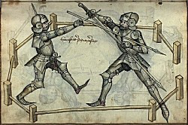
A Knight’s Training
At age 7- the page is sent to castle of another lord
Waited on his hosts and practiced fighting skills
Age 14- the page is now a squire
Acts as a servant to a knight
Age 21- squire becomes a full-fledged knight
After becoming a knight- most travel a year or two
Gained experience in local wars and tournaments

Slide 6
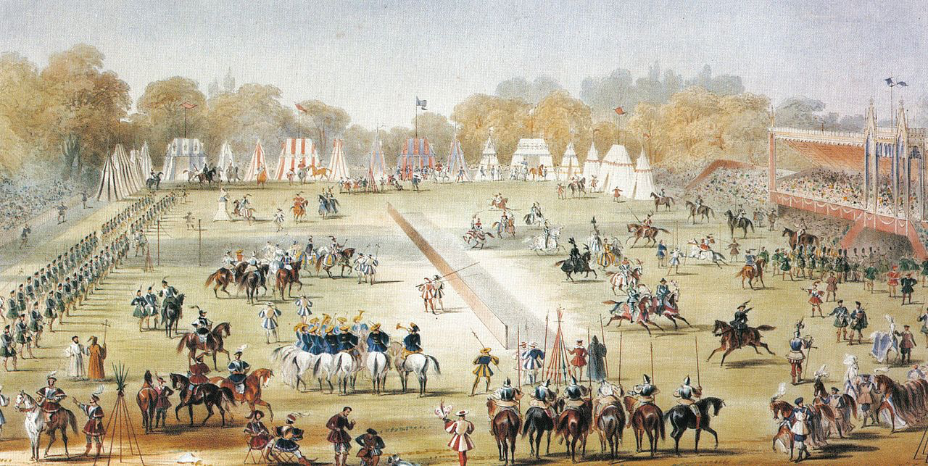
Tournaments
Mock-battles
Combined recreation with combat training
Two armies charged, trumpets blared, lords and ladies cheered
Like a real battle- bloody and fierce
Winners could demand a large ransom from the defeated knights

Slide 7
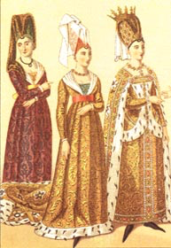
Women’s Role in Feudal Life
Noblewomen-
Thought to be inferior to men- church view and generally accepted at that time
Acted as head of estate when their husbands were off in battle- defended the estate with force
Held little property- lords passed land down to sons, not daughters

Slide 8
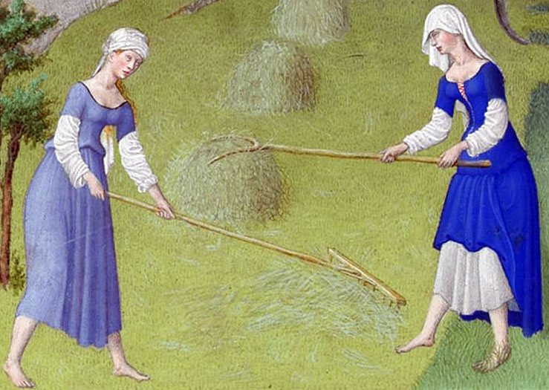
Women’s Role in Feudal Life
Peasant women-
Performed endless labor around the house and in the fields
Raised children and took care of the family
Not educated

