Slide 1
The Atlantic Slave Trade

Slide 2
Setting the Stage
Sugar plantations and tobacco farms required a large supply of workers to make them profitable for their owners. European owners had planned to use Native Americans as a source of cheap labor. But millions of Native Americans died from disease, warfare, and brutal treatment. Therefore, the Europeans in Brazil, the Caribbean and the southern colonies of North America soon turned to Africa for workers. This demand for cheap labor resulted in the brutalities of the slave trade.

Slide 3
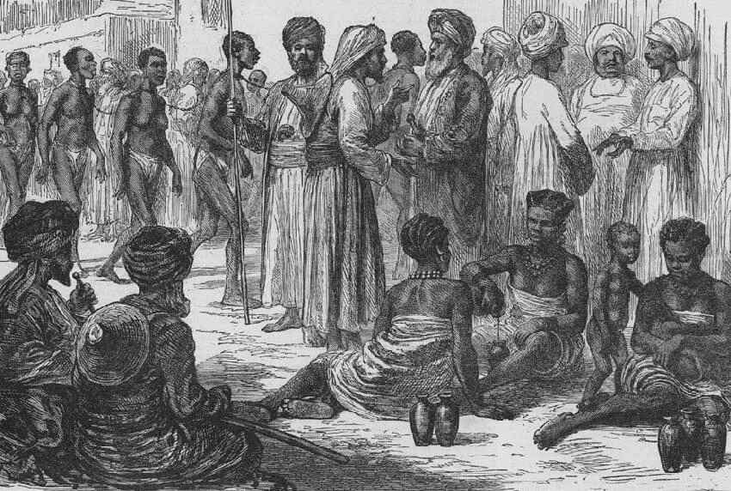
Slavery in Africa
Had existed in Africa for centuries
Starts with spread of Islam
Muslims transport about 17 million Africans as slaves between 650 and 1600
Had some legal rights
Opportunities for social mobility
Could escape slavery by marrying into the family they served

Slide 4
The Demand for Africans
Many had been exposed to European diseases
Had experience in farming
Less likely to escape- didn’t know their way around the new world
Skin color made it easier to catch them if they did escape

Slide 5
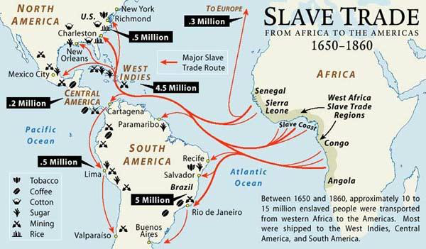
The Atlantic Slave Trade
The Atlantic Slave Trade- buying and selling of Africans for work in the Americas
1500-1870- about 9.5 million Africans had been sent to the Americas

Slide 6
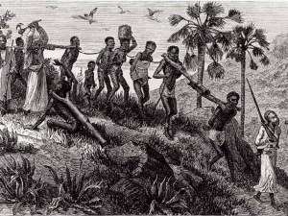
African Involvement
Many African rulers and merchants captured Africans from inland
Brought to the coast to trade Europeans for gold, guns, etc.

Slide 7
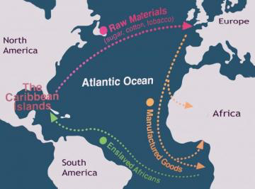
The Triangular Trade
Europeans take manufactured goods to west coast of Africa
Trade goods for Africans
Take Africans to West Indies
Trade slaves for sugar, coffee and tobacco
Take these products back to Europe
Another route took the sugar to New England, traded for rum, took the rum to Africa to trade for slaves

Slide 8
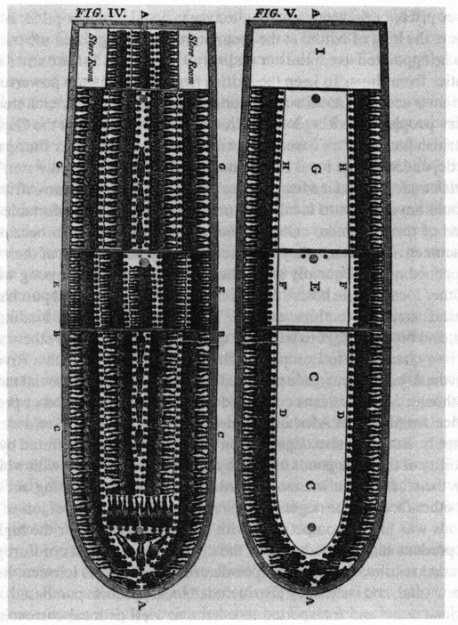
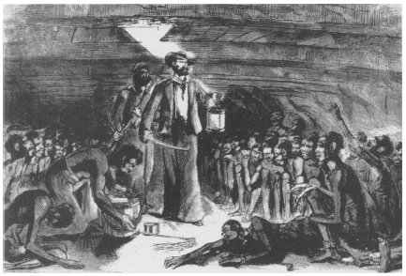
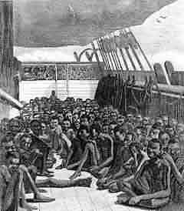
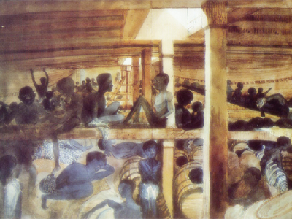
The Middle Passage
The voyage that brought slaves to the West Indies, North and South America
Slaves packed on ships
Endured whippings, beatings and diseases
Some committed suicide by jumping overboard when they got the chance
About 20% died on every ship

Slide 9
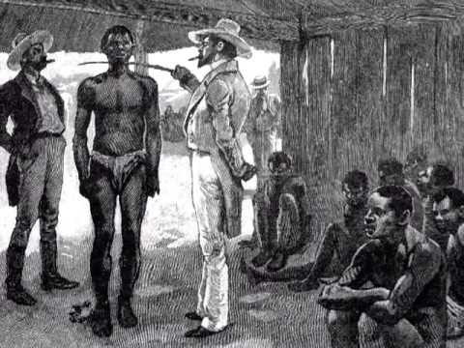
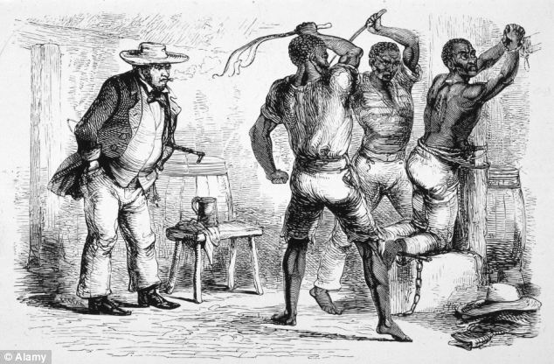
Slavery in the Americas
Auctioned off
Lived on little food, in small huts
Work long days
Beatings
Never got your freedom

Slide 10
Resistance and Rebellion
Kept cultural aspects alive
Music and stories of their ancestors
Break tools, uprooting plants and working slowly
Thousands ran away
Open revolts and violence

Slide 11
Consequences of the Slave Trade
Africa-
Many cultures lost generations of their fittest members
Families torn apart
Introduced guns into the continent
America-
Contributed to economic and cultural development
Left scars that took a long time to heal

