Slide 1
The Aztecs Control Central Mexico

Slide 2
Setting the Stage
While the Maya were developing their civilization to the south, other high cultures were evolving in central Mexico. Some of the most important developments took place in and around the Valley of Mexico. This valley, where modern Mexico City is located, eventually became the site of the greatest empire of Mesoamerica, the Aztec.

Slide 3
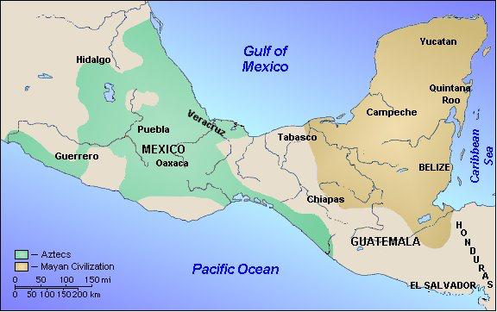
Homeland
Valley of Mexico- mountain basin
Several large, shallow lakes
Good resources
Fertile soil

Slide 4
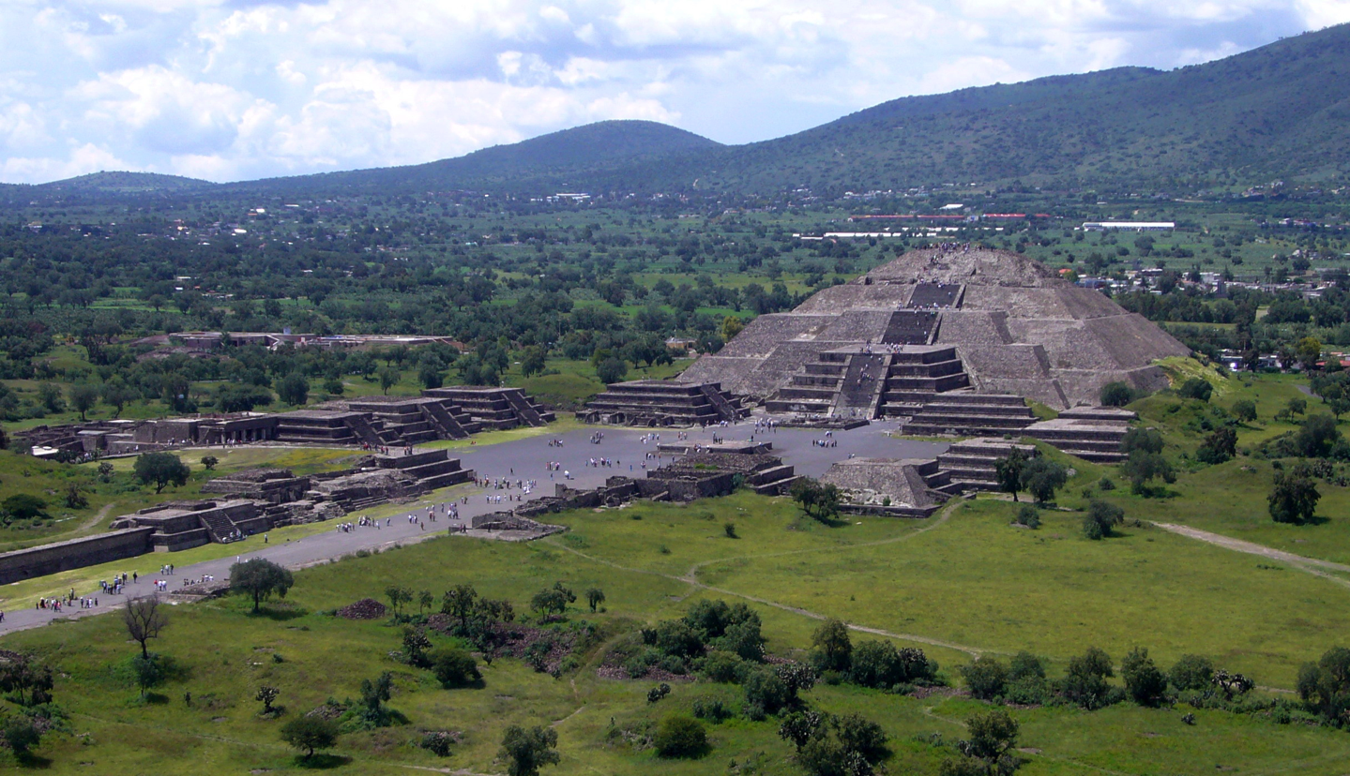
TeotihuacáN
Massive early city-state just outside Mexico City
150,000 to 200,000 people- one of largest cities in world at that time
Central avenue with 20 pyramids dedicated to the gods

Slide 5
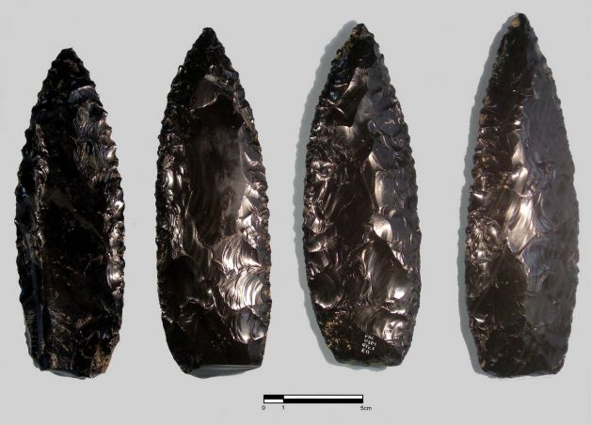
TeotihuacáN
Strong trade
Obsidian- green or black volcanic glass used to make razor-sharp weapons
Sharp decline
Invasion or conflict among ruling classes
Almost completely abandoned by 750

Slide 6
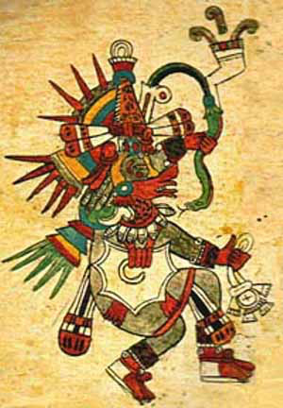
Toltecs Take Over
900- take power in central Mexico
Warlike people
Lots of human sacrifice
1000- Topiltzin tries to change the religion
Wants to follow Quetzalcoatl- the Feathered Serpent
Some rebel- force Topiltzin and followers to flee
Legend says Quetzalcoatl will return for payback
Toltec power declines and eventually collapses

Slide 7
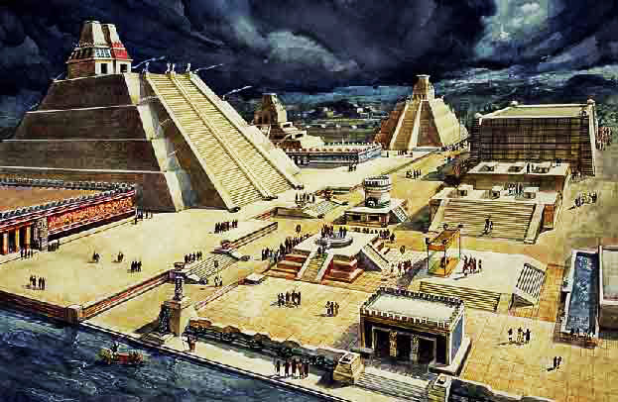
The Aztec Empire
Arrive in the Valley around 1200
Poor, nomadic people- find work as soldiers-for-hire
Eventually settle in 1325 and found the city Tenochtitlán

Slide 8
Growth of Aztecs
1428- join with city-states of Texcoco and Tlacopan in the Triple Alliance
Becomes leading power in the Valley
Eventually control over 80,000 square miles and between 5 and 15 million people

Slide 9
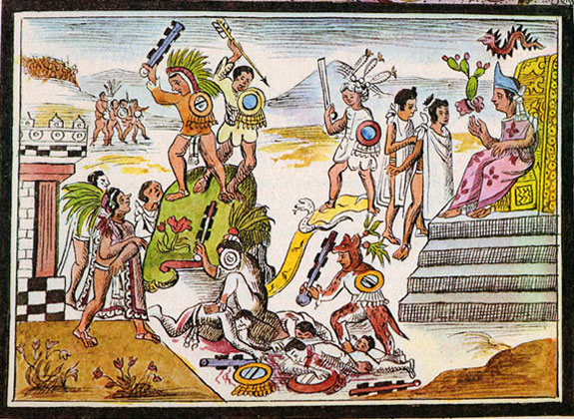
Growth of Aztecs
Base power on military conquests
Allowed local rule
Demand tribute- gold, maize, cacao beans, cotton, jade, etc.
If no tribute- Aztecs destroyed the village and captured or slaughtered the inhabitants

Slide 10
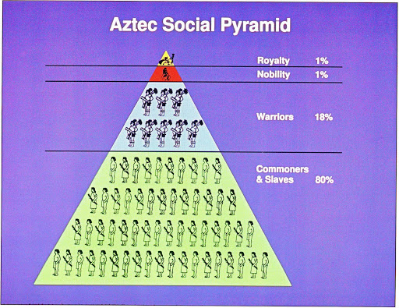
Classes
Emperor is at top- absolute power
Palace, servants, wives, visitors don’t wear shoes and keep heads down so they don’t look at him
Nobles- government officials, priests, military leaders
Own vast estates, ruled like lords, great wealth
Commoners- merchants, artisans, soldiers, farmers
Enslaved persons- captives forced to work

Slide 11
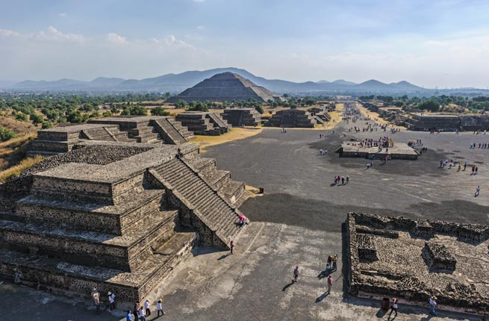
Tenochtitlán
200,000 to 400,000 people- larger than any European capital at the time
Island connected by 3 bridges
Tlatelolco- huge market, economic heart of city
Included massive, walled complex with palaces, temples and government buildings

Slide 12
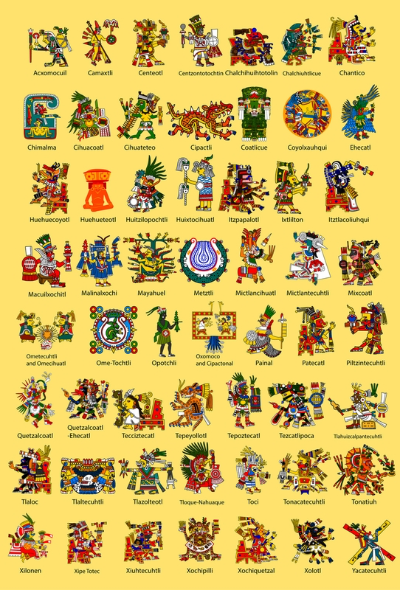
Religion
Major role- Tenochtitlán has hundreds of temples dedicated to over 1,000 gods
Worship same gods in many different forms
Elaborate public ceremonies
Offerings to gods, ritual dramas, songs and dances with masked performers, religious festivals

Slide 13
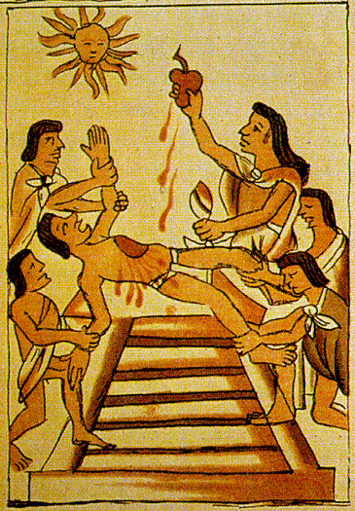
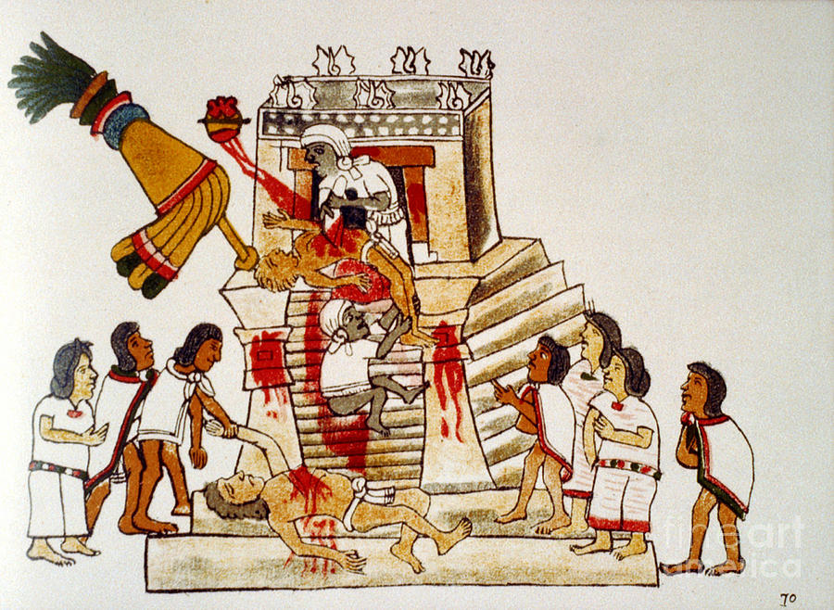
Religion
Human sacrifices to Huitzilopochtli (sun god)
Believed he had to battle forces of evil to make the sun rise each day
Needs nourishment of human blood
Thousands each year
Led to altar atop the Great Temple, priests carved out their hearts using obsidian knives
Prisoners of war were preferred sacrifices- went to war not for territory, but for prisoners

Slide 14
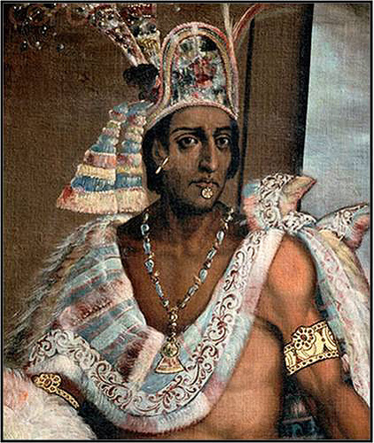
Problems in the Empire
1502- Montezuma II crowned emperor
With population growing, emperor calls for more tributes and sacrifices
Many provinces rebel
Over time, Montezuma tries to lessen pressure
Resentment still grows
Many see bad omens in every unusual occurrence

Slide 15
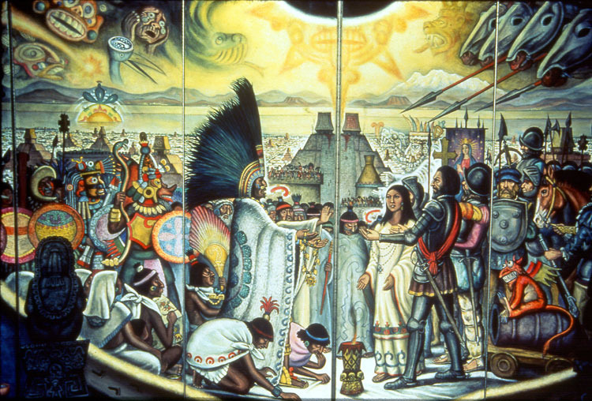
Problems in the Empire
Spanish arrive
Brings to mind the legend of the return of the god Quetzalcoatl

