Slide 1
The Enlightenment Spreads

Slide 2
Setting the Stage
The philosophes’ views about society often got them in trouble. In France it was illegal to criticize either the Catholic Church or the government. Many philosophes landed in jail or were exiled. Voltaire, for example, experienced both punishments. Nevertheless, the Enlightenment spread throughout Europe with the help of books, magazines, and word of mouth. In time, Enlightenment ideas influenced everything from the artistic world to the royal courts across the continent.

Slide 3
A World of Ideas
Paris- intellectual and cultural capital of Europe in the 1700s
Salons- regular social gatherings where intellectuals gathered to discuss ideas of the Enlightenment

Slide 4
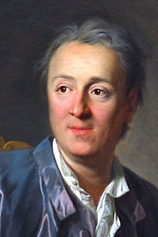
Diderot’s Encyclopedia
Denis Diderot- created large set of books that many leading scholars contributed essays to
Called it Encyclopedia and published in 1751
Enlightenment views in it angered French government and Catholic Church- banned it
Attracted attention of growing literate middle class

Slide 5
New Artistic Styles
Neoclassical style replaces baroque style
Baroque- grand, ornate design- seen in places like Versailles
Neoclassical- simple and elegant, borrowed ideas and themes from classical Greece and Rome

Slide 6
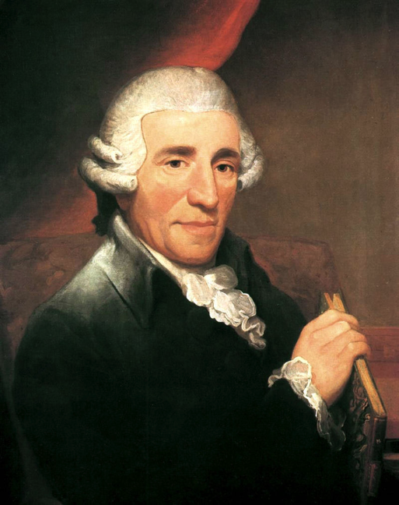
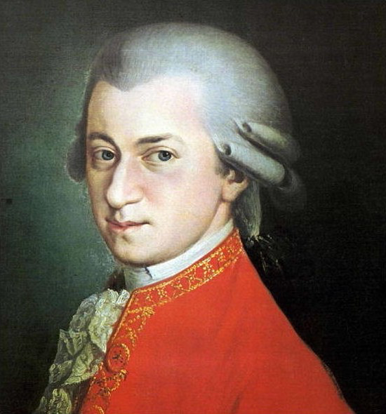
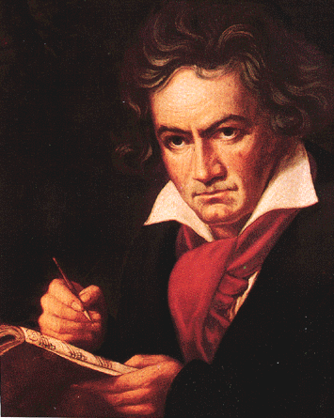
Changes in Music
Had been dominated by composers
Johann Sebastian Bach and George Friedrich Handel
Dramatic organ and choral music
New, lighter, elegant style known as classical emerged
Franz Joseph Haydn, Wolfgang Amadeus Mozart and Ludwig van Beethoven

Slide 7
Changes in Literature
Started writing novels
Carefully crafted plots
Used suspense
Explored characters’ thoughts and feelings

Slide 8
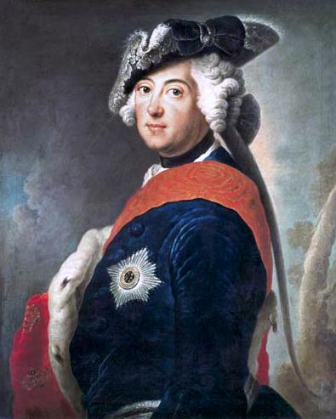
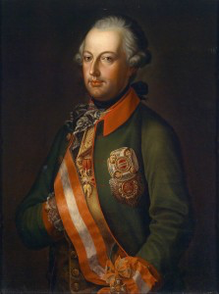
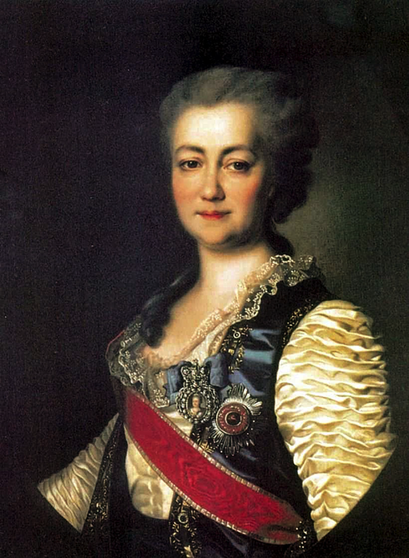
Enlightenment and Monarchy
Many philosophes believed best government was monarchy with the ruler respecting the people’s rights
Enlightened despots- monarchs who embraced the idea
Three emerge- Frederick II of Prussia, Holy Roman Emperor Joseph II of Austria, and Catherine the Great of Russia

Slide 9
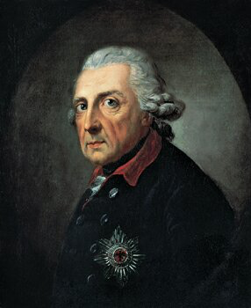
Frederick the Great
Prussia, 1740-1786
Granted many religious freedoms
Reduced censorship
Improved education
Reformed justice system and abolished torture
Goal of serving and strengthening his country
Never tried to change social order
Believed serfdom was wrong, but did nothing to end it since he needed support of the wealthy

Slide 10
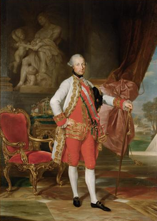
Joseph II
Austria, 1780-1790
Legal reforms
Freedom of the press
Freedom of worship
Abolished serfdom and ordered peasants be paid for their labor with cash
Nobles hated this and it was undone after Joseph II’s death

Slide 11
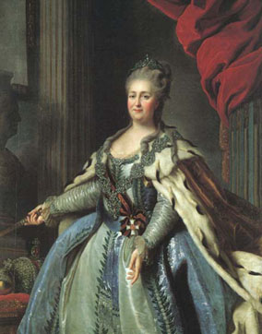
Catherine the Great
Russia, 1762-1796
Exchanged letters with Voltaire
Formed commission to review Russia’s laws
Recommended allowing religious toleration and outlawing torture and capital punishment
The commission doesn’t accomplish any of it
Views about enlightened ideas changed after an uprising
Violently crushes the uprising and is convinced she needs noble support to keep the throne

Slide 12
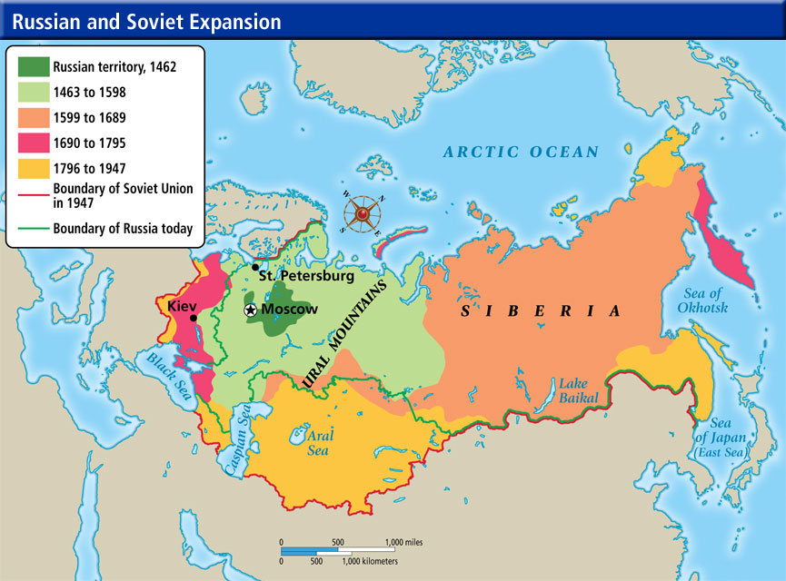
Catherine Expands Russia
Wars with Ottomans
Wins control of the northern shore of the Black Sea
Polish king was weak- 3 powers try to take over
1772- Russia, Prussia and Austria all take a piece of Poland
Known as the First Partition of Poland
Poland disappears as a country for over a century

