Slide 1
The Mongol Empire

Slide 2
Setting the Stage
Kublai Khan, the grandson of Genghis Khan, assumed the title Great Khan in 1260. In theory, the Great Khan ruled the entire Mongol Empire. In reality, the empire had split into four khanates. Other descendants of Genghis ruled Central Asia, Persia and Russia as semi-independent states. So, Kublai focused instead on extending the power and range of his own khanate, which already included Mongolia, Korea, Tibet and northern China. To begin, however, he had to fulfill the goal of his grandfather to conquer all of China.

Slide 3
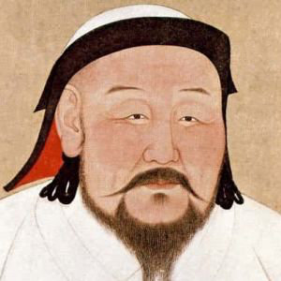
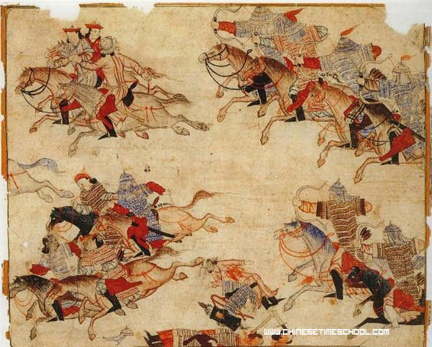
Kublai Khan Becomes Emperor
Kublai attacks China for several years
Finally takes over in 1279 and becomes China’s new emperor
Founds Yuan Dynasty- lasts until 1368

Slide 4
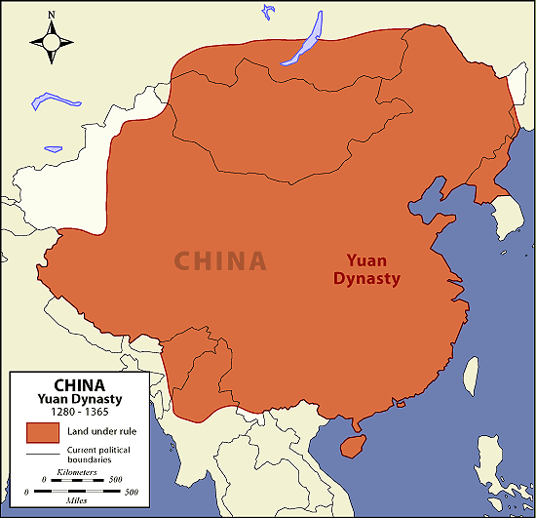
Importance of Kublai’s Rule
Unites China for 1st time in over 300 years
Because of this, he’s considered one of China’s great emperors
Control of Mongols across all of Asia opened China to more foreign contacts and trade
Tolerated Chinese culture and made few changes

Slide 5
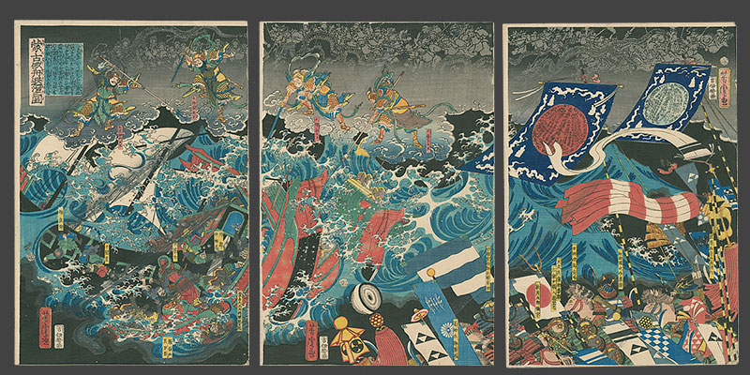
Failure Conquering Japan
Launches 2 major attacks in 1274 and 1281
2nd attack has over 150,000 soldiers- largest seaborne invasion force until WWII
After 53 days it’s a standstill
Typhoon sweeps in, destroys Mongol ships and kills soldiers

Slide 6
Mongol Rule in China
Mongols live apart from Chinese and obey different laws
Kept Chinese out of high levels of government, but keep lots at local level
Extends Grand Canal to Beijing
Builds 1,100 mile paved highway from Hangzhou to Beijing

Slide 7
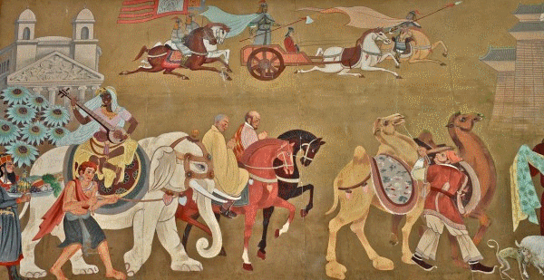
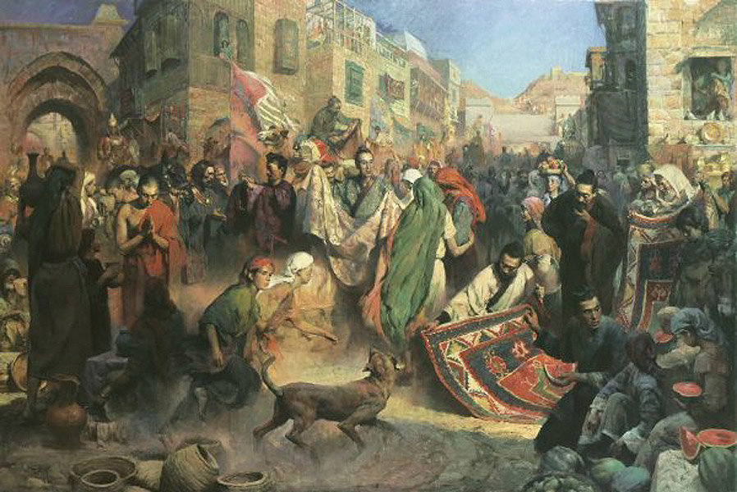
Foreign Trade
Increased under Kublai due to Mongol Peace
Carry silk, porcelain, gunpowder, compasses, paper currency and playing cards to Europe
Invites foreign merchants to China

Slide 8
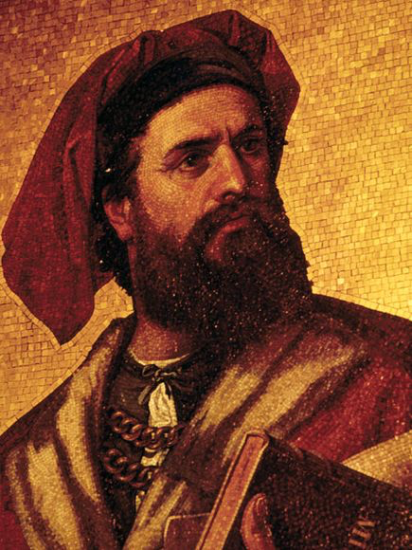
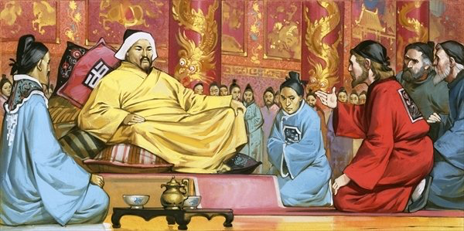
Marco Polo at the Mongol Court
Marco Polo- Venetian trader, traveled Silk Road with father and uncle
Learned several Asian languages in his travels
Kublai sends him to various Chinese cities on government missions
Serves Kublai for 17 years

Slide 9
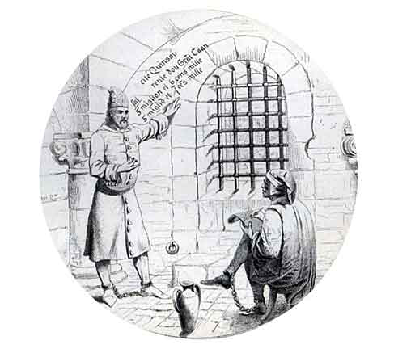
Marco Polo at the Mongol Court
Returns to Venice
Captured and imprisoned in war against Genoa
Tells stories to other prisoners
China’s fabulous cities, wealth, burning of “black stones” (coal)
A prisoner records the stories
Huge hit in Europe

Slide 10
Problems for the Mongols
Kublai sends exhibitions into Southeast Asia
Suffers humiliating defeats- huge loss of expense and lives
Big spending on wars, public works and luxuries led to higher taxes

Slide 11
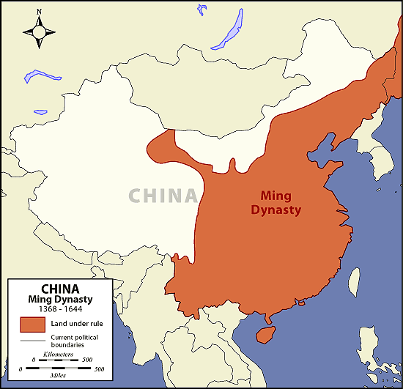
The End of Mongol Rule
1294- Kublai dies
Family members argue over who should rule- changes hands 4 times in 8 years
1300s- Rebellions break out
Fueled by years of famine, flood, disease, economic problems, corruption and Mongol humiliation of the Chinese
1368- overthrow Mongols
Ming Dynasty is founded

Slide 12
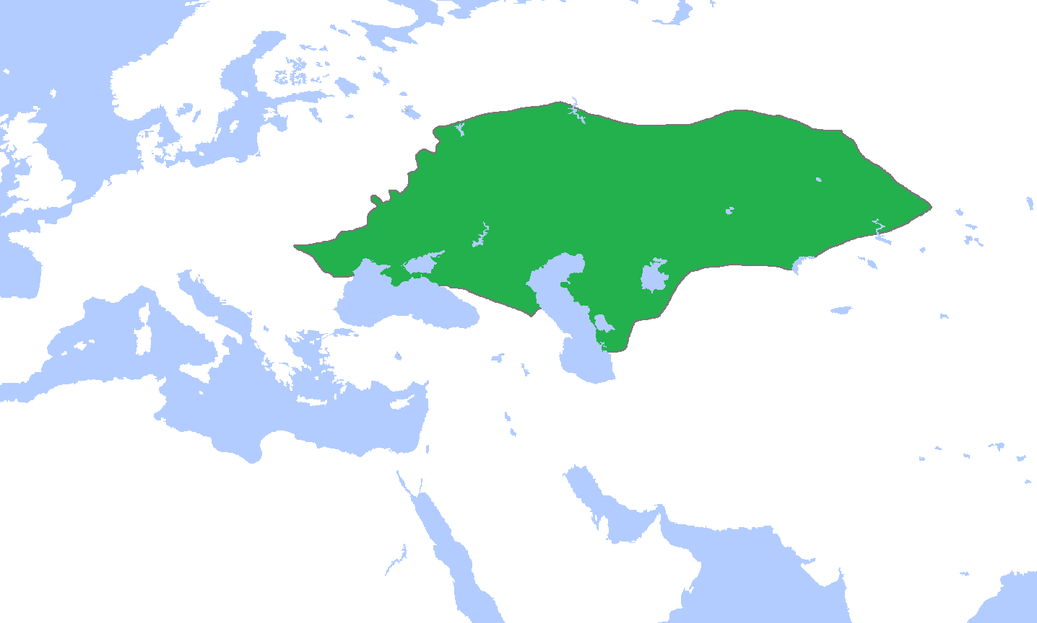
Decline of the Mongol Empire
Entire empire had disintegrated by time of Yuan Dynasty collapse
Only Golden Horde in Russia stayed in power

