Slide 1
Turkish Empires Rise in Anatolia

Slide 2
Setting the Stage
To the east of Constantinople and south of Russia, the mighty Muslim empire of the Abbasids had ruled since the eighth century. By the mid-tenth century, however, their control of the region would end as a powerful group known as the Turks emerged.

Slide 3
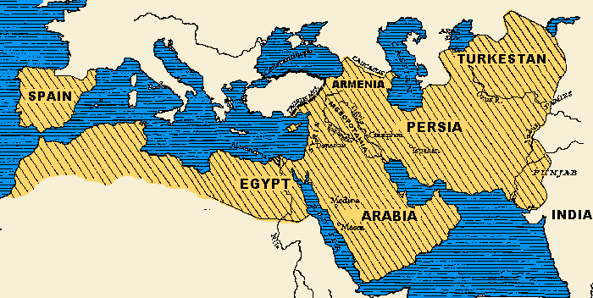
The Rise of the Turks
Abbasids struggle to keep control over empire
756- Spain breaks away
788- Morocco
800- Tunisia
809- Regions of Persia
868- Egypt
945- Persian army ends power of the caliph (Islamic religious or political leader)

Slide 4
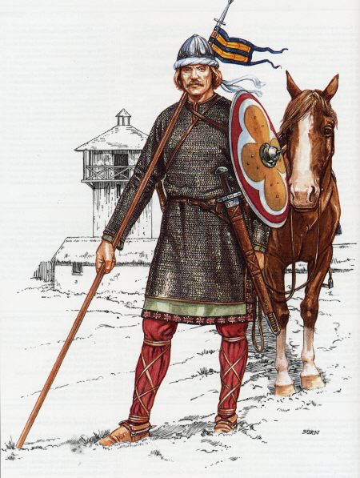
The Conquering Seljuks
Turks- nomads, rode horses on plains, herd sheep and goats, lived in tents, use camels to carry goods
900s- Turks start converting to Islam and migrating into the weakened Abbasid Empire
One of the 1st groups to migrate was the Seljuks
1055- attacked and captured Baghdad from the Persians
20 years later, take over Anatolia from Byzantines

Slide 5
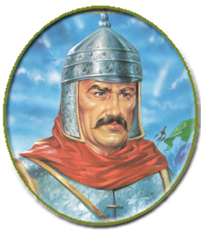
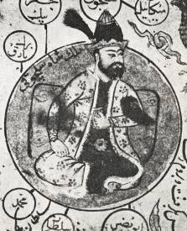
Turks Secure Persian Support
Toghril Beg (founder of Seljuk Dynasty) makes Persian city of Isfahan the capital
Treats Persians well and appoints them as government officials
Looked to Persians for cultural and religious guidance
Shah Malik builds mosques in Isfahan

Slide 6
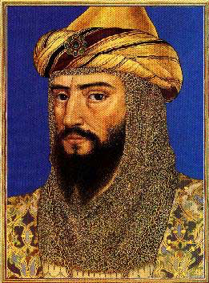
Seljuks Confront Crusaders
1092- Shah Malik dies, empire becomes loose collection of minor kingdoms
1095- Crusades are launched and Europeans take Jerusalem and Anatolia area
1187- Fragments of the Seljuk Empire follow Saladin and retake Jerusalem
Able to fight off European attacks going forward

Slide 7
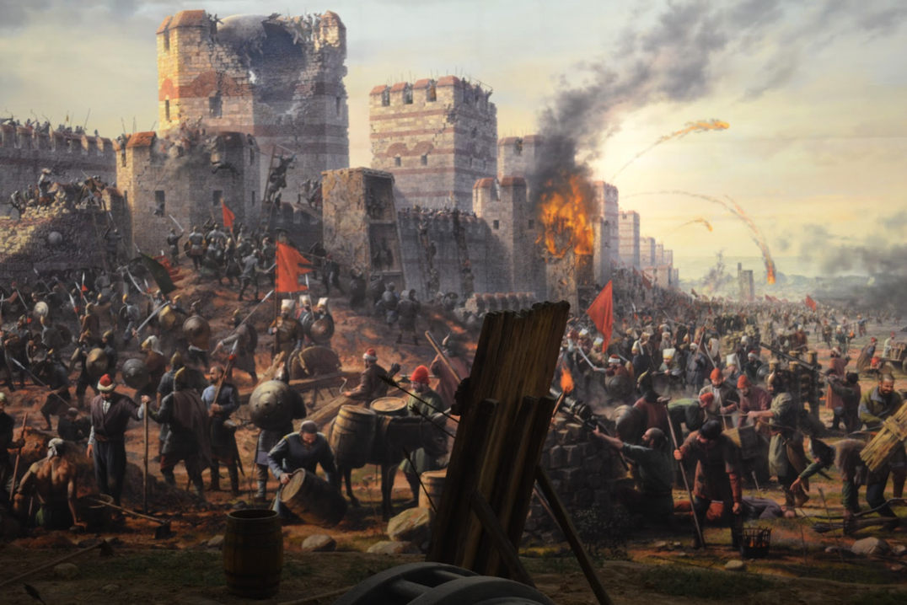
Seljuks Face the Mongols
1258- Genghis Khan’s grandson Hulagu leads troops to Baghdad
Terrorized for 50 days- defensive walls still stood
Mongols build towers to catapult attacks over the walls
Hulagu takes Baghdad, burns the caliph’s palace and has tens of thousands killed
Executes last Abbasid caliph by wrapping him in a carpet and having him trampled to death by horses

Slide 8
Turks Evolve
As the Mongols crumble, another group of Turks rise- the Ottomans
Build an empire that lasts into the 1900s

