Slide 1
Absolute Rulers of Russia

Slide 2
Setting the Stage
Ivan III of Moscow, who ruled Russia from 1462 to 1505, accomplished several things. First, he conquered much of the territory around Moscow. Second, he liberated Russia from the Mongols. Third, he began to centralize the Russian government. Ivan III was succeeded by his son, Vasily, who ruled for 28 years. Vasily continued his father’s work of adding territory to the growing Russian state. He also increased the power of the central government. This trend continued under his son, Ivan IV, who would become an absolute ruler.

Slide 3
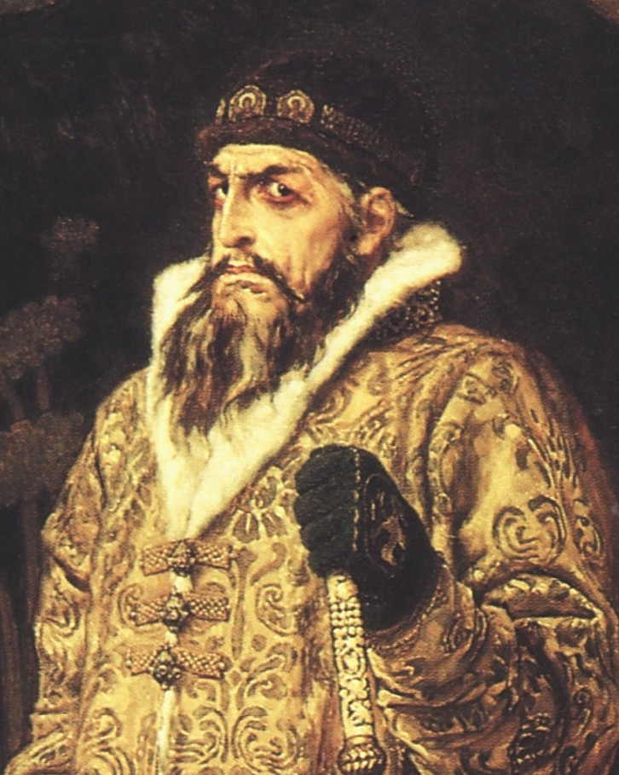
The First Czar
1533- Ivan IV (Ivan the Terrible) takes over at 3 years old
Boyars (Russia’s land owning nobles) fought for power and to control Ivan
At 16, Ivan takes power and crowns himself czar
Married Anastasia from the Romanov family

Slide 4
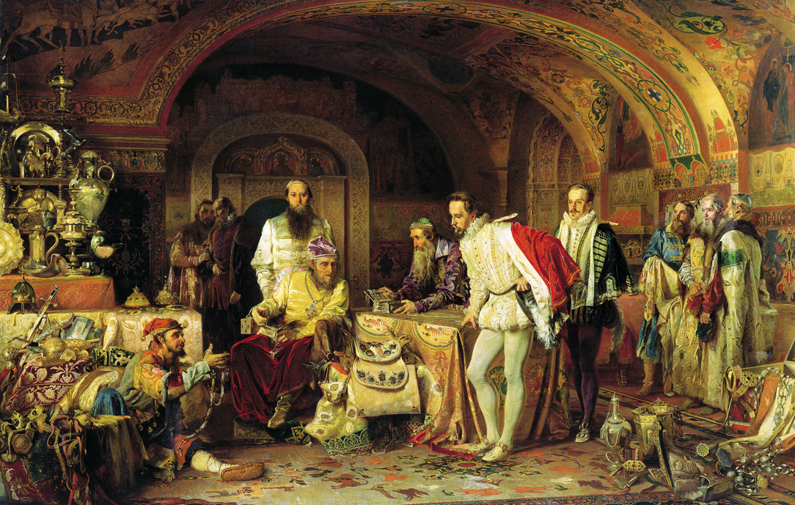
The Good Period
1547-1560
Won land for Russia
Gave Russia a code of laws
Ruled justly

Slide 5
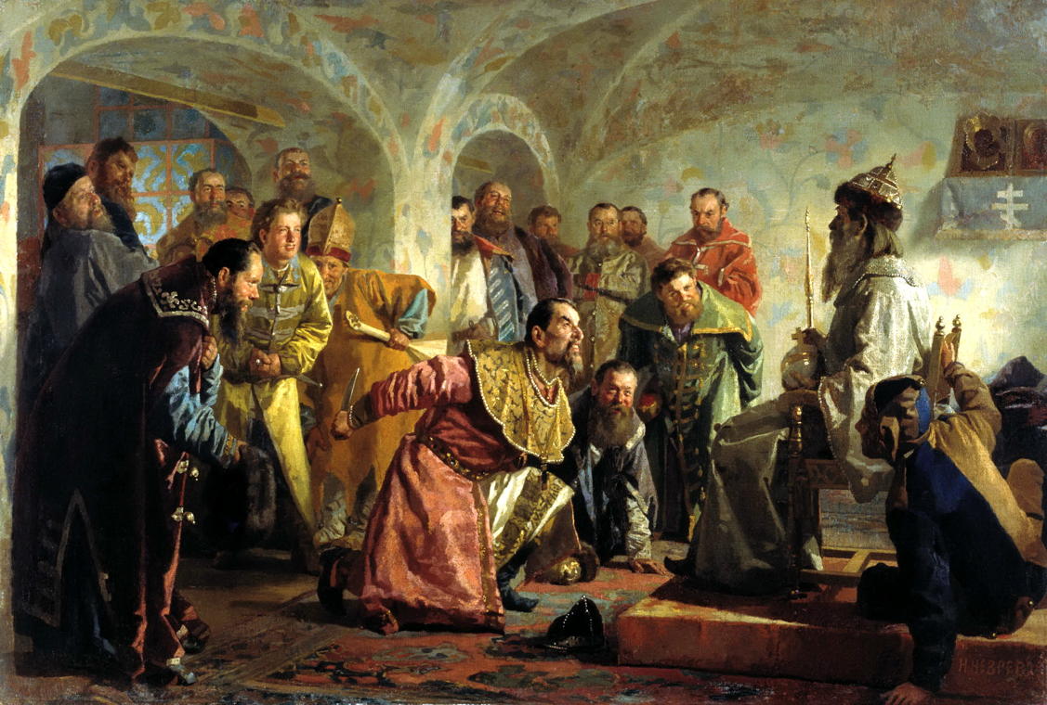
Rule by Terror
Anastasia dies
Ivan accuses the Boyars of poisoning her
Creates own police force- job is to hunt down and kill people Ivan considered to be traitors
Thousands died

Slide 6
Rule by Terror
During a violent argument, Ivan killed his oldest son and heir to the throne
Ivan dies 3 years later, leaving the throne to his weak, second son

Slide 7
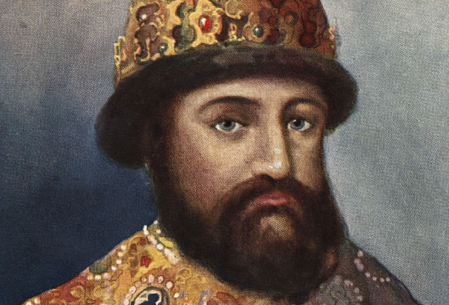
Rise of the Romanovs
Ivan’s son dies without an heir
Russia falls into turmoil- The Time of Troubles
Boyars struggle for power, heirs of czars die mysteriously
1613- representatives meet to choose the next czar
Select Michael Romanov- grandnephew of Ivan the Terrible
Romanov dynasty rules for 300 years from 1613-1917

Slide 8
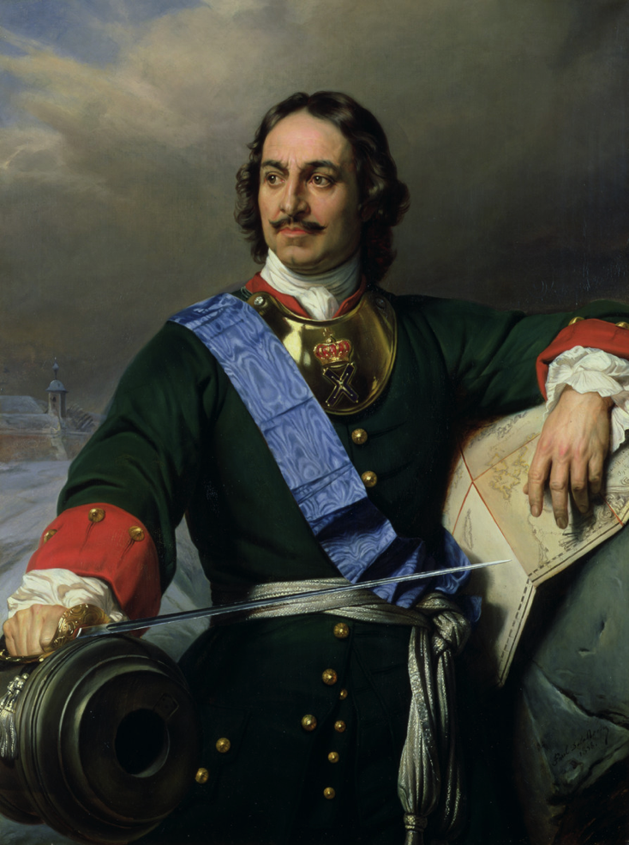
Peter the Great
Takes over in 1696
Russia was behind
Cut off from Europe by Mongol rule during the Renaissance and Age of Exploration
Religious differences- Russia was Eastern Orthodox and viewed Westerners as heretics and avoided them

Slide 9
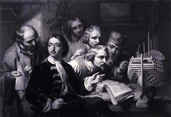
Peter the Great
Peter travels through western Europe
Goal to learn about European customs and manufacturing techniques
Returns with goal of westernization- using western Europe as a model for change

Slide 10
Peter’s Reforms
Puts the Russian Orthodox Church under state control
Reduced power of landowners
Hired European officers for his military
Built up to 200,000 soldiers
High taxes to support the military

Slide 11
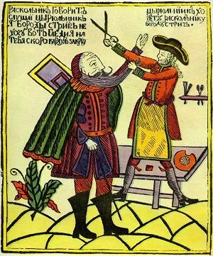
Westernizing Russia
Introduced potatoes
Started Russia’s first newspaper
Raised women’s status by having them attend social gatherings
Ordered the nobles to give up their traditional clothes for Western fashions
Advanced education by opening a school of navigation and introducing schools for the arts and sciences

Slide 12
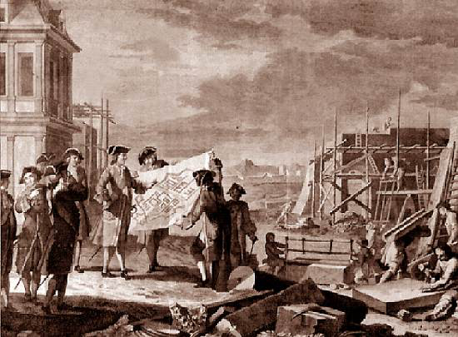
Establishing St. Petersburg
Peter wants a seaport to make it easier to travel to the West
Battles Sweden to gain a piece of the Baltic coast
Russia occupies the land, but doesn’t officially get it until 21 years of war had passed
Built a city at the site and called it St. Petersburg
Peter dies in 1725 and Russia is now a power in Europe

