Slide 1
England and France Develop

Slide 2
Setting the Stage
By the early 800s, small Anglo-Saxon kingdoms covered the former Roman province of Britain. In Europe, the decline of the Carolingian Empire in the 900s left a patchwork of feudal states controlled by local lords. Gradually, the growth of towns and villages, and the breakup of the feudal system were leading to more centralized government and the development of nations. The earliest nations in Europe to develop a strong unified government were England and France.

Slide 3
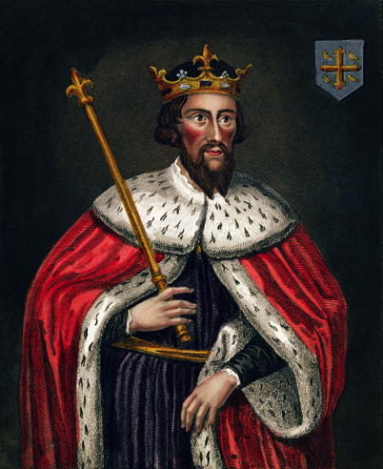
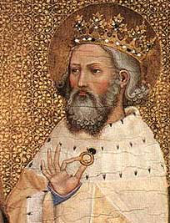
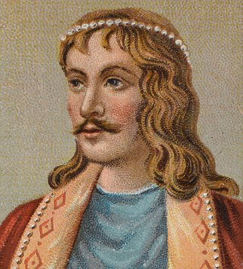
England Absorbs Waves of Invaders
In the 800s, Vikings invaded
Alfred the Great, Anglo-Saxon king fought them off and united one kingdom called England (land of the Angles)
1016, Danish king Canute conquered England
1042, King Edward the Confessor took control, but died in 1066 without an heir
Leads to a struggle for power and one last invasion

Slide 4
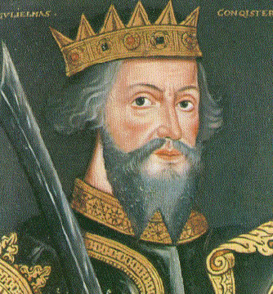
The Norman Conquest
William the Conqueror, duke of Normandy
Descendants of Vikings, but French in culture
Cousins with king Edward so claimed crown
Invades with an army and battles Harold Godwinson for the crown

Slide 5
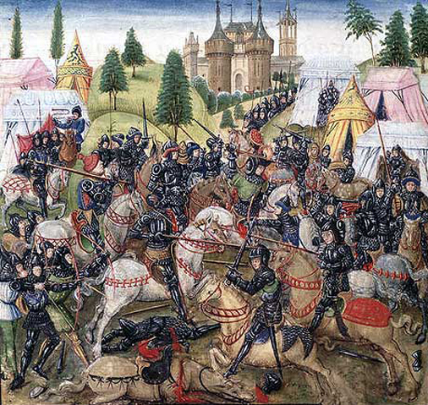
The Norman Conquest
The Battle of Hastings-
Normans won after Harold was killed by an arrow through is eye
William declared all England his personal property
Granted land to 200 Norman lords

Slide 6
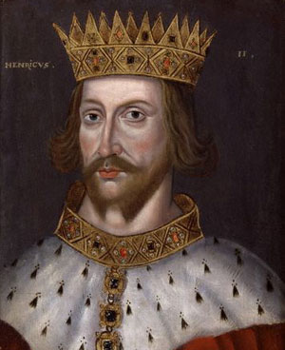
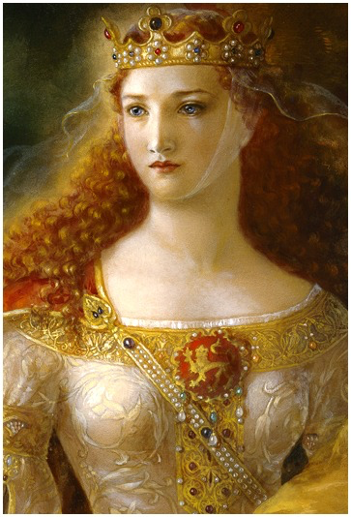
England’s Evolving Government
English kings had 2 goals-
Add to their French lands
Strengthen their own power over the nobles and the Church
English king Henry II added to land by marrying Eleanor of Aquitaine from France

Slide 7
Juries and Common Law
Strengthened royal courts
Sent royal judges throughout England once a year
Collected taxes, settled lawsuits, punished crimes
Introduced use of a jury- 12 neighbors of the accused who answered the judges questions about the case
The rulings in these courts became known as common law- basis for many laws in English-speaking countries today

Slide 8
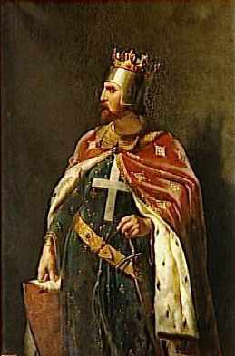
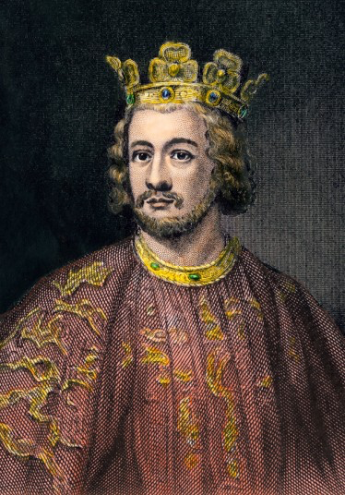
The Magna Carta
After Henry, his son Richard the Lion Hearted took over
After Richard, his brother John took over
John was weak- John Softsword
Lost Normandy and all his lands in France

Slide 9
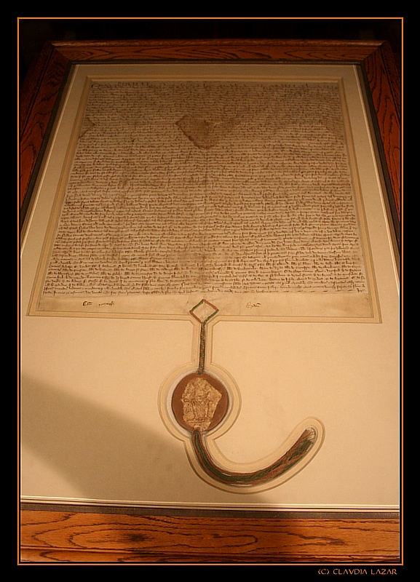
The Magna Carta
Leads to problems with his own nobles
June 15, 1215- nobles forced John to sign the Magna Carta
Basic political rights and limits kings powers
No taxation without representation
Jury trial
Guarantees what are considered basic legal rights in England and the U.S.

Slide 10
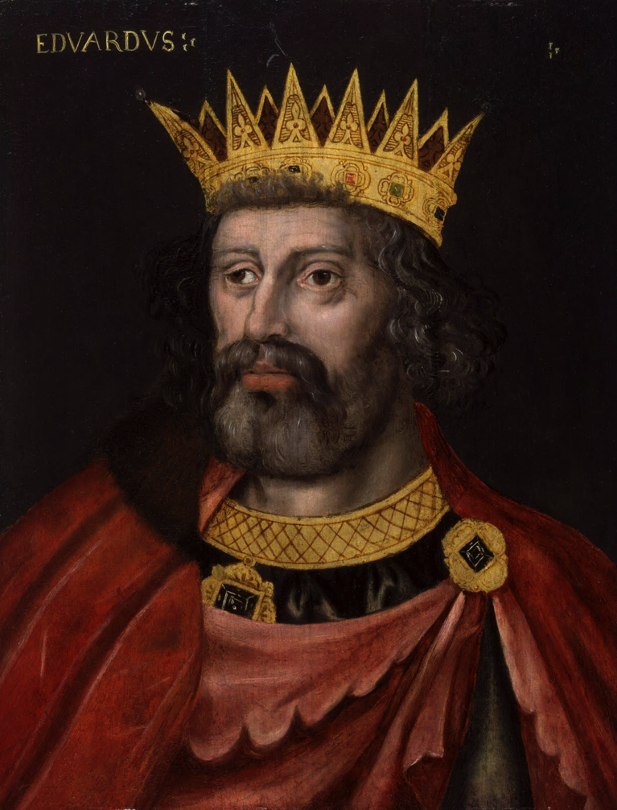
The Model Parliament
Edward I takes over after John
Needs to raise taxes to finance his wars
Calls together the first parliament (legislature)
Meet at Westminster in London
Two houses- citizens of wealth and commoners

Slide 11
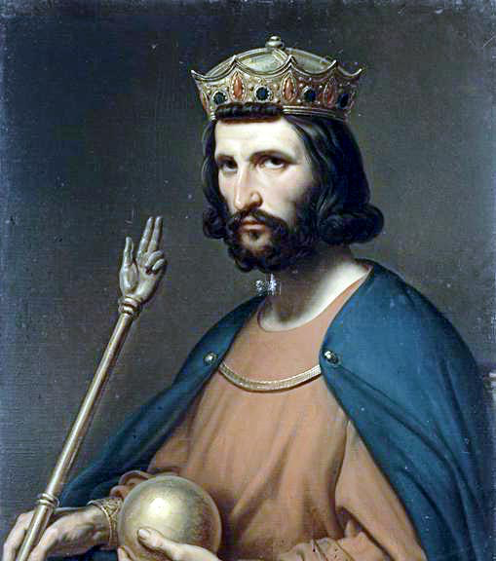
Developments in France
1000- France had 47 feudal territories
987- last member of the Carolingian family dies
Hugh Capet, and undistinguished duke, takes over
Capet ruled a small territory, but it had Paris in it
Starts Capetian dynasty- 987-1328

Slide 12
France Becomes a Separate Kingdom
Capet and his successors were weak, but benefited from conditions
Ruled over area in middle of trade routes
Gradually spread their power outward and unite France

Slide 13
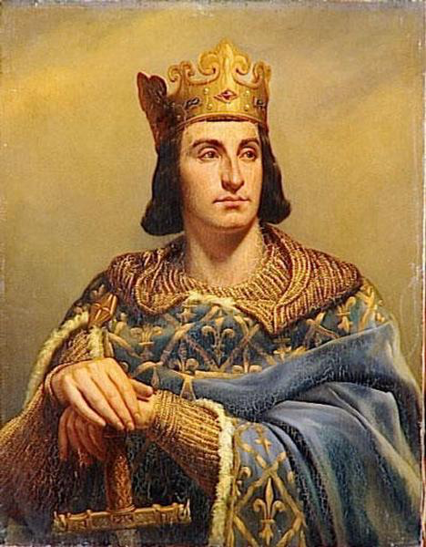
Expansion of France
Philip II, called Philip Augustus, ruled from 1180-1223
One of the most powerful Capetians
Wants to limit English kings in France
Little success against Henry II and Richard the Lion Hearted, but lots of success when John takes over
Tripled the land under his control

Slide 14
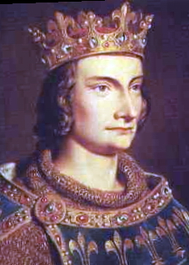
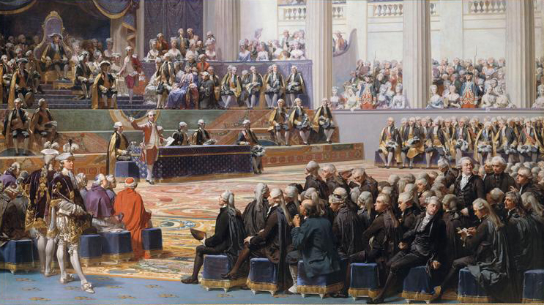
Expansion of France
Philip IV (rules from 1285-1314) runs into problems with the pope
Pope doesn’t want priests to pay taxes to the king
Philip creates a system like English Parliament
Estates-General- combination of church leaders (1st estate), great lords (2nd estate), and commoners, landholders or merchants (3rd estate)

Slide 15
Beginnings of Democracy
As kings tried to allow more participation to increase their power over outside pressures, they unknowingly start sowing the seeds of democracy

