Slide 1
Feudal Powers in Japan

Slide 2
Setting the Stage
Japan lies east of China, in the direction of the sunrise. In fact, the name Japan comes from the Chinese word ri-ben, which means “origin of the sun” or “land of the rising sun”. From ancient times, Japan had borrowed ideas, institutions, and culture from the Chinese people. Japan’s genius was its ability to take in new ideas and make them uniquely its own.

Slide 3
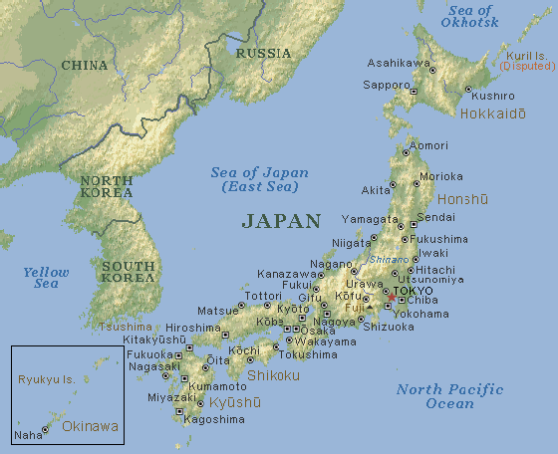
Geography of Japan
Separated from Korea by 120 miles of water, China by 500 miles
Made up of about 4,000 islands- over 1,200 miles long
Southern- mild climate, lots of rainfall
Mountainous- only 12% of land suitable for farming
Coal, oil, iron in short supply
Typhoons, earthquakes and tidal waves are common

Slide 4
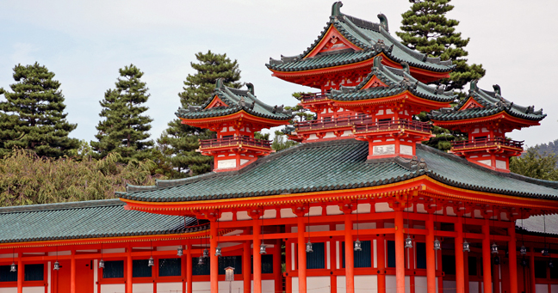
Early Japan
Hundreds of clans controlled their own territories
Each have own religion and gods
Eventually combine to form Japan’s earliest religion- called Shinto (way of the gods)

Slide 5
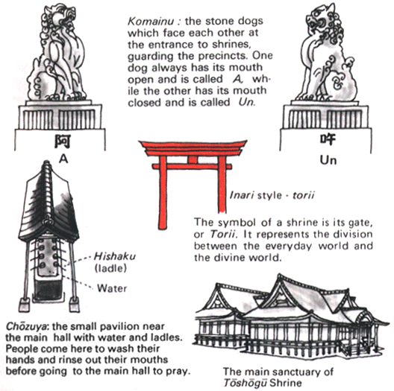
Shinto
Based on respect for forces of nature and worship of ancestors
Believe in kami- divine spirits that dwelled in nature
Beautiful tree, rock, waterfall or mountain was home of a kami

Slide 6
The Yamato Emperors
400s- Yamato clan takes power
Claim to be descended from sun goddess Amaterasu
600s- chiefs call themselves emperors
Didn’t control much of Japan
Competing clans would win battles, then rule in the emperors name
Have figurehead emperor, and actual ruling power behind the emperor

Slide 7
Japanese Culture
Expands during 400s- more contact with Chinese and Koreans
700s- Japanese accept Buddhism
Keep Shinto beliefs and mix it with Buddhism
Send missions to China to study Chinese civilization
Adopt system of writing, art styles, lifestyles (cooking, gardening, drinking tea, hairdressing), government set up, civil service system (failed)

Slide 8
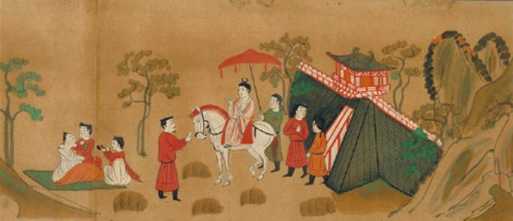
Life in Heian Period
Late 700s- capital moved from Nara to Heian
Many nobles moved there too
Fill days with rituals and artistic pursuits
Rules dictate everything- length of swords, color of robes, forms of address, how to dress
Etiquette important- don’t laugh in public
Everyone expected to write poetry and paint

Slide 9
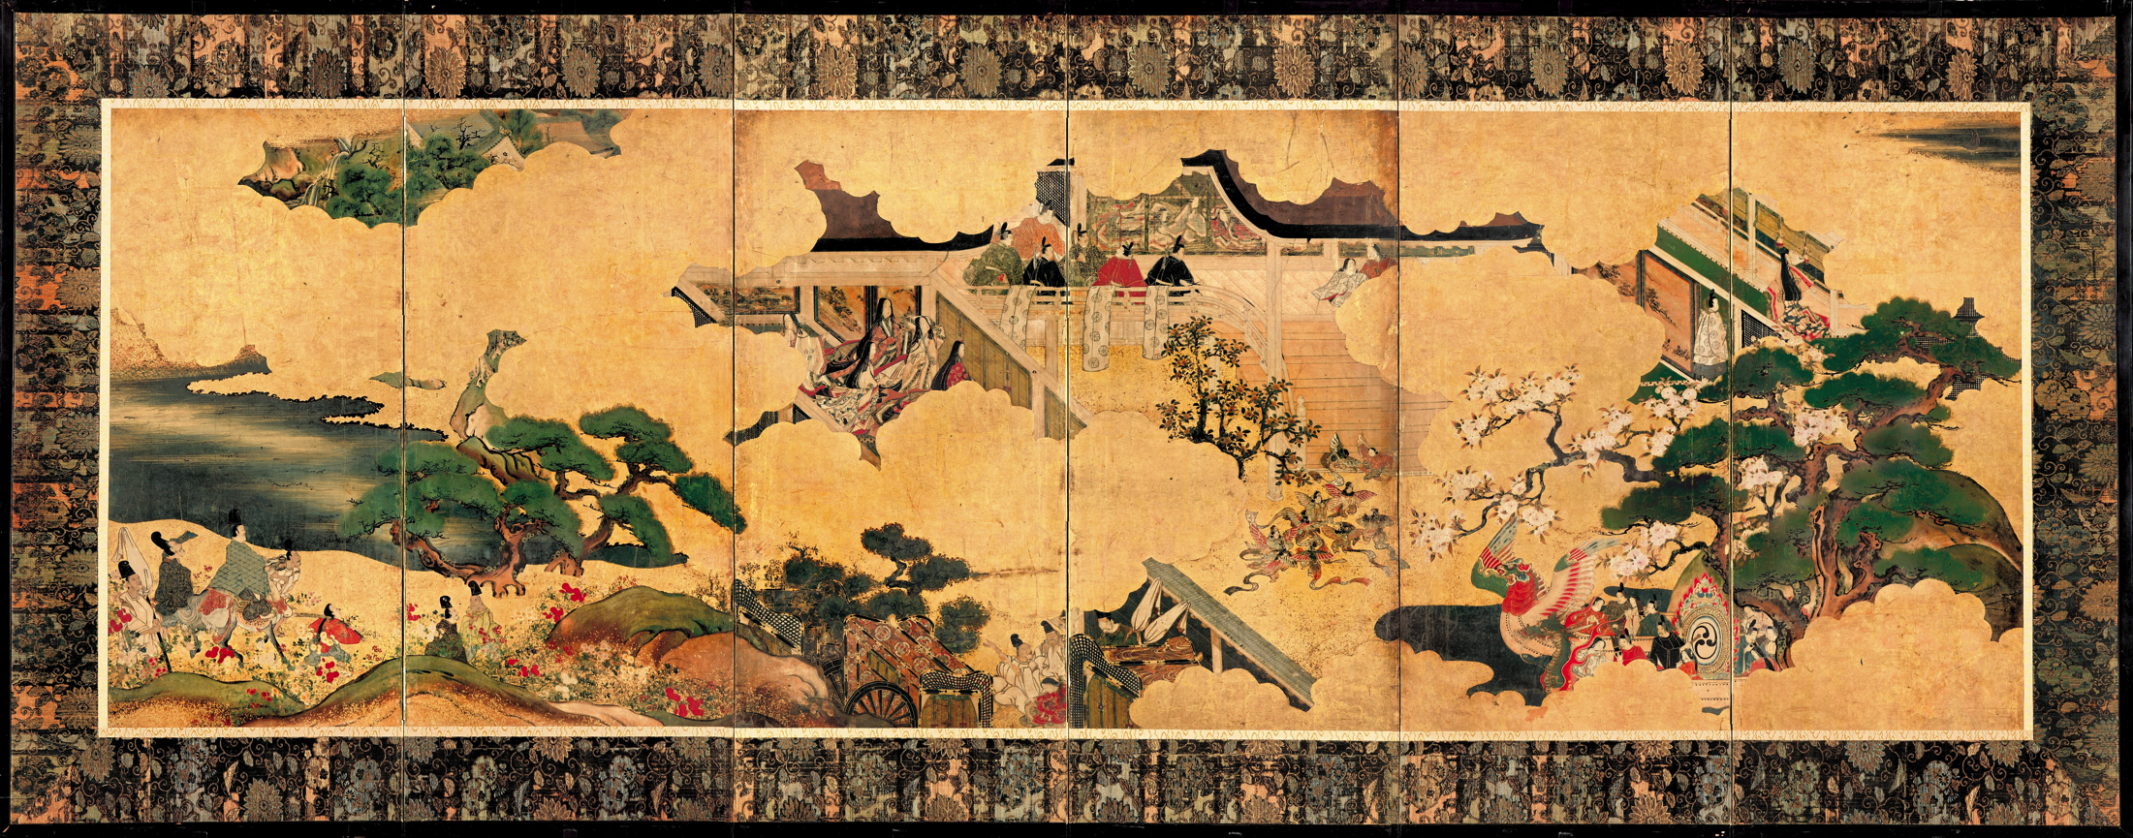
Life in Heian Period
11th century- Lady Murasaki Shikibu writes The Tale of Genji
Account of the life of a prince in the imperial court
Considered world’s 1st novel

Slide 10
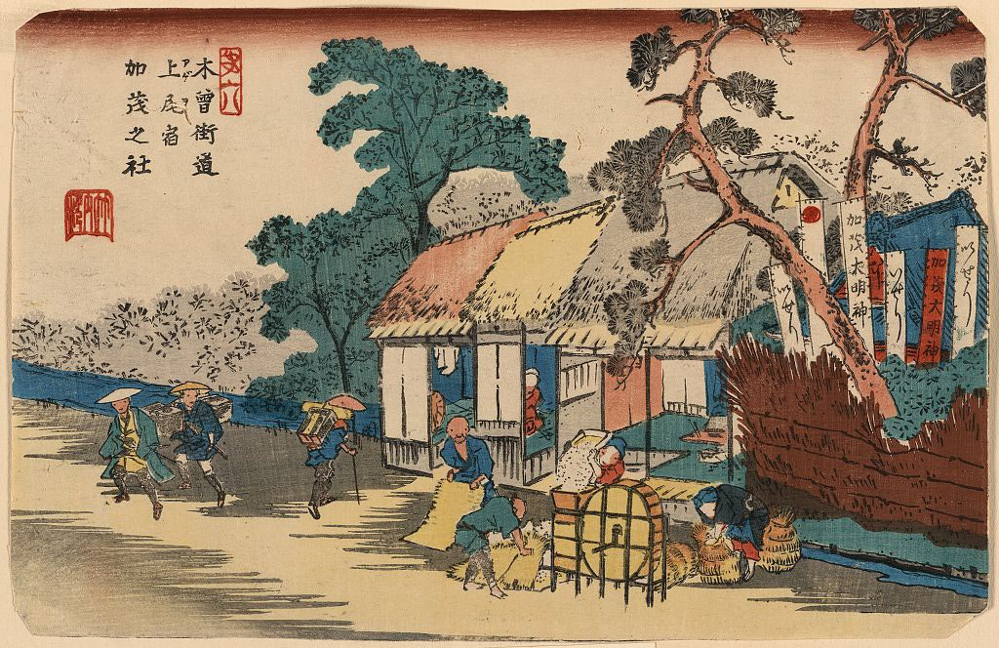
Feudalism Erodes Imperial Authority
Mid-1000s- landowners set up private armies
Armed soldiers on horseback preyed on farmers and travelers, pirates take control of seas
Small landowners trade parts of land to strong warlords for protection
Warlords gain more land and more power
Begins more localized rule rather than central government rule

Slide 11
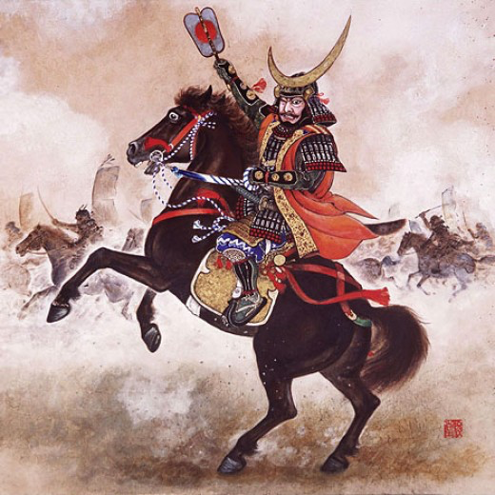
Samurai Warriors
Wars between rival lords was common
Surround themselves with samurai- “one who serves”
Live by code of Bushido- “the way of the warrior”- show reckless courage, reverence for the gods, fairness and generosity to those weaker than himself
Dying honorable death more important than living long life

Slide 12
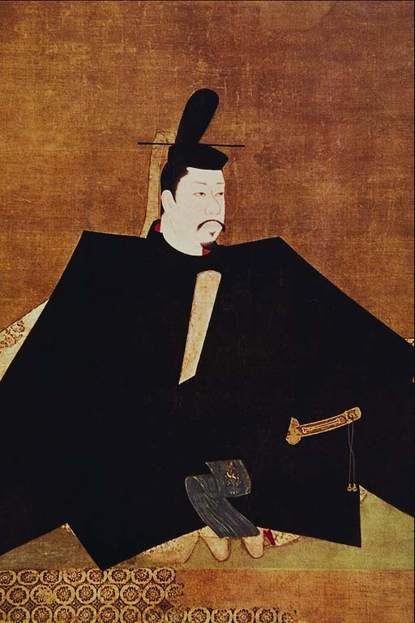
The Kamakura Shogunate
Late 1100s- 2 powerful clans fight for power
After 30 years, Minamoto family takes over
Yoritomo becomes shogun- supreme general of emperor’s army- military dictator
Power centers out of military headquarters at Kamakura
Shoguns rule through puppet emperors from 1200s through 1868

Slide 13
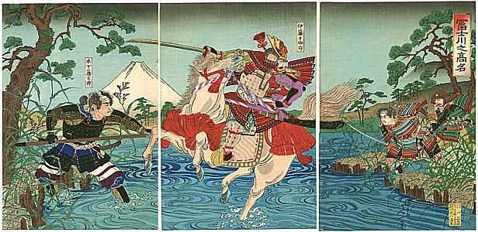
The Kamakura Shogunate
Strong enough to fight off Mongol invasions in 1274 and 1281
Drained treasury- can’t pay samurai
Samurai attach themselves more to local lords
Fight each other for power over other lords

