Slide 1
The American Revolution

Slide 2
Setting the Stage
Philosophes such as Voltaire considered England’s government the most progressive in Europe. The Glorious Revolution of 1688 had given England a constitutional monarchy. In essence, this meant that various laws limited the power of the English king. Despite the view of the philosophes, however, a growing number of England’s colonists in North America accused England of tyrannical rule. Emboldened by Enlightenment ideas, they would attempt to overthrow what was then the mightiest power on earth and create their own nation

Slide 3
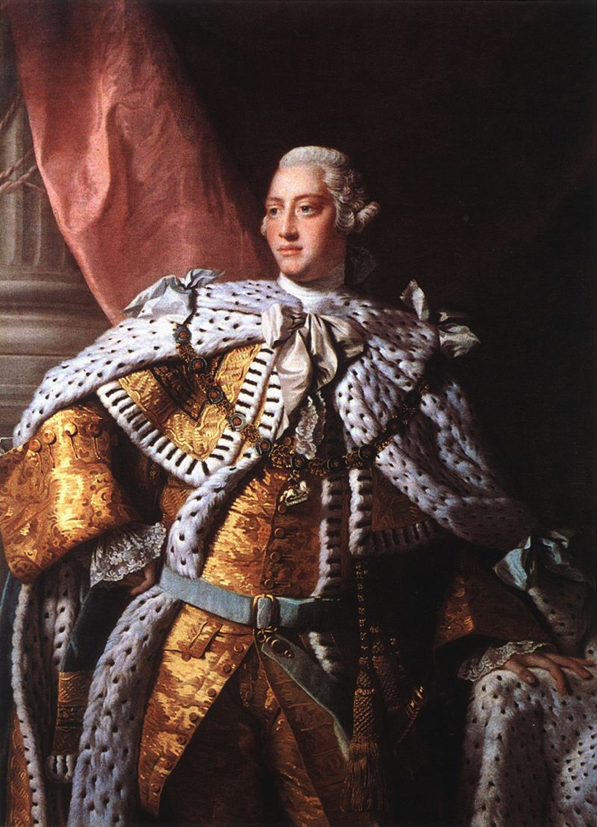
Britain and Its American Colonies
King George III takes over 1760
Colonial population was just over 2 million
Colonies thrived on trade with nations of Europe
Each of the 13 colonies had their own government
People start to see themselves as Virginians or Pennsylvanians rather than English

Slide 4
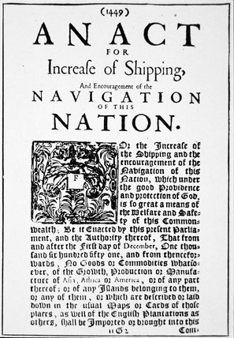
The Navigation Act
1651- Prevented colonists from selling most valuable products to any country except Britain
Had to pay high taxes on imported French and Dutch goods

Slide 5
Taxes Put in Place
French and Indian War
Between Britain and France
Britain emerges victorious
Britain goes into debt fighting the war- start taxing colonists
Stamp Act- tax to put an official stamp on printed material
Leads to taxation without representation argument

Slide 6
Boston Tea Party
Tea Act benefits the East India Company
December 16, 1773- Colonists dress as Indians and board 3 East India Company ships
Dump 18,000 pounds of tea into Boston Harbor

Slide 7
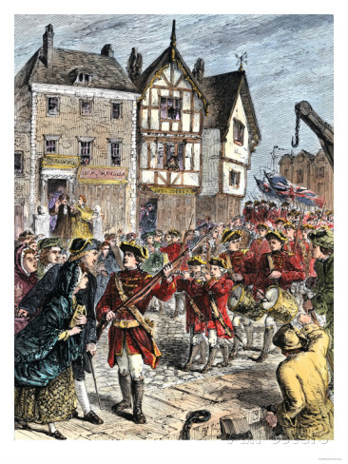
Britain Responds
Intolerable Acts-
Shut down Boston Harbor
Colonists had to quarter British soldiers
Boston put under martial law

Slide 8
First Continental Congress
1774- 56 delegates meet
Develop a list of colonial rights
Said colonists should fight back if Britain used force
Colonists begin to stockpile arms

Slide 9
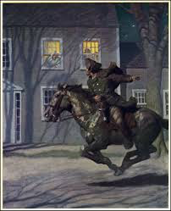
Britain’s Response
Send troops to Concord, Massachusetts
Believed to be a large stockpile of arms there
Paul Revere, William Dawes and Sam Prescott ride and warn colonists that the British are coming

Slide 10
Lexington and Concord
Lexington- British meet the minutemen- civilian soldiers who could be ready to fight in a minute’s notice
Someone fires the first shot
8 minutemen killed
First battle is over in less than 15 minutes

Slide 11
Lexington and Concord
British march to Concord, find no weapons
On their march back they are attacked by 3,000 to 4,000 minutemen
The Revolutionary War has begun

Slide 12
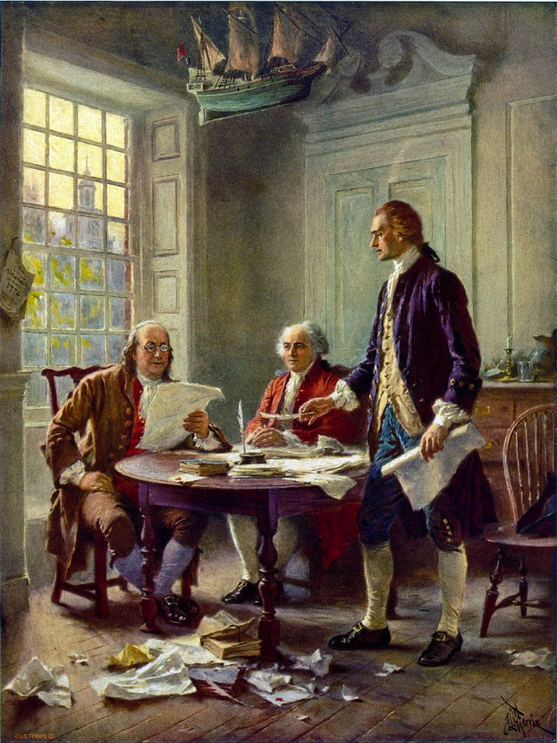
Second Continental Congress
1775- Place Washington in charge of continental army
1776- Appoint committee to write the Declaration of Independence
Thomas Jefferson writes final draft
July 4, 1776- The colonies adopt the Declaration of Independence

Slide 13
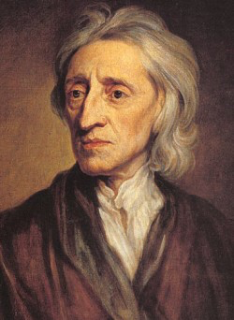
Influence of the Enlightenment
Use Enlightenment ideas to justify independence
King was a tyrant who broke the social contract
Ideas of Declaration from John Locke
Natural rights
List of King George III’s abuses of power

Slide 14
American Views on War
Loyalists- opposed independence and supported the King
Patriots- supported independence

Slide 15
Winning the War
Continental Army is trained under Prussian Friedrich Von Steuben and Frenchman Marquis de Lafayette
Great military leaders- turn tide of the war

Slide 16
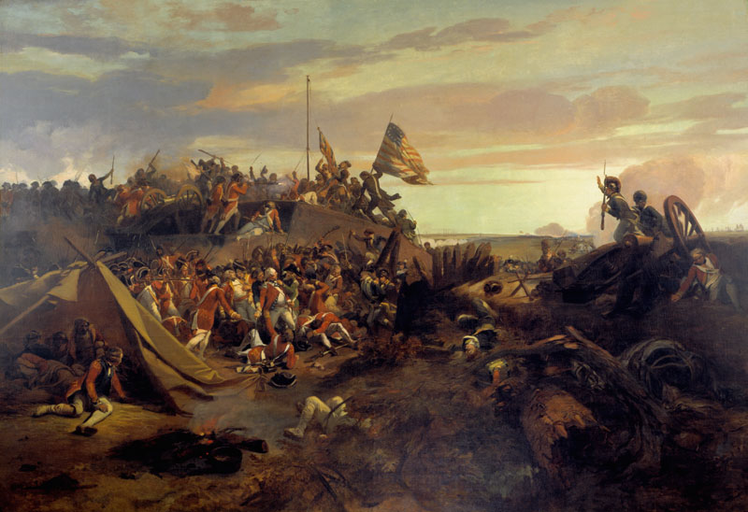
Yorktown
French defeat the British naval fleet
17,000 French and American troops attack around the clock
October 19, 1781- British General Charles Cornwallis surrenders
America has defeated the greatest military power in the world

Slide 17
Reasons Behind Victory
Americans’ motivation for fighting was stronger than Britain
Overconfident British generals made several mistakes
Time on Americans side
Fighting overseas, 3,000 miles away led tax-weary British citizens to call for peace
Louis XVI was eager to weaken France’s rival

Slide 18
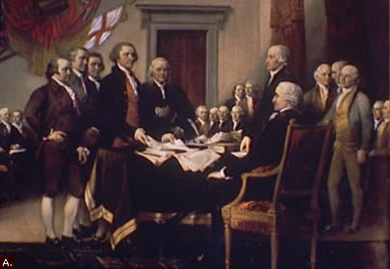
Establishing a Government
1781- Articles of Confederation
Republic- citizens rule through elected representatives
Weak national government
Each state had 1 vote in Congress
Problems emerge- too weak, no way to raise money, to hard to pass laws or regulate states

Slide 19
Constitutional Convention
55 delegates familiar with ideas of Locke, Montesquieu and Rousseau
Federal system- 3 separate branches with national, state and local governments
Checks and balances

Slide 20
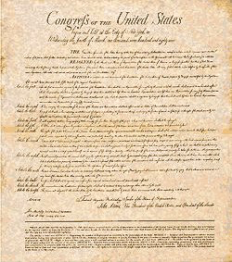
Bill of Rights
Federalists- supporters of the constitution
Antifederalists- opposed a strong central government
Bill of Rights- first 10 amendments
Added in 1791 to address disputes between the Federalists and Antifederalists
Many of the rights advocated by Voltaire, Rousseau and Locke

