Slide 1
The Columbian Exchange and Global Trade

Slide 2
Setting the Stage
The colonization of the Americas dramatically changed the world. It prompted both voluntary and forced migration of millions of people. It led to the establishment of new and powerful societies. Other effects of European settlement of the Americas were less noticeable but equally important. Colonization resulted in the exchange of new items that greatly influenced the lives of people throughout the world. The new wealth from the Americas resulted in new business and trade practices in Europe.

Slide 3
The Columbian Exchange
Global transfer of foods, plants and animals during the colonization of the Americas
Brought items Europeans had never seen before
Tomatoes, squash, pineapples, tobacco cacao beans, turkey
Impacts of corn and potatoes
European and Asian goods coming to America-
Horses, cattle, sheep, pigs, bananas, black-eyed peas, yams, wheat, rice, barley, oats

Slide 4
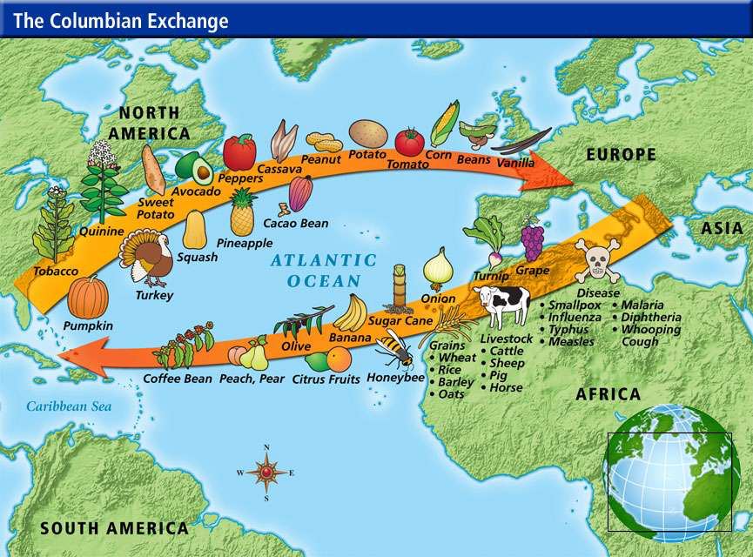

Slide 5
The Rise of Capitalism
Economic system based on private ownership and the chance at profit
Now not just governments or great lords controlled all the wealth
Business across Europe flourished
All the gold and silver coming over led to inflation in Europe

Slide 6
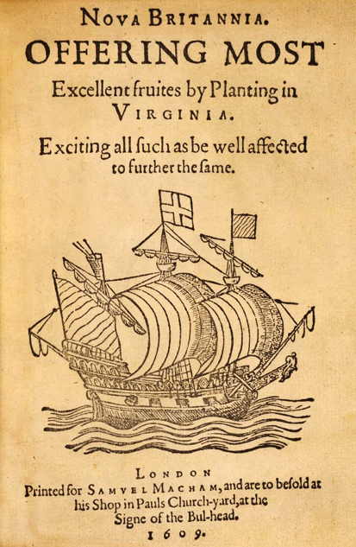
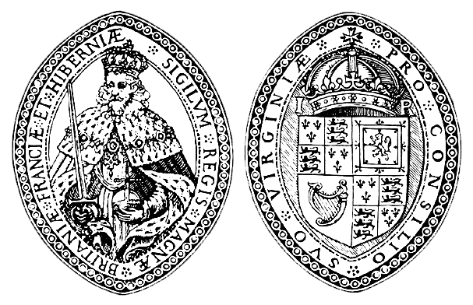
Joint-Stock Companies
Works like a modern-day corporation- investors buy shares of stock in a company
Involved a number of people combining their wealth for a common purpose
Colonization was expensive and a great risk
People combine money
If failed- investors lost only their small share
If succeeded- shared in the profits

Slide 7
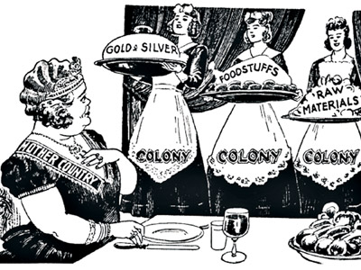
Mercantilism
A country’s power depends mainly on its wealth
Goal of every country became to obtain as much wealth as possible
Could increase wealth and power in 2 ways-
Obtain as much gold and silver as possible
Establish a favorable balance of trade- sell more goods than you buy
Ultimate goal is to be self-sufficient
Colonies provide vital goods that couldn’t be found in the home country

Slide 8
Economic Revolution
Spurred the growth of towns in Europe
Rise of merchants who controlled great wealth
More social mobility
Increased the wealth of European nations

