Slide 1
The Inca Create a Mountain Empire

Slide 2
Setting the Stage
While the Aztecs ruled in the Valley of Mexico, another people- the Inca- created an equally powerful state in South America. From Cuzco, their capital in southern Peru, the Inca spread outward in all directions. They brought various Andean peoples under their control and build an empire that stretched from Ecuador in the north to Chile in the south. It was the largest empire ever seen in the Americas.

Slide 3
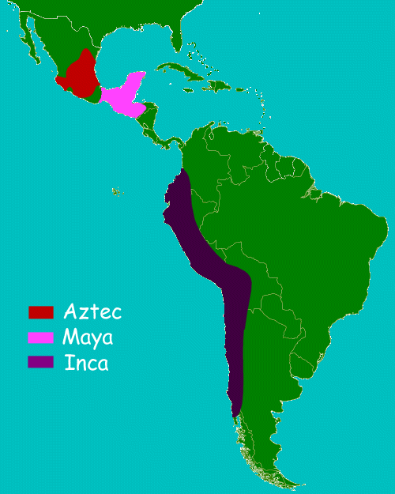
Incan Beginnings
Wanderers who settle on fertile lands in Valley of Cuzco
1200s- developed a kingdom in the Valley
Believe Incan ruler was descended from sun god, Inti
Only men from 1 of 11 noble lineages believed to be descendants of the sun god could be the Incan leader

Slide 4
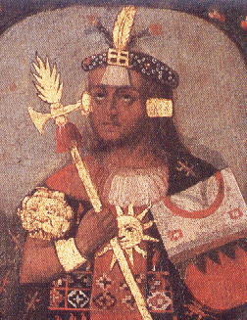
Pachacuti Builds an Empire
Takes over 1438
Conquered all of Peru, then moved for more
By 1500- rule over 2,500 miles
Called “Land of the Four Quarters”
Includes about 16 million people

Slide 5
Pachacuti Builds an Empire
Builds through diplomacy and military force
Have powerful military, but use only when necessary
Offered honorable surrender before attacking
Allow to keep customs and rulers in exchange for loyalty to Incan state

Slide 6
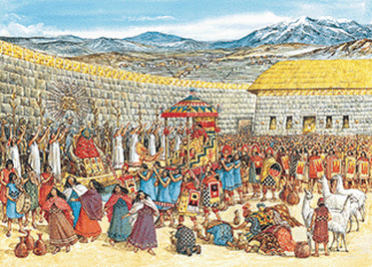
Incan Government Creates Unity
Divide territory into manageable units
Efficient economic system
Extensive road system
Single official language- Quechua
Found schools to teach Incan ways

Slide 7
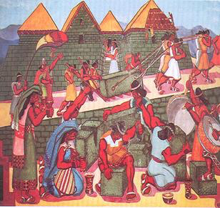
Incan Government Creates Unity
Regulate production and distribution of goods
Ayllu- extended family group, took on tasks too big for a single family
Build irrigation canals, cut agricultural terraces, store food to distribute during hard times

Slide 8
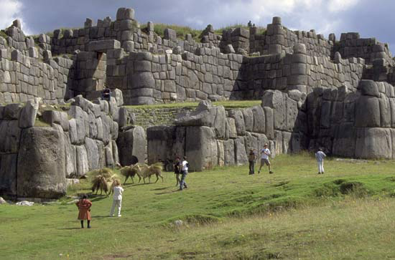
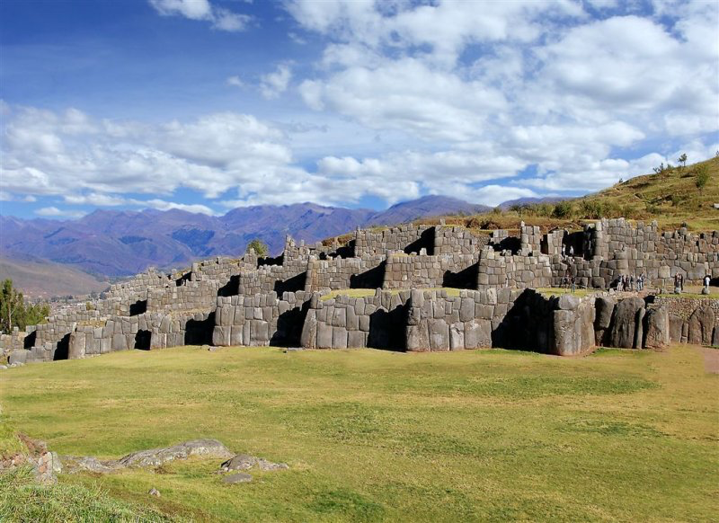
Cuzco
Capital of empire
Temples, plazas and palaces
Buildings built of solid stone
No iron tools, no wheel, no mortar
Fit huge blocks of stone perfectly together
Still standing today, survived the regions frequent earthquakes

Slide 9
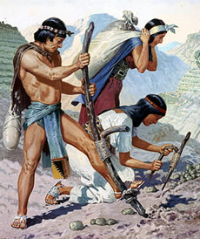
Ruling
Demand mita- labor tribute, requires all able-bodied citizens to work for the state a certain number of days every year
Work for state and are cared for in exchange
Made sure people didn’t go hungry in hard times

Slide 10
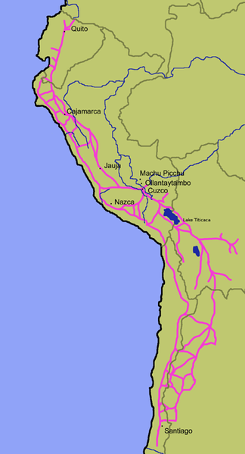
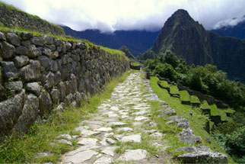
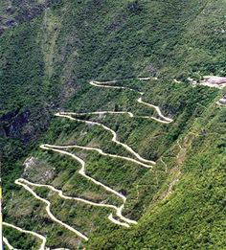
Public Works Projects
Road system
Symbolized power of Incans
14,000 mile long network cover mountains and deserts
Built guesthouses along roads for travelers to stay at
Chasquis- system of runners/messengers, like a postal service

Slide 11
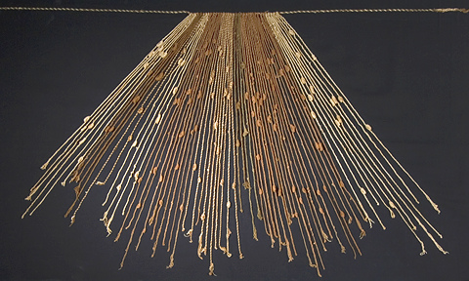
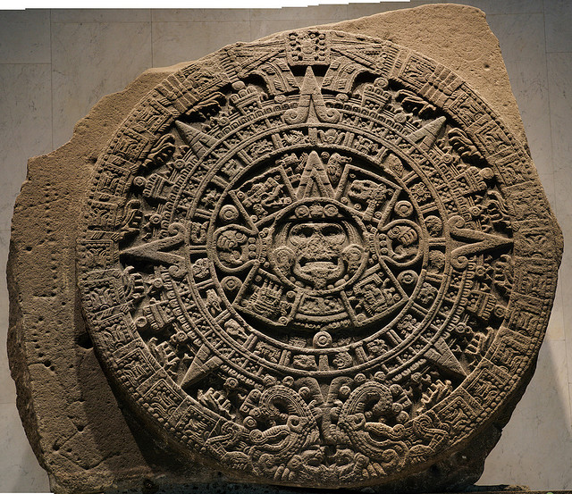
Record-Keeping
Never develop a writing system
Oral history was big
Quipu- set of knotted strings used to record data
Knots and position on string indicate number
Colors of string indicate category- red = warriors, yellow = gold, etc.
2 types of calendars
One for night, one for day

Slide 12
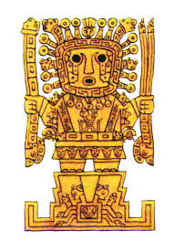
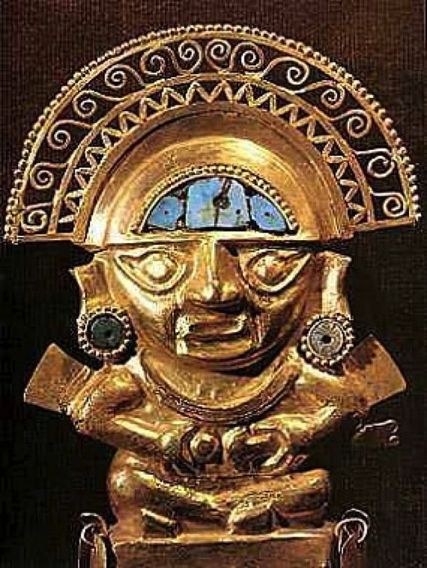
Religion
Fewer gods than Aztecs
Key nature spirits- moon, stars and thunder
Creator god- Viracocha
Sun god- Inti

Slide 13
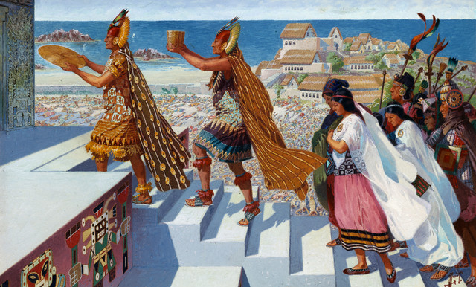
Religion
Led by priests
mamakuna- “virgins of the sun”, unmarried women drafted for a lifetime of religious service
Yamacuna- men, full-time workers for state
Sacrifice of llamas for gifts

Slide 14
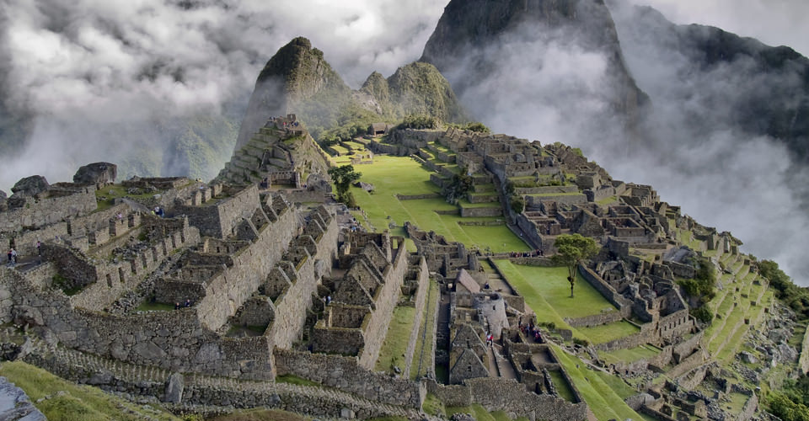
Great Cities
Cuzco- tons of gold (“sweat of the sun”)
Garden with plants and animals made entirely from gold and silver
Walls of buildings covered in gold sheeting
Machu Picchu- debate over use
Religious center
Estate of Pachacuti
Retreat for Incan nobility and rulers

Slide 15
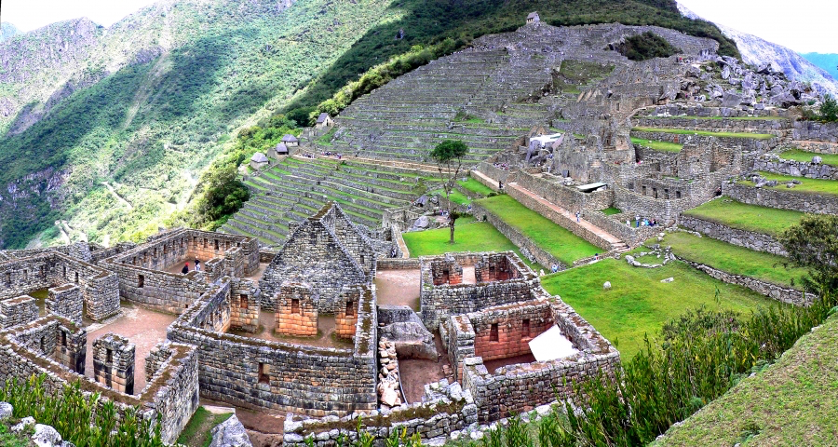
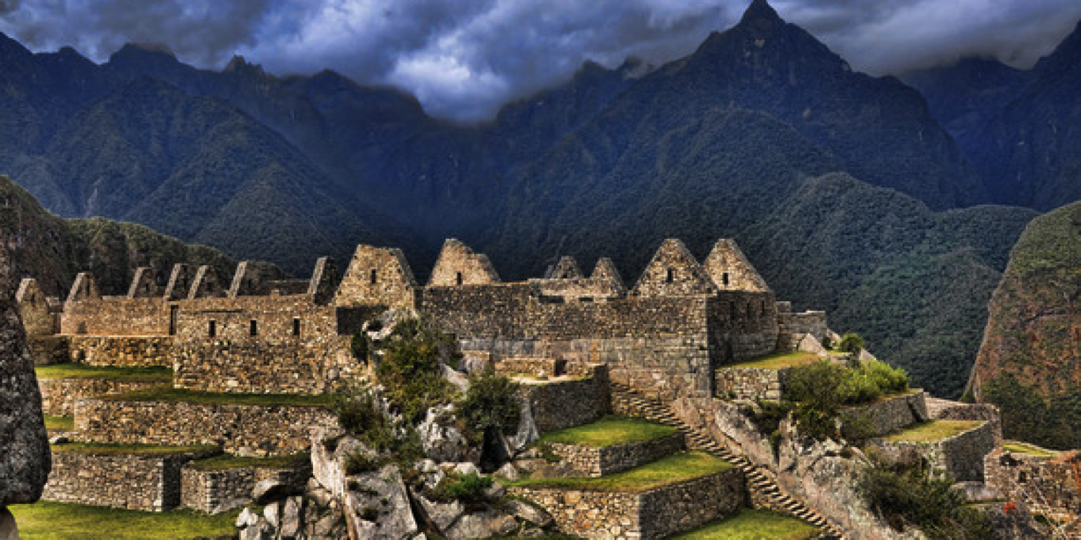
Machu Picchu

Slide 16
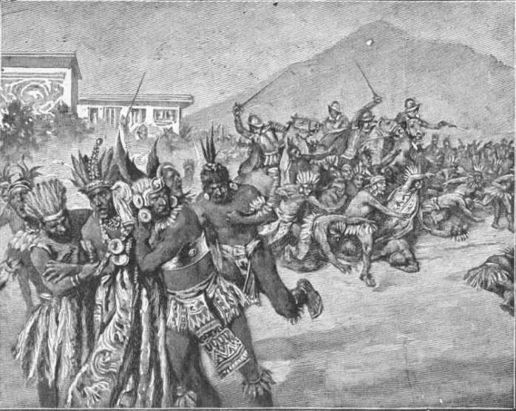
Discord in the Empire
1520s- Ruler Huayna Capac get gift box in Ecuador
Opens it and butterflies and moths fly out- bad omen
Weeks later he dies- probably smallpox
Empire is split between his sons
Atahualpa gets Ecuador (1/5th of empire)
Huascar gets the rest
Soon, Atahualpa claims to rule the whole empire
Civil war follows- Atahualpa wins, but empire is torn apart
Spanish arrive in the last days of this war and further divide the empire

