Slide 1
The Power of the Church

Slide 2
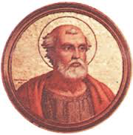
The Far-Reaching Authority of the Church
Pope Gelasius I-
Said two swords- pope held spiritual one, emperor held political one
Pope should bow to emperor in political matters, emperor should bow to the pope in religious ones
In reality, they competed for power

Slide 3
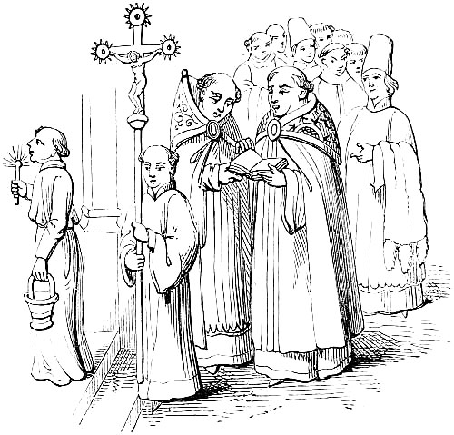
The Structure of the Church
Pope in Rome headed the Church
Clergy- religious officials including bishops and priests, fell under his authority
Bishops supervised priests

Slide 4
Religion as a Unifying Force
Feudalism divided people, but the Church brought people together
Was a stable force during an era of constant warfare

Slide 5
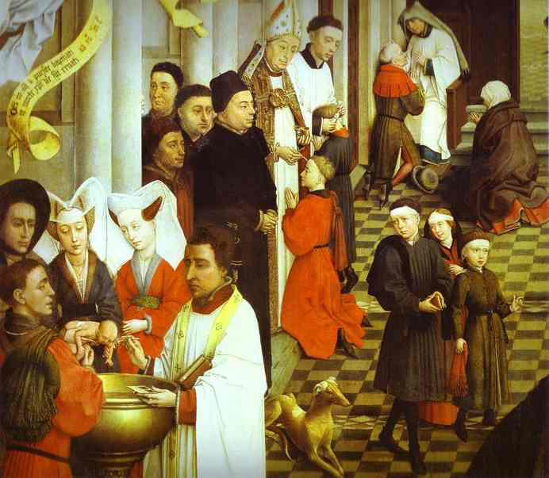
Sacraments
Important religious ceremonies administered by priests and other clergy
Paved the way for salvation
Example- baptism- allowed people to become part of the Christian community

Slide 6
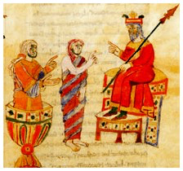
Church Law
Canon law- laws in marriage and religious practices
Established courts to try people accused of breaking canon law

Slide 7
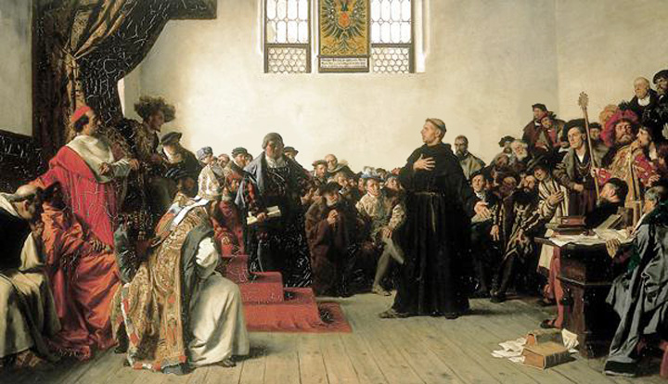
Punishments
Excommunication- banishment from the Church
Popes used this to keep political power- could excommunicate kings
Meant the king was denied salvation, freed the king’s vassals of any duty to him

Slide 8
Punishments
Interdict- many sacraments and religious services could not be performed in the king’s lands
The king’s people believed without these sacraments and services they would be doomed to hell

Slide 9
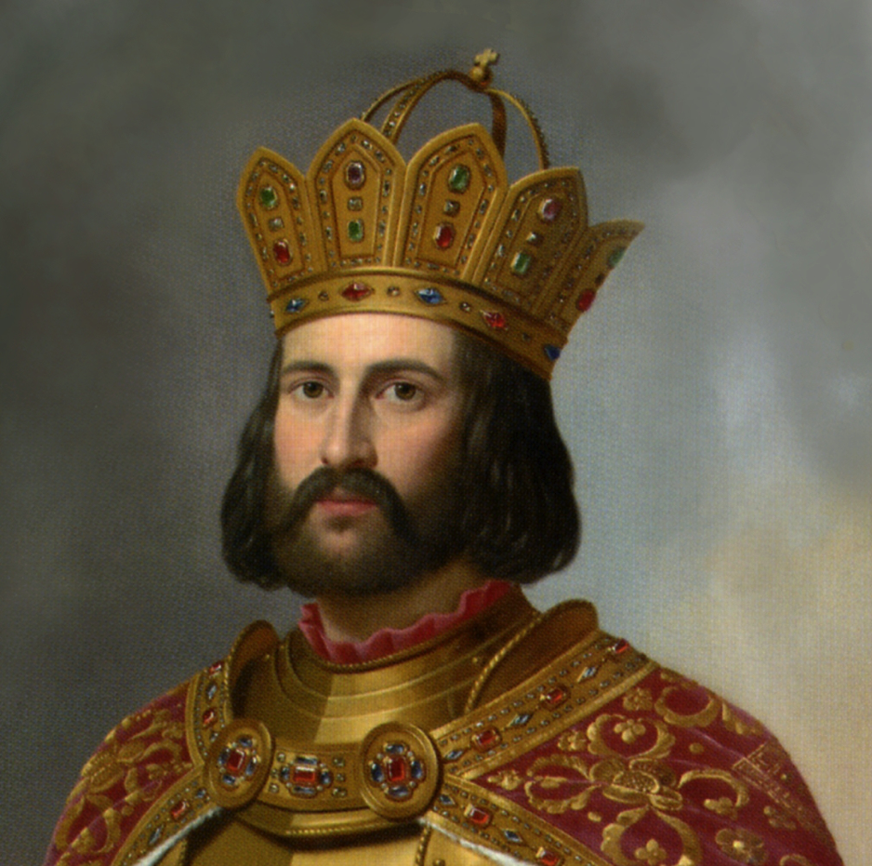
The Church and the Holy Roman Empire
Developed by Otto I, or Otto the Great
King of Germany in 936
Limited nobles, allied himself with clergy
Invaded Italy on the pope’s behalf- in 962 the pope crowns Otto as emperor

Slide 10
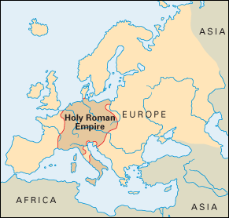
Holy Roman Empire
Strongest state in Europe until 1100
Otto tries to revive Charlemagne’s empire- caused trouble
Popes and nobles resent German’s power over Italy

Slide 11
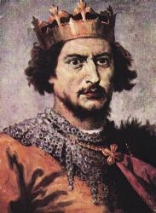
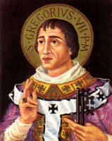
Clashes
Battle over lay investiture- power to appoint church officials
German emperor Henry IV claims he has that power, but Pope Gregory VII banned lay investiture
Henry orders the pope to step down
The pope excommunicated Henry

Slide 12
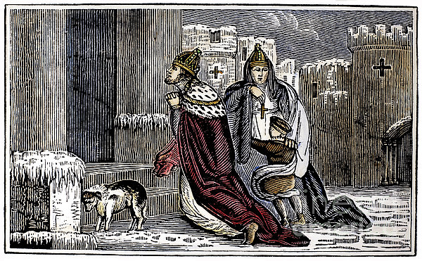
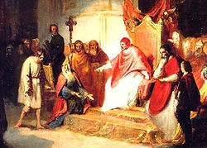
Showdown at Canossa
Henry crossed the snowy Alps to the castle at Canossa
Begs outside the gates for 3 days
The pope ends the excommunication- Henry runs home to punish rebellious nobles

Slide 13
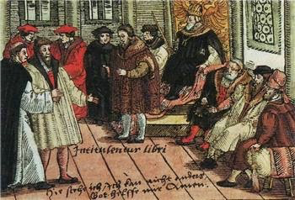
Concordat of Worms
Continued battle over lay investiture until 1122
Representatives meet in German city of Worms
Concordat of Worms- church appointed bishops, but emperors could veto

Slide 14
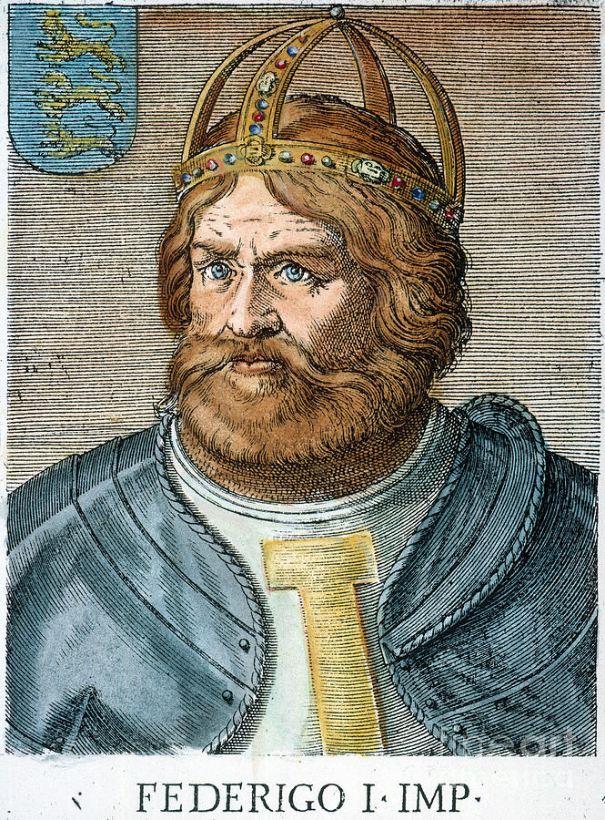
Disorder in the Empire
Frederick I takes over
Raids rich Italian cities
Lombard League- alliance of Italian merchants and the pope

Slide 15
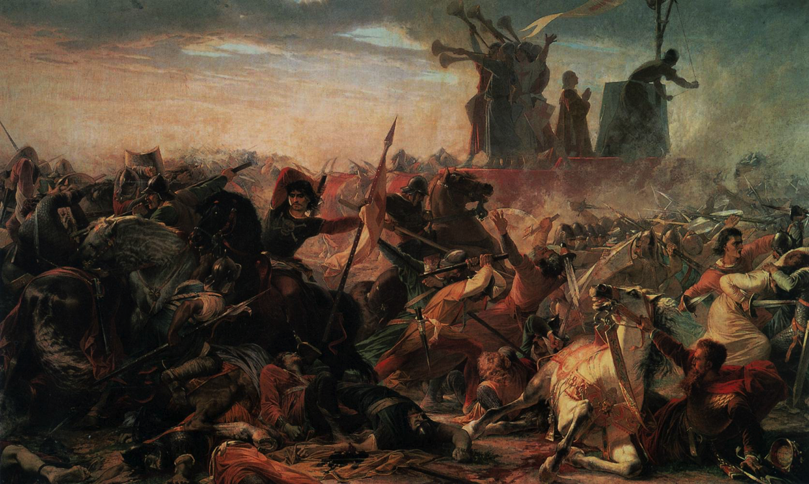
Disorder in the Empire
Battle of Legnano- the Lombard League against Frederick’s army
Lombard League used crossbows to defeat the knights
Frederick returned home, but his empire crumbled

