Slide 1
Kingdoms of Southeast Asia and Korea

Slide 2
Setting the Stage
To the south of China lies the region called Southeast Asia. It includes the modern countries of Myanmar (Burma), Laos, Cambodia, Vietnam, Malaysia, Indonesia, Thailand, Singapore, Brunei and the Philippines. Thousands of miles from this region, to China’s northeast, lies the Korean peninsula. This peninsula is currently divided between North Korea and South Korea. In the shadow of powerful China, many small but prosperous kingdoms rose and fell in Southeast Asia and Korea.

Slide 3
Geography of Southeast Asia
Between Indian and Pacific oceans
From Asia almost to Australia
2 main parts-
Indochina- mainland peninsula that borders China to north and India to west
The islands
In the warm, humid tropics
Many different cultures settle in the region
Key to power is control of trade routes and harbors

Slide 4
Influence of India and China
India-
Indian trade ships come in first century
Hindu and Buddhist missionaries come
Indian influence shapes politics and religion
China-
Ideas spread through migration and trade
Exert political influence over area with direct rule or demand tribute

Slide 5
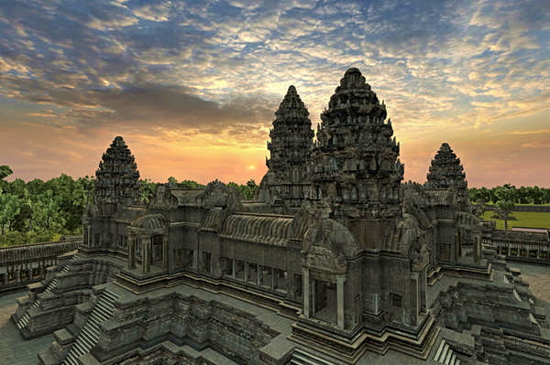
The Khmer Empire
What is now Cambodia
800s- create an empire by conquering neighboring kingdoms
Build irrigation systems, waterways and improve rice cultivation- grow 3 to 4 crops of rice a year
Capital- Angkor- build city-temple complexes
Angkor Wat- one of world’s greatest architectural achievements
Dedicated to Hindu god Vishnu and used as observatory

Slide 6
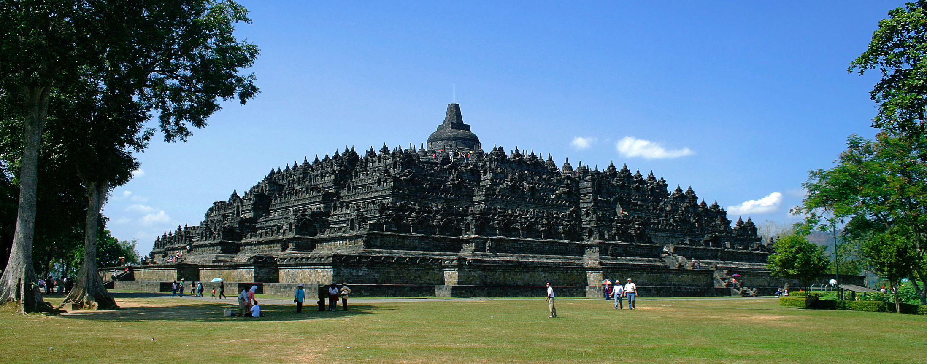
Island Trading Kingdoms
Sailendra- agricultural kingdom on Java
Build Buddhist temple at Borobudur around 800- another of world’s greatest architectural achievements
9 terraced levels like stepped pyramid

Slide 7
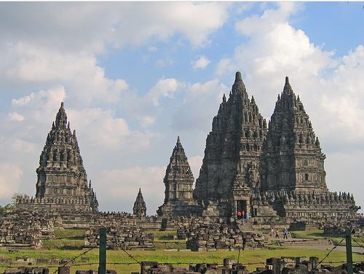
Island Trading Kingdoms
Srivijaya- control Strait of Malacca and waters around Sumatra, Borneo and Java
Great wealth- tax the trade in these waters
Capital of Palembang becomes a center of Buddhist learning
Chinese Monks could study instead of traveling to India

Slide 8
Island Trading Kingdoms
Dai Viet- currently Vietnam
Absorb many Chinese cultural aspects
Buddhism and ideas on government
Also keep spirit of independence and keep aspects of own culture
Women have more freedom and influence than Chinese women

Slide 9
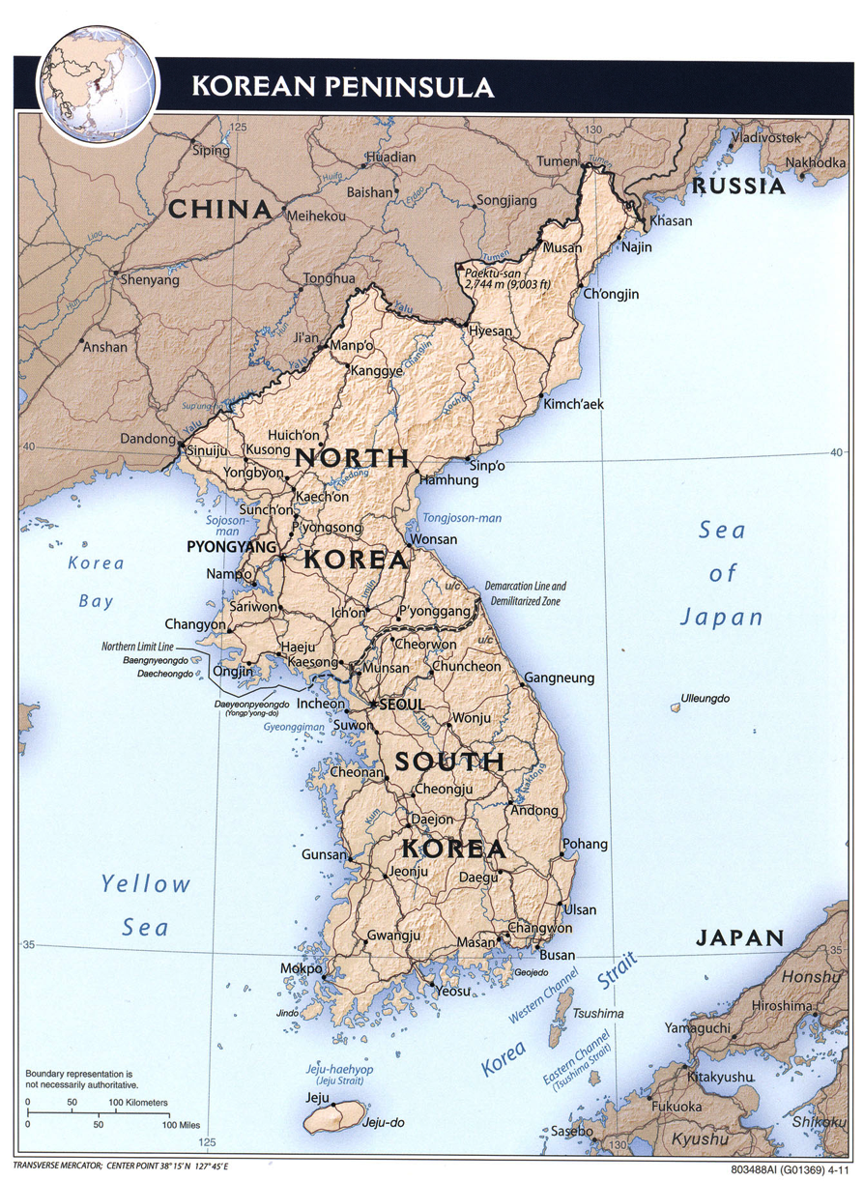
Korean Dynasties
Located on peninsula close to Japan
Hot in summer, very cold in winter
Mountainous land
Somewhat isolated due to mountainous region blocking northern neighbor Manchuria and seas

Slide 10
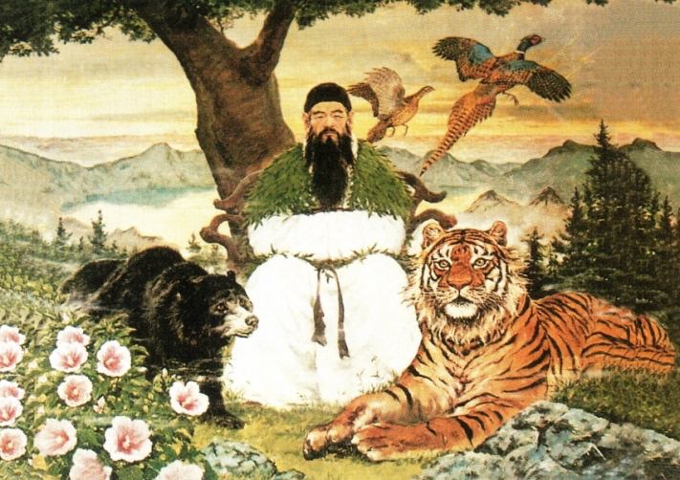
Korean Dynasties
Legend says founded by Tan’gun
Father was a god, mother was a bear
Another legend says founded by royal descendants of Chinese Shang Dynasty
Shows 2 sides of Korean culture
Distinct people with own native traditions
Culture shaped by Chinese from early times

Slide 11
Early Korea
Different clans controlled different sections of the country
Chinese Han Empire controls much of country in 100s
Ideas of centralized government, Confucianism, Buddhism and writing
Koreans form 3 rival kingdoms during this time

Slide 12
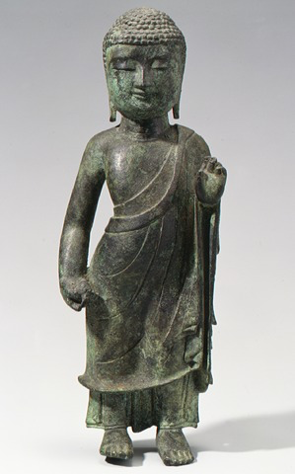
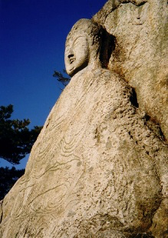
Early Korea
600s- one of the kingdoms, the Silla, take power
Build Buddhist monasteries, make stone and bronze sculptures, develop writing system

Slide 13
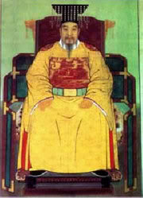
The Koryu Dynasty
935- rebel officer Wang Kon takes control and becomes king
Koryu Dynasty lasts from 935-1392
Models government after China’s
Make civil service system- doesn’t work- sharply divided classes

Slide 14
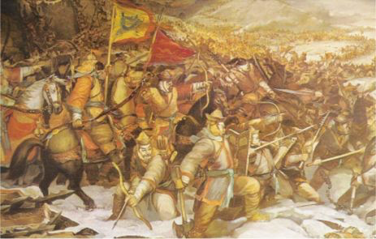
The Koryu Dynasty
Taken over by Mongols in 1231
Demand 20,000 horses, clothing for 1 million soldiers, take many children and artisans as slaves
Occupy Korea until 1360s when Mongol Empire collapses

Slide 15
The Koryu Dynasty
Overthrown in 1392 by military leaders
Establish Choson, or Yi, Dynasty
Rules for 518 years

Slide 16
Koryu Culture
Produced great achievements
Celadon pottery- famous for milky green glaze
Thousands of wooden blocks for printing all the Buddhist scriptures
Destroyed by Mongols- sparks national effort to recreate them
Make more than 80,000 blocks in the new set- still exist today

