Slide 1
Parliament Limits the English Monarchy

Slide 2
Setting the Stage
During her reign, Queen Elizabeth I of England had frequent conflicts with Parliament. Many of the arguments were over money, because the treasury did not have enough funds to pay the queen’s expenses. By the time Elizabeth died in 1603, she had left a huge debt for her successor to deal with. Parliament’s financial power was one obstacle to English rulers’ becoming absolute monarchs. The resulting struggle between Parliament and the monarchy would have serious consequences for England.

Slide 3
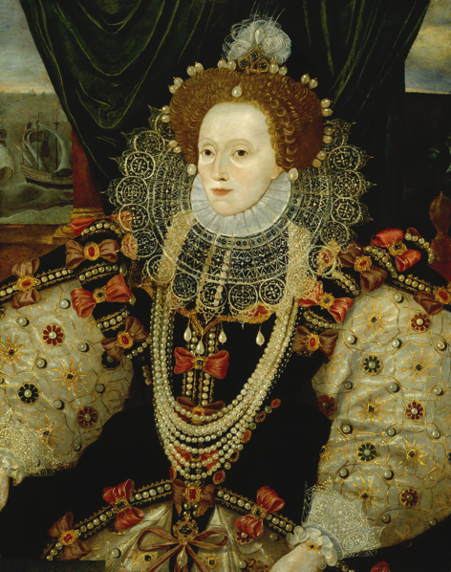
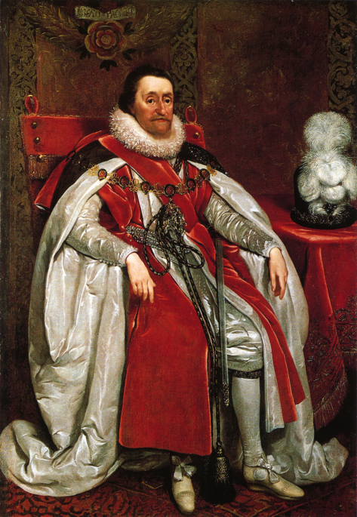
Monarchs Defy Parliament
Elizabeth had no child- cousin James Stuart (king of Scotland) takes over as king of England
Struggles with Parliament over money
Offends Puritan members of Parliament by not changing Catholic practices in the English Church

Slide 4
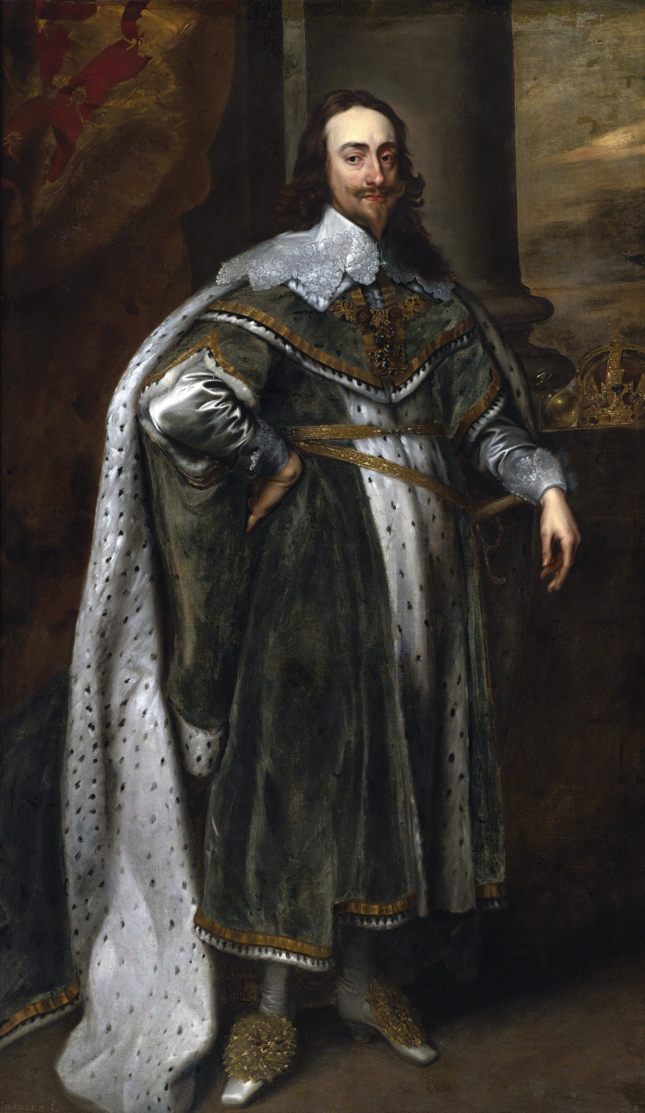
Monarchs Defy Parliament
1625- James dies and his son Charles I takes over
Charles always needed money
At war with Spain and France
1628- asks Parliament for money
They refuse until he signs the Petition of Right

Slide 5
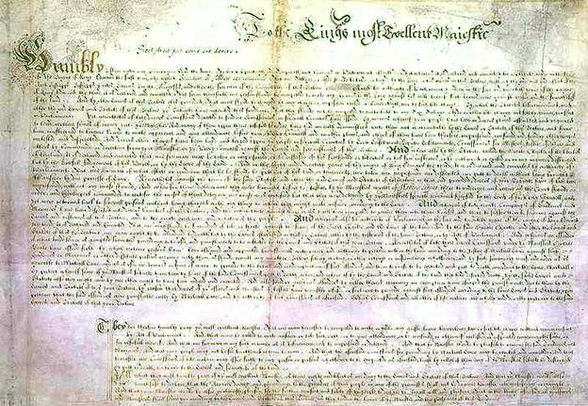
The Petition of Right
Said the King would not-
Imprison subjects without due cause
Levy taxes without Parliament’s consent
House soldiers in private homes
Impose martial law in peacetime
Charles signs it, but ignores it and dismisses Parliament
Still important- Contradicted idea of absolute monarchy

Slide 6
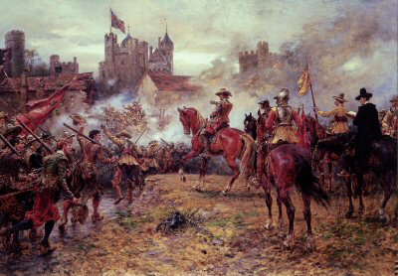
English Civil War
Charles wants both Scotland and England to follow Catholicism
Scotland rebels
Charles needs money to address the situation and is forced to call Parliament back into session

Slide 7
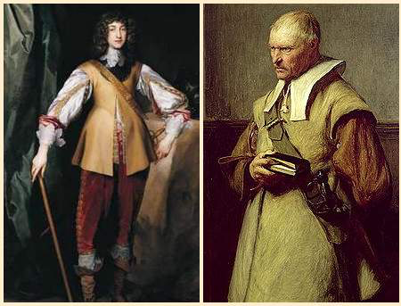
English Civil War
1641- Parliament passes laws limiting royal power
Charles tries to arrest Parliament’s leaders, but they escape
Londoners gather outside the palace
Charles flees to northern England and establishes an army
1642-1649- Civil War between the Cavaliers and the Roundheads

Slide 8
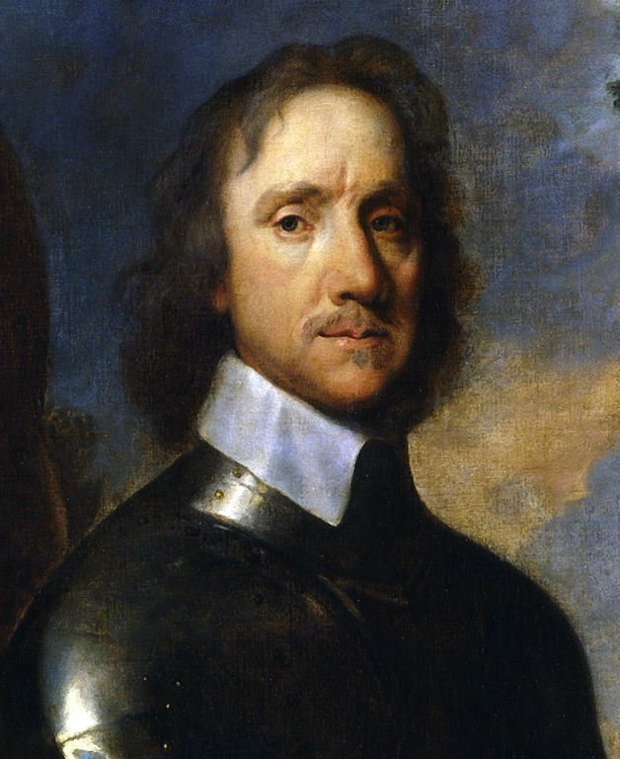
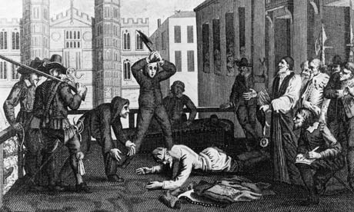
English Civil War
Puritan General Oliver Cromwell leads troops and captures the king
Charles is put on trial for treason against Parliament
Executed shortly after
1st time a king had been publicly put on trial and executed

Slide 9
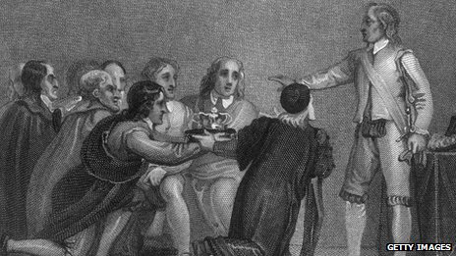
Cromwell’s Rule
Abolishes the monarchy and House of Lords
Establishes a republican form of government
Writes a constitution, but Cromwell eventually tears it up and becomes a military dictator

Slide 10
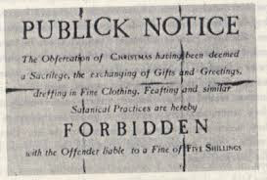
Cromwell’s Rule
Faces uprisings in Ireland
Takes troops to crush the rebellion
Gives Irish land and homes to the English soldiers
Seeks to reform society with the Puritans
Abolished activities they saw as sinful (theater, sporting events and dancing)
Favored religious toleration of all Christians except Catholics

Slide 11
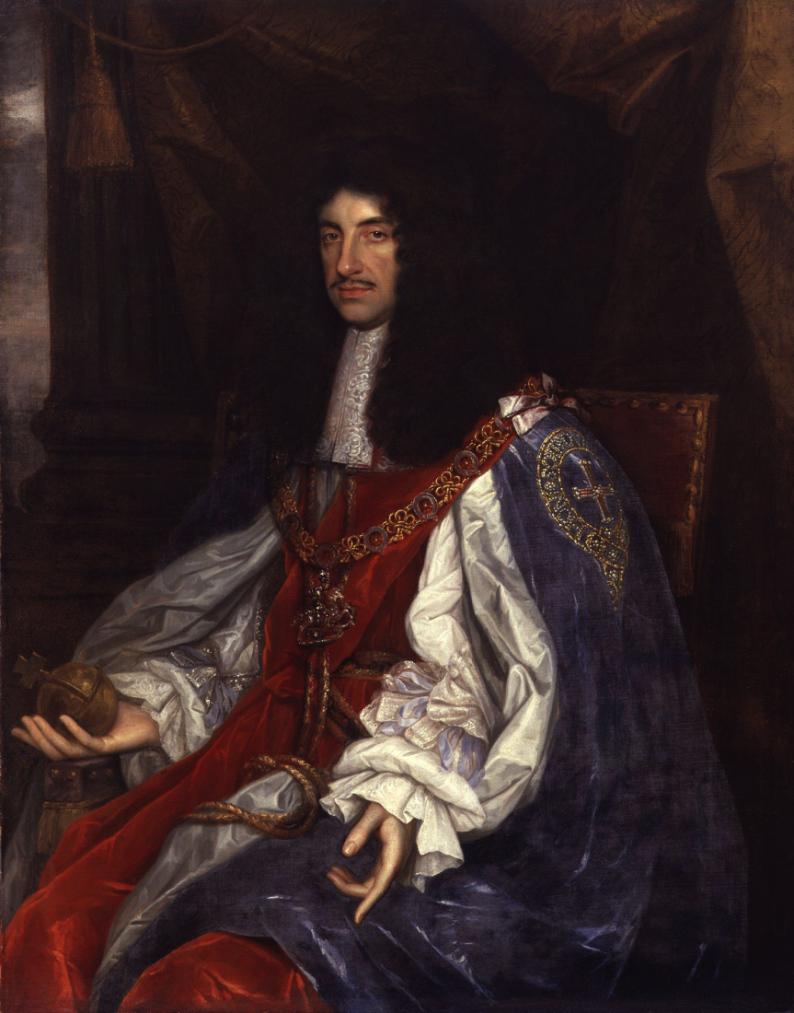
Charles II Takes Over
1658- Cromwell dies and his government collapses
Parliament meets and votes to have Charles I’s son take over

Slide 12
Charles II’s Rule
The Restoration- Charles II’s period of rule because he restored the monarchy
Passed habeas corpus-
Prisoners had to be taken before a judge to tell them their charges
The judged decided if they would be tried or set free
A king couldn’t jail someone just for opposing them

Slide 13
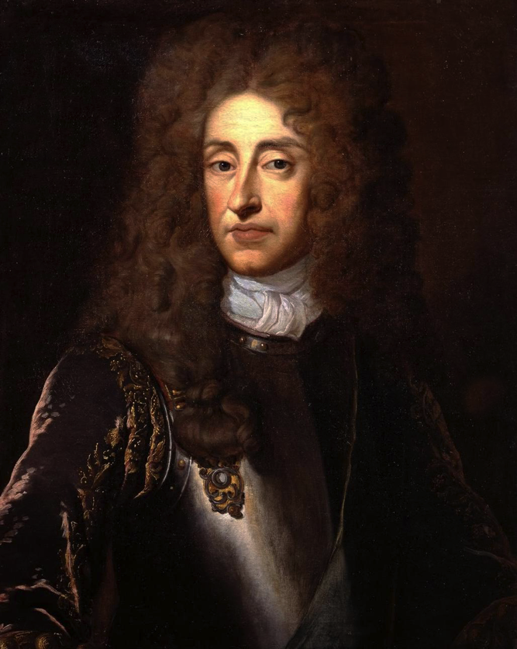
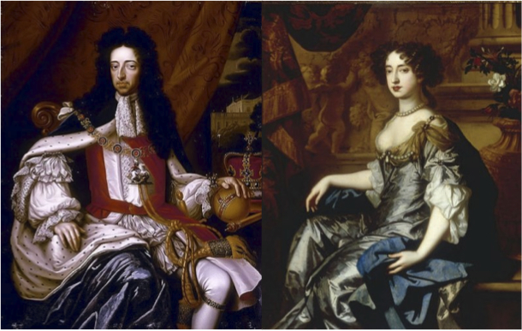
James II Takes Over
1685- Charles dies, and with no heirs, his brother James takes over
Appoints several Catholics to high office
Parliament objects, so he dissolves it
1688- James has a boy
Protestants terrified at the idea of a line of Catholic kings
James also has a daughter, Mary, who was married to William of Orange (prince of the Netherlands)

Slide 14
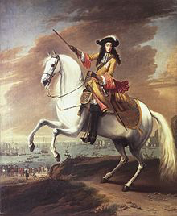
The Glorious Revolution
Members of Parliament ask William and Mary to overthrow King James
William leads an army to London
James fled to France without any blood being shed

Slide 15
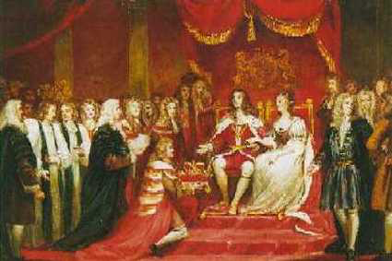
Limits on Monarch’s Power
William and Mary recognize Parliament as their partner in governing
England becomes a constitutional monarchy- laws limit the rulers power

Slide 16
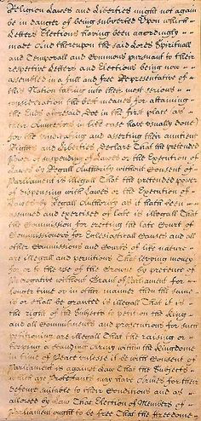
Limits on Monarch’s Power
Bill of Rights
No suspending of Parliament’s laws
No levying taxes without a specific grant from Parliament
No interfering with freedom of speech in Parliament
No penalty for a citizen who petitions the king about grievances

Slide 17
The Cabinet System Develops
No British monarch could rule without consent of Parliament
Parliament couldn’t rule without consent of the monarch
If the 2 disagreed, government came to a standstill
The Cabinet- government ministers, or officials who acted in the ruler’s name but in reality represent the major party of Parliament
Leader of majority party heads the cabinet and is called the Prime Minister

