Slide 1
The Hundred Years’ War and the Plague

Slide 2
Setting the Stage
The 1300s were filled with disasters, both natural and human-made. The Church seemed to be thriving but soon would face a huge division. A deadly epidemic claimed millions of lives. So many people died in the epidemic that the structure of the economy changed. Claims to thrones in France and England led to wars in those lands. The wars would result in changes in the governments of both France and England. By the end of the century, the medieval way of life was beginning to disappear.

Slide 3
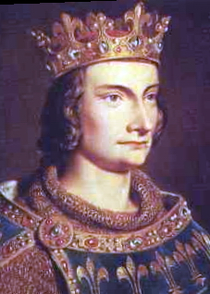
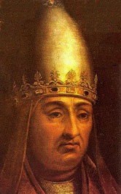
A Church Divided
1300- Pope Boniface VIII battles with King Philip IV
The king had the pope held prisoner and planned to put him on trial
The elderly pope was rescued, but died a month later

Slide 4
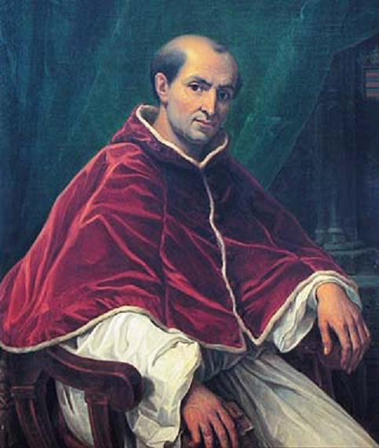
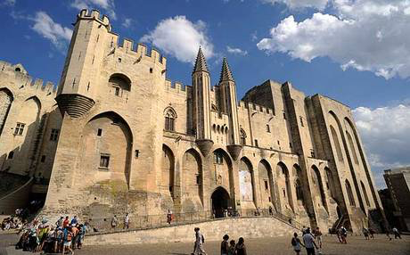
A Church Divided
Philip IV persuaded the College of Cardinals to choose a French archbishop as the new pope
Clement V moved from Rome to Avignon in France

Slide 5
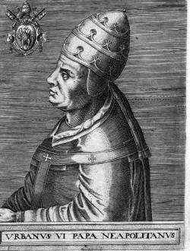
The Great Schism
1378- Cardinals gather to elect new pope
Crowds outside chant for an Italian pope to be chosen
They select Urban VI, who was Italian- arrogant and pushed for reform
Many regret their decision

Slide 6
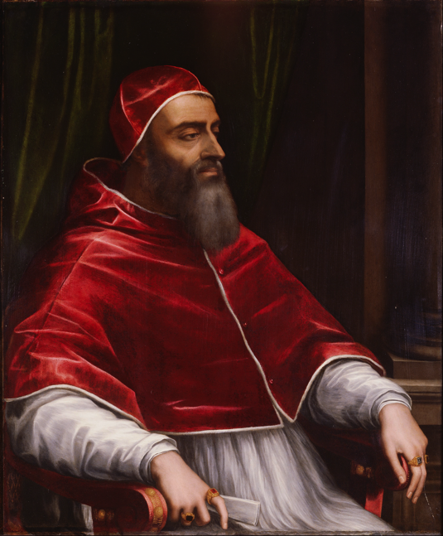
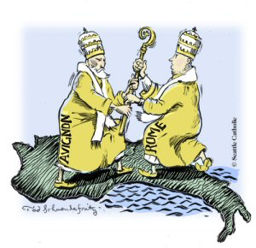
The Great Schism
A few months later, they elect a second pope- Clement VII
Clement VII lived in Avignon, Urban VI lived in Rome
Both popes claimed to be the legitimate pope and excommunicated the other
Led to a split of the Church, known as the Great Schism
Stayed split until 1417, when Martin V takes over as pope

Slide 7
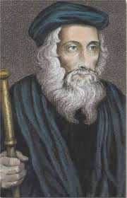
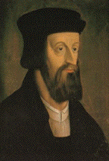
Scholars Question the Church
John Wycliffe- preached Jesus was the head of the Church, not the pope
Jan Hus- taught that the authority of the Bible was higher than the pope
Was excommunicated, later tried and burned at the stake in 1415

Slide 8
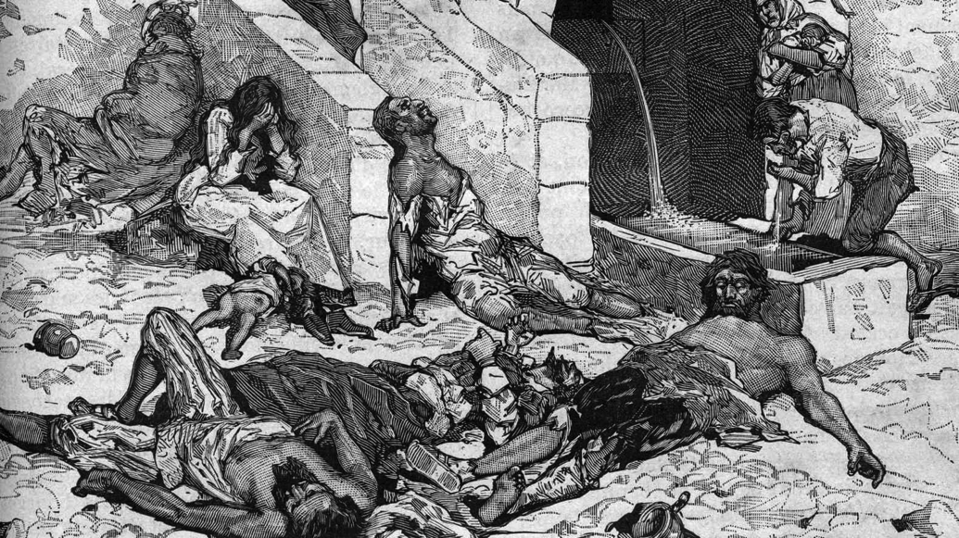
The Bubonic Plague Strikes
1300s- 1/3 of Europe died from the plague
Ripped apart communities- everyone separated
The Bubonic Plague-
Began in Asia
Also known as the Black Death
Produced purplish or blackish spots on the skin
Traveled along trade routes
Killed about 25 million Europeans

Slide 9
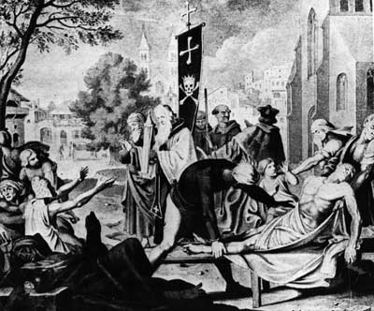
Effects of the Plague
Town populations fell
Trade declined, prices rose
Manor system crumbled
Peasants revolted in England, France, Italy and Belgium
Jews were blamed for bringing on the plague
The Church lost its prestige when prayers failed to stop the outbreak

Slide 10
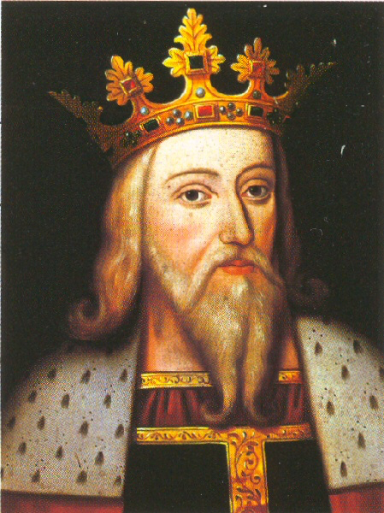
The Hundred Years’ War
From 1337-1453
Started when the last Capetian king died and England’s Edward III, being Philip IV’s grandson, claimed the throne
Back and forth war, until France finally forced England out in 1453

Slide 11
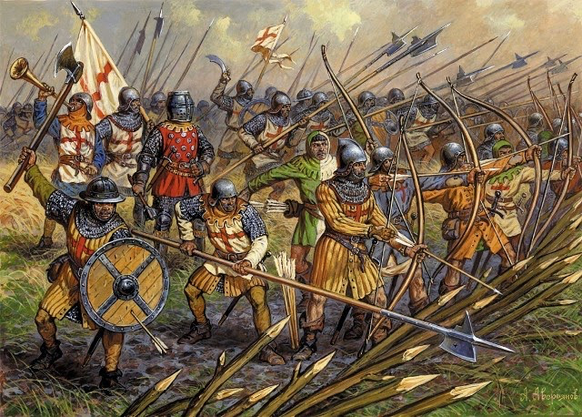
The Hundred Years’ War
New warfare develops- the longbow
Introduced by the English
Battle of Crecy- English outnumbered 3:1, but launch thousands of arrows at the French as they attack
Kill over a 1/3 of the French troops
Eventually the knight becomes extinct as new warfare methods overtake them

Slide 12
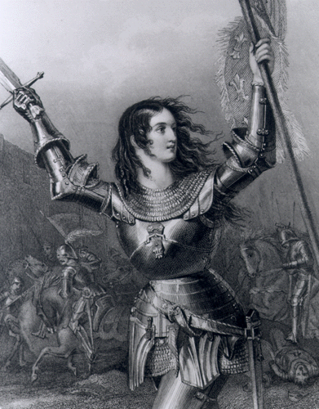
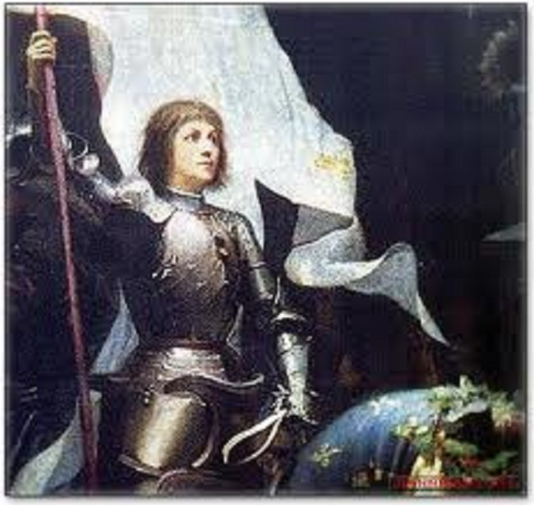
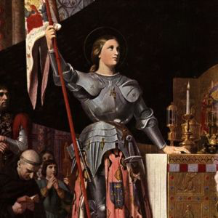
Joan of Arc
Had visions to push English conquerors back and return the French crown to Charles VII, son of Charles VI

Slide 13
Joan of Arc
Leads troops in storming Orleans- pushed back, but in retreat, Joan suddenly turns and attacks again- French troops follow and win

Slide 14
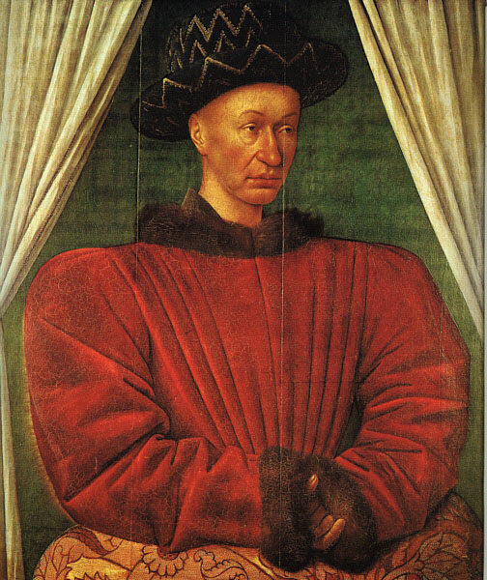
Joan of Arc
Persuades Charles to go with her to Reims, where he was crowned king in 1429

Slide 15
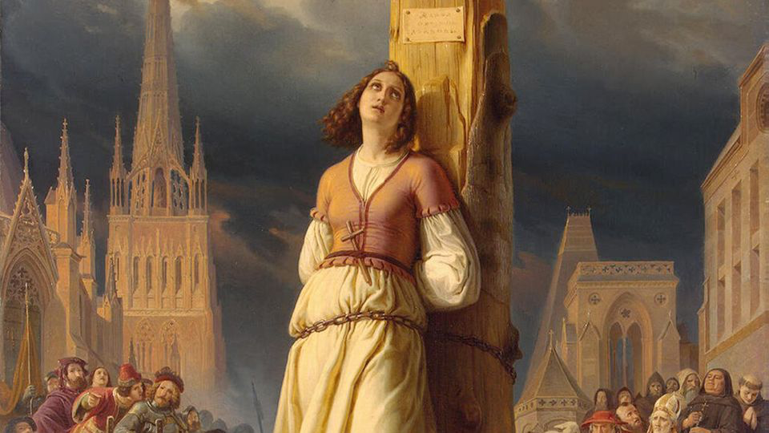
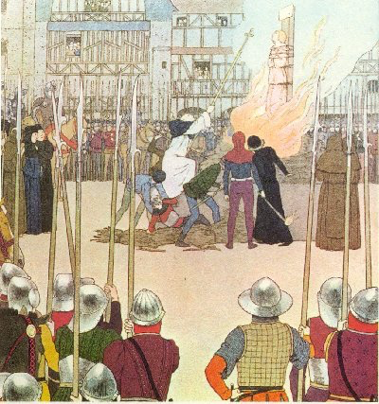
Joan of Arc
1430- she is captured and handed over to the Church for trial
Charles does nothing to try to rescue or save her
Condemned as a witch and heretic- burned at the stake in 1431

Slide 16
Impact of the Hundred Years’ War
People saw the king as a national leader, fighting for the glory of the country, not just a feudal lord
Power of the French monarch increased
England had internal turmoil, known as the War of the Roses, where two noble powers fought over the throne
Some say the end of the war marks the end of the Middle Ages- the age of the Church and the age of Chivalry slowly died

