Slide 1
World Religions and Ethical Systems

Slide 2
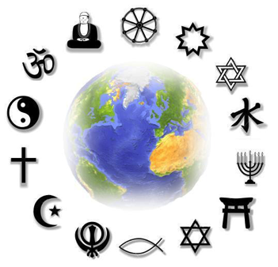
Global View
Religion- organized system of beliefs, ceremonies, practices and worship that centers around one or more gods
Has had significant impact on world history
Guided beliefs and actions of millions around the globe
Brought people together and torn them apart
Effects what people wear and how they behave
Thousands of religions in the world

Slide 3
Global View

Slide 4
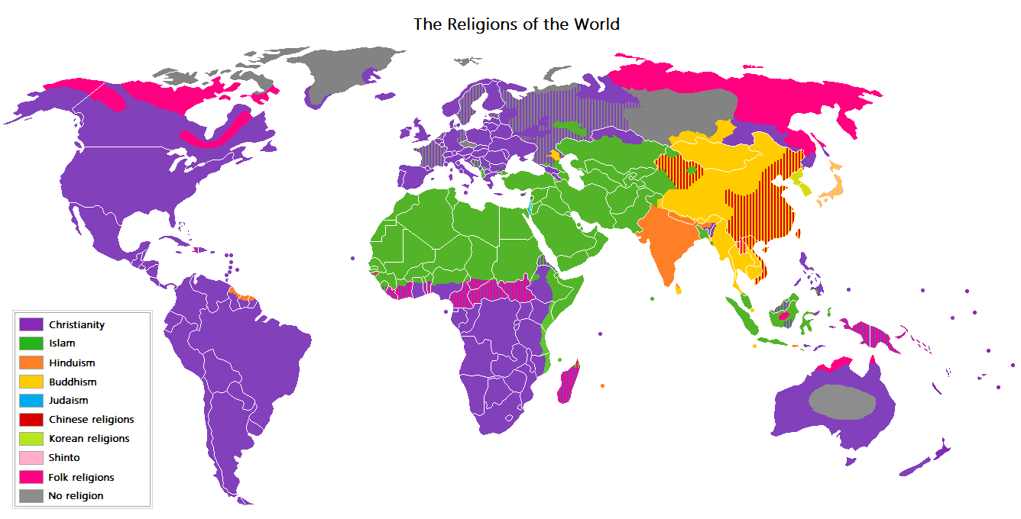
Religions by Region

Slide 5
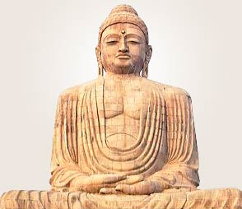
Buddhism
Influenced Asian religion, society and culture for over 2,500 years
Today, most live in Sri Lanka, east and Southeast Asia, and Japan
Several sects- group within religion that distinguishes itself by one or more unique beliefs

Slide 6
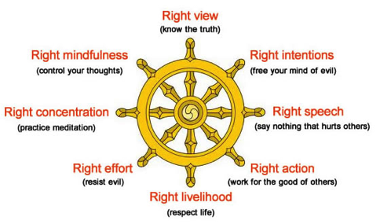
Buddhism
United in belief in Buddha’s teachings
Known as Dharma
Teaching symbolized by a wheel
Key to happiness is detachment from all worldly goods and desires
Achieved by following the Noble Eightfold Path, or the Middle Way, a life between earthly desires and extreme forms of self-denial

Slide 7
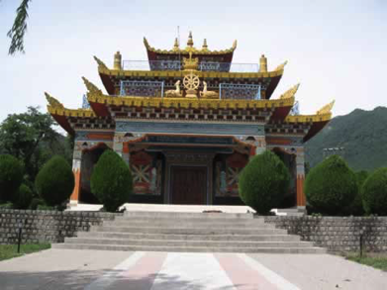
Buddhism
Worship practices-
Statues of Buddha appear in shrines
Strive to follow Buddha’s teachings
Meditation- form of religious contemplation
Make offerings at shrines, temples and monasteries

Slide 8
Buddhism
Worship practices-
Believe in rebirth- all living beings are reborn after death and continue to exist
All living beings possess potential for spiritual growth and possibility of rebirth as humans

Slide 9
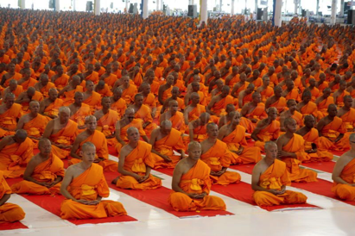
Buddhism
Leadership-
Buddhist monks and nuns- those who dedicated their entire life to the teachings of Buddha
Expected to live a life of poverty, mediation and study
Learn humility by begging for food and money

Slide 10
Buddhism
Major Sects-
Theravada
Mahayana
Mantrayana
The Three Cardinal Faults
Greed
Hatred
Delusion

Slide 11
Buddhism
Dhammapada (Verses of Righteousness)- one of most well-known Buddhist scriptures
Collection of sayings on Buddhist practices
Dhammapada (avoid envying others):
“Let him not despise what he has received, nor should he live envying the gains of others. The disciple who envies the gains of others does not attain concentration” Dhammapada 365

Slide 12
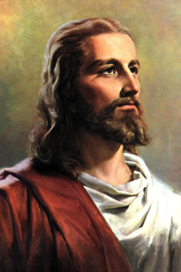
Christianity
Largest religion in world- 2 billion followers
Based on life and teachings of Jesus
Most are members of 1 of 3 major groups-
Roman Catholics, Protestants or Eastern Orthodox
Existence of only 1 God- Jesus is the son of God
Jesus entered world and died to save humanity from sin
Crucifixion of Jesus represents Jesus’ love for humanity by dying for its sins
Reach salvation by following the teachings of Jesus Christ

Slide 13
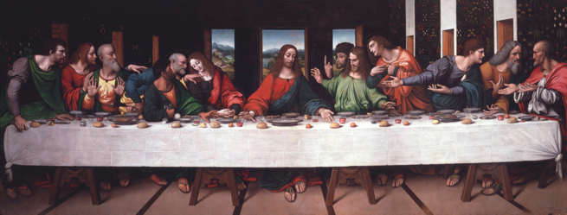
Christianity
Worship practices-
Worship as group
Services include praying, singing and sermon
Some services include baptism
Some include communion- bread and wine consumed in remembrance of Jesus’ death- celebrates last meal Jesus took with his disciples

Slide 14
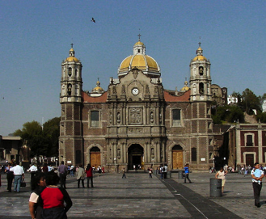
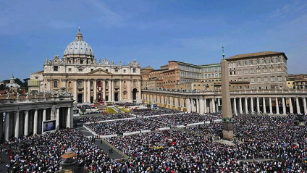
Christianity
Ritual-
Each year, hundreds of thousands visit Basilica of Guadalupe in northern Mexico City
Considered holiest place in Mexico
Site where Virgin Mary is said to have appeared twice in 1531
Hundreds of thousands visit the Vatican in Rome, Italy
Home of the pope
Celebration of religious holidays

Slide 15
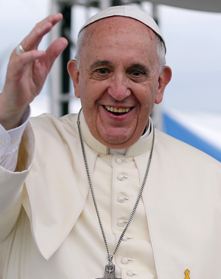
Christianity
Leadership-
Catholic church has the pope
In some churches, services leader is called priest
Others called ministers and clergy
Conduct worship services and preside over marriages and funerals
Monks and nuns also provide leadership

Slide 16
Christianity
Major sects-
Roman Catholic
Eastern Orthodox
Protestant-
Baptist, Methodist, Lutheran, Episcopal, Mormon, Presbyterian, Church of God, Pentecostal, etc.
In U.S. alone- over 30 Protestant denominations with over 400,000 members each

Slide 17
Christianity
The Bible
Most sacred book of Christian religion
Two major parts-
Old Testament- focuses on Jewish history
New Testament- describes teachings of Jesus Christ
New Testament:
“‘Men, what must I do to be saved?’ And they said, ‘Believe in the Lord Jesus, and you will be saved, you and your household’” Acts 16:30-31

Slide 18
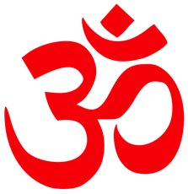
Hinduism
One of oldest surviving religions
India, Indonesia, parts of Africa, Europe and the Western Hemisphere
Collection of religious beliefs developed over thousands of years
Reach true enlightenment and happiness only after freeing themselves from earthly desires
Achieve through worship, attainment of knowledge and lifetime of virtuous acts
“Om” or “Aum” is most sacred syllable and often used in prayers

Slide 19
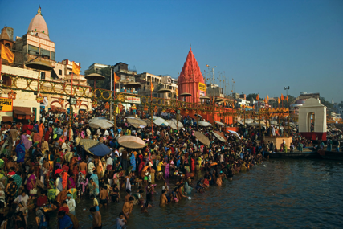
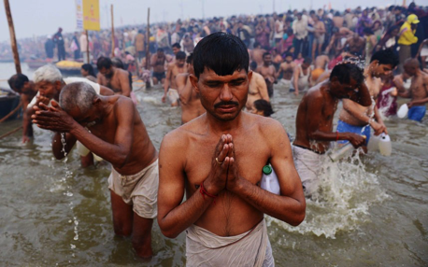
Hinduism
Worship, ritual and celebration-
Thousands make pilgrimage to India’s Ganges River
Considered sacred site
Bathe in the water- believe it will cleanse and purify them
Sick and disabled believe it will cure their ailments

Slide 20
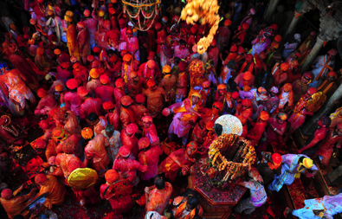
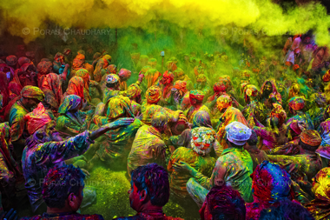
Hinduism
Worship, ritual and celebration-
Festival of Holi
Originally harvest festival
Symbolizes triumph of good over evil
Recalls story of Prince Prahlada- faced death rather than cease worshipping Vishnu
People dance in streets in colored powder and dyed water

Slide 21
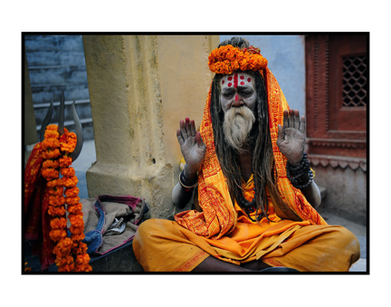
Hinduism
Leadership-
Gurus- spiritual teachers- spread Hindu beliefs
Believed to have had the gods’ word revealed to them
Brahmin priests- take care of the divine images in temples and read from the sacred books

Slide 22
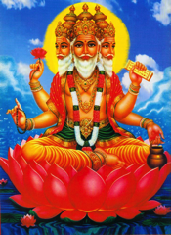
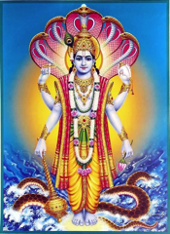
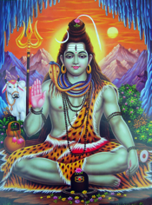
Hinduism
Major sects-
Shaktism
Reform Hinduism
Vaishnavites
Shaivites
Three main gods-
Brahma- creator of the universe
Vishnu- preserver of the universe
Shiva- destroyer of the universe

Slide 23
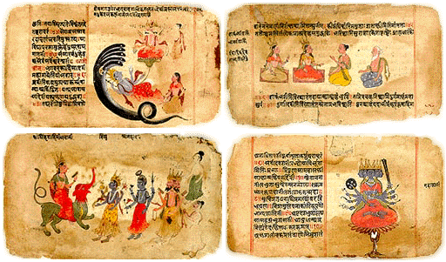
Hinduism
Vedas are oldest Hindu scriptures
Older than sacred writings of any other major religion
Rig Veda (oldest of four Vedas):
“He who gives liberally goes straight to the gods; on the high ridge of heaven he stands exalted” Rig Veda 1.125.5

Slide 24
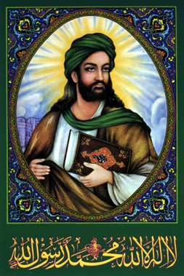
Islam
Based on teachings of Muhammad (called the Prophet by followers)
Followers known as Muslims
Believe God revealed teachings to Muhammad through angel Gabriel
Southwest to Central Asia, parts of Africa, Southeast Asia
Sunni- believe leaders should follow Muhammad’s example
Shi’a- believe leaders should be Muhammad’s descendants

Slide 25
Islam
Only one God, called Allah
Believe in all prophets of Judaism and Christianity
Show devotion by performing lifelong acts of worship known as the Five Pillars of Islam
Faith, prayer, almsgiving (charity), fasting and a pilgrimage to Mecca
Crescent moon – relates to new moon beginning each month in Islamic lunar calendar
Orders religious life for Muslims
Points of star represent 5 pillars

Slide 26
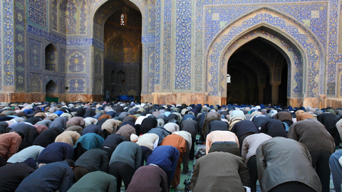
Islam
Worship practices-
Face Mecca and pray 5 times throughout the day
No priests or clergy
Imam- Muslim community leader who conducts prayers in a mosque
Ulama- scholar class including religious teachers

Slide 27
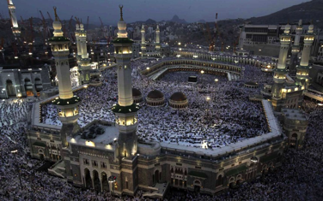
Islam
Rituals and celebrations-
Hajj- pilgrimage to Mecca in Saudi Arabia at least once in your life (if physically and financially able)
Perform several rites, or acts of worship- walk seven times around the Ka’aba (house of worship that Muslims face in prayer)
Ramadan- sacred month when Muslims fast- abstain from food and drink from dawn to sunset
Night of Power- most important night of Ramadan, when angel Gabriel first spoke to Muhammad

Slide 28
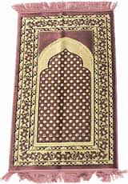
Islam
Major sects-
Sunni
Shi’a
Prayer Rug-
Pray by kneeling on rug
Design includes a pointed or arch-shaped pattern
Rug must be placed so arch points toward Mecca

Slide 29
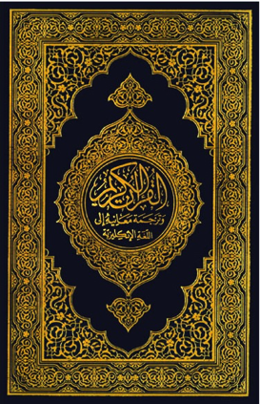
Islam
The Qur’an- sacred book of Muslims
Spiritual guide on matters of Muslim faith and daily life
Qur’an (instructing to appreciate the world’s physical and spiritual riches):
“Do you not see that God has subjected to your use all things in the heavens and on earth, and has made His bounties flow to you in exceeding measure, both seen and unseen?” Qur’an, sura 31:20

Slide 30
Judaism
About 14 million followers
First major religion to teach existence of only one God
Basic laws and teachings come from Torah- first five books of Hebrew Bible
Serve God by studying Torah and living by its teachings
Orthodox- closely observe laws of Torah
Conservative and Reform- interpret Torah less strictly and literally
Star of David- universal symbol of Judaism- refers to King David- ruled Kingdom of Israel from 1000-962 B.C.

Slide 31
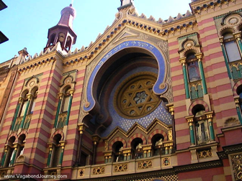
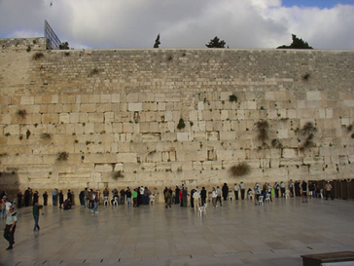
Judaism
Worship practices-
Synagogue- Jewish home of worship and center of Jewish community life
Many make pilgrimage to Western Wall
Built in second century B.C.
Forms western wall of courtyard of Second Temple of Jerusalem
Temple destroyed by Romans in 70 A.D.

Slide 32
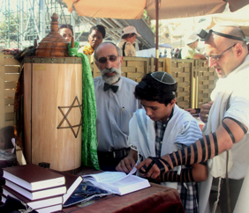
Judaism
Ritual and celebration-
At age 12 (girls) and 13 (boys)- enter adult religious community
Marked in synagogue with event called bar mitzvah for boy and bat mitzvah for girl
Many different holidays honoring their history and God

Slide 33
Judaism
Leadership-
Rabbi- congregation’s teacher and spiritual leader

Slide 34
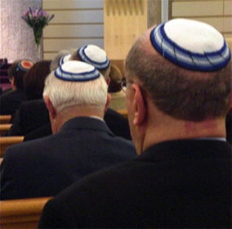
Judaism
Major sects-
Reform
Orthodox
Conservative
Yarmulke
Men are not supposed to leave their head uncovered
Many wear cap called yarmulke or kippah

Slide 35
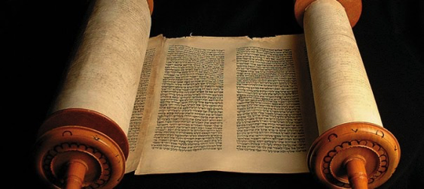
Judaism
Torah- during synagogue service the scroll is lifted and congregation declares “This is the Law which Moses set before the children of Israel”
Torah (Moses’s law regarding belief in one God):
“Hear O Israel: the Lord our God, the Lord is One” Deuteronomy 6:4

Slide 36
Confucianism
Not a religion in traditional sense- no clergy and no gods to worship
Ethical system providing direction for personal behavior and good government
Guides millions of Chinese and people of the East- many view it as a religion
Based on teachings of Chinese scholar Confucius
Stresses social and civic responsibility
Yin and yang symbol- represents opposite forces in the world working together- social order and harmony that Confucianism stresses

Slide 37
Confucianism
Ritual and celebration-
Filial piety- respect children owe their parents
Traditionally- complete obedience
Celebrate Confucius’s birthday on September 28
Known as Teacher’s Day in Taiwan- Confucius was a teacher and pushed education as part of fulfilled life

Slide 38
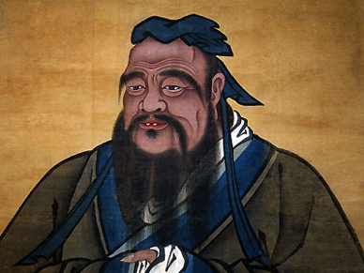
Confucianism
Leadership-
Confucius born during crisis and violence in China
Hoped teachings would restore order- never had political power to put teachings into practice
Ideas became foundation of Chinese thought for more than 2,000 years

Slide 39
Confucianism
The Five Relationships- believed society should be organized around five basic relationships between the following:
Ruler Subject
Father Son
Husband Wife
Older brother younger brother
Friend Friend

Slide 40
Confucianism
Golden rule- “do not do unto others what you would not want others to do unto you”

Slide 41
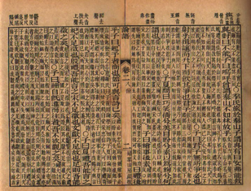
Confucianism
The Analects- earliest and most authentic record of Confucius’s ideas
Collected by his students around 400 B.C.
Analects (gives advice regarding virtue and pride):
“The Master said: ‘Don’t worry if people don’t recognize your merits; worry that you may not recognize theirs’” Analects 1.16
“The Master said: ‘Do not be concerned that others do not recognize you; be concerned about what you are yet unable to do” Analects 14.30

